Slide 1
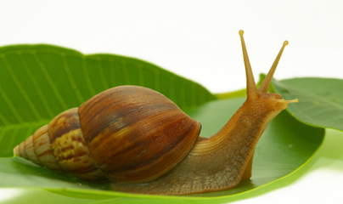
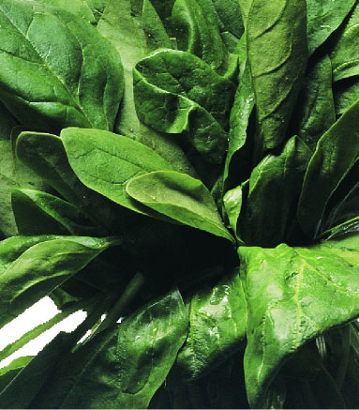
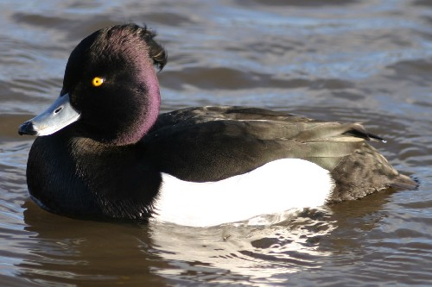
WALT – sequence animals in the food chain
Which do you think comes first in the food chain?
Which do you think comes next?
So which one comes last?

Slide 2
The Food Chain
Eaten By
Eaten By
Producer
Green Plant
Primary Consumer
Snail
Secondary Consumer
Tufted Duck
Who are the Consumers?
Who is the Producer?

Slide 3
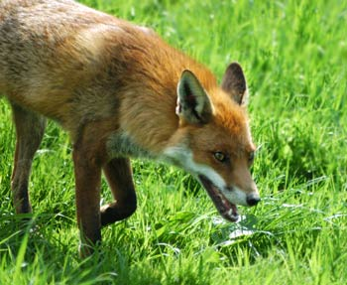
Where would I put a fox in this food chain?
So is the fox a producer or a consumer?

Slide 4
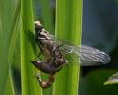
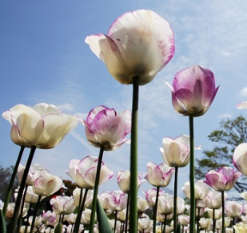
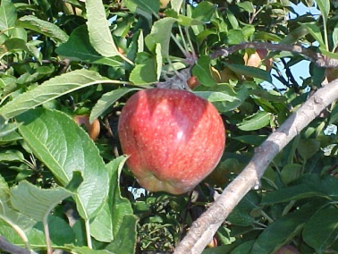
Can you sort these into the right categories?
Producers | Consumers

Slide 5
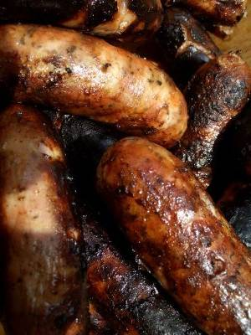
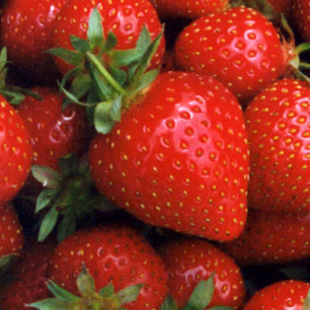
A herbivore eats only plants. Many insects are herbivores but some
large animals are herbivores too, such as cows and deer.
An omnivore eats both plants (which includes fruit and vegetables) and meat. Humans are omnivores, so are hedgehogs.
A carnivore eats only meat. Birds of prey like the Peregrine are carnivores along with animals such as snakes and cats.

Slide 6
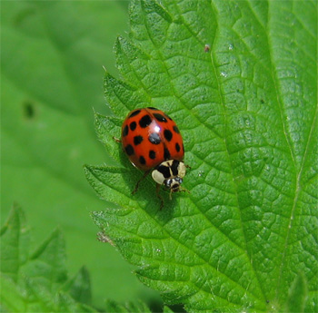
Can you give me one example of a carnivore that’s not on your sheet?
Can you give me one example of a producer?
Can you give me one example of a consumer?
Can you tell me what a herbivore is?
Can you tell me what a carnivore is?
Can you tell me what an omnivore is?
So what can you tell me about this ladybird now?

