Slide 1
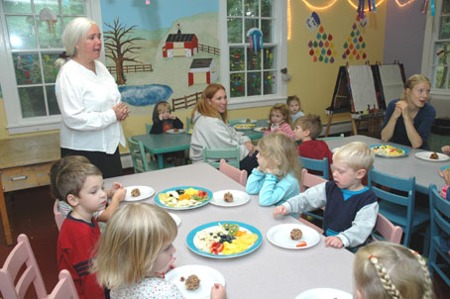
Learning Objectives Today I am Learning…
That humans need water and food to stay alive
That there are many different foods
That we eat different
kinds of food
That we can record
information in drawings
and charts

Slide 2
Success Criteria
I need to…
Know why I put a food in a food group
Know what happens if I don’t eat and drink
Describe some of the foods I eat by type or
taste

Slide 3
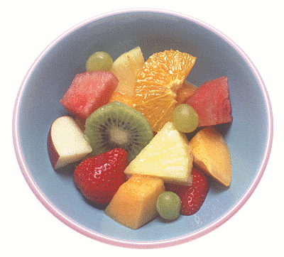
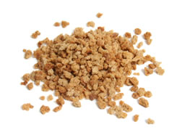
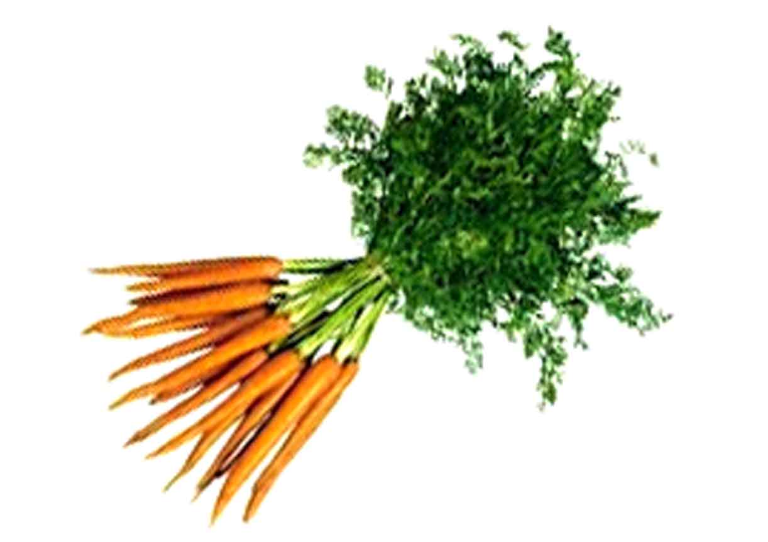
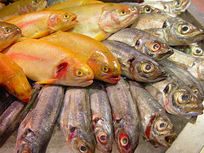
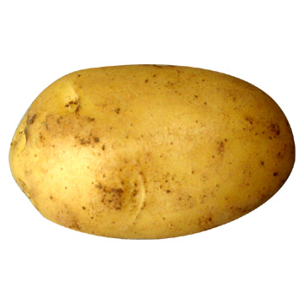
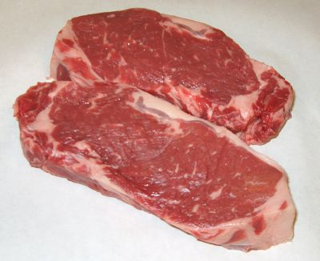
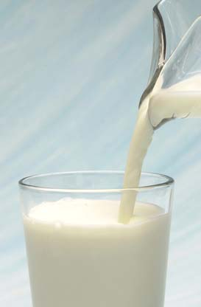
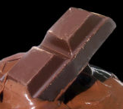
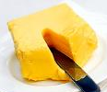
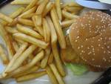
Sort food into the five groups.
Remember, the groups are:
Bread, cereals
and potatoes
Fruit and vegetables
Meat and fish
Milk and dairy
Fatty and sugary

Slide 4
How does food help us?
Fruit and vegetables contain minerals and vitamins. They stop us becoming poorly.
Milk and dairy foods contain calcium. It helps our bones, teeth and nails to grow.
Meat and fish contain protein. It helps our body to grow and repair itself.
Bread, cereals and potatoes contain fibre and carbohydrates. This helps us to digest our food.
Fatty and sugary foods contain fat. They give us energy, but only in small amounts.

Slide 5
Activity
Food Groups: Our Favourite Food
Which of these foods are favourites?
Food Groups: What do they do?
How does each food group help to keep us healthy?
Food Groups: What do they do?
What is in each food group?

