Slide 1


Slide 2
In this chapter, you will learn:
What is a Bunsen burner.
How to use the Bunsen burner.
Heating substances with a Bunsen burner.
Find out which flame is hotter.

Slide 3
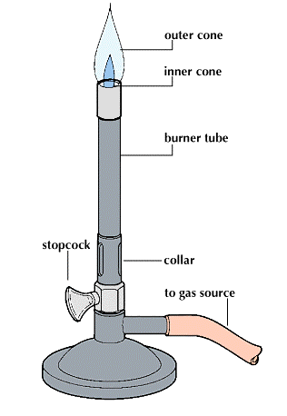
A Bunsen Burner
The first Bunsen burner
  Outer core
  Inner core
  Burner tube
  Stopcock
  Collar

Slide 4
Robert Bunsen
We heat things with a Bunsen burner in the laboratory.
Robert Bunsen, a German chemist, invented this apparatus in 1855.

Slide 5
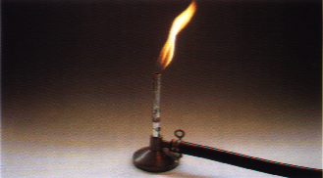
A Bunsen Burner

Slide 6
What are the parts of a Bunsen burner?
Label the diagram using these words.
air hole chimney collar tubing gas tap
chimney
gas tap
tubing
collar
air hole

Slide 7
How do we use a Bunsen burner?
1. Join the burner to a gas tap.

Slide 8
How do we use a Bunsen burner?
2. Close the air hole.

Slide 9
How do we use a Bunsen burner?
3. Light a match and hold it over the chimney.
Turn on the gas tap.

Slide 10
The Bunsen flame I
What will be the colour of the flame when the air hole is closed?
This is a luminous flame.

Slide 11
The Bunsen flame II
Open the air hole slowly.
What will be the colour of the flame when the air hole is opened?
This is a non-luminous flame.

Slide 12
Check point
Use suitable words to fill in the blanks.
The non-luminous flame is (a) in colour.
The luminous flame is (b) in colour.
The (c) flame is easier to see.
(a) yellow
(b) blue
(c) luminous

Slide 13
Which kind of flame is hotter?
Flame I
with air hole CLOSED
yellow in colour
luminous
Flame II
with air hole OPENED
blue in colour
non-luminous
?
?

Slide 14
How to know which flame is hotter?
To contact the flame with your hand?
X
To measure the temperature by a thermometer?
X
To compare the time taken to make the water boiled ?

Slide 15
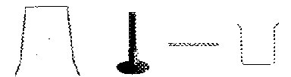
How to heat an object? (1)
The apparatus used in the procedure of heating:
What are these?
Bunsen Burner
Wire gauze
Beaker
Tripod

Slide 16
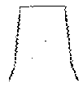

How to heat an object? (2)
3 Place a wire gauze onto the tripod
2. Put a tripod over the Bunsen Burner
1 .Prepare a Bunsen Burner

Slide 17

How to heat an object? (3)
5. Then add water into the beaker
4. Put a beaker onto the wire gauze

Slide 18
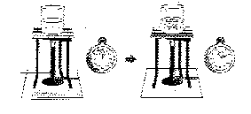
Measuring the time taken to boil a certain amount of water
Fill a beaker with 50 cm³ of tap water
Set up the apparatus as shown in the diagram
Heat the water with a flame of Bunsen Burner until it boils
Use stop-watch to find out the time taken
Stop-watch

Slide 19
Experiments to compare which flame is hotter
Experiment 1
with the air hole of Bunsen Burner CLOSED
yellow flame
Experiment 2
with the air hole of Bunsen Burner OPENED
blue flame

Slide 20
Experiment 1 (a)
Light a Bunsen Burner with the air hole closed
Light a match and hold it over the chimney.
Turn on the gas tap

Slide 21
Experiment 1 (b)
Put a beaker of water with 50 cm³ of tap water onto the tripod
Heat the water until it boil
Record the time needed by using
Stop-watch

Slide 22
Experiment 2 (a)
Light a Bunsen Burner with the air hole opened
Light a match and hold it over the chimney.
Turn on the gas tap

Slide 23
Experiment 2 (b)
Put a beaker of water with 50 cm³ of tap water onto the tripod
Heat the water until it boil
Record the time needed by using stop-watch

Slide 24
Result of the experiments
1. Which flame make the water boiled first?
Yellow or blue flame?
Ans: Blue flame
2. Which flame is hotter?
Ans: Blue flame

Slide 25
Conclusion
So, Blue flame is better for heating

Slide 26
Practical exercises
Do you know how to use Bunsen Burner?
Do you know how to boil water?
Do the experiment yourself
NOW!

