Slide 1
SAFETY IN THE LAB

Slide 2
It is very important to follow safety procedures in any lab situation because:
Some lab activities require the use of flammable materials and caustic chemicals.
Some of the equipment you will be using is very expensive.
To ensure a safe science classroom, here is a list of safety rules for you to follow.

Slide 4
Listen carefully to instructions. Read and follow directions.
Note any special warning and
double-check labels to be sure
that you are using the correct chemical.
Lab partners should check that they both understand the directions before proceeding with an experiment.
Ask the teacher for clarification if necessary.

Slide 5
No rough play or practical jokes are permitted in the science classroom.
Inappropriate behavior will result in a loss of lab privileges.
You are graded on some of your lab work. Loss of lab privileges will result in a lower grade.

Slide 6
Do not run an experiment in the lab without an instructor present.
Do not perform experiments that you have designed before obtaining the authorization of a teacher.

Slide 7
Never eat or drink anything during labs - some of the chemicals you will be using may be toxic.
Never taste any substance unless you are told to do so.
Keep hands away from face, eyes and mouth while handling chemicals or preserved specimens.

Slide 8
Accidents do happen. Report any accident, even a minor one, immediately to the teacher.
Do not use chipped or cracked glassware. Never handle broken glass with your bare hands.
Report any chemical spill or broken equipment immediately. Follow your teacher’s instructions as to how to clean up.

Slide 9
Wear goggles when indicated. Goggles MUST be worn when using burners and strong acids or bases.

Slide 11
Clean your work area with a damp paper towel after returning equipment to its proper place.
If you have been handling chemicals or preserved materials, wash your hands before leaving the room.
Dispose of materials as instructed by your teacher. Some chemicals may be poured into the sink with cold running water. Sometimes special containers are used to dispose of materials.
Solids should never be disposed of in the sink. Never return unused chemicals to their original containers.

Slide 12
Lab Expectation #10
Always carry microscopes and balances with both hands. Wipe off any substance that spills on them immediately.

Slide 13
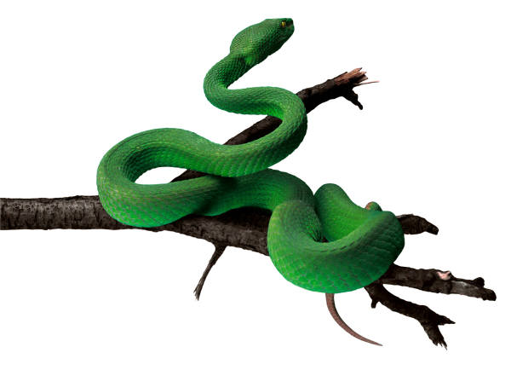
Lab Expectation #11
Follow the care instructions and handle live animals gently.
Wash hands before and after handling live animals.

Slide 14
Lab Expectation #12
Treat preserved biological materials with respect.
When using scalpels and other sharp instruments, grasp only by the handles and carry with tips and points pointing downwards.
Always cut away from your body.

Slide 15
AVOID ACCIDENTS:
Keep the working area clean and free of
unnecessary materials.
Keep the aisles clear of books and book bags.

Slide 16
Safety Equipment
Learn where the safety equipment is and learn how to use it.
- Any type of fire must be reported to the teacher immediately. Your teacher will use the fire extinguisher if necessary.
- If something gets in your eye, immediately flush with water from the eyewash station.

Slide 17
Use the correct technique to smell chemicals!
Always use the “wafting”
technique to smell substances.

Slide 18
Safety with a burner
When using a bunsen or alcohol burner, light only when ready to begin the experiment and extinguish as soon as the experiment is completed.
Always take extra care around an open flame. Tie back long hair and never reach over a flame.
When heating a test tube, always use a holder. Hold it tilted and point it away from yourself and from other students. Move the tube in the flame to prevent overheating in one area.

Slide 19
CONSEQUENCES FOR INAPPROPRIATE BEHAVIOR IN SCIENCE LABS:
1. YOU WILL BE SENT OUT OF THE ROOM AND MISS THE
REST OF THE LAB.
If the lab is graded, you will receive zero for your grade.
AND
2. YOU WILL MISS THE NEXT LAB ACTIVITY - Instead, you will be
given busy work to do, and will be responsible for cleaning up
the lab after the other students have finished.
If this lab is graded, you will receive another zero for your grade.
3. FOR MORE SERIOUS OFFENCES SUCH AS ONES IN WHICH THE BEHAVIOR
RESULTS IN A STUDENT BEING HURT OR EQUIPMENT BROKEN, #1 AND #2
WILL APPLY.
IN ADDITION, YOU WILL BE SENT TO THE DEAN OR PRINCIPAL
WITH A RECOMMENDATION FOR A TWO HOUR DETENTION.

Slide 20
Lab Safety Contract
I agree to follow the above laboratory safety rules for my own safety and the safety of my classmates. I realize that violations of the rules will result in my not being allowed to participate in lab exercises.
Your Signature

