Slide 1
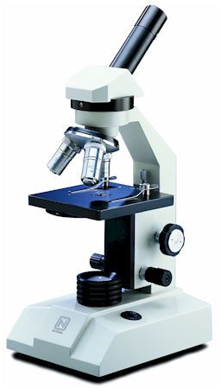
Microscopes/

Slide 2
It is estimated that the human race grows daily by about 214,000 people.
It takes only 15 watts of electricity going through a human body to stop the heart. Common lightbulbs run on about 25 to 75 watts of electricity.

Slide 3
Microscopes
Objectives:
To name the parts of the microscope and describe their functions

Slide 4
Microscopes
Objectives:
To name the parts of the microscope and describe their functions
To describe how to properly use a compound microscope.

Slide 5
Microscopes
Objectives:
To name the parts of the microscope and describe their functions
To describe how to properly use a compound microscope.
To compare a compound to a light microscope

Slide 6
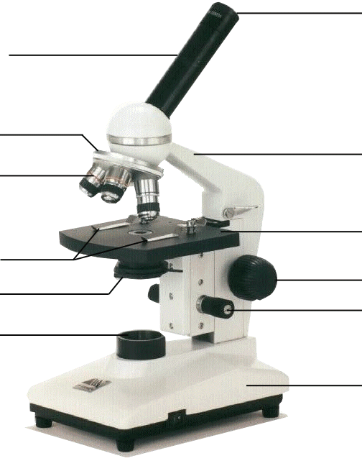
Label the parts on your microscope picture.
Eyepiece/ocular lens magnification = 10X

Slide 7
Label the parts on your microscope picture.
Eyepiece/ocular lens magnification = 10X
Arm-Support

Slide 8
Label the parts on your microscope picture.
Eyepiece/ocular lens magnification = 10X
Arm-Support
Stage - support

Slide 9
Label the parts on your microscope picture.
Eyepiece/ocular lens magnification = 10X
Arm-Support
Stage - support
Coarse adjust – general focus

Slide 10
Label the parts on your microscope picture.
Eyepiece/ocular lens magnification = 10X
Arm-Support
Stage - support
Coarse adjust – general focus
Fine Focus – high power focus

Slide 11
Label the parts on your microscope picture.
Eyepiece/ocular lens magnification = 10X
Arm-Support
Stage - support
Coarse adjust – general focus
Fine Focus – high power focus
Base - support

Slide 12
Label the parts on your microscope picture.
Eyepiece/ocular lens magnification = 10X
Arm-Support
Stage - support
Coarse adjust – general focus
Fine Focus – high power focus
Light source
Base - support

Slide 13
Label the parts on your microscope picture.
Eyepiece/ocular lens magnification = 10X
Arm-Support
Stage - support
Coarse adjust – general focus
Diaphragm – adjusts amount of light
Fine Focus – high power focus
Light source
Base - support

Slide 14
Label the parts on your microscope picture.
Eyepiece/ocular lens magnification = 10X
Arm-Support
Stage - support
Stage clips – holds slide
Coarse adjust – general focus
Diaphragm – adjusts amount of light
Fine Focus – high power focus
Light source
Base - support

Slide 15
Label the parts on your microscope picture.
Eyepiece/ocular lens magnification = 10X
Objective Lenses Scanning = 4X
Low Power = 10X
High power = 40X
Arm-Support
Stage - support
Stage clips – holds slide
Coarse adjust – general focus
Diaphragm – adjusts amount of light
Fine Focus – high power focus
Light source
Base - support

Slide 16
Label the parts on your microscope picture.
Eyepiece/ocular lens magnification = 10X
Revolving nosepiece
Objective Lenses Scanning = 4X
Low Power = 10X
High power = 40X
Arm-Support
Stage - support
Stage clips – holds slide
Coarse adjust – general focus
Diaphragm – adjusts amount of light
Fine Focus – high power focus
Light source
Base - support

Slide 17
Label the parts on your microscope picture.
Eyepiece/ocular lens magnification = 10X
Revolving nosepiece
Objective Lenses Scanning = 4X
Low Power = 10X
High power = 40X
Arm-Support
Stage - support
Stage clips – holds slide
Coarse adjust – general focus
Diaphragm – adjusts amount of light
Fine Focus – high power focus
Light source
Base - support

Slide 18
Magnification of a Compound Microscope
Because you are looking through multiple lenses the lenses have a “compounding” effect.
The eyepiece always magnifies 10X
Eyepiece
Objective Lens
Magnification
Scanning lens (red)
10X
Low Power (yellow)
10X
High Power (blue)
10X

Slide 19
Magnification of a Compound Microscope
Each of the objective lenses have their own magnification
Eyepiece
Objective Lens
Magnification
Scanning lens (red)
10X
4X
Low Power (yellow)
10X
10X
High Power (blue)
10X
40X

Slide 20
Magnification of a Compound Microscope
You then multiply the eyepiece with the objective lens to determine the total magnification
Eyepiece
Objective Lens
Magnification
Scanning lens (red)
10X
4X
40X
Low Power (yellow)
10X
10X
100X
High Power (blue)
10X
40X
400X

Slide 21
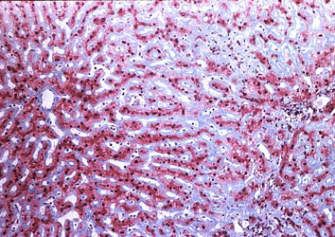
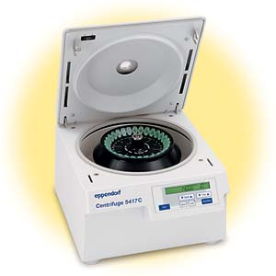
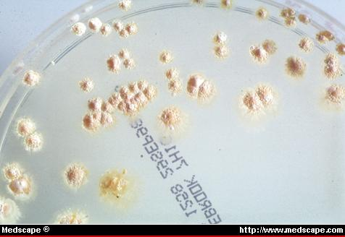
Other Laboratory Techniques
Staining
  Dyes are added to slides to bring out detail and stain certain features.
Centrifugation
  A device that can spin tubes up to 20,000X/min. This is used to separate samples (I.e. parts of cells
Cell Culture
  Cells of a particular kind are grown on plates with all their required nutrients.

Slide 22
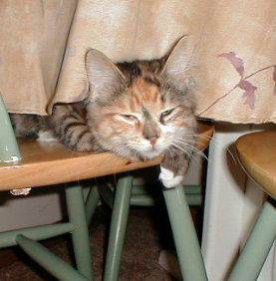
Limits of Resolution
As we focus the microscope to higher powers we see more and more detail, until a certain point. Then objects become blurry and detail is lost. Think of blowing up a picture too big.
Resolution is out ability to distinguish two points as separate.
Electron Microscopes have a much higher limit of resolution.
Click here to zoom

Slide 24
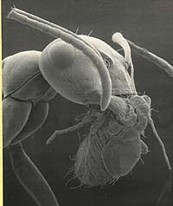
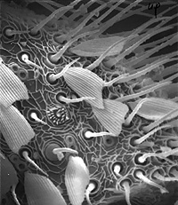
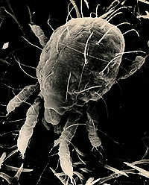
The Electron Microscope
Allows us to see very high resolution images
SCALES AND SETAE ON LEPIDOPTERA
Dust mite
PREDATORY ANT WITH PEAR PSYLLA IN ITS MOUTH

Slide 25
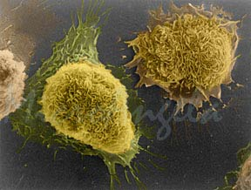
The Electron Microscope
How does it work?
They use giant electromagnets to sent a stream of electrons over the specimen. This image is then read by a computer.

Slide 26
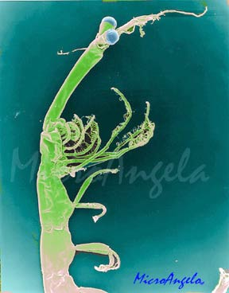
Light verses Electron Microscopes
 | Light | Electron
Means of Transmitting image | Ray of light | Beam of electron
Focuses with
Stains tissue with
Slices tissue with
magnification
Type of cells viewed
Year introduced
Amount of detail

Slide 27
Light verses Electron Microscopes
 | Light | Electron
Means of Transmitting image | Ray of light | Beam of electron
Focuses with | Lenses | Magnets
Stains tissue with
Slices tissue with
magnification
Type of cells viewed
Year introduced
Amount of detail

Slide 28
Light verses Electron Microscopes
 | Light | Electron
Means of Transmitting image | Ray of light | Beam of electron
Focuses with | Lenses | Magnets
Stains tissue with | Colorful dyes | Heavy metals
Slices tissue with
magnification
Type of cells viewed
Year introduced
Amount of detail

Slide 29
Light verses Electron Microscopes
 | Light | Electron
Means of Transmitting image | Ray of light | Beam of electron
Focuses with | Lenses | Magnets
Stains tissue with | Colorful dyes | Heavy metals
Slices tissue with | Steel | Diamonds
magnification
Type of cells viewed
Year introduced
Amount of detail

Slide 30
Light verses Electron Microscopes
 | Light | Electron
Means of Transmitting image | Ray of light | Beam of electron
Focuses with | Lenses | Magnets
Stains tissue with | Colorful dyes | Heavy metals
Slices tissue with | Steel | Diamonds
magnification | 2000X | 250,000 or more
Type of cells viewed
Year introduced
Amount of detail

Slide 31
Light verses Electron Microscopes
 | Light | Electron
Means of Transmitting image | Ray of light | Beam of electron
Focuses with | Lenses | Magnets
Stains tissue with | Colorful dyes | Heavy metals
Slices tissue with | Steel | Diamonds
magnification | 2000X | 250,000 or more
Type of cells viewed | Living or dead | Dead only
Year introduced
Amount of detail

Slide 32
Light verses Electron Microscopes
 | Light | Electron
Means of Transmitting image | Ray of light | Beam of electron
Focuses with | Lenses | Magnets
Stains tissue with | Colorful dyes | Heavy metals
Slices tissue with | Steel | Diamonds
magnification | 2000X | 250,000 or more
Type of cells viewed | Living or dead | Dead only
Year introduced | 1660’s | 1930’s
Amount of detail

Slide 33
Light verses Electron Microscopes
 | Light | Electron
Means of Transmitting image | Ray of light | Beam of electron
Focuses with | Lenses | Magnets
Stains tissue with | Colorful dyes | Heavy metals
Slices tissue with | Steel | Diamonds
magnification | 2000X | 250,000 or more
Type of cells viewed | Living or dead | Dead only
Year introduced | 1660’s | 1930’s
Amount of detail | Flat image | 3-D image

Slide 34
General Procedures
• Make sure all backpacks are out of the aisles before you get a microscope! Always carry the microscope with one hand on the Arm and one hand on the Base.
• Wear your glasses, the microscope will focus to your eyesight!
• Keep both eyes open, your brain will learn to ignore the other eye.

Slide 35
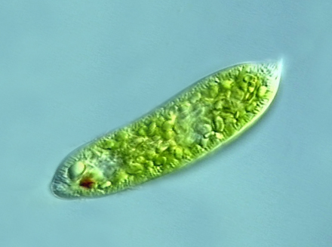
Focusing a Specimen
Always start on low power or scanning.

Slide 36
Focusing a Specimen
Always start on low power or scanning.
Focus the specimen using the course adjust.

Slide 37
Focusing a Specimen
Always start on low power or scanning.
Focus the specimen using the course adjust.
Re-center. If high power is needed, turn only after re-centering!

Slide 38
Focusing a Specimen
Always start on low power or scanning.
Focus the specimen using the course adjust.
Re-center. If high power is needed, turn only after re-centering!
Now use the FINE FOCUS ONLY for your final adjustments.

Slide 39

Making a Wet Mount
1. Gather a very thin slice/piece of whatever your specimen is. All samples should be paper thickness or thinner!
2. Place ONE drop of water directly over the specimen. 3. Place the cover slip at a 45 degree angle with one edge touching the water drop, and let go.

Slide 40
Making good drawings
Don’t even think of starting your drawing unless you have a pencil (colored are even better) drawings in pen are unacceptable. This is for two reasons:
(a) You can erase pencil!
(b) You can shade in areas more easily in pencil
In the upper left hand corner of each circle include the specimen name as written on the slide label. In the upper right hand corner, include the magnification (100x or 430x).
Label Everything you identify!
Cheek cell
100X
Cell membrane
nucleus

Slide 41
Student handouts
Microscope notes page

Slide 42
Microscopes
Microscope Parts
Label with structure and function
Magnification of Lenses
Eyepiece
Objective Lens
Magnification
Scanning lens (red)
10X
Low Power (yellow)
10X
High Power (blue)
10X

Slide 43
Light verses Electron Microscope
Practice live Cell Sketches
 | Light | Electron
Means of Transmitting image
Focuses with
Stains tissue with
Slices tissue with
magnification
Type of cells viewed
Year introduced
Amount of detail

