Slide 1
THE NATURAL NUMBERS
N
0, 1, 2, 3, 4. . .

Slide 2
REMEMBER
0
zero
1 2 3 4 5
one two three four five
6 7 8 9 10
six seven eight nine ten

Slide 3
11 12 13 14 15
Eleven Twelve Thirteen Fourteen Fifteen
16 17 18 19 20
Sixteen Seventeen Eighteen Nineteen Twenty
21 22 23 . . .
Twenty-one Twenty-two Twenty-three . . .

Slide 4
30 Thirty
40 Forty
50 Fifty
60 Sixty
70 Seventy
80 Eighty
90 Ninety
100 A Hundred
1 000 A Thousand
1 000 000 A Million
1 000 000 000 A Billion

Slide 5
Operations
5 + 3 Five plus three
8 – 3 Eight minus three
6 x 2 Six times two
15 / 3 Fifteen divided by three

Slide 6
Comparisons
7 > 5 Seven is greater than five
5 < 7 Five is less than seven
3 = 3 Three is equal to three

Slide 7
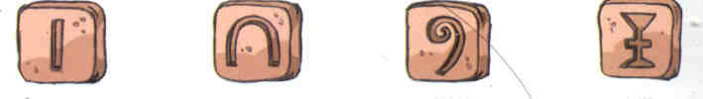
1.- EVOLUTION OF NUMBERS
The numbers appeared due to the necessity of counting.
Primitive societies created symbols to express
quantities like how many animals they had hunted. They made marks on bones and on stones.
The Egyptians used these symbols:
ONE TEN A HUNDRED A THOUSAND

Slide 8
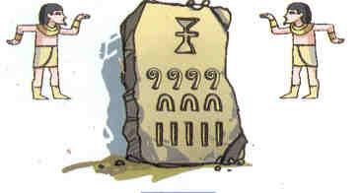
What quantity is written on the stone?

Slide 9
.
Are you sure that you are right?
Yes, you are. The quantity is 1,435

Slide 10
As you know, The Romans used this letters:
I V X L
One Five Ten Fifty
C D M
A Hundred Five Hundred A Thousand

Slide 11
What quantities are written?
a) MVI
b) CXLII

Slide 12
What quantities are written?
a) MVI 1 006
b) CXLII 142

Slide 13
a) M = 1000
  V = 5
  I = 1
  MVI = 1006
  b) C = 100
  X = 10
  L = 50
  I I = 2
  CXLII = 142
  Note: Remember to subtract when the smaller number is
  on the left.

Slide 14
1.- THE NATURAL NUMBER SET
The Natural Number Set is represented with the letter N
N = { 0, 1, 2, 3, ... }
Operations
Addition
2314 + 25 = ?

Slide 15
2 | 3 | 1 | 4
+ |  | 2 | 5
2 | 3 | 3 | 9
Remember when writing:
* Unities under unities
* Ten unities under ten unities
* Hundred under hundred
 | H | TU | U
T | H | TU | U
T | H | TU | U

Slide 16
2. Subtraction:
 | 9 | 3 | 4
- |  | 2 | 5
 | 9 | 0 | 9
Remember when writing:
* Unities under unities
* Ten unities under ten unities
* Hundred under hundred
 | H | TU | U
- | H | TU | U
 | H | TU | U

Slide 17
3. Multiplication:
 | 3 | 5 | 4
x |  | 2 | 6
2 | 1 | 2 | 4
7 | 0 | 8
9 | 2 | 0 | 4
Remember when writing:
* Unities under unities
* Ten unities under ten unities
* Hundred under hundred

Slide 18
4. Division:
7 | 2 | 6 | 23
 | 2 | 6 | 3 | 1
 |  | 3
Remember:
Dividend = 726
Divisor = 23
Quotient = 31
Remainder = 3
Dividend = Divisor x Quotient + Remainder
726 = 23 x 31 + 3

Slide 19
Operations hierarchy
1st. First, solve the parenthesis
2nd. After that, solve the multiplication and division operations.
3rd. Finally, solve the addition and the subtraction operations.

Slide 20
Example:
32 – 3 * ( 7 + 6 : 3) =
32 - 3 * ( 7 + 2) =
32 – 3 * 9 =
32 – 27 =
5

