Slide 1
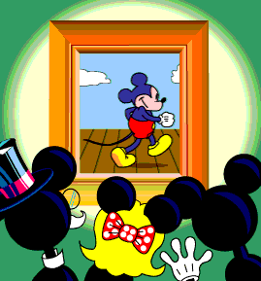
Rate, Ratio, Proportion

Slide 2
What is the ratio of cats to mice?
Number of Cats:
3
Number of Mice:
6
Express the ratio as a fraction:
Express the ratio in words:
3 to 6
Express the ratio with a colon:
3:6

Slide 3
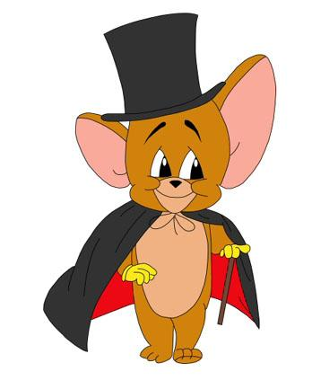
What is a ratio?
Example: There are 300 computers and 1200 students in our school. What is the ratio of computers to students?
A ratio is a comparison of two quantities.
Express the ratio in words:
300 to 1200
Express the ratio with a colon:
300 : 1200
Express the ratio as a fraction:
How many students are there for one computer?

Slide 4
What is an Equivalent Ratio?
If we refer to the previous example we can say the
same thing in two different ways:
1.There are 300 computers for 1200 students
OR
2.There is 1 computer for every 4 students
Express the ratio as a fraction:
Equivalent ratios make the same comparison.
Bring the fraction to lowest terms:

Slide 5
Practice With Equivalent Ratios
Find an equivalent ratio by dividing:
# 1
→ Divide by 30
# 2
→ Divide by 3
# 3
→ Divide by 25

Slide 6
Practice With Equivalent Ratios
Find an equivalent ratio by multiplying:
# 4
→ Multiply by 5
# 5
→ Multiply by 12
# 6
→ Multiply by 6

Slide 7
John and Mary make strawberry punch.
Whose punch has a stronger strawberry taste?
John:
2 parts concentrate
4 parts water
Mary:
3 parts concentrate
5 parts water
→ Write the ratio
→ Write the ratio
→ Divide 2 by 4
→ Divide 3 by 5
→ Write as a percentage
→ Write as a percentage
0.5x100 = 50 %
concentrate
0.6x100 = 60 % concentrate
stronger strawberry taste

Slide 8
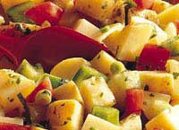
Ratio and Proportion
Example 1 A recipe that serves 4 people uses 5 potatoes. How many potatoes are needed to serve 28 people?
# 1
Let x be the number of potatoes required to serve 28 people.
# 2
Since the recipe is the same, we have two equivalent ratios:
# of people:
# of potatoes:
# 3
Cross multiply
4x = 5 (28)
4x = 140
# 4
Divide by 4 to find x
x=35 potatoes

Slide 9
Example 2
A floral design uses two red roses for every three yellow roses. How many red roses will be in a garden that contains 500 roses in total?
# 1
Let r be the number of red roses.
Let y be the number of yellow roses.
# 2
Write the ratio:
# 3
One design requires 2 + 3 = 5 roses in total
# 4
How many designs are there in the garden?
500 ÷ 5 = 100 designs
# 5
How many red roses are in the garden?
100 designs x 2 red roses per design
= 200 red roses

