Slide 1
Volume of Solids
Area of Any Triangle
Area of Parallelogram
Area of Kite & Rhombus
Area of Trapezium
Composite Area
Volume & Surface Area
Surface Area of a Cylinder
Exam Type Questions
Volume of a Cylinder
Composite Volume

Slide 2
Simple Areas
Definition : Area is “ how much space a shape takes up”
A few types of special Areas
Any Type of Triangle
Parallelogram
Rhombus and kite
Trapezium

Slide 3
Any Triangle Area
Learning Intention
Success Criteria
  1. To develop a formula for the area of ANY triangle.
  To know the formula for the area of ANY triangle.
Apply formula correctly.
(showing working)
Use the formula to solve problems.
Answer containing
appropriate units

Slide 4
Any Triangle Area
h = vertical height
Sometimes called the altitude
h
b

Slide 5
Any Triangle Area
Example 2 : Find the area of the triangle.
Altitude h outside triangle this time.
10cm
4cm

Slide 6

Any Triangle Area
Hint : Use
Pythagoras Theorem first !
Example 3 : Find the area of the isosceles triangle.
www.mathsrevision.com
5cm
4cm
8cm

Slide 7
Parallelogram Area
Important NOTE
h = vertical height
h
b

Slide 8
Rhombus and Kite Area
Learning Intention
Success Criteria
  1. To develop a single formula for the area of ANY rhombus and Kite.
  To know the formula for the area of ANY rhombus and kite.
Apply formulae correctly.
(showing working)
Use the formula to solve problems.
Answer containing
appropriate units

Slide 9
Area of a Rhombus
This part of
the rhombus
is half of the small
rectangle.
d
D

Slide 10
Area of a Kite
Exactly the same process as the rhombus
d
D

Slide 11
Rhombus and Kite Area
Example 2 : Find the area of the V – shape kite.
4cm
7cm

Slide 12
Trapezium Area
Learning Intention
Success Criteria
  1. To develop a formula for the area of a trapezium.
  To know the formula for the area of a trapezium.
Apply formula correctly.
(showing working)
Use the formula to solve problems.
Answer containing
appropriate units

Slide 13
Trapezium Area
a cm
Two triangles WXY and WYZ
X
Y
1
h cm
2
W
Z
b cm

Slide 14
Trapezium Area
Example 1 : Find the area of the trapezium.
5cm
4cm
6cm

Slide 15
Composite Areas
Learning Intention
Success Criteria
  1. To show how we can apply basic area formulae to solve more complicated shapes.
  To know the term composite.
2. To apply basic formulae to solve composite shapes.
Answer containing
appropriate units

Slide 16
Composite Areas
We can use our knowledge of the basic areas
to work out more complicated shapes.
Example 1 : Find the area of the arrow.
3cm
5cm
6cm
4cm

Slide 17
Composite Areas
Example 2 : Find the area of the shaded area.
8cm
11cm
4cm
10cm

Slide 18
Summary Areas
Any Type of Triangle
Rhombus and kite
Parallelogram
Trapezium

Slide 19
Volume of Solids
Prisms
Learning Intention
Success Criteria
  To understand the
  prism formula for calculating volume.
  To know the volume formula for any prism.
Work out volumes for
various prisms.
Answer to contain
appropriate units and working.

Slide 20
Volume of Solids
Definition : A prism is a solid shape with
uniform cross-section
Hexagonal Prism
Cylinder
(circular Prism)
Triangular Prism
Pentagonal Prism
Volume = Area of Cross section x length

Slide 21
Definition : A prism is a solid shape with
uniform cross-section
Q. Find the volume the triangular prism.
Triangular Prism
Volume = Area x length
= 20 x 10 = 200 cm³
10cm
20cm²

Slide 22
Volume of Solids
Definition : A prism is a solid shape with
uniform cross-section
Q. Find the volume the hexagonal prism.
43.2cm²
www.mathsrevision.com
Volume = Area x length
20cm
= 43.2 x 20 = 864 cm³
Hexagonal Prism

Slide 23
Net and Surface Area
Triangular Prism
Bottom
4cm
4cm
BT
Back
FT
10cm
4cm
Front
4cm
5 faces
3 congruent rectangles
10cm
2 congruent triangles
This is a NET for the triangular prism.

Slide 24
Example
Find the surface area of the right angle prism
Working
Triangle Area =
= 2 x3 =6cm²
Rectangle 1 Area = l x b
= 3 x10 =30cm²
5cm
Rectangle 2 Area = l x b
3cm
10cm
= 4 x 10 =40cm²
4cm
Rectangle 3 Area = l x b
= 5 x 10 =50cm²
2 triangles the same
1 rectangle 3cm by 10cm
Total Area
= 6+6+30+40+50 = 132cm²
1 rectangle 4cm by 10cm
1 rectangle 5cm by 10cm

Slide 25
Net and Surface Area
The Cuboid
Bottom
3cm
4cm
LS
Back
RS
4cm
Top
3cm
3cm
5cm
Front
4cm
6 faces
Top and bottom congruent
5cm
Front and back congruent
Left and right congruent
This is a NET for the cuboid

Slide 26
Example
Find the surface area of the cuboid
Working
Front Area = l x b
= 5 x 4 =20cm²
Top Area = l x b
= 5 x 3 =15cm²
4cm
Side Area = l x b
= 3 x 4 =12cm²
3cm
5cm
Total Area
= 20+20+15+15+12+12
= 94cm²
Front and back are the same
Top and bottom are the same
Right and left are the same

Slide 27
Surface Area
of a Cylinder
Learning Intention
Success Criteria
  To explain how to calculate the surface area of a cylinder by using basic area.
  To know split up a cylinder.
2. Calculate the surface area of a cylinder.

Slide 28
Surface Area
of a Cylinder
The surface area of a cylinder is made up of 2 basic shapes can you name them.
Cylinder
(circular Prism)
2πr
Curved Area =2πrh
Top Area =πr²
Roll out
curve side ⇨
h
Bottom Area =πr²
Total Surface Area = 2πr² + 2πrh

Slide 29
Surface Area
of a Cylinder
Example : Find the surface area of the cylinder below:
3cm
Surface Area = 2πr² + 2πrh
10cm
= 2π(3)² + 2π x 3 x 10
= 18π + 60π
Cylinder
(circular Prism)
= 78π cm

Slide 30
Surface Area
of a Cylinder
Diameter = 2r
Example : A net of a cylinder is given below.
Find the diameter of the tin and the total
surface area.
2πr = 25
2r =
25
9cm
25cm
π
Surface Area = 2πr² + 2πrh
= 2π(25/2π) ² + 2π(25/2π)x9
= 625/2π + 25x9 = 324.5 cm

Slide 31
Volume of a Cylinder
The volume of a cylinder can be thought as being a pile
of circles laid on top of each other.
Volume = Area x height
h
= πr²
x h
Cylinder
(circular Prism)
= πr²h

Slide 32
Volume of a Cylinder
Example : Find the volume of the cylinder below.
5cm
V = πr²h
10cm
= π(5)²x10
Cylinder
(circular Prism)
= 250π cm

Slide 33
Other Simple Volumes
Composite volume
is simply volumes that are made up from basic volumes.
r
r
h
D
h
Cylinder
(circular Prism)
r
Cylinder = πr²h

Slide 34
Volume of Solids
Prisms
Learning Intention
Success Criteria
  To calculate volumes for composite shapes using knowledge from previous sections.
  To know what a composite volume is.
Work out composite volumes using previous knowledge of basic prisms.
Answer to contain
appropriate units and working.

Slide 35
Other Simple Volumes
Composite volume
is simply volumes that are made up from basic volumes.
r
r
h
D
h
Cylinder
(circular Prism)
r
Cylinder = πr²h

Slide 36
Volume of a Solid
Composite volume
is simply volumes that are made up from basic volumes.
Q. Find the volume the composite shape.
Volume = Cylinder + half a sphere
r
h = 6m
2m

Slide 37
Volume of a Solid
Composite Volumes
are simply volumes that are made up from basic volumes.
Q. This child’s toy is made from 2 identical cones.
Calculate the total volume.
Volume = 2 x cone
r = 10cm
h = 60cm

Slide 38
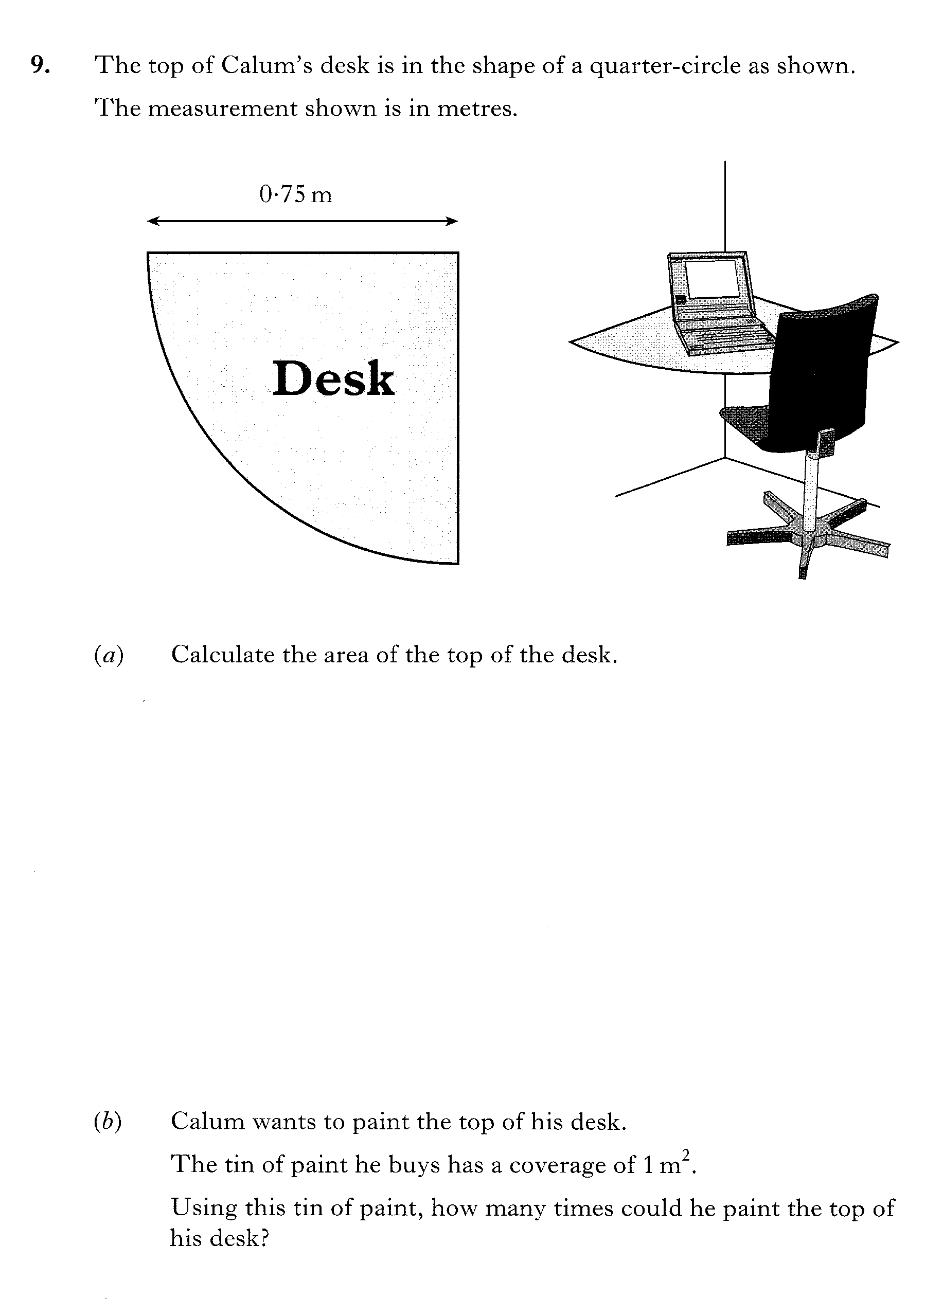

Slide 39
