Slide 1
Mass, Volume
and
Density

Slide 2
Let me say it now…if you don’t put the labels on your answers…
It
Will
Be
WRONG!!!!!

Slide 3
Mass: A measurement of the amount of matter in an object
It can be measured with a triple beam balance
It is measured in grams.

Slide 4
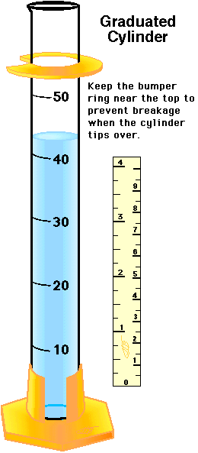
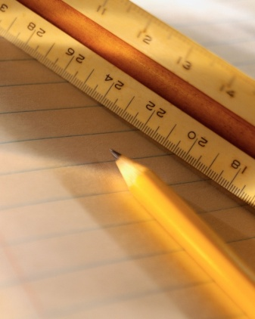
Volume: Is the amount of space an object takes up.
There are several ways to calculate volume. We are going to look at the ruler method and the water displacement method.

Slide 5
Using a Ruler
Just a quick reminder…we only measure in the metric system in this class!!!
So how do we find the volume of an object using a ruler?

Slide 6
If you said Length X Width X Height…you are ahead of the curve!
Height
Width
Length

Slide 7
L x W x H. ( We use this method when the object has a regular shape.)
Height
Width
Length

Slide 8
So our formula looks like this:
L x W x H
Height = 2
Width = 3
Length = 4
What is our answer?

Slide 9
If you said only 24 you would be wrong…why?
Height = 2
Width = 3
Length = 4

Slide 10
So what is the label we use?
Height = 2
Width = 3
Length = 4
Centimeters cubed = written like this cm ³

Slide 11
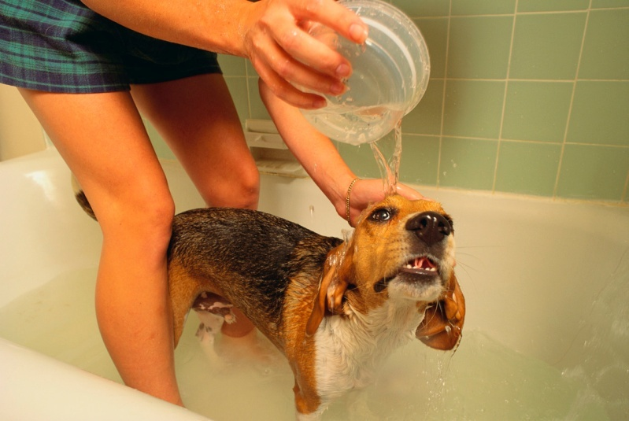
How many of you have every gotten into the tub only to find out you have filled it too high and water flows over the top?

Slide 12
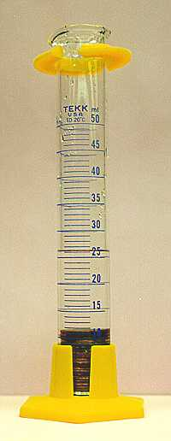
Water
Displacement
So what is water displacement?

Slide 13
Water Displacement
How does it work?

Slide 14
Water Displacement
Just like when you got into the tub, the water level had to go up in proportion to the amount of space you were taking up.

Slide 15
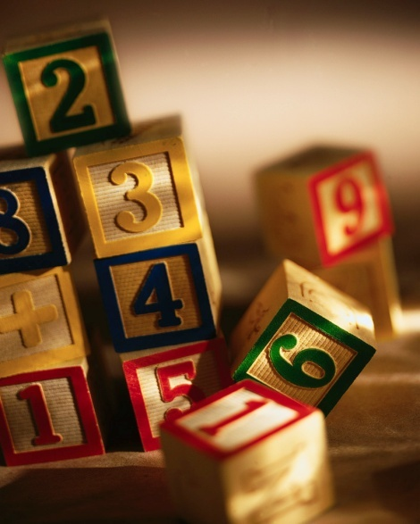
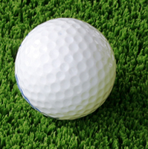
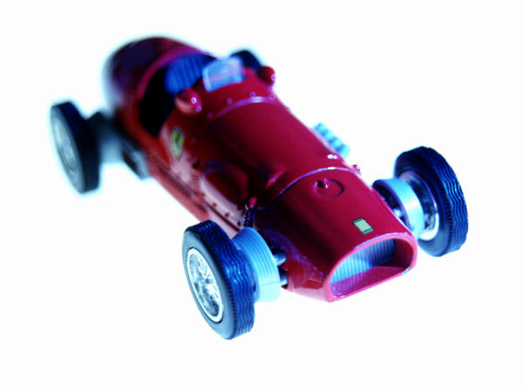
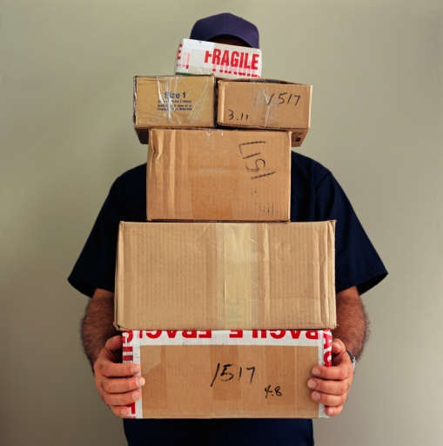
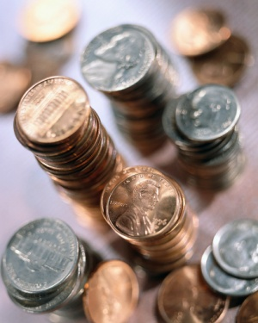
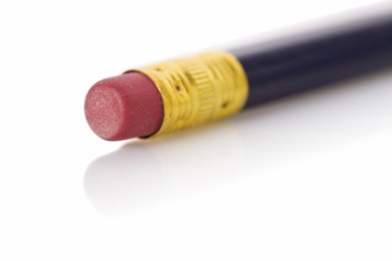
What type of objects are you going to use water displacement on?

Slide 16
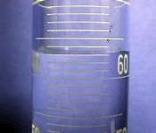
Water Displacement
So would be the first step?

Slide 17
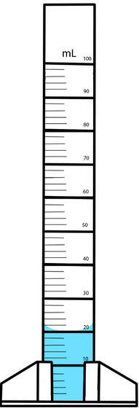
Water Displacement
Place a known amount of water into the graduated cylinder
How much water is in this graduated cylinder?

Slide 18
Water Displacement
Read your graduated cylinder carefully…remember to record your unit of measurement.
20 mL

Slide 19
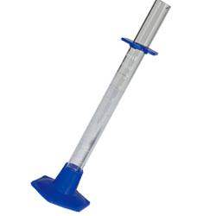
Water Displacement
Very carefully place your object into the graduated cylinder…what are some things you need to be aware of as you place the object into the graduated cylinder?

Slide 20
Water Displacement
Don’t drop it directly into the graduated cylinder – tilt the cylinder to the side and slide it to the bottom…GENTLY
Only place enough water in the graduated cylinder to cover the object by several mL.

Slide 21
Water Displacement
After placing the object carefully in the graduated cylinder, what should you do now?

Slide 22
Water Displacement
Read the volume of the water after the object has been put in, then…

Slide 23
Water Displacement
subtract your beginning water level from you ending water level.
25 mL
20 mL
5 mL
Ending Water Level
-Beginning Water Level
Volume of the object

Slide 24
Water Displacement
Now what is the unit of measurement we will be using with our answer.
mL

Slide 25
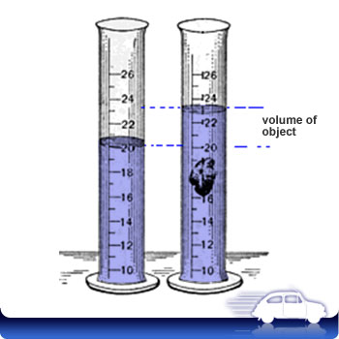
What is the volume of this object?
3 mL

Slide 26
Just to review…if you have a regular uniformly shaped object that has a measureable length, height and width, we use which method of calculating volume?
If the object is irregularly shaped, then we use what method to calculate volume?

Slide 27
Now comes the fun part…we have covered how to mass an object, how to calculate volume – so we are ready to move on to calculating…
Density

Slide 28
Density is the relationship of mass to volume.

Slide 29
Density is the amount of matter that is packed into a specific space. It is determined by using the formula mass divided by volume (M/V = D)

Slide 30
Now let’s practice a problem…
Density = 20 g
10 cm ³
What is the density?
2 g/cm³

Slide 31
2 g/cm³
When we label the problem we have to use both the grams and the cm³…why?
2 xy
4 xz
2 y
4 z
20 g
10 cm³
=

Slide 32
Let’s do some practice problems:
75 mL of water was measured. An object was carefully dropped into the graduated cylinder. The water level rose to 90 mL. What is the volume of the rock?
15 mL

Slide 33
Let’s do some practice problems:
If the mass of an object is 30 grams and the volume of the 15 mL, what is the density?
Density = 2g/mL

Slide 34
Let’s do some practice problems:
If the measurements of a metal bar are 10 cm, 5 cm and 2 cm, what is the volume of the metal bar?
Volume = 100 cm³

Slide 35
Let’s do some practice problems:
If the mass of the metal bar is 250 gm and the volume is 100 cm³, what is the density?
Density = 2.5 g/cm³

