Slide 1
Time

Slide 2
Converting Time
Revision
Learning Intention
Success Criteria
  To revise previous work on converting between
  12 and 24 hr clock and vice versa.
  Change from 12 to 24 hour clock.
  2. Change from 24 to 12 hour clock.

Slide 3
12/24 Hour Clock
midnight
1 am
2 am
3 am
4 am
5am
6 am
7 am
8 am
9 am
10 am
11 am
0000
0100
0200
0300
0400
0500
0600
0700
0800
0900
1000
1100
midday
1 pm
2 pm
3 pm
4 pm
5 pm
6 pm
7 pm
8 pm
9 pm
10 pm
11 pm
1200
1300
1400
1500
1600
1700
1800
1900
2000
2100
2200
2300
To go from 12 hour clock to 24 hour clock just add 12 to the pm hours:
Examples
8 pm becomes
2000
9 pm becomes
2100
6:30 pm becomes
1830
11:30 pm becomes
2330
4:20 pm becomes
1620
3:10 pm becomes
1510

Slide 4
12/24 Hour Clock
midnight
1 am
2 am
3 am
4 am
5am
6 am
7 am
8 am
9 am
10 am
11 am
0000
0100
0200
0300
0400
0500
0600
0700
0800
0900
1000
1100
midday
1 pm
2 pm
3 pm
4 pm
5 pm
6 pm
7 pm
8 pm
9 pm
10 pm
11 pm
1200
1300
1400
1500
1600
1700
1800
1900
2000
2100
2200
2300
To go from 24 hour clock to 12 hour clock just subtract 12 from the hours if it is greater than 12:
Examples
2000 becomes
8 pm
2100 becomes
9 pm
1730 becomes
5:30 pm
2208 becomes
10:08 pm
2006 becomes
8:06 pm
1350 becomes
1:50 pm

Slide 5
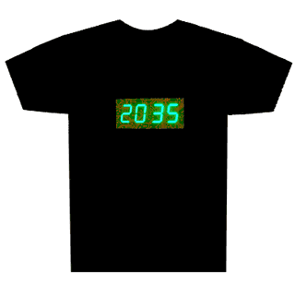
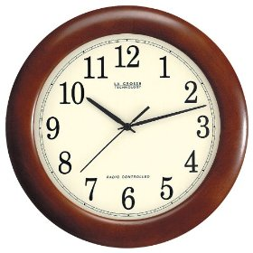
Converting Time
Let’s make up our own questions !
Key Points
pm times add on 12
12 hour clock
24 hour clock
Analogue clock
Digital clock
ALWAYS use AM or PM
ALWAYS 4 digits
Hours 1 - 12
NEVER use AM or PM
greater than 12
subtract 12
Hours 0 - 24

Slide 6
Counting Method
When working out time difference we will use the
Counting Method. This method will always work.
Example : Find the time difference between
08 40 hrs and 11 10 hrs
Hrs Mins
nearest
hour
hours
What’s left
20
08 40
09 00
11 00
11 10
2
+
10
20 mins
2 hrs
10 mins
2 30

Slide 7
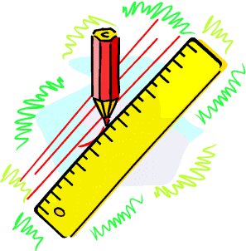
But there are
60 minutes = 1hour
70 mins = 1hr 10mins
Counting Method
A bus leaves Kirkintilloch Main Street at 14 40 hrs
and arrives in Aberdeen at 18 50 hrs.
How long was the journey.
nearest
hour
hours
What’s left
Hrs Mins
20
14 40
15 00
18 00
18 50
3
20 mins
3 hrs
50 mins
+
50
3 70
4hrs 10 mins

Slide 8
Using Timetables
*
*
Kirkie Bus Station
0825
0925
1025
2025
2125
2225
Bishopbriggs
0837
0937
1037
And
2037
2137
2237
Milton
0843
0943
1043
Every
2043
2143
2243
Springburn
0848
0948
1048
Hour
2048
2148
2248
Port Dundas
0854
0954
1054
Until
2054
2154
2254
George Square
0902
1002
1102
2102
2202
2302
Glasgow Bus Station
0914
1014
1114
2114
2214
2314
*
How long does the first bus take from Kirkie to Glasgow.
nearest
hour
Hrs Mins
hours
What’s left
35
35
08 25
09 00
09 00
09 14
0
0
35 mins
0 hrs
14 mins
+
14
14
49

Slide 9
But there are
60 minutes = 1hour
Counting Method
Let’s make up our own question !
The key steps are left on the slide to help you.
nearest
hour
hours
What’s left
Hrs Mins
mins
hrs
mins
+

Slide 10
Counting Method

Slide 11
Time
Minutes and Secs
Learning Intention
Success Criteria
  To work out accuracy to 1 and 2 decimal places.
  1. Round to 1 and 2 decimal places.

Slide 12
Time
Minute & Seconds
Rounding time to 1 or 2 decimal places is
just the same as rounding any number.
Example : Round the times to 1 and 2 decimals places
(a) 4.573 secs
4.6 secs to 1 decimal place
4.57 secs to 2 decimal place
(b) 52.455 secs
52.5 secs to 1 decimal place
52.46 secs to 2 decimal place

Slide 13
Time
Minute & Seconds
Note : In athletics the winner of a race corresponds to
the smallest time.
Example : In a race the times are as follows
Mark 11.01 sec, Caitlin 10.05sec, Owen 10.03 sec,
Amy 10.92 sec and Euan 10.73 sec.
Work out who won the race and the order they came in.
1st Owen 10.03 sec
2nd Caitlin 10.05sec
4th Amy 10.92 sec
3rd Euan 10.73 sec
5th Mark 11.01 sec

Slide 14

Time
Minute & Seconds
Example : In a race Katrina beat Daniel by 0.53 sec. Daniel’s time was 10.46 secs.
What was Katrina’s time ?
Katrina won therefore her time will be 0.53 less.

