Slide 1
Dissolving and separating solutions

Slide 2
Dissolving model
Solute
Solution
Solvent

Slide 3
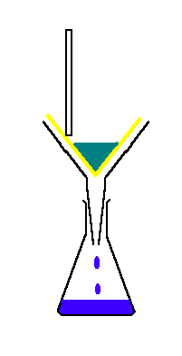
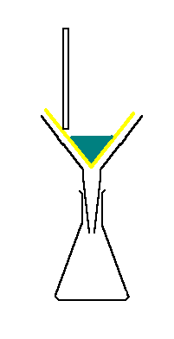
Filtering
Glass rod
Filter paper
Cloudy liquid
Filter funnel
Filtrate

Slide 4
Filtering
What does filtering do to a cloudy liquid?
  it makes it crystal clear
What does filtering remove from cloudy liquids?
  insoluble materials
Why will filtering not remove any dissolved materials?
  dissolved particles are all separate from each other
  they are able to pass through the tiny holes in the filter paper, as do the liquid particles

Slide 5
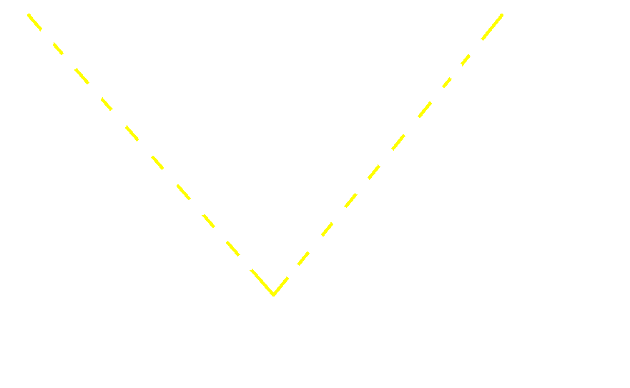
Filtering model
insoluble particles are unable to pass through the tiny holes in the filter paper
How does filtering work?
Filter paper
Solvent particles
Dissolved particles
Insoluble particles

Slide 6
Filtering and dissolving key words
Key word | Explanation
 | Solid that will not dissolve
 | Solid that will dissolve
 | Liquid that will dissolve solids
 | Liquid with dissolved solid
 | Solid that has dissolved
 | Clear filtered liquid
 | Solution that is ‘full up’
Soluble
Solvent
Insoluble
Solute
Filtrate
Solution
Saturated
Insoluble
Soluble
Solvent
Solution
Solute
Filtrate
Saturated

Slide 7
Evaporation and distillation
What happens when a liquid evaporates?
  it changes from a liquid to a gas
What happens to any dissolved solids in the liquid?
  dissolved solids get left behind
What happens during distillation?
  a liquid is first evaporated by heating
  then cooled to change it back into a liquid
What is distillation used for?
  to remove dissolved solids from liquids

Slide 8
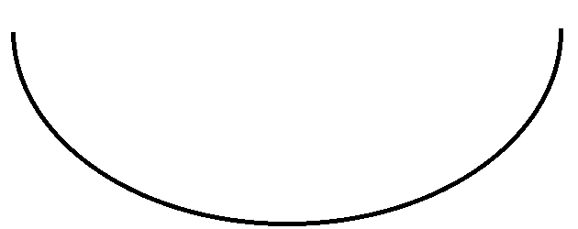
Evaporation model
Dissolved particles
Solvent particles
What happens to the dissolved solid particles?
dissolved solid gets left behind and forms into crystals
Solvent vapour
Heat
Heat

Slide 9
Using a Leibig condenser
Thermometer
Reading?
100^{O}C
Cooling water jacket
Steam
Boiling inky water
Distillate (pure water)
What is in the bubbles?
Steam

Slide 10
Evaporation and distillation key words
Key word | Explanation
 | Change from a liquid to a gas
 | Change from a gas to a liquid
 | An evaporated liquid (a gas)
 | Purifying a liquid by first evaporating then condensing
 | A distilled liquid
Evaporate
Evaporate
Condense
Vapour
Distil
Distillate
Evaporate
Condense
Vapour
Distil
Distillate

Slide 11
Fractional distillation
What is fractional distillation used for?
  to separate a mixture of two or more liquids
How does fractional distillation work?
  it can separate a mixture of liquids that have different boiling points
  the mixture is slowly heated until the liquid with the lowest boiling point starts to boil off from the mixture and is collected by condensing it

Slide 12
Chromatography
What is chromatography used for?
  to separate a mixture of dissolved solids
How does chromatography work?
  the different chemicals in a mixture of dissolved solids have different size particles
  when dissolved in a liquid, these different sized particles travel through special paper at different rates and so separate out

Slide 13
Strip chromatography model
Chromatography paper
Solute A
Solute B
Mixture of solutes A & B
Solvent

Slide 14
Chromatography problems
Which two samples were probably the same?
Which was a mixture of two materials?
Samples A and D; they both moved the same distance so they are probably the same
Sample B was a mixture of two materials because it separated out into two spots
Chromatography paper
Start reference mark
Test sample
A
B
C
D
A
B
C
D
Solvent

Slide 15
Drop chromatography model
Chromatography paper
Solute A
Solute B
Mixture of solutes A & B
Solvent added a drop at a time

Slide 16
Predicting chromatography results
What separate pigments may be observed?
The primary pigments yellow and red mix to make orange

Slide 17
Predicting chromatography results
What separate pigments may be observed?
The primary pigments blue and red mix to make purple

Slide 18
Predicting chromatography results
What separate pigments may be observed?
The primary pigments yellow, red and blue mix to make black

