Slide 1
Matter: Properties & Change
Chapter 3

Slide 2
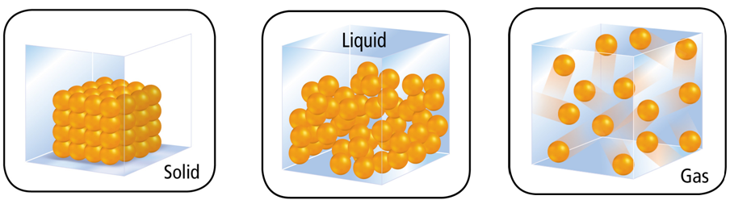
A. Matter
Matter – anything that has mass and takes up space
  Everything around us
Chemistry – the study of matter and the changes it undergoes

Slide 3
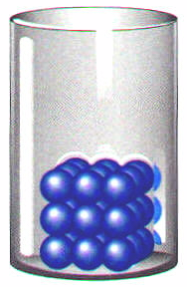

B. Four States of Matter
Solids
  particles vibrate but can’t move around
  fixed shape
  fixed volume
  incompressible

Slide 4
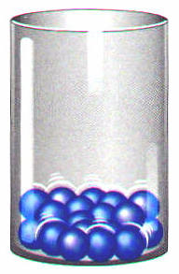

B. Four States of Matter
Liquids
  particles can move around but are still close together
  variable shape
  fixed volume
  Virtually incompressible

Slide 5
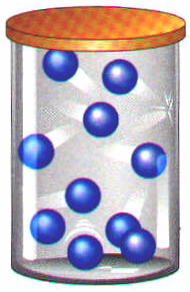
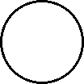
B. Four States of Matter
Gases
  particles can separate and move throughout container
  variable shape
  variable volume
  Easily compressed
  Vapor = gaseous state of a substance that is a liquid or solid at room temperature

Slide 6
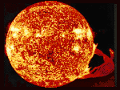
B. Four States of Matter
Plasma
  particles collide with enough energy to break into charged particles (+/-)
  gas-like, variable
  shape & volume
  stars, fluorescent
  light bulbs, TV tubes

Slide 7
II. Properties & Changes in Matter (p.73-79)
  Extensive vs. Intensive
  Physical vs. Chemical

Slide 8
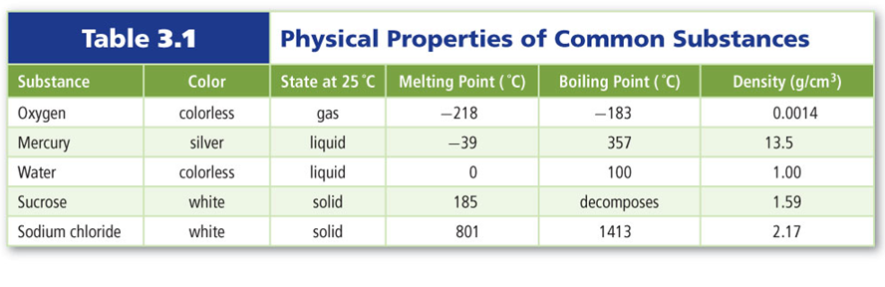
A. Physical Properties
Physical Property
  can be observed without changing the identity of the substance

Slide 9
A. Physical Properties
Physical properties can be described as one of 2 types:
Extensive Property
  depends on the amount of matter present (example: length)
Intensive Property
  depends on the identity of substance, not the amount (example: scent)

Slide 10
B. Extensive vs. Intensive
Examples:
  boiling point
  volume
  mass
  density
  conductivity
  intensive
  extensive
  extensive
  intensive
  intensive

Slide 11
C. Density – a physical property
Derived units = Combination of base units
Volume (m³ or cm³ or mL)
  length × length × length
  Or measured using a graduated cylinder
1 cm³ = 1 mL
1 dm³ = 1 L
Density (kg/m³ or g/cm³ or g/mL)
  mass per volume
M
V
D =

Slide 12
C. Density
Mass (g)
Volume (cm³)

Slide 13
C. Density
An object has a volume of 825 cm³ and a density of 13.6 g/cm³. Find its mass.
GIVEN:
V = 825 cm³
D = 13.6 g/cm³
M = ?
WORK:
M = DV
M = (13.6 g/cm³)(825cm³)
M = 11,220 g
M = 11,200 g

Slide 14
C. Density
A liquid has a density of 0.87 g/mL. What volume is occupied by 25 g of the liquid?
GIVEN:
D = 0.87 g/mL
V = ?
M = 25 g
WORK:
V = M
D
V = 25 g
0.87 g/mL
= 28.736 mL
V = 29 mL

Slide 15
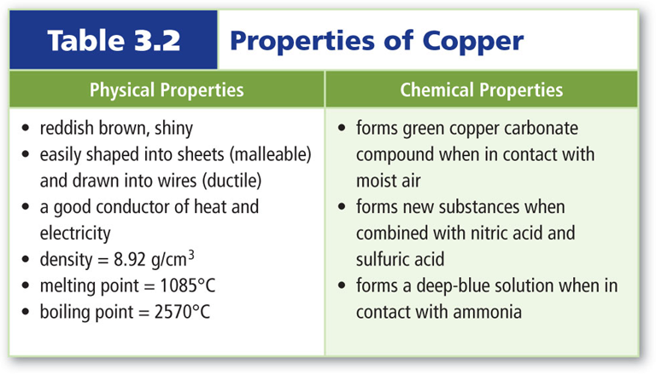
D. Chemical Properties
Chemical Property
  describes the ability of a substance to undergo changes in identity

Slide 16
E. Physical vs. Chemical Properties
Examples:
  melting point
  flammable
  density
  magnetic
  tarnishes in air
  physical
  chemical
  physical
  physical
  chemical

Slide 17
F. Physical Changes
Physical Change
  changes the form of a substance without changing its identity
  properties remain the same
Examples: cutting a sheet of paper, breaking a crystal, all phase changes

Slide 18
F. Phase Changes – Physical
Evaporation =
Condensation =
Melting =
Freezing =
Sublimation =
Liquid -> Gas
Gas -> Liquid
Solid -> Liquid
Liquid -> Solid
Solid -> Gas

Slide 19
G. Chemical Changes
Process that involves one or more substances changing into a new substance
  Commonly referred to as a chemical reaction
  New substances have different compositions and properties from original substances

Slide 20
G. Chemical Changes
Signs of a Chemical Change
  change in color or odor
  formation of a gas
  formation of a precipitate (solid)
  change in light or heat

Slide 21
H. Physical vs. Chemical Changes
Examples:
  rusting iron
  dissolving in water
  burning a log
  melting ice
  grinding spices
  chemical
  physical
  chemical
  physical
  physical

Slide 22
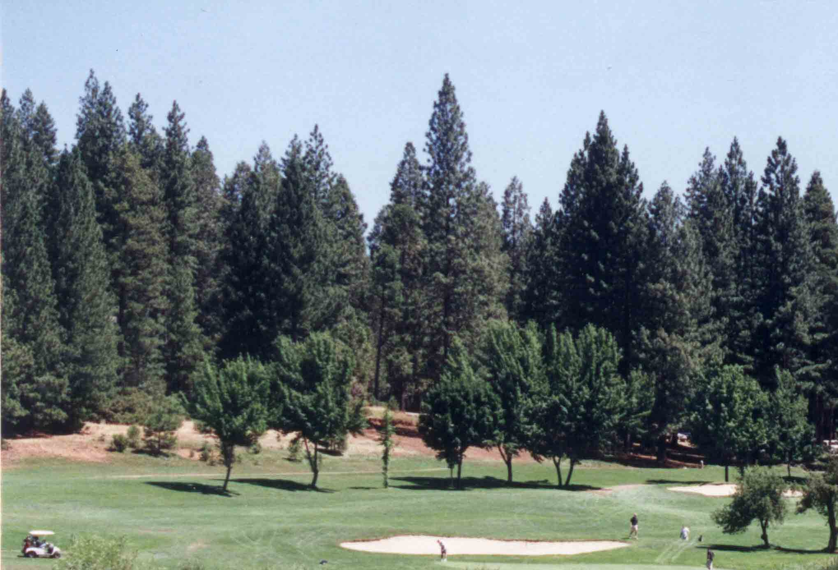
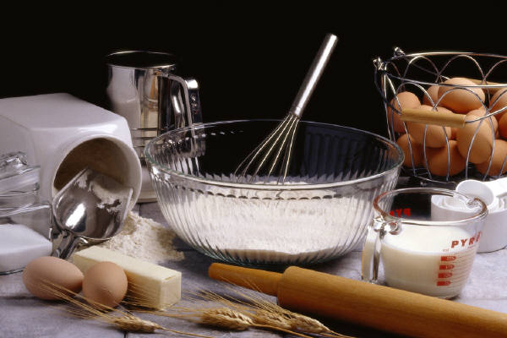
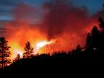
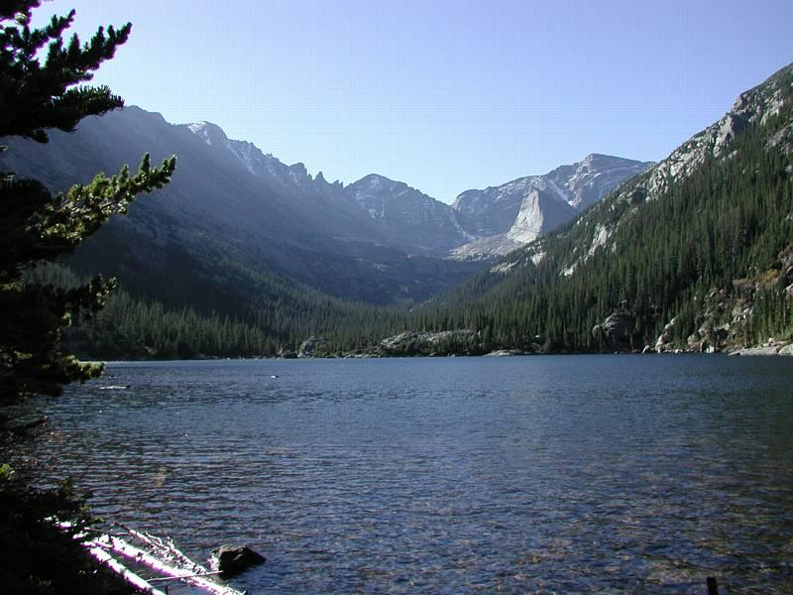

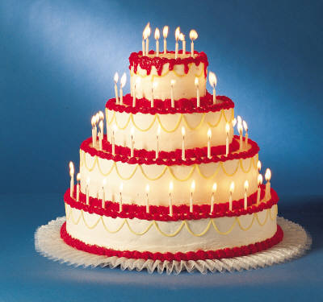
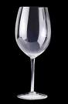
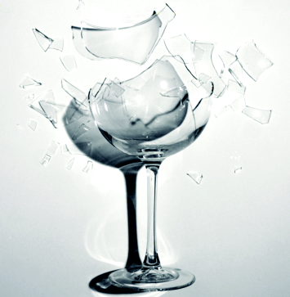
What Type of Change?
→
↓
→
→

Slide 23
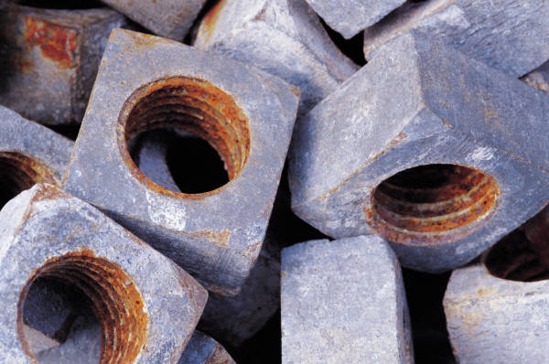
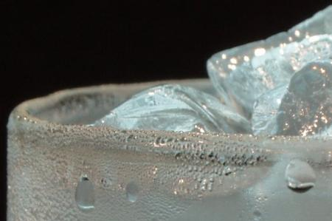
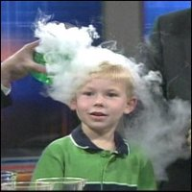
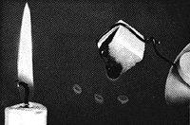
What Type of Change?

Slide 24
I. Law of Conservation of Mass
Although chemical changes occur, mass is neither created nor destroyed in a chemical reaction
Mass of reactants equals mass of products
mass_{reactants} = mass_{products}
A + B → C

Slide 25
I. Conservation of Mass
In an experiment, 10.00 g of red mercury (II) oxide powder is placed in an open flask and heated until it is converted to liquid mercury and oxygen gas. The liquid mercury has a mass of 9.26 g. What is the mass of the oxygen formed in the reaction?
GIVEN:
Mercury (II) oxide → mercury + oxygen
M_{mercury(II) oxide} = 10.00 g
M_{mercury} = 9.86 g
M_{oxygen} = ?
WORK:
10.00 g = 9.86 g + m_{oxygen}
M_{oxygen} = (10.00 g – 9.86 g)
M_{oxygen} = 0.74 g
Mercury (II) oxide → mercury + oxygen
Mmercury(II) oxide = 10.00 g
Mmercury = 9.26
Moxygen = ?
mass_{reactants} = mass_{products}

Slide 26
III. Classification of Matter (pp. 80-87)
  Matter Flowchart
  Pure Substances
  Mixtures

Slide 27
A. Matter Flowchart
MATTER
yes
no
Can it be physically separated?
MIXTURE
PURE SUBSTANCE
yes
Is the composition uniform?
no
yes
Can it be chemically decomposed?
no
Homogeneous Mixture
(solution)
Heterogeneous Mixture
Compound
Element

Slide 28
A. Matter Flowchart
Examples:
  graphite
  pepper
  sugar (sucrose)
  paint
  soda
  element
  hetero. mixture
  compound
  hetero. mixture
  solution

Slide 29
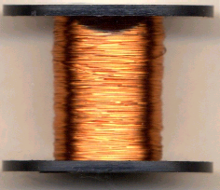
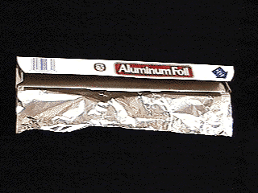
B. Pure Substances
Element
  composed of identical atoms
  EX: copper wire, aluminum foil

Slide 30
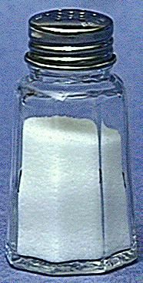
B. Pure Substances
Compound
  composed of 2 or more elements in a fixed ratio
  properties differ from those of individual elements
  EX: table salt (NaCl)

Slide 31
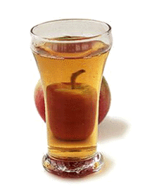
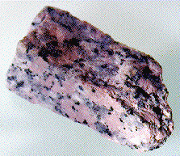
C. Mixtures
Variable combination of 2 or more pure substances.
Heterogeneous
Homogeneous

Slide 32
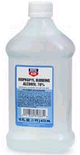
C. Mixtures
Solution
  homogeneous
  very small particles
  particles don’t settle
  EX: rubbing alcohol

Slide 33
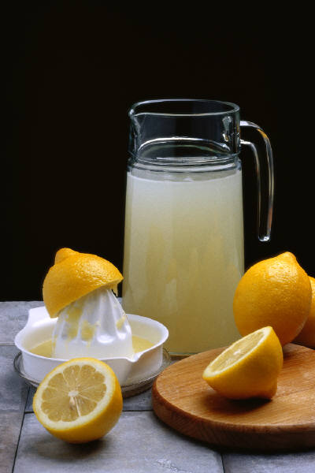
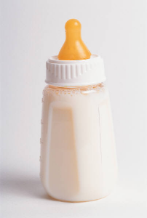
C. Mixtures
Heterogeneous
  medium-sized to large-sized particles
  particles may or may not settle
  EX: milk, fresh-squeezed
  lemonade

Slide 34
C. Mixtures
Examples:
  tea
  muddy water
  fog
  saltwater
  Italian salad dressing
Answers:
  Solution
  Heterogeneous
  Heterogeneous
  Solution
  Heterogeneous

