Slide 1
Separating Mixtures

Slide 2
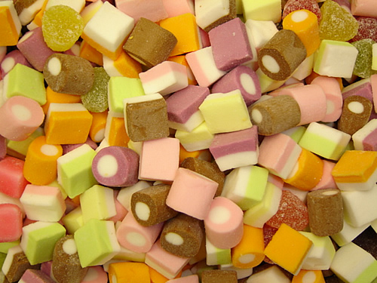
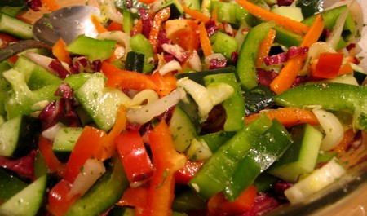
What is a mixture?
When two or more materials or substances are mixed together but do not chemically combine.
This means they retain their original properties.
This means they can be separated by physical means.

Slide 3
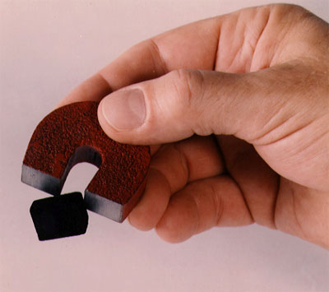
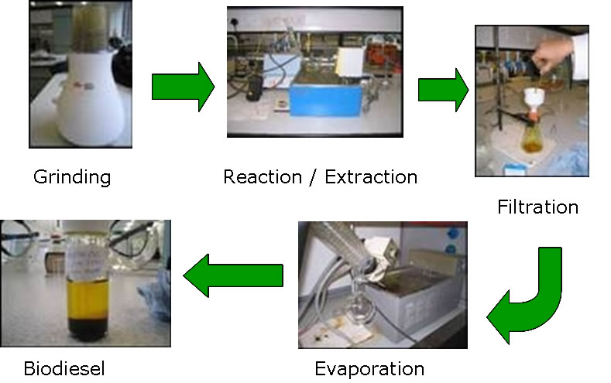
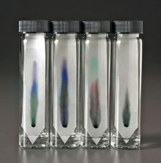
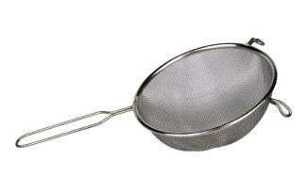
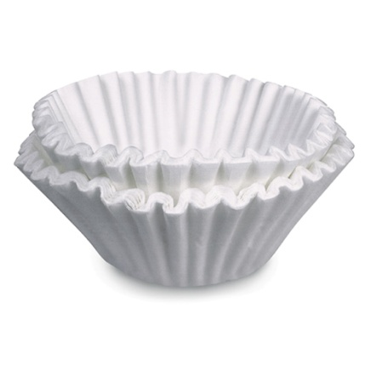
What are the different ways of separating mixtures?
Magnetism
Hand separation
Filtration
Sifting or sieving
Extraction and evaporation
Chromatography

Slide 4

Magnetism
If one component of the mixture has magnetic properties, you could use a magnet to separate the mixture. Iron, nickel, and cobalt are all materials that are magnetic.
Not all metals are magnetic: gold, silver, and aluminum are examples of metals that are not magnetic.

Slide 5
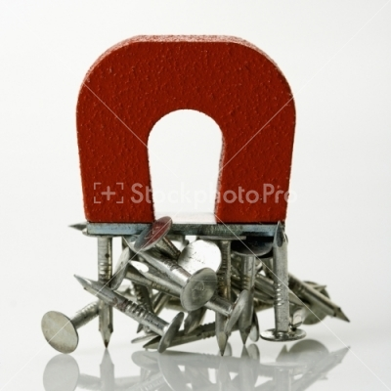
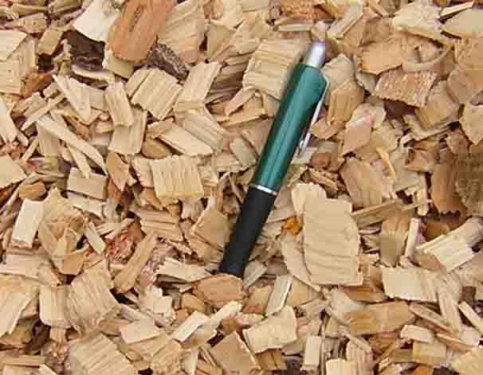
Example of magnetism
Using a magnet to separate nails from wood chips.

Slide 6
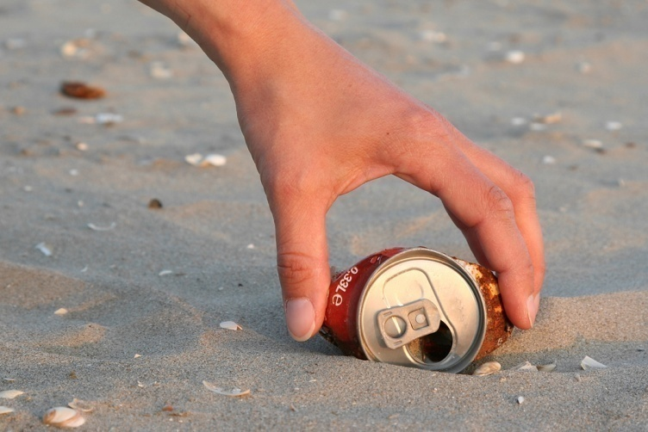
Hand separation
Separating the parts of a mixture by hand.
Only useful when the particles are large enough to be seen clearly.
Useful for: separating parts of a salad.

Slide 7
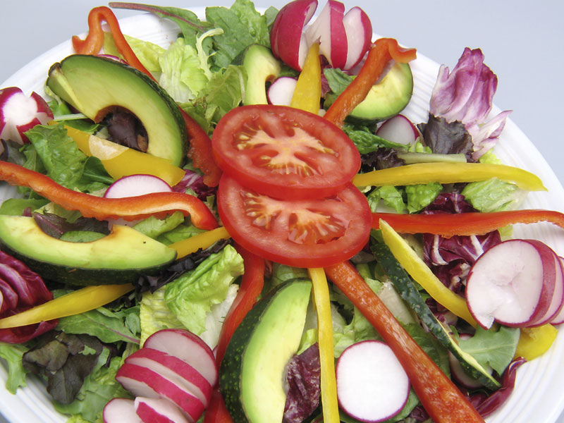
Example of hand separation:
Using your fork to separate tomatoes, lettuce, cucumber, onions, etc. in your salad.

Slide 8
Filtration
Used when separating a solid substance from a fluid (a liquid or a gas) by passing a mixture through a porous material such as a type of filter.
Works by letting the fluid pass through but not the solid.
Examples of filters: coffee filter, cloth, oil filter, even sand!

Slide 9
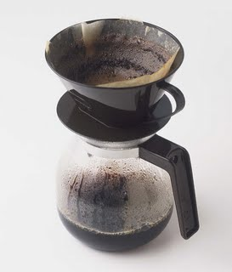
Example of filtration:
Using a coffee filter to separate the coffee flavor from the coffee beans.

Slide 10
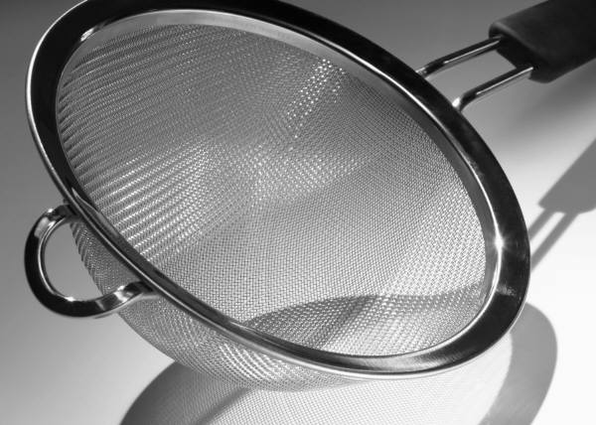
Sifting or sieving
Used to separate a dry mixture which contains substances of different sizes by passing it through a sieve, a device containing tiny holes.

Slide 11
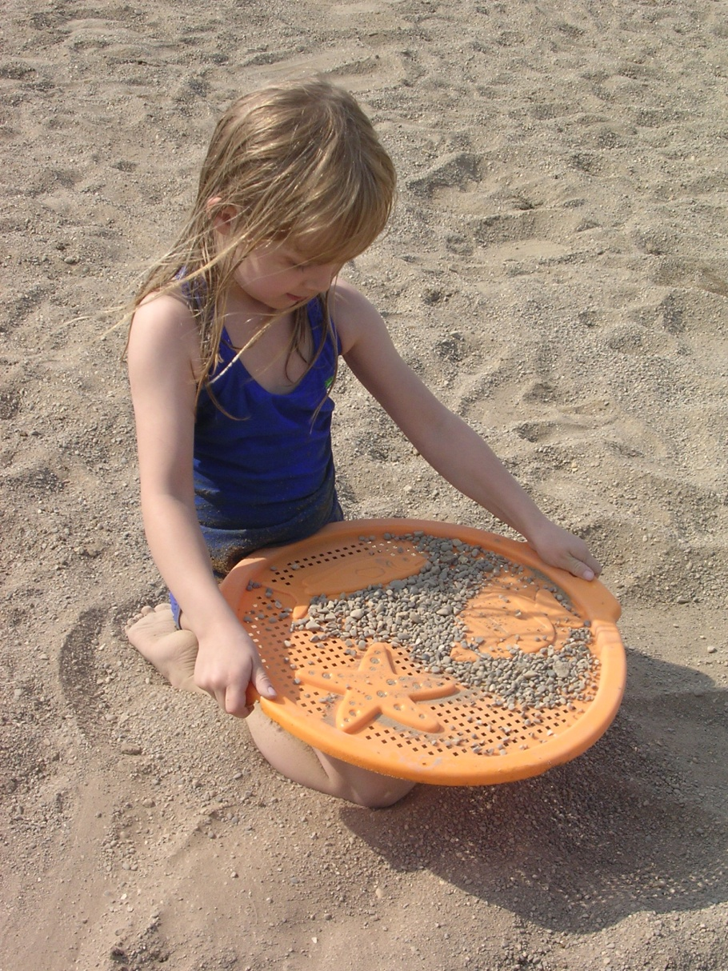
Example of sifting/sieving:
Using a sieve to separate sand from pebbles.

Slide 12
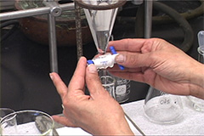
Extraction
Used to separate an insoluble solid (something that doesn’t dissolve in a liquid) from a soluble solid (something that DOES dissolve in a liquid). Done by adding a solvent (liquid that does the dissolving) to the mixture. Then pouring the liquid through a filter.

Slide 13
Example of extraction
With a mixture of sugar and sand, pouring water in the mixture which causes the sugar to dissolve. Then pouring the solution through a filter, causing the sand to separate from the sugar water.

Slide 14
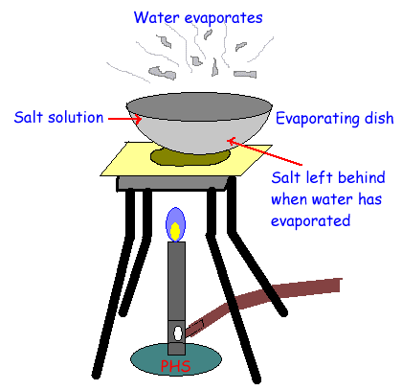
Evaporation
Allowing the liquid to evaporate, leaving the soluble solid behind.
Example: heating sugar water. The water evaporates and the sugar crystals are left behind.

Slide 15
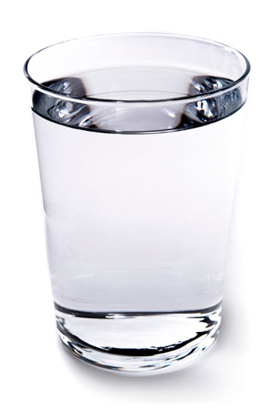
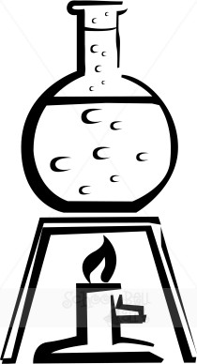
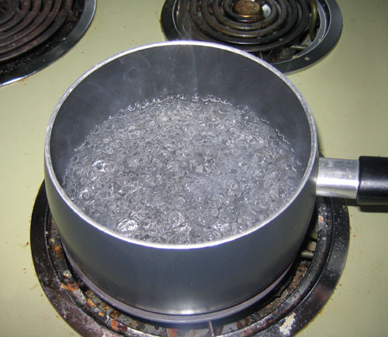
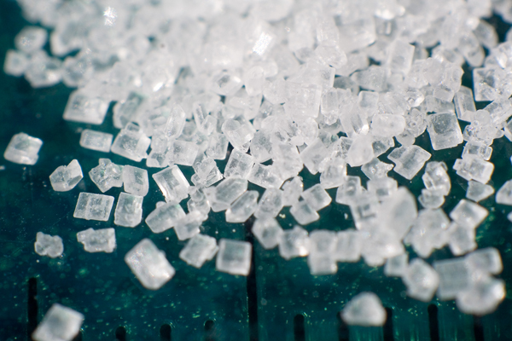
Example of using extraction and evaporation together:
Using water to dissolve sugar, then letting the water evaporate, leaving the sugar behind.

Slide 16
Chromatography
Used to separate dissolved substances in a solution from each other.
Stationary Phase
Separation
Mobile Phase
Mixture
Components

Slide 17
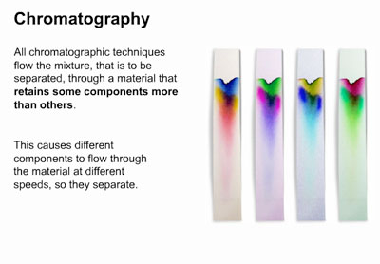
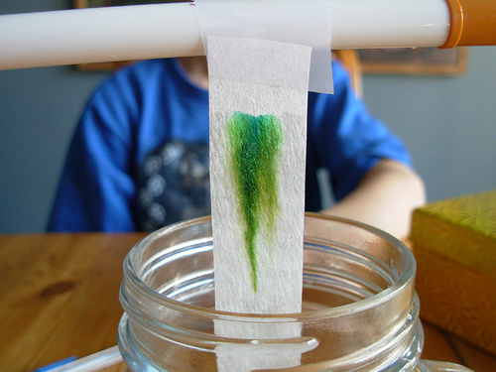
Example of chromatography:
Using chromatography paper to separate ink into it’s original components.

