Slide 1


7F Simple chemical reactions
7F
Simple chemical reactions
Chemical change
Reactions with acid
Reactions with oxygen

Slide 2
7F Simple chemical reactions
Chemical change

Slide 3
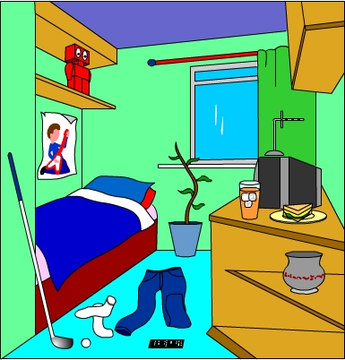


7F Chemical change – Changing materials
The world around us contains many different materials.
How many different materials can you see in this bedroom?

Slide 4
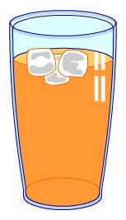
7F Chemical change – Changing materials
Materials can be changed in different ways.
A physical change means a material changes size, shape or state of matter.
e.g. Ice melts at room temperature.
A physical change can be easy to reverse.
What is the reverse of ice melting?

Slide 5
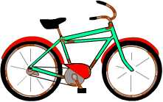
7F Chemical change – Changing materials
A chemical change to a material results in a completely new material being made.
e.g. A bicycle left outside has become rusty.
A chemical change is very difficult to reverse.
Could you change the rusty bicycle back into a non-rusty one?

Slide 6
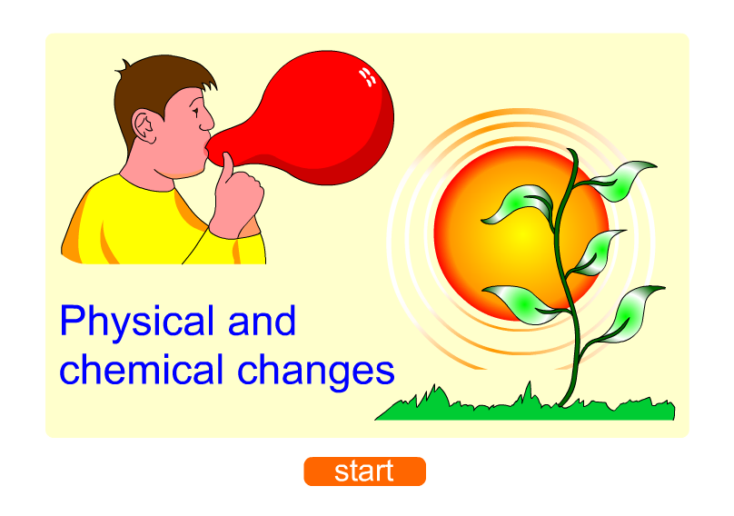
7F Chemical change – Physical or chemical?

Slide 7
7F Chemical change – What is a chemical reaction?
A chemical change is also called a chemical reaction.
A chemical reaction can be shown by a word equation:
reactants products
The starting materials that react with each other are called the reactants.
The new materials produced by the reaction are called the products.
What does the arrow in the word equation mean?

Slide 8
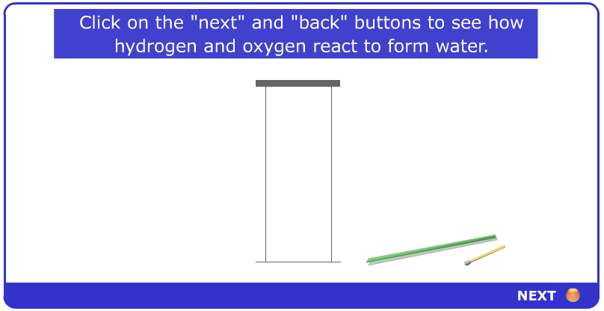
7F Chemical change – Formation of water
The word equation for the formation of water is:
hydrogen + oxygen water
Name the reactants and the product of this reaction.

Slide 9
7F Chemical change – Test your reactions!
1. In a chemical reaction, the properties of the reactants and products are…
a) exactly the same.
b) very different.
c) very colourful.
2. When a chemical reaction takes place, the products can be turned back into the reactants…
a) very easily.
b) with difficulty.
c) with a magic wand.
Notes:
TEACHER’S NOTES
Answers:
1b)
2b)

Slide 10
7F Chemical change – Test your reactions!
3. The speed of a chemical reaction…
a) is always very slow.
b) is always very fast.
c) can range from very slow to very fast.
4. The products of a chemical reaction are shown on the left-hand side of a word equation.
a) Always.
b) Sometimes.
c) On Thursdays.
Notes:
TEACHER’S NOTES
Answers:
3c)
4a)

Slide 11
7F Chemical change – Test your reactions!
5. The arrow in the middle of a word equation means…
a) “turn right”.
b) “react to make”.
c) “equals”.
6. The starting materials involved in a chemical reaction are said to…
a) act like each other.
b) react with each other.
c) read to each other.
Notes:
TEACHER’S NOTES
Answers:
5B)
6b)

Slide 12
7F Chemical change – Test your reactions!
7. Which of these processes is an example of an everyday chemical reaction?
a) Freezing water.
b) Melting butter.
c) Baking bread.
8. Which of these is not a sign that a chemical reaction has taken place?
a) Boiling.
b) Bubbling.
c) Blowing.
Notes:
TEACHER’S NOTES
Answers:
7c)
8c)

Slide 13
7F Chemical change – Test your reactions!
9. When sodium metal is heated it can react with chlorine gas. The word equation for the reaction is:
sodium + chlorine sodium chloride
What is the product of this reaction?
a) sodium.
b) chlorine.
c) sodium chloride.
10. Rust forms when iron reacts with oxygen in the air. The word equation for this chemical reaction is:
a) iron + rust → oxygen
b) iron + oxygen → rust
c) iron → rust + oxygen
Notes:
TEACHER’S NOTES
Answers:
9c)
10b)

Slide 14
7F Simple chemical reactions
Reactions with acid

Slide 15
7F Reactions with acid - Acids in chemical reactions
What do you know about acids?
Weak acids, like lemon juice and vinegar, are harmless.
Strong acids must be handled with care.
They are dangerous because they can react easily
with materials such as skin, wood and cloth.
You need to know about the chemical reactions of acids with metals and carbonates.

Slide 16
7F Reactions with acid - Metals in chemical reactions
What do you know about metals?
Metals are usually solid, shiny and strong. They are also good conductors of heat and electricity.
Metals can be changed into new substances when they are involved in a chemical reaction.
Some metals can react with acids.
This type of chemical reaction is called corrosion.

Slide 17

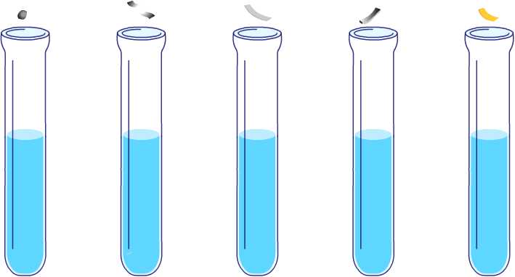

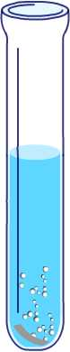


7F Reactions with acid - Reaction of metals with acid
Do all metals react with acids in the same way?
sodium
magnesium
iron
lead
copper
iron - the metal reacts slowly, producing a few bubbles
magnesium - the metal reacts quickly with the acid, producing lots of bubbles
lead - the metal reacts very slowly, producing very few bubbles
copper - no bubbles, no reaction with acid
sodium - the metal bursts into flames, a very strong reaction
Notes:
TEACHER’S NOTES
- table of results?
- Which metal is the most reactive?
- Which metal is the least reactive?
- What gas is being formed?

Slide 18
7F Reactions with acid - Reaction of metals with acid
When a metal does react with acid, the metal gets smaller and seems to disappear.
But has the metal really disappeared?
The metal has reacted with some of the acid.
The products of this chemical reaction are a salt and the gas hydrogen.
Complete the word equation for the reaction of a metal with an acid:
metal
+
acid
?
+
?

Slide 19
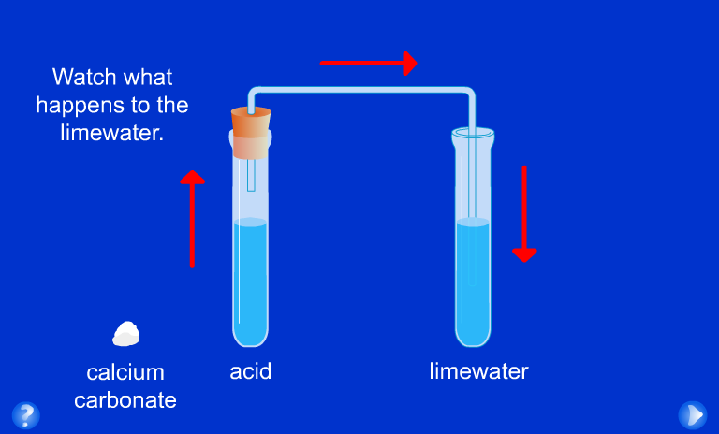
7F Reactions with acid - Reaction of carbonates with acid
Carbonates are chemicals that contain carbon and oxygen.
Carbonates can react with acids.

Slide 20
7F Reactions with acid - Reaction of carbonates with acid
Calcium carbonate reacts with acid to produce a gas which turns the limewater cloudy.
What is the name of this gas?
The other products of this reaction are a salt and water.
Complete the word equation for the reaction of a carbonate with acid:
carbonate
+
acid
?
+
?
+
?

Slide 21
7F Simple chemical reactions
Reactions with oxygen

Slide 22

7F Reactions with oxygen – What is burning?
Burning is a chemical reaction.
When things burn they react with oxygen in the air and energy is released as heat and light.
This chemical reaction is also called combustion.
Can you name the three things needed for combustion?

Slide 23
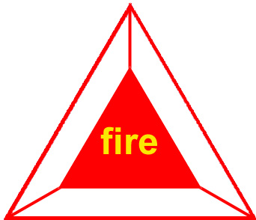
7F Reactions with oxygen – Fire triangle
A fire only burns with all three parts of the fire triangle.
oxygen
This colourless gas is needed for all substances to burn.
heat
Some energy is needed to start the burning reaction – this is usually heat energy from a spark or a flame.
oxygen
heat
fuel
fuel
Any substance that can burn (or combust) is called a fuel.
How can firefighters use the fire triangle to control fires?

Slide 24
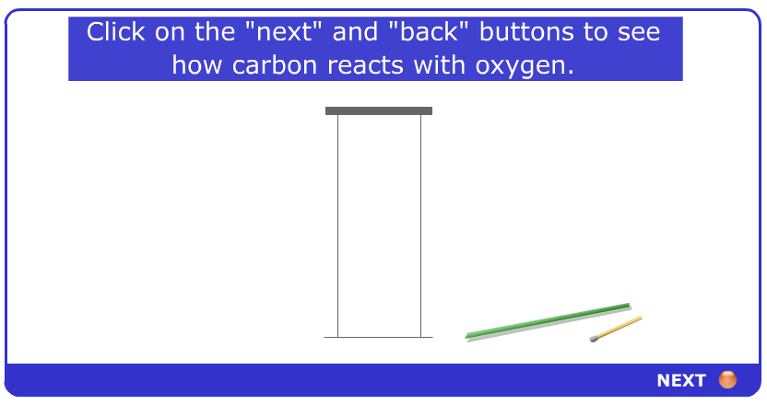
7F Reactions with oxygen – Products of burning
Complete the word equation for this reaction:
carbon
+
oxygen
?

Slide 25
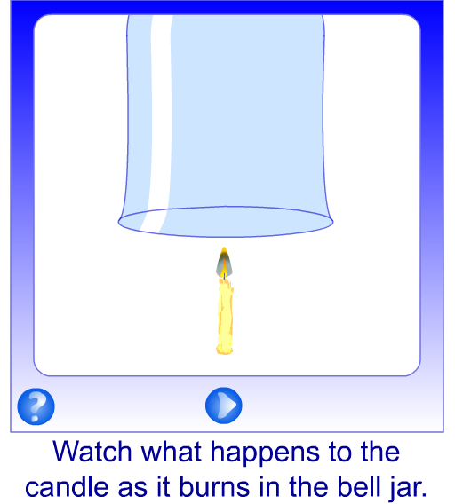
7F Reactions with oxygen – Candle in bell jar
Oxygen is a gas found in the air around us.
Is oxygen the only gas found in the air?

