Slide 1

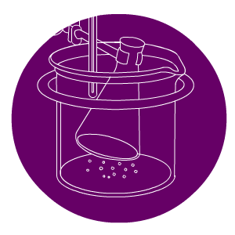

Simple Chemical Reactions

Slide 2
Contents
7F Simple Chemical Reactions
Chemical reactions everywhere
Reactions with acid
Word equations
Reactions with oxygen
Summary activities

Slide 3
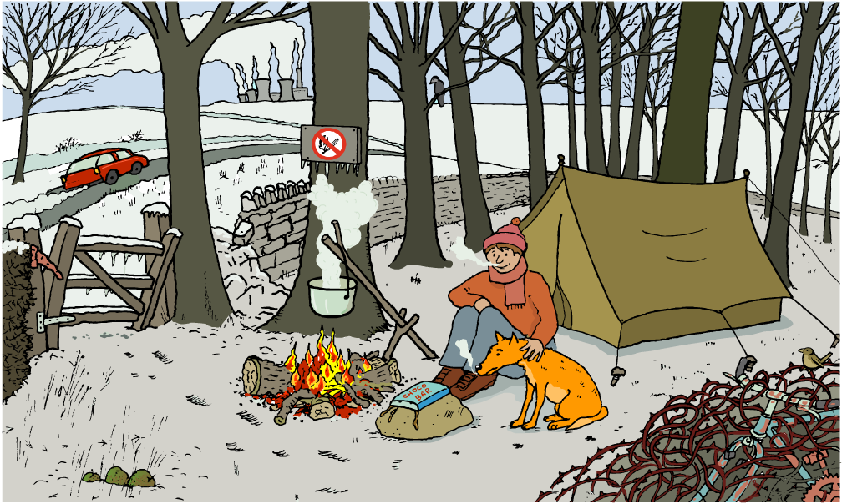
Physical and chemical changes
How many physical and chemical changes can you spot?

Slide 4
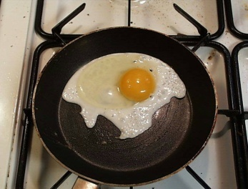
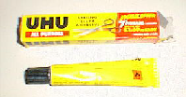
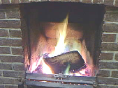
What is a chemical reaction?
Chemical reactions do not only happen in the laboratory.
Chemical reactions happen anywhere that new substances are made:
cooking
rusting
sticking
burning
making metals
living!
Can you think of any other chemical reactions?

Slide 5
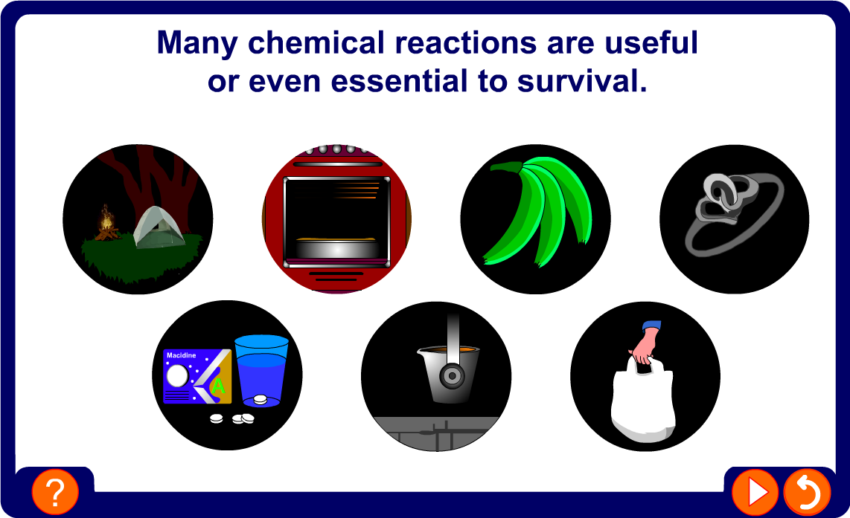
Useful chemical reactions

Slide 6
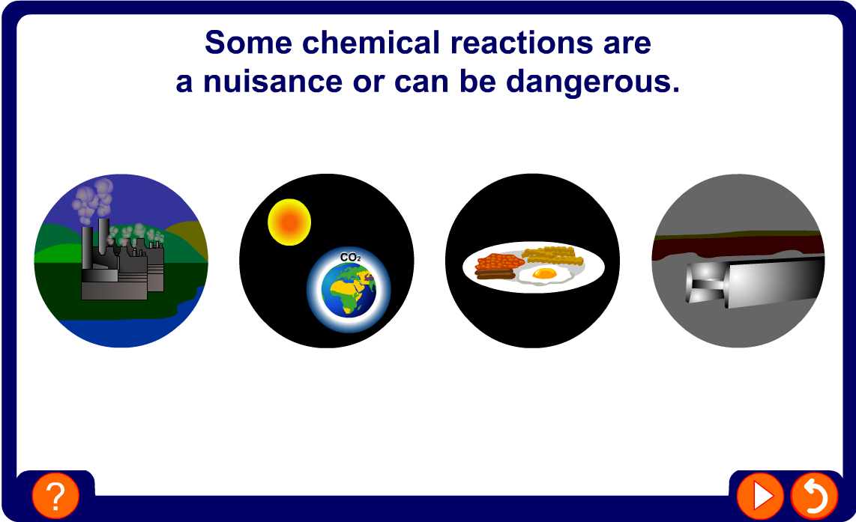
Non-useful chemical reactions

Slide 7

Reactants and products
In a chemical reaction, one or more new substances are formed.
The starting substances used in a reaction are reactants.
The new substances formed in a reaction are products.
reactants
products
The arrow means “change into”. In a chemical reaction,
all the reactants change into the products.
It is difficult to reverse a chemical reaction and change the products back into the reactants.

Slide 8
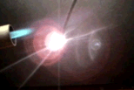
More about chemical changes
Chemical changes are usually difficult to reverse.
Magnesium burns in oxygen to form magnesium oxide. It is not possible to “un-burn” the magnesium once it has been burnt.
magnesium
oxygen
magnesium oxide
Many reactions need energy to get them started.
Many reactions (like the burning of magnesium) give out
heat energy once the reaction has started.
Heat energy being given out is one sign of a chemical reaction. What other signs of a chemical reaction are there?

Slide 9
Contents
7F Simple Chemical Reactions
Chemical reactions everywhere
Reactions with acid
Word equations
Reactions with oxygen
Summary activities

Slide 10
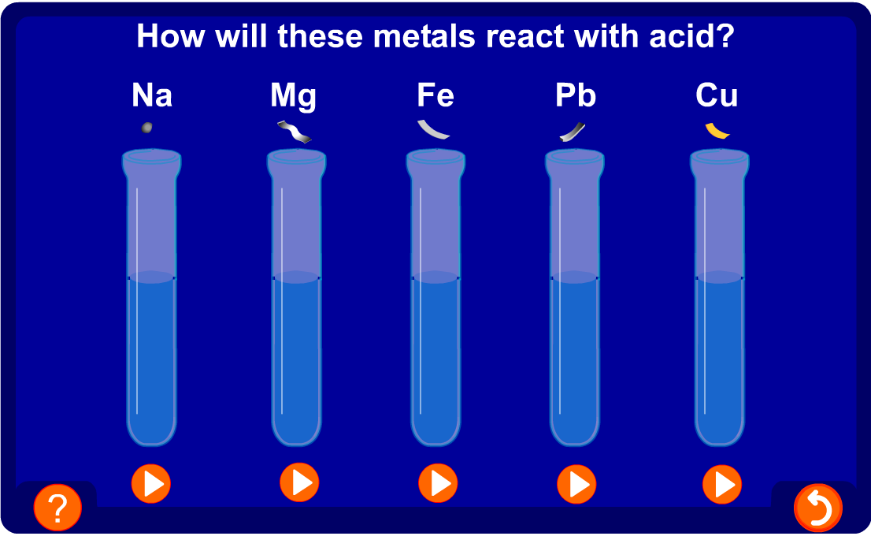
Reaction of acid with metals

Slide 11
Test for hydrogen
Many metals react with acids. When this happens the metal fizzes as bubbles are produced.
hydrogen
burning splint
What do the bubbles mean?
magnesium + acid
A gas is produced.
How can you test to find out if the gas produced is hydrogen?
Place a burning splint next to the mouth of test tube.
A ‘squeaky pop’ as the gas ignites shows that hydrogen is the gas produced in this reaction.

Slide 12
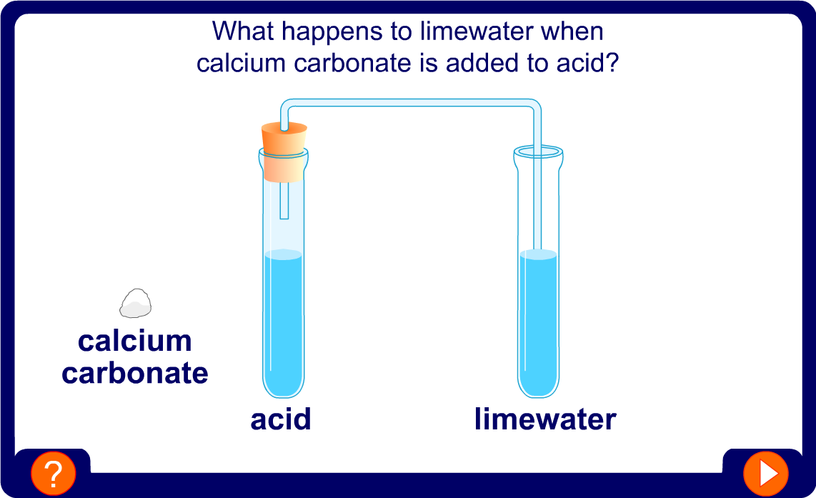
Reaction of acid with a metal carbonate

Slide 13

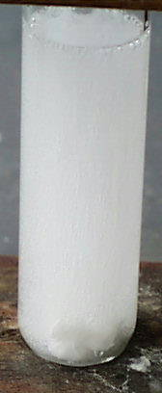
Test for carbon dioxide
When a metal carbonate reacts with acid it fizzes and then seems to disappear. The carbonate and the acid have reacted and changed into a salt, water and carbon dioxide.
metal
carbonate
acid
a salt
water
carbon
dioxide
Carbon dioxide can be tested for using the limewater test.
When carbon dioxide gas is bubbled through limewater, it turns the limewater cloudy or milky white.

Slide 14
Contents
Contents
7F Simple Chemical Reactions
Chemical reactions everywhere
Reactions with acid
Word equations
Reactions with oxygen
Summary activities

Slide 15
Word equations
A word equation is used as a quick, shorthand way of writing a chemical reaction.
reactants
products
There are always three parts to a word equation:
1. The names of the reactants.
2. An arrow.
3. The names of the products.
What is the word equation for hydrogen reacting with oxygen to form water?
hydrogen
oxygen
water

Slide 16




Reactant or product?
In this chemical reaction, which substances are the reactants and which substances are products?
magnesium
copper oxide
magnesium oxide
copper
Substance | Reactant or Product?
magnesium oxide
magnesium
copper oxide
copper
product
reactant
reactant
product

Slide 17
Write the word equations
What are the word equations for the following reactions?
1. Magnesium burns brightly in oxygen to form magnesium oxide.
magnesium
oxygen
magnesium oxide
2. Calcium hydroxide reacts with hydrochloric acid to form calcium chloride and water.
calcium hydroxide
hydrochloric acid
calcium chloride
water
3. Sodium reacts with hydrochloric acid to form sodium chloride and hydrogen.
sodium
hydrochloric acid
sodium chloride
hydrogen

Slide 18
Contents
Contents
7F Simple Chemical Reactions
Chemical reactions everywhere
Reactions with acid
Word equations
Reactions with oxygen
Summary activities

Slide 19
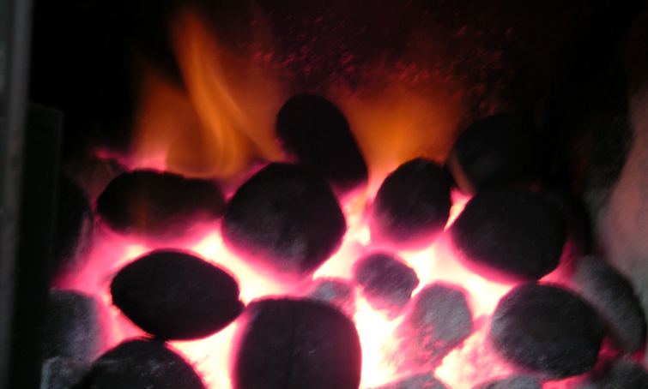
What is combustion?
Combustion is the scientific word for burning and is a type of chemical reaction.
Combustion is the reaction when a substance burns and reacts with oxygen to produce heat and light energy.

Slide 20
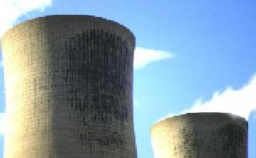
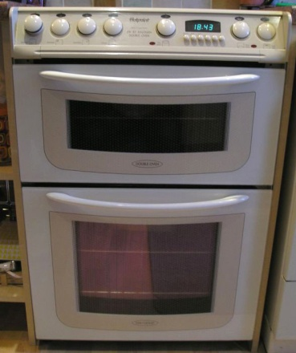
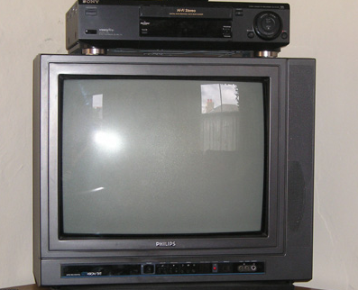
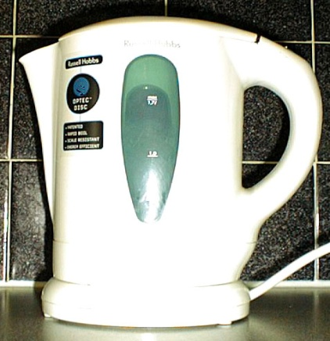
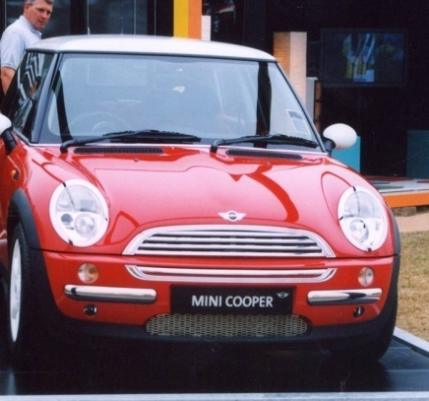
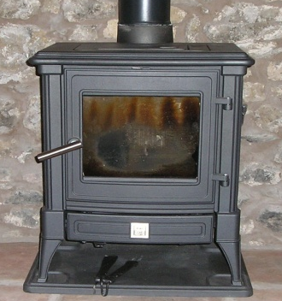
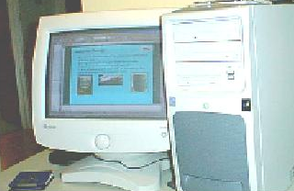
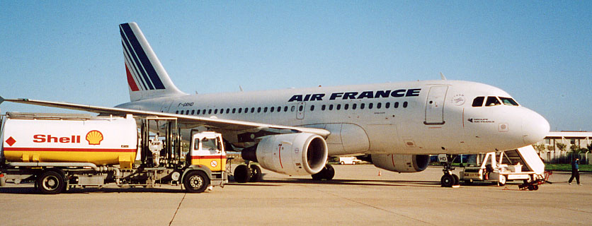
Using combustion
Burning has been an important source of energy since primitive man and is still a hugely important process today.
Burning fuel, like coal, petrol and natural gas, provides > 90% of the energy needed for transport, factories and in the home.
How different would life be without combustion?

Slide 21
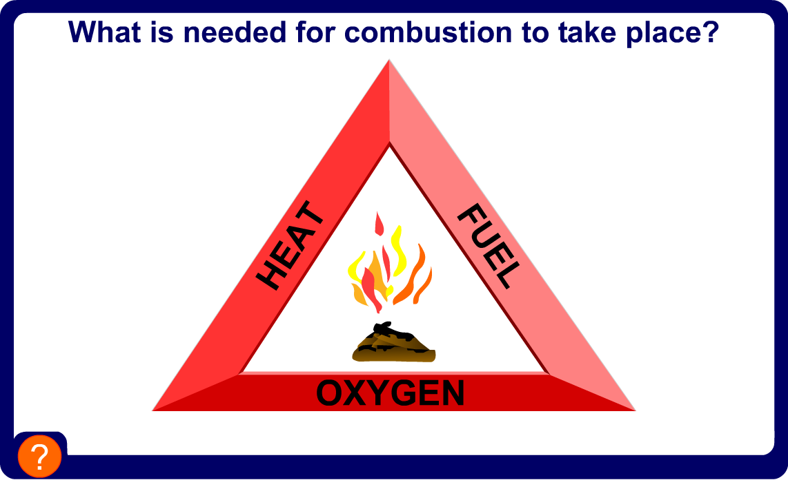
Fire triangle

Slide 22
Equations for combustion
When substance burns and react with oxygen the new substances formed are called “oxides”.
What are the word equations for these combustion reactions?
1. Coal (made from carbon) burns and forms carbon dioxide:
carbon
oxygen
carbon dioxide
2. Hydrogen burns and forms dihydrogen oxide (i.e water!):
hydrogen
oxygen
water
3. Methane burns and forms carbon dioxide and water:
methane
oxygen
carbon dioxide
water

Slide 23
Combustion of methane
The natural gas, methane, is often burnt for cooking. Methane is made up of carbon and hydrogen.
What gas does methane react with when it burns?
oxygen
What substance will the carbon in methane change into when it burns in oxygen?
carbon dioxide
What substance will the hydrogen in methane change into when it burns in oxygen?
water
What is the word equation for the combustion of methane?
methane
oxygen
carbon dioxide
water

Slide 24
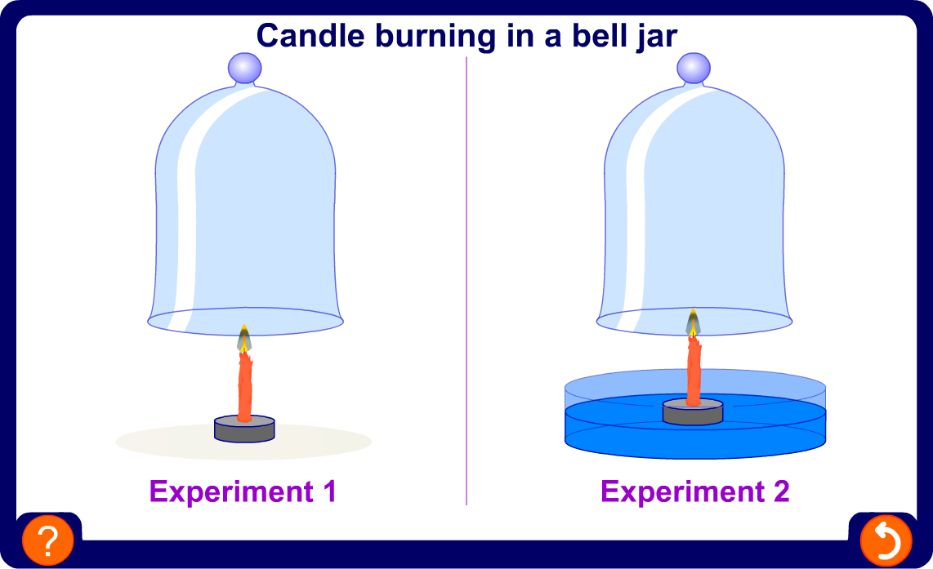
Candle burning in bell jar

Slide 25
Contents
Contents
7F Simple Chemical Reactions
Chemical reactions everywhere
Reactions with acid
Acid reactions
Reactions with oxygen
Summary activities

Slide 26
Glossary
carbon dioxide – A gas that turns limewater cloudy.
chemical reaction – A change in which new substances are made and cannot easily be reversed.
combustion – The scientific word for burning which is the reaction of a substance with oxygen.
fuel – A material that burns and generates useable energy.
hydrogen – A gas that makes a lighted splint produce a ’squeaky pop’.
products – The new substances produced in a chemical reaction and shown on the left of a word equation.
reactants – The starting substances used in a chemical reaction and shown on the right of a word equation.
word equation – A summary of a chemical reaction.

