Slide 1


Angles

Slide 2
Labelling line segments
When a line has end points we say that it has finite length.
It is called a line segment.
We usually label the end points with capital letters.
For example, this line segment
A
B
has end points A and B.
We can call this line, line segment AB.

Slide 3
Lines in a plane
A flat two-dimensional surface is called a plane.
Any two straight lines in a plane either intersect once …
This is called the point of intersection.
Notes:
Ask pupils how we could draw two infinitely long lines that will never meet. The answer would be to draw them in different planes. We can imagine, for example, one plane made by one wall in the room and another plane made by the opposite wall. If we drew a line on one wall and a line on the other, they would never meet, even if the walls extended to infinity.
When two lines intersect two pairs of equal angles are formed.

Slide 4
Lines in a plane
… or they are parallel.
We use arrow heads to show that lines are parallel.
Parallel lines will never meet. They stay an equal distance apart.
This means that they are always equidistant.
Notes:
Pupils should be able to identify parallel and perpendicular lines in 2-D and 3-D shapes and in the environment.
For example: rail tracks, double yellow lines, door frame or ruled lines on a page.

Slide 5
Vertically opposite angles
When two lines intersect, two pairs of vertically opposite angles are formed.
a
d
b
c
a = c
and
b = d
Vertically opposite angles are equal.

Slide 6
Perpendicular lines
What is special about the angles at the point of intersection here?
a
b
a = b = c = d = 90°
d
c
Lines that intersect at right angles are called perpendicular lines.
Notes:
Pupils should be able to explain that perpendicular lines intersect at right angles.

Slide 7
The distance from a point to a line
What is the shortest distance from a point to a line?
O
The shortest distance from a point to a line is always the perpendicular distance.
Notes:
Ask pupils to point out which line they think is the shortest and ask them what they notice about it.
Ask pupils if they think that the shortest line from a point to another line will always be at right angles.
Reveal the rule.

Slide 8
Angles
When two lines meet at a point an angle is formed.
a
An angle is a measure of rotation from one of the line segments to the other.
We often label angles using lower-case letters or Greek letters such as θ, theta.
Notes:
Remind pupils that in mathematics a positive rotation is anticlockwise.

Slide 9
Labelling lines, angles and shapes
Sometimes, the vertices in a diagram are labelled with capital letters. For example,
This is line segment AD.
This is angle ABD, ABD
A
or ABD.
D
B
C
This is triangle BCD or BCD .
Notes:
Discuss how the letters at the vertices can be used to label angles, line segments and shapes.
It is the labeling of angles that pupils often find most difficult. Explain that there are two angles at vertex B. We have to use three letters to distinguish between angle ABD and angle CBD. We could also have angle ABC which is equal to the sum of angles ABD and CBD. It is the middle letter that tells us the vertex containing the angle.
Ask pupils to tell you what the quadrilateral is called using the letters at its vertices.

Slide 10
Types of angle
Acute angle
0º < a < 90º
Right angle
a = 90º
a
a
Obtuse angle
90º < a < 180º
Reflex angle 180º < a < 360º
a
a
Notes:
Pupils should be able to classify angles acorrding to whether they are acute, right-angled, obtuse or reflex.

Slide 11
Angles on a straight line and at a point
Angles on a line add up to 180°
Angles at a point add up to 360°
a
b
a
b
d
c
a + b + c = 180°
a + b + c + d = 360°
because there are 180° in a half turn.
because there are 360° in a full turn.
Notes:
This slide is a reminder of rules established at KS3.

Slide 12
Complementary and supplementary angles
Two complementary angles add up to 90°.
Two supplementary angles add up to 180°.
a
a
b
b
a + b = 90°
a + b = 180°
Notes:
Ask pupils to give examples of pairs of complementary angles. For example, 32° and 58º.
Give pupils an acute angle and ask them to calculate the complement to this angle.
Ask pupils to give examples of pairs of supplementary angles. For example, 113° and 67º.
Give pupils an angle and ask them to calculate the supplement to this angle.

Slide 13
Angles made with parallel lines
When a straight line crosses two parallel lines eight angles are formed.
a
b
d
c
e
f
h
This line is called a traversal.
g
Which angles are equal to each other?
Notes:
Ask pupils to give any pairs of angles that they think are equal and to explain their choices.

Slide 14
Corresponding, alternate and interior angles
Corresponding angles are equal
Alternate angles are equal
Interior angles add up to 180°
a
a
a
b
b
b
a = b
a = b
a + b = 180°
Look for an F-shape
Look for a Z-shape
Look for a C- or U-shape
Notes:
Tell pupils that these are called corresponding angles because they are in the same position on different parallel lines.

Slide 15

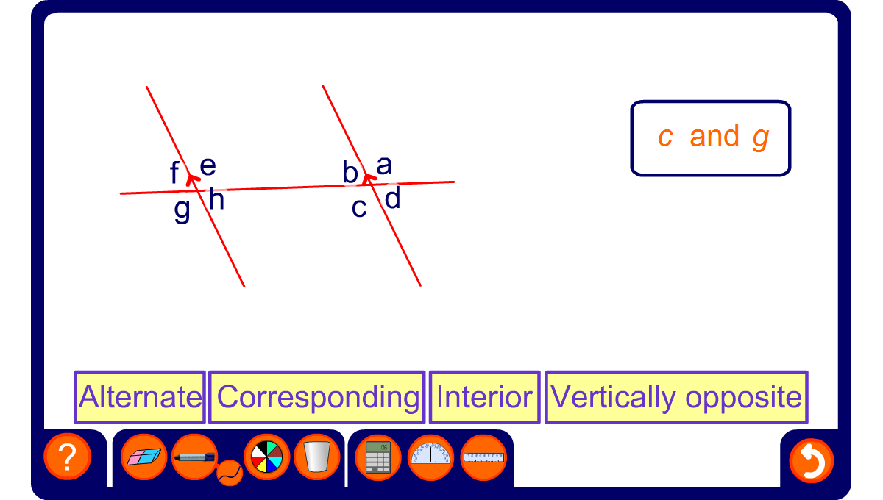
Angles and parallel lines

Slide 16
Calculating angles
Calculate the size of angle a.
28º
a
Hint: Add another parallel line.
45º
a = 28º + 45º =
73º
Notes:
Ask pupils to explain how we can calculate the size of angle a using what we have learnt about angles formed when lines cross parallel lines.
If pupils are unsure reveal the hint.
When a third parallel line is added we can deduce that a = 28º + 45º = 73º using the equality of alternate angles.

