Slide 1


Polygons
A polygon is a 2-D shape made when line segments enclose a region.
A
The end points are called vertices. One of these is called a vertex.
B
The line segments are called sides.
E
C
D
2-D stands for two-dimensional.
These two dimensions are length and width. A polygon has no height.

Slide 2
Polygons
A regular polygon has equal sides and equal angles.
In a convex polygon all of the interior angles are less than 180°.
All regular polygons are convex.
In a concave polygon some of the interior angles are more than 180°.
Notes:
Define these key terms. Explain that in a concave polygon some of the interior angles are reflex angles.

Slide 3
Naming polygons
Polygons are named according to their number of sides.
Number of sides | Name of polygon
3
4
5
6
7
8
9
10
Triangle
Quadrilateral
Pentagon
Hexagon
Heptagon
Octagon
Nonagon
Decagon
Notes:
Pupils should learn any of the names that they do not know already.

Slide 4
Interior angles in polygons
The angles inside a polygon are called interior angles.
b
c
a
The sum of the interior angles of a triangle is 180°.

Slide 5
Exterior angles in polygons
When we extend the sides of a polygon outside the shape
exterior angles are formed.
e
d
f

Slide 6
Sum of the interior angles in a quadrilateral
What is the sum of the interior angles in a quadrilateral?
c
d
f
a
b
e
We can work this out by dividing the quadrilateral into two triangles.
a + b + c = 180°
and
d + e + f = 180°
So,
(a + b + c) + (d + e + f ) = 360°
The sum of the interior angles in a quadrilateral is 360°.

Slide 7
Sum of interior angles in a polygon
We already know that the sum of the interior angles in any triangle is 180°.
c
a + b + c = 180 °
a
b
We have just shown that the sum of the interior angles in any quadrilateral is 360°.
d
a
c
b
a + b + c + d = 360 °
Do you know the sum of the interior angles for any other polygons?
Notes:
Pupils may remember the rule for finding the sum of the interior angles in a polygon from Key Stage 3 work.

Slide 8
Sum of the interior angles in a polygon
We’ve seen that a quadrilateral can be divided into two triangles …
… a pentagon can be divided into three triangles …
… and a hexagon can be divided into four triangles.
How many triangles can a hexagon be divided into?
Notes:
Explain that to find the smallest number of triangles that a polygon can be divided into, we draw straight lines from one vertex to each of the other vertices. We cannot produce a triangle by joining a vertex to either of the two verticies adjacent to it.
Ask pupils how many triangles a heptagon can be divided into.
What about a dodecagon, a shape with 12 sides?

Slide 9
Sum of the interior angles in a polygon
The number of triangles that a polygon can be divided into is always two less than the number of sides.
We can say that:
A polygon with n sides can be divided into (n – 2) triangles.
The sum of the interior angles in a triangle is 180°.
So,
The sum of the interior angles in an n-sided polygon is (n – 2) × 180°.
Notes:
Pupils should learn this rule.

Slide 10
Interior angles in regular polygons
A regular polygon has equal sides and equal angles.
We can work out the size of the interior angles in a regular polygon as follows:
Name of regular polygon | Sum of the interior angles | Size of each interior angle
Equilateral triangle
180°
180° ÷ 3 =
60°
Square
2 × 180° = 360°
360° ÷ 4 =
90°
Regular pentagon
3 × 180° = 540°
540° ÷ 5 =
108°
Regular hexagon
4 × 180° = 720°
720° ÷ 6 =
120°
Notes:
Ask pupils to complete the table for regular polygons with up to 10 sides.

Slide 11
The sum of exterior angles in a polygon
For any polygon, the sum of the interior and exterior angles at each vertex is 180°.
For n vertices, the sum of n interior and n exterior angles is n × 180° or 180n°.
The sum of the interior angles is (n – 2) × 180°.
We can write this algebraically as 180(n – 2)° =
180n° – 360°.

Slide 12
The sum of exterior angles in a polygon
If the sum of both the interior and the exterior angles is 180n°
and the sum of the interior angles is 180n° – 360°,
the sum of the exterior angles is the difference between these two.
The sum of the exterior angles = 180n° – (180n° – 360°)
= 180n° – 180n° + 360°
= 360°
The sum of the exterior angles in a polygon is 360°.
Notes:
Discuss this algebraic proof that the sum of the exterior angles in a polygon is always 360°.

Slide 13

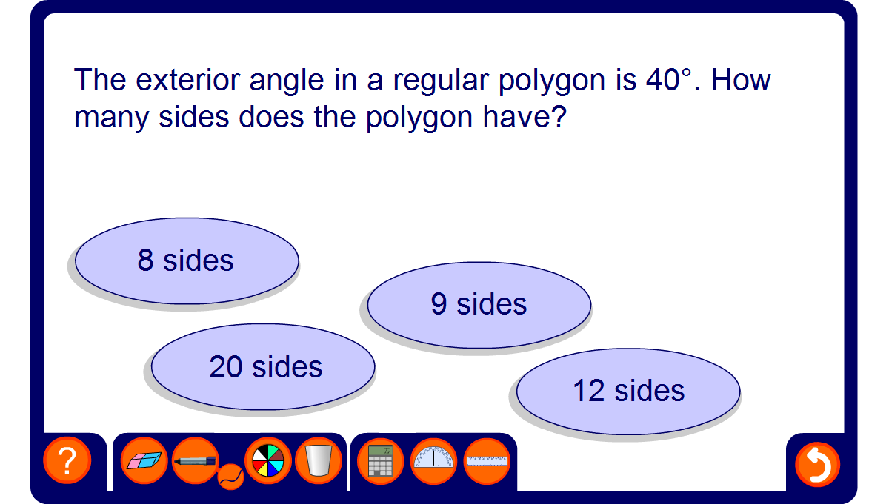
Find the number of sides
Notes:
Challenge pupils to find the number of sides in a regular polygon given the size of one of its interior or exterior angles.
Establish that if we are given the size of the exterior angle we have to divide this number into 360° to find the number of sides. This is because the sum of the exterior angles in a polygon is always 360° and each exterior angle is equal.
Establish that if we are given the size of the interior angle we have to divide 360° by (180° – the size of the interior angle) to find the number of sides. This is because the interior angles in a regular polygon can be found by subtracting 360° divided by the number of sides from 180°.

