Slide 1
Geometric Construction Notes

Slide 2
Table of Contents
How to navigate this presentation
Geometric Construction Introduction
Drawing Guidelines
Parts of the Safe-T Compass
How to Use the Safe-T Compass
Draw a Perpendicular Bisector to a Line
Bisect an Arc
Bisect an Angle
Transfer an Angle
Construct a Triangle From 3 Sides
Construct a Equilateral Triangle

Slide 3
Geometric Construction Introduction
Based on principles of pure geometry and may be applied to any shape regardless of the size.
CAD is based on geometric construction so understanding geometric construction makes understanding how CAD tools work easier and increases proficiency.

Slide 4
Drawing Guidelines
Draw constructions very lightly using guidelines.
Do NOT erase your guidelines- show your work.
Only trace over the final solution NOT the construction.

Slide 5



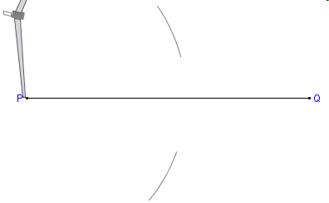
Draw a Perpendicular Bisector to a Given Line
Begin with a given line
1. Place the compass point on one end point (ep) of the line.
2. Adjust the compass radius to approximately 2/3 the length of the line (radius must be > ½ the length of the line but actual size does not matter)
3. Draw an arc above and below the line.

Slide 6
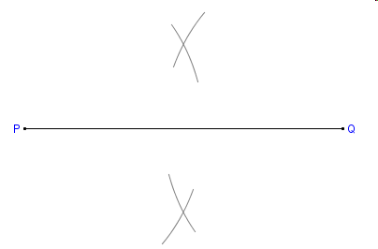
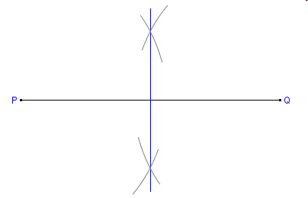
Draw a Perpendicular Bisector to a Given Line
Without adjusting the radius place the compass point on the opposite ep of the line .
Draw arcs intersecting the first two
Connect the intersections using a straight edge.

Slide 7
Draw a Perpendicular Bisector to a Given Line- Solution

Slide 8
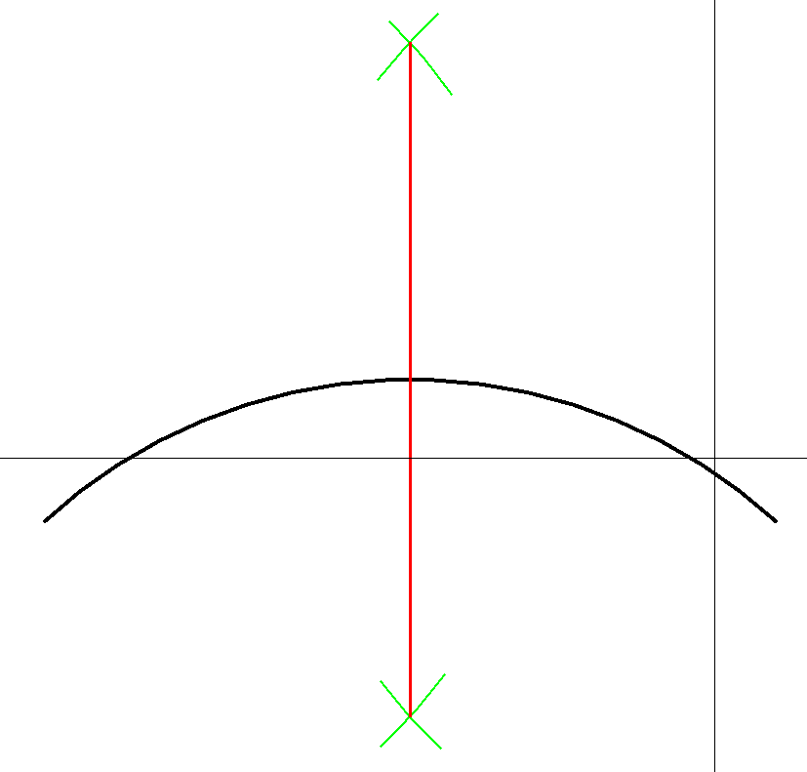
Bisect an Arc
An arc is a curved line and is bisected using the same steps.
Imagine a line between the end points of the arc.
Bisect the imagined line as you did to complete the perpendicular bisect

Slide 9
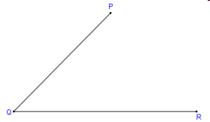
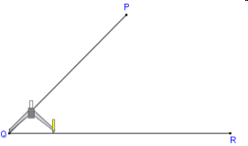
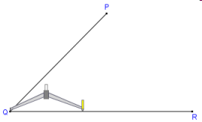
Bisect Angle
Begin with a given angle
Place the compass point on the Vertex (Q) and adjust to a width approximately half the length of 1 leg of the angle (exact width is NOT important)

Slide 10
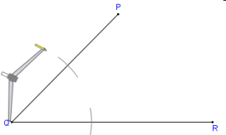
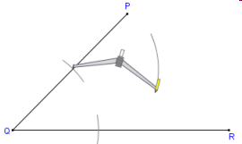
Bisect Angle
Draw an arc across each leg of the angle
Move the compass point to the intersection of one of the legs and arc.
Draw an arc in the interior of the angle.

Slide 11
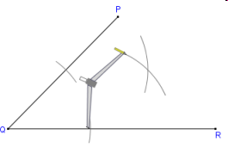
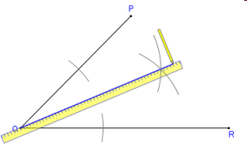
Bisect Angle
Without changing the radius of the compass do the same on the other leg of the angle so the arcs intersect
Using a straight edge connect the vertex and intersection of the two arcs.

Slide 12
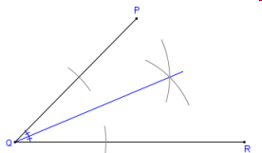
Bisect Angle- Solution

Slide 13
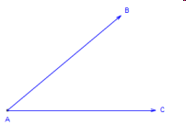
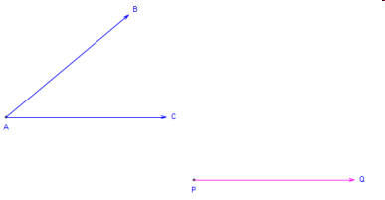
Transfer an Angle
Begin with a given angle
Draw one leg of the angle at a new location and choose the ep to use as the vertex

Slide 14
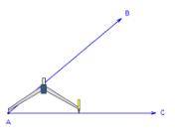
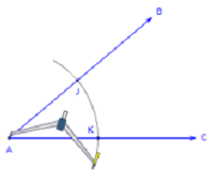
Transfer an Angle
Place the compass point on the vertex of the angle
Draw an arc at any convenient radius intersecting both legs of the angle

Slide 15
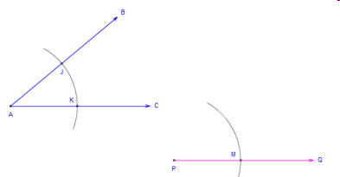
Transfer an Angle
Without changing the width of the compass place the compass point on the ep of the line that will be the vertex
Draw a similar arc intersecting the line and extending above or below.

Slide 16
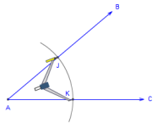
Transfer an Angle
Place the point of the compass on the intersection of the arc and one of the legs
Adjust the compass so the lead is on the other intersection of the arc and opposite leg .

Slide 17
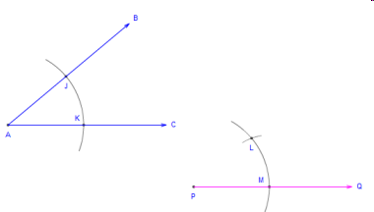
Transfer an Angle
Without changing the radius of the compass place the point on the intersection of the arc and line at the new location
Draw an arc that intersects the other arc

Slide 18
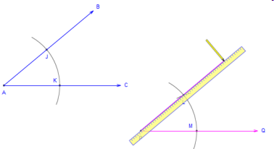
Transfer an Angle
Use a straightedge to draw a line from the vertex through the intersection of the 2 arcs

Slide 19
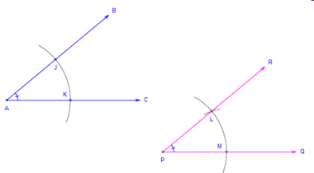
Transfer an Angle-Solution

Slide 20
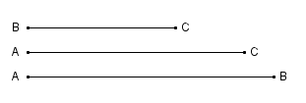

Construct a Triangle Given 3 Sides
Begin with the 3 given sides
Draw a point that will be 1 vertex of the triangle.
Measure one of the sides with your compass. You will use this as the base of the triangle

Slide 21


Construct a Triangle Given 3 Sides
3. Without changing the radius of the compass place the point of the compass on the vertex point. Draw an arc to the side of the point.
4. Draw an arc to the side of the point.
5. Make a point on the arc. This will be the second vertex of the triangle

Slide 22

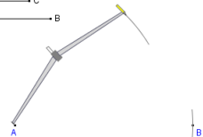
Construct a Triangle Given 3 Sides
6. Using the Compass measure the length of one of the other given sides
7. Without changing the radius. Place the compass point on one of the two vertices and draw an arc above or below the base.

Slide 23
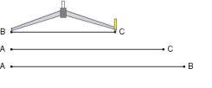
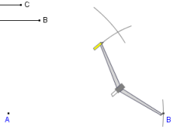
Construct a Triangle Given 3 Sides
8. Using the Compass measure the length of the last side
9. Without changing the radius. Place the compass point on the other vertex and draw an arc that intersects the other arc.- This becomes the 3rd vertex.

Slide 24
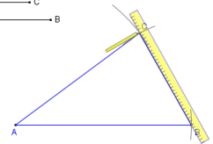
Construct a Triangle Given 3 Sides
10. Connect the 3 vertices using a straight edge.

Slide 25
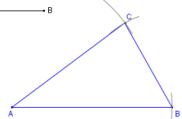
Construct a Triangle Given 3 Sides- Solution

Slide 26
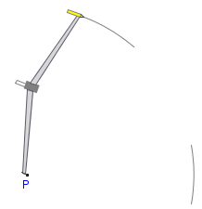
Construct an Equilateral Triangle Given 1 Side
1. Begin by Making a point- This will be the first vertex
2. Using the compass measure the length of the given side and set the compass point on your first vertex.
3. Draw arcs to the side of the first vertex where you want the 2nd vertex and an arc above or below to locate the 3rd vertex

Slide 27
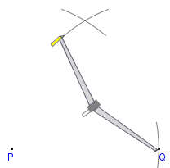
Construct an Equilateral Triangle Given 1 Side
4. Place a point on one of the two arcs- This will be the second vertex
5. Without adjusting the radius of the compass place the point on the second vertex point and draw an arc intersecting the first arc.

Slide 28
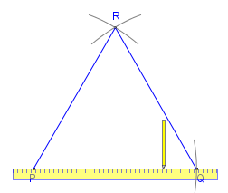
Construct an Equilateral Triangle Given 1 Side
4. Connect the three vertices using a straight edge

Slide 29
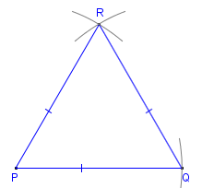
Construct an Equilateral Triangle Given 1 Side- Solution

