Slide 1
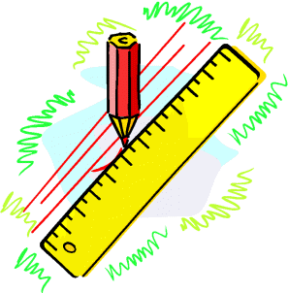
Scales & Drawing
Enlarge & Reduce Shapes
Revise Drawing Triangles
Scales and Map Reading
Bearings

Slide 2
Starter Questions
www.mathsrevision.com

Slide 3
Scales & Drawing
Enlargement & Reduction
Learning Intention
Success Criteria
1. To draw an enlarged or reduced drawing for various shapes.
To be able to draw scaled drawing of a shape either an enlargement or reduction.
www.mathsrevision.com

Slide 4
Scales & Drawing
Enlargement & Reduction
Example : Enlarge the shape by a factor of 2.
Simply double what you have in both directions
4 boxes wide
2 boxes wide
www.mathsrevision.com
Factor of 2
1 box down
2 boxes wide

Slide 5
Scales & Drawing
Enlargement & Reduction
Example : Reduce the triangle by a factor of 4.
Simply quarter what you have in both directions
12
www.mathsrevision.com
Factor of 1/4
3
4
1

Slide 6
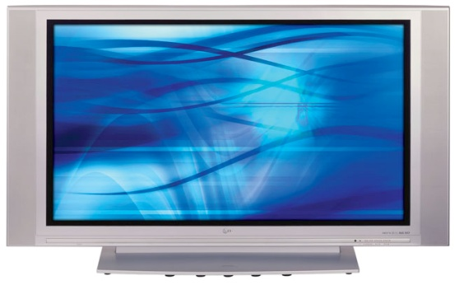
Scales & Drawing
Enlargement & Reduction
Example : Say whether the following is a enlargement
or reduction. Find the missing by first
working out scale factor value.
10
5
www.mathsrevision.com
Factor of
10
20

Slide 7
Starter Questions
www.mathsrevision.com

Slide 8
Scales & Drawing
Drawing SAS, ASA and SSS Triangles
Learning Intention
Success Criteria
1. To revise drawing SAS, ASA and SSS triangles
To know the steps for drawing SAS, ASA and SSS triangles.
www.mathsrevision.com

Slide 9
Drawing SAS Triangles
SAS Triangles
Side
Angle
Side

Slide 10
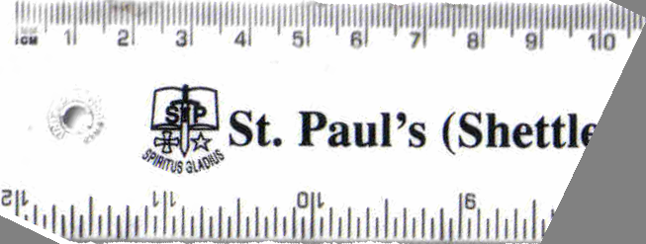
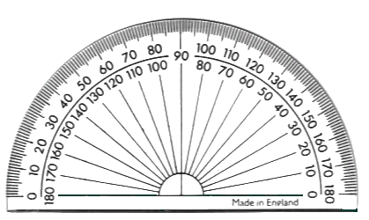
Drawing SAS Triangles
Toolkit required
Ruler
2. Protractor
3. Pencil & Paper

Slide 11
Drawing SAS Triangles
C
30º
B
Example : Draw to scale the triangle ABC
with AB = 6cm and angle CAB = 30º and AC = 5cm
A
Step 1 Draw line AB=6cm
Step 2 Measure
angle CAB from A
C
X
Step 3 Draw the line
AC = 5cm through X. Label it C.
A
B
Step 4 Join C to B.
Check angles add to 180º

Slide 12
Drawing ASA Triangles
ASA Triangles
Angle
Side
Angle

Slide 13
Drawing ASA Triangles
Toolkit required
Ruler
2. Protractor
3. Pencil & Paper

Slide 14
Drawing ASA Triangles
R
Q
Example : Draw to scale the triangle PQR
with PQ = 8cm and angle RPQ = 30º and angle RQP = 40º
P
Step 1 Draw line PQ
Step 2 Measure
Angle RPQ from P
R
Step 3 Measure
angle RQP from Q
P
Q
Step 4 Intersection point is R
Check angles add to 180º

Slide 15
Drawing SSS Triangles
SSS Triangles
Side
Side
Side

Slide 16
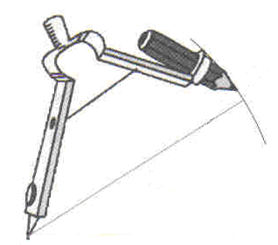
Drawing SSS Triangles
Toolkit required
Ruler
2. Compass
3. Pencil & Paper

Slide 17
Drawing SSS Triangles
Z
X
Example : Draw to scale the triangle XYZ
with XY = 3cm and XZ = 5cm and YZ = 4cm
y
Step 1 Draw line XY=3cm
Z
Step 2 Use your compass to draw part of a circle centre X radius XZ=5cm
Step 3 Use your compass to draw part of a circle centre Y radius YZ=4cm
Step 4 Intersection point is labelled Z
X
Y
Step 5 Draw in line XZ and YZ to complete triangle
Check angles add to 180º

Slide 18
Starter Questions
www.mathsrevision.com

Slide 19
Scales & Drawing
Drawing Quadrilaterals & Polygons
Learning Intention
Success Criteria
To show how to bisect a line at right angles.
How to bisect and angle.
How to draw 60º angle.
To be able to :
Bisect a line at right angles.
Bisect an angle.
Draw a 60º angle.
www.mathsrevision.com

Slide 20
Bisecting a line at right angles
Toolkit required
Ruler
2. Compass
3. Pencil & Paper

Slide 21
2
cut
Bisecting a line at right angles
We want to find the midpoint of PQ
A
Step 1 Set your compass to a size greater than half of PQ.
Step 2 Draw an arc, centre P and another arc centre Q.
P
Q
Step 3 Join the 2 points A and B where the arcs intersect.
B
The line AB will bisect PQ, and does so at right angles.

Slide 22
2
cut
Bisecting an angle
We want to cut ∠PQR in half (Bisect it)
P
Step 1 With centre Q and using any radius, draw an arc, cutting PQ at M and QR at N.
M
T
Step 2 With the same radius as above , draw an arc centre M and another, centre N. Where they meet call it T.
Q
R
N
Step 3 Join QT. This line will cut ∠PQR in half.
Can you see QMTN is a rhombus ?

Slide 23
Drawing a 60º angle
R
Step 1 Draw a line PQ.
Step 2 With radius PQ draw an arc centre P.
Step 3 With radius PQ draw an arc centre Q.
60º
P
Q
Step 4 The 2 arcs intersect at R. Join P to R.
Angle RPQ is 60º

Slide 24
Starter Questions
www.mathsrevision.com

Slide 25
Scales & Drawing
Learning Intention
Success Criteria
1. To understand the term scaled drawing, read maps and interpret distance.
To be able to understand the term scaled drawings.
2. Interpret scaled drawing into real-life measurements.
St. Andrew’s Secondary

Slide 26
Scales & Drawing
Definition
A scale of
1 cm = 2m
www.mathsrevision.com
This simply means for every 1cm measured on a
drawing this represents 2m in real-life.

Slide 27
Scales & Drawing
3 x 50 = 150m
Example
This line measures 3cm
What is the distance in real-life
1cm = 50m
4 x 2 = 8 miles
Example
www.mathsrevision.com
1cm = 2miles
This line measures 4cm
What is the distance in real-life

Slide 28
Scales & Drawing
Problem
The scaled drawing has a scale of 1cm = 2.5m
XT measures 4cm of the drawing and represents
a steel wire support for the flag pole.
What is the real-life length of the wire.
www.mathsrevision.com
T
1cm = 2.5m
4 x 2.5 = 10m
X

Slide 29
Starter Questions
www.mathsrevision.com

Slide 30
Scales & Drawing
Bearings
Learning Intention
Success Criteria
1. Know the steps on how to work out a bearing.
To understand how to work out a bearing and it apply to problems.
2. Apply knowledge to problems.
St. Andrew’s Secondary

Slide 31
Bearings
360/000º
N
1. Measured from North.
060º
2. In a clockwise direction.
60º
270º
W
E
090º
3. Written as 3 figures.
S
180º
N
N
N
315º
W
145º
E
W
E
W
E
230º
315º
145º
230º
S
S
S

Slide 32
Scales & Drawing
Bearings
Example
The bearing from A to B is 70º.
What is the bearing from B to A.
North
North
Bearing
from B to A is :
www.mathsrevision.com
70º
70º
+ 180º
B
70º
= 250º
A

Slide 33
Scales & Drawing
Bearings
Example
The bearing from X to Y is 30º.
What is the bearing from Y to X.
North
North
30º
Bearing
from Y to X is :
www.mathsrevision.com
Y
30º
+ 180º
30º
= 210º
X

