Slide 1
Scaled Drawings
Working with Scales
Making Simple Scale Drawings
Harder Scale Drawings
Compass Points
Bearings

Slide 2
Scale Drawings & Bearings
Learning Intention
Success Criteria
  1. To understand the term scale drawing and how they are used in real life.
  To be able to understand the term scale drawings.
2. Interpret scale drawing into real-life measurements.

Slide 3
Scales
Definition
A scale of
1 cm = 2m
This simply means for every 1cm measured on a
drawing this represents 2m in real-life.

Slide 4
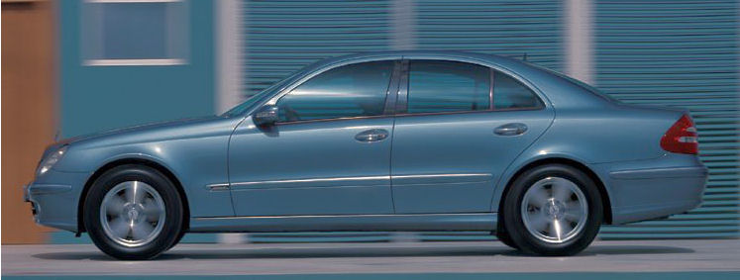
Scales
In order to make sense of a map or scale diagram
the scale must be known.
For this scale model
1 cm represents 1m
4 cm
This means for every 1 metre of the actual car, 1cm is drawn on the map.

Slide 5

Scales
The scale of this drawing is
1cm = 5m
6cm
What is the actual length
of the tree ?
6 x 5 =
30m

Slide 6
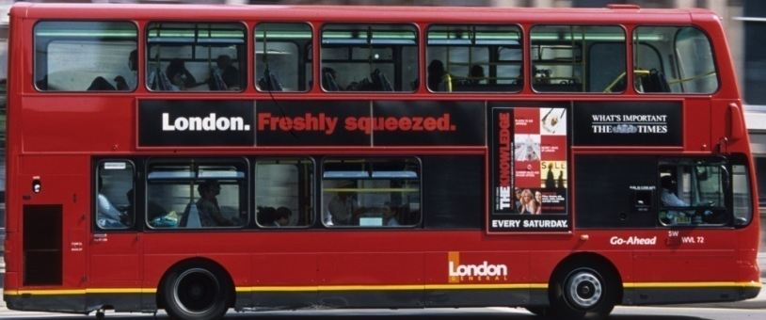
Scales
The scale of this drawing is
1cm = 90cm
What is the actual length
of the bus in metres ?
5cm
5 x 90 =
450cm
4.5m

Slide 7
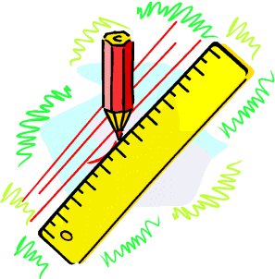

Scale Drawings & Bearings
MTH 2-17c
MTH 2-17d
MTH 3-17b
Learning Intention
Success Criteria
1. Interpret information in a problem and create a suitable scale drawing.
  1. To draw a scale drawing given suitable information.
www.mathsrevision.com

Slide 8
Scaled Drawings
MTH 2-17c
MTH 2-17d
MTH 3-17b
Problem
A garden is rectangular in shape and
has length 12m and breadth 8m.
Make rough sketch of the garden.
12m
Draw an accurate
scaled drawing of the garden
Use a scale of
1cm represents 2m
www.mathsrevision.com
8m

Slide 9
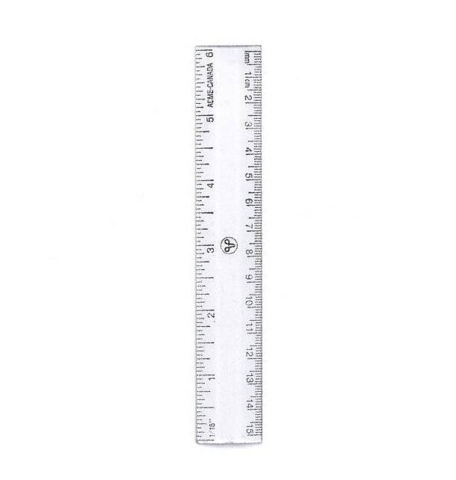
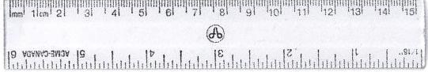
Scaled Drawings
MTH 2-17c
MTH 2-17d
MTH 3-17b
Use a scale of
1cm represents 2m
1cm represents 2m
12m
8m
12m
www.mathsrevision.com
8m

Slide 10
Scaled Drawings
MTH 2-17c
MTH 2-17d
MTH 3-17b
Problem
A road junction is triangular in shape.
A rough sketch is given below.
Draw an accurate
scaled drawing of the garden
Use a scale of
1cm represents 2m
www.mathsrevision.com
20m
12m

Slide 11
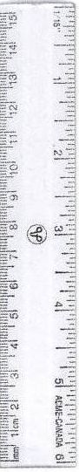
Scaled Drawings
MTH 2-17c
MTH 2-17d
MTH 3-17b
Use a scale of
1cm represents 2m
1cm represents 2m
Find the real life length of the 3rd side
20m
20m
www.mathsrevision.com
12m
2 x 11.6 =
23.2m
12m

