Slide 1
Acids and Alkalis
Learning Objectives
To know that solutions can be sorted by whether they are: acid, alkali or neutral.
To understand that an alkali reacts with an acid to cancel it out.
To know that indicators show you how acidic or alkaline a solution is.

Slide 2
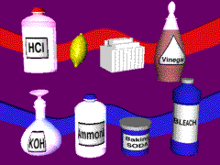
Acids and alkalis
When a substance dissolves in water it makes a solution.
Solutions can be sorted by whether they are: acid, alkali or neutral.

Slide 3


When the oxide
of some non-metals
dissolve in water
they make an acid.
Acids have a sour taste.
They are corrosive.

Slide 4
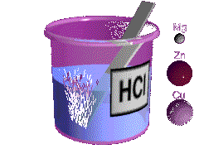
Acids react with metals and carbonates.
Metal + Acid Salt + Hydrogen
magnesium + magnesium chloride + hydrochloric acid hydrogen
Acid + Carbonate Salt + Water + Carbon
dioxide
sulphuric acid + copper sulphate + water +
copper carbonate carbon dioxide

Slide 5
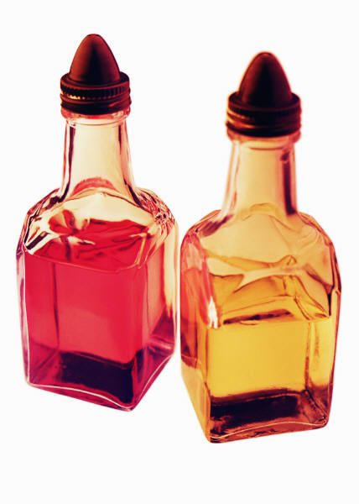
Acids
There are many acids present in our everyday lives.
Lemon juice contains citric acid, and vinegar contains ethanoic acid.
Some strong acids are hydrochloric acid, sulphuric acid and nitric acid.
Some weak acids are ethanoic acid, citric acid and carbonic acid.

Slide 6
Common Acids in the laboratory
Hydrochloric acid
HCl
sulfuric acid
H₂SO₄
Nitric acid
Nitric acid
HNO₃
Ethanoic acid
CH₃COOH
Phosphoric acid
H₃PO₄
Study the chemical formula of all the acids, which element is common in all the acids?
hydrogen

Slide 7
Acids in water
Complete the following to show the dissociation of the following acids.
H₂SO₄ (aq) → 2H⁺ (aq) + SO₄²⁻ (aq)
CH₃COOH (aq) H⁺ (aq) + CH₃COO⁻ (aq)

Slide 8
Basicity of acids
The basicity of an acid is the no. of hydrogen ions produced when one molecule of the acid ionises/dissociates in water.
Acid
Basicity
HCl
HCl
monobasic
H₂SO₄
dibasic
HNO₃
monobasic
H₃PO₄
tribasic
CH₃COOH
monobasic
H₂CO₃
dibasic

Slide 9
Bases and Alkalis, Pg 5
Bases
mostly metal oxides or hydroxide
Formula of oxide :
O²⁻
Formula of hydroxide:
OH⁻
Question:
Give an exception of a base which is not metal oxide or hydroxide
Aq NH₃

Slide 10
Bases and Alkalis
Alkalis
Alkalis =Soluble bases
Examples of alkalis:
all group 1 hydroxide such as NaOH, KOH
calcium hydroxide (limewater),
  Ca(OH)₂
aqueous ammonia (NH₃.H₂O)
aqueous barium hydroxide, Ba(OH)₂

Slide 11
Bases and Alkalis
Alkalis
When alkalis dissolve in water, hydroxide ions, OH⁻ are produecd.
Why is aqueous ammonia (Formula NH₃.H₂O) an alkali?
Ammonia dissociates in water to give hydroxide ions and ammonium ions.
The alkaline properties of aqueous ammonia is due to
hydroxide ions.

Slide 12
Bases and Alkalis
Chemical Reactions
Bases react with acid to form salt and water, a process called neutralisation.
Alkalis give precipitates with solutions of most metal salts.
2NaOH (aq) + CuSO₄ (aq)
→ Cu(OH)₂ + Na₂SO₄
(s) (aq)
Blue ppt

Slide 13
Bases and Alkalis
Chemical Reactions
When warmed, bases react with ammonium salts to give salt, water and ammonia.
Ammonium salt + base → salt + water+ ammonia
NaOH + NH₄Cl → NaCl + H₂O + NH₃
Observation
Colourless and pungent gas liberated. The sodium hydroxide solution remains colourless.

Slide 14
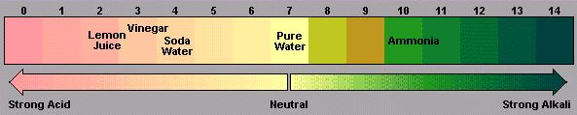
The pH scale
pH - measure of the concentration of H⁺ in solution.
- between 0 and 14
Acidic
lower pH
-> higher conc. of H⁺
Alkaline
higher pH
-> higher conc. of OH-

Slide 15
Indicators
- Substances that have different colours in acidic and alkaline solutions.
- most are regarded as weak acids

Slide 16
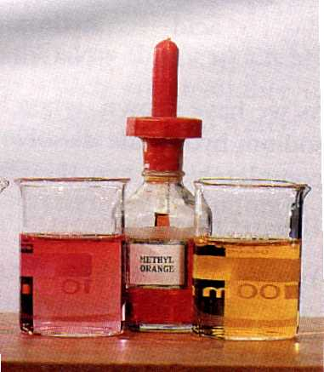
Indicators
E.g.
Methyl Orange
in acidic medium - red
in allkaline medium - yellow
pH at which it changes colour - pH 4
colour at this pH -
orange

Slide 17
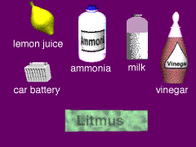
Litmus
Test
Litmus is an indicator. It changes colour in acid and alkaline solutions.
Litmus is red in an acid.
Litmus is blue in an alkali.

Slide 18

Neutralisation
Acids and alkalis react with each other. The alkali cancels out the acid in the reaction. This is called neutralisation.
A salt is made.

Slide 19
Salts
The salt made depends on the acid and alkali used.
The salt contains the metal atom from the alkali, and part of the acid molecule.
The salts of sulphuric acid are known as sulphates.
The salts of hydrochloric acid are known as chlorides.
The salts of nitric acid are known as nitrates.

Slide 20
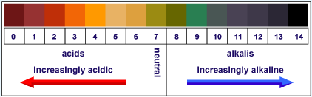
Universal Indicator
Universal indicator changes colour in acids and alkalis.
ACIDS
ALKALIS
Neutral
        Its colour shows the strength of an acid or alkali.

Slide 21
The pH scale
1 – 6
8 - 14
Alkalis
7
Acids
Neutral

Slide 22
Applications of Neutralisation
Insect Stings
Bee stings are acidic
and can be neutralised with
baking soda (bicarbonate of soda).
Wasp stings are alkaline and can be neutralised with vinegar.
Indigestion: Our stomach carries
around hydrochloric acid.
Too much of this leads to indigestion.
To cure indigestion, you can neutralise the excess acid with baking soda or specialised indigestion tablets.

Slide 23

More Applications of Neutralisation?
Factory Waste: Liquid waste from factories is often acidic. If it reaches a river it will destroy and kill sea life of many forms. Neutralising the waste with slaked lime can prevent this.
Soil Treatment: When soils are too acidic (often as a result of acid rain) they can be treated with slaked lime, chalk or quicklime, all alkalis. Plants and crops grow best in neutral soils.

