Slide 1
BASIC CELL STRUCTURE

Slide 2
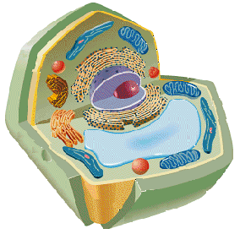
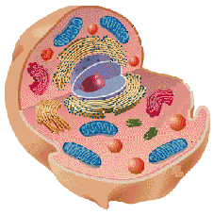
Introduction
Cells are the basic units of organisms
  Cells can only be observed under microscope
Two basic types of cells:
Animal Cell
Plant Cell

Slide 3
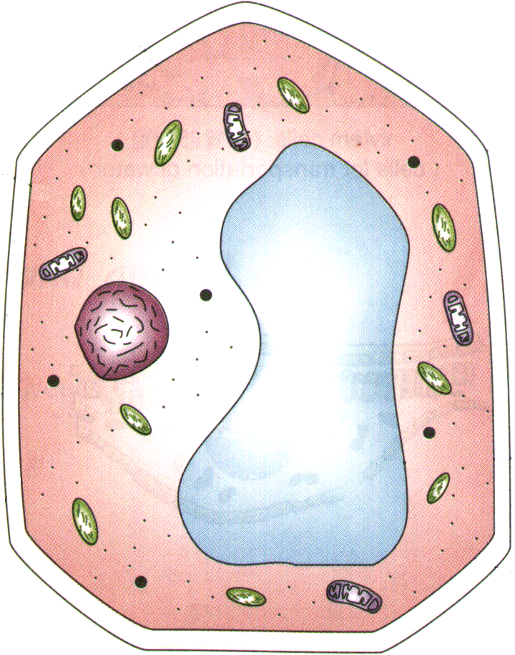
Plant Cell
Cell wall
  Made of cellulose which forms very thin fibres
  Strong and rigid
  In plant cells only

Slide 4
Plant Cell
Cell wall
  Protect and support the enclosed substances (protoplasm)
  Resist entry of excess water into the cell
  Give shape to the cell

Slide 5
Plant Cell
Cell wall
  A dead layer
  Large empty spaces present between cellulose fibres
  ∴freely permeable

Slide 6
Plant Cell
Cell membrane
  Lies immediately against the cell wall
  Made of protein and lipid ∴Selectively permeable

Slide 7
Plant Cell
Cell membrane
  A living layer
  Can control the movement of materials into and out of the cell

Slide 8
Plant Cell
Cytoplasm
  Jelly-like substance enclosed by cell membrane
  Provide a medium for chemical reactions to take place

Slide 9
Plant Cell
Cytoplasm
  Contains organelles and granules :
    e.g. chloroplast
    e.g. mitochondrion

Slide 10
Organelles
very small size – can only be observed under electron microscope
has specific functions
in cytoplasm

Slide 11
Plant Cell
Chloroplast
  Contain the green pigment chlorophyll
    To trap light energy, to make food by photosynthesis

Slide 12
Plant Cell
Chloroplast
  Contain starch grains (products of photosynthesis)

Slide 13
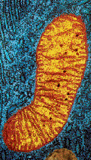
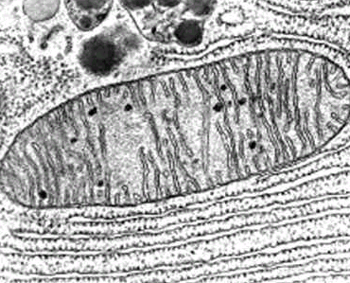
Plant Cell
Mitochondrion
( mitochondria )
  Rod shape
  For respiration

Slide 14
Plant Cell
Mitochondrion
( mitochondria )
  Active cells ( eg. sperms, liver cells) have more mitochondria

Slide 15
Plant Cell
Non-living granules
  Starch granules
  Oil droplets
  Crystals of insoluble wastes

Slide 16
Plant Cell
Vacuole
  large central vacuole
  Surrounded by tonoplast
  Contains cell sap
    a solution of chemicals (sugars, proteins, mineral salts, wastes, pigments)

Slide 17
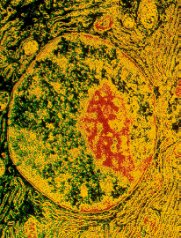
Plant Cell
Nucleus
  Control the normal activities of the cell
  Bounded by a nuclear membrane
  Contains thread-like chromosomes

Slide 18
Plant Cell
Nucleus
  Each cell has fixed number of chromosomes
    Chromosomes carry genes
      genes control cell characteristics

Slide 19
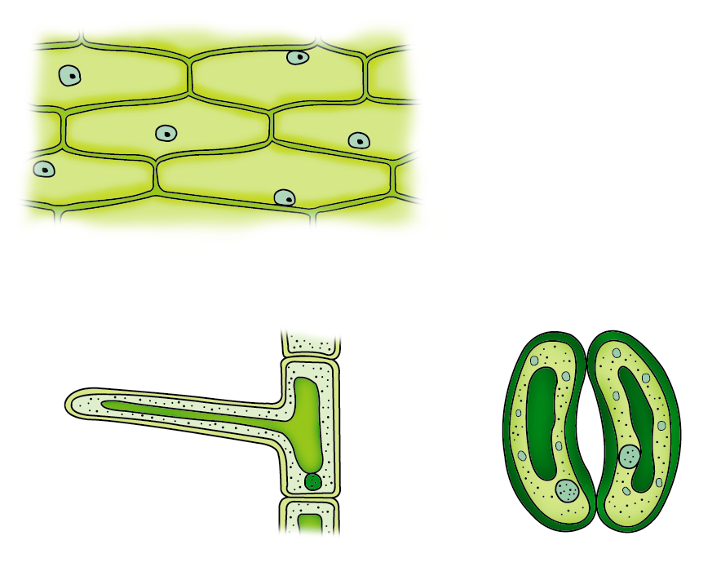
Different kinds of plant cells
Onion Epidermal Cells
Guard Cells
root hair
Root Hair Cell

Slide 20
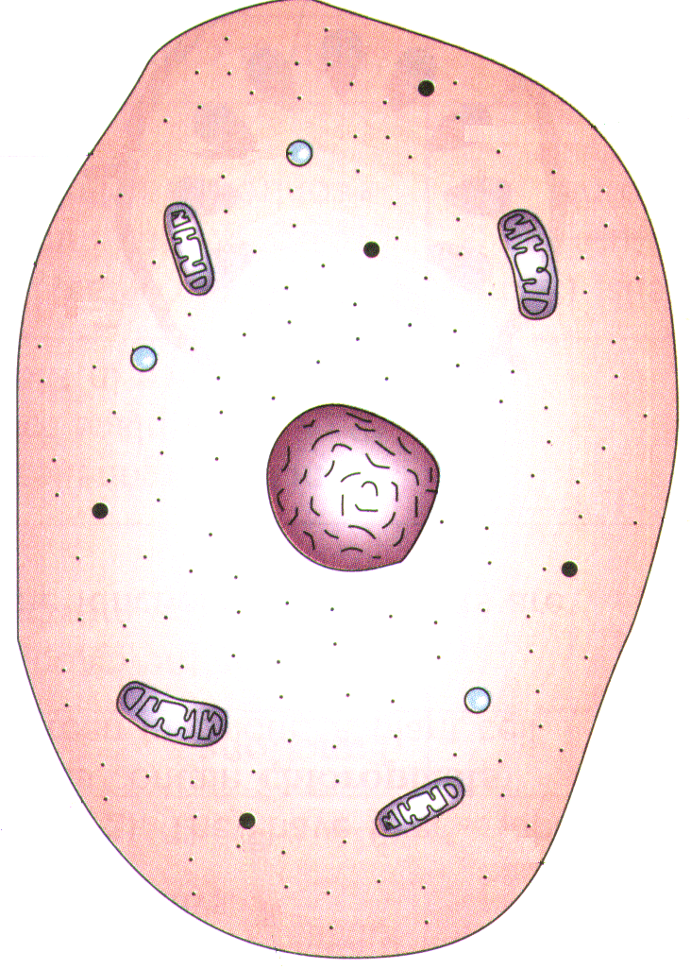
Animal cell
vacuole
cytoplasm
No cell wall and chloroplast
nucleus
Stores glycogen granules and oil droplets in the cytoplasm
mitochondrion
cell membrane
glycogen granule

Slide 21
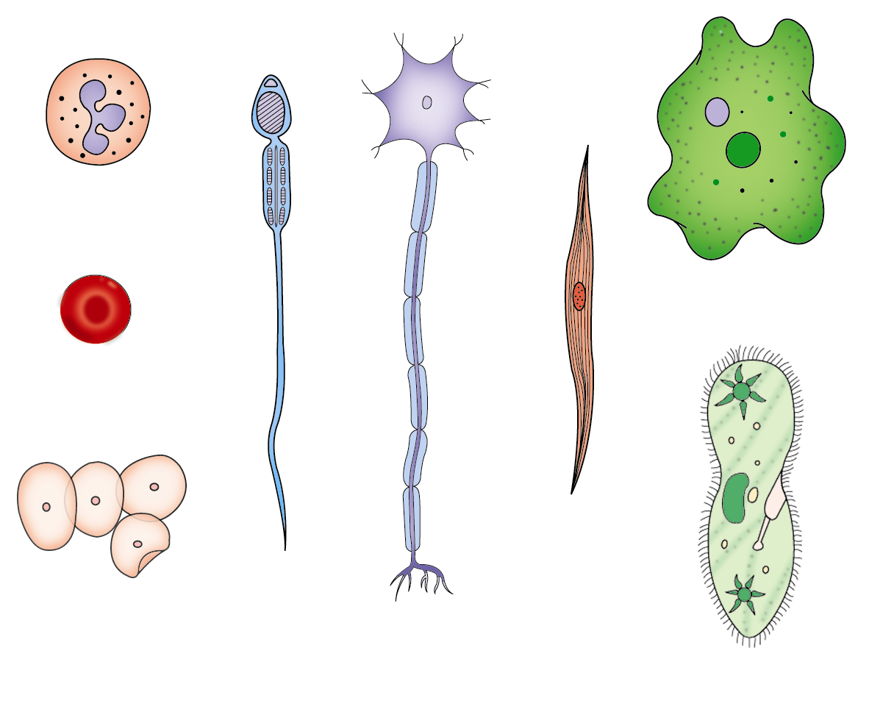
Different kinds of animal cells
white blood cell
Amoeba
red blood cell
muscle cell
sperm
cheek cells
nerve cell
Paramecium

Slide 22
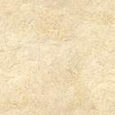
Similarities between plant cells and animal cells
Both have a cell membrane surrounding the cytoplasm
Both have a nucleus
Both contain mitochondria

Slide 23
Differences between plant cells and animal cells
Animal cells
Plant cells
Relatively smaller in size
Relatively larger in size
Irregular shape
Regular shape
No cell wall
Cell wall present

Slide 24
Differences between plant cells and animal cells
Animal cells
Plant cells
Vacuole small or absent
Large central vacuole
Glycogen granules as food store
Starch granules as food store
Nucleus at the centre
Nucleus near cell wall

Slide 25
The cell as the basic unit of life
Cell is the smallest unit of living organisms
Unicellular organisms are made of one cell only
The cells of multicellular organisms are specialized to perform different functions
  e.g. mesophyll cells for photosynthesis and root hair cells for water absorption

Slide 26
Levels of organization
Cells are grouped together and work as a whole to perform special functions

Slide 27
Tissue
A group of similar cells to perform a particular function
  Animals : epithelial tissue, muscular tissue
  Plants : vascular tissue, mesophyll

Slide 28
Organ
Different tissues group together to carry out specialized functions
  Heart : consists of muscles, nervous tissue and blood vessels
  Leaf : consists of epidermis, mesophyll and vascular tissue

Slide 29
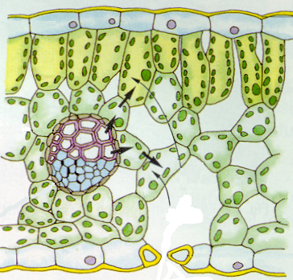
The Structures of a Leaf
Chloroplast
Palisade Mesophyll Cell
Spongy Mesophyll Cell
Air Space
Stoma

Slide 30
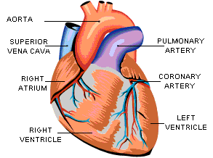
The Structures of a Heart

Slide 31
System
Several organs and tissues work together to carry out a particular set of functions in a co-ordinated way
  Human : digestive, respiratory, excretory, circulatory and reproductive systems
  Plant : root and shoot systems

Slide 32
System in our body
examples of systems :
Digestive System
Respiratory System
Circulatory System
Nervous System
Reproductive System

Slide 33
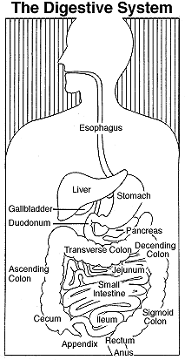

Slide 35
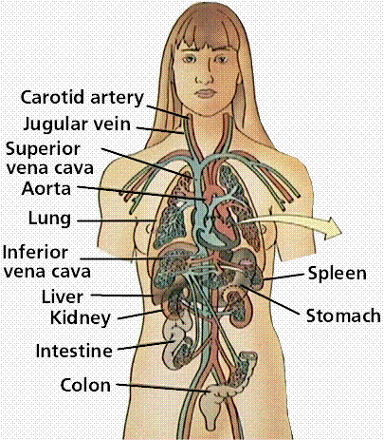
The Circulatory System

Slide 36
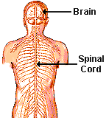
The Nervous System

Slide 37
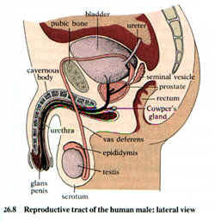
Male Reproductive System

Slide 38
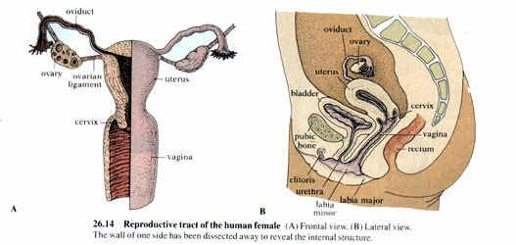
Female Reproductive System

Slide 39
Level of Organization
cells (e.g. muscle cells, nerve
cells)
tissues (e.g. muscle, epithelium)
organs (e.g. heart, lungs, stomach)
systems (e.g. circulatory system)
organisms (e.g. man)

Slide 40
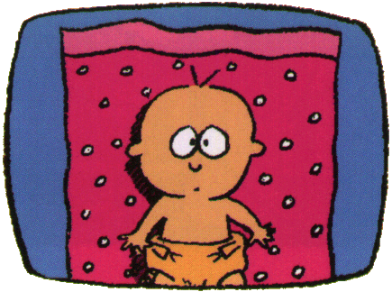
It’s You

Slide 41
~ END ~

