Slide 1
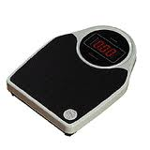
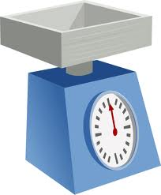
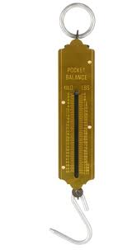
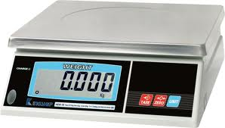
Force
newtonmeters
A force is a push or a pull.
A force can cause an object to:
speed up
slow down
change direction
change shape
Force is measured in
newtons (N).
Force is measured with a
newtonmeter.

Slide 2
Some types of force
Contact
Two bodies touch when their repulsive molecular forces (due to electrons) equal the force that is trying to bring them together.
Friction
(also air resistance)
When two bodies are in contact their attractive molecular forces (due to electrons and protons) try to prevent their common surfaces moving relative to each other.
Tension
The force exerted by a body when it is stretched. It is due to attractive molecular forces.
Electrostatic
Attractive and repulsive forces due to bodies being charged.
Gravitational
The force exerted on a body due to its mass.

Slide 3
Force pairs
Forces always occur in pairs.
Whenever two bodies interact, the forces they exert on each other are equal and opposite.

Slide 4
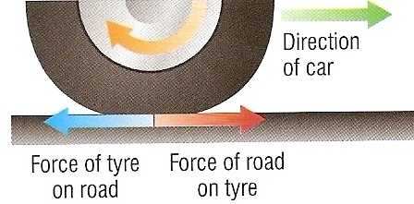
Friction in action
A car is able to move forwards due to friction acting between its tyres and the road.
The force of friction of the road on the tyre acts in the forward direction and is equal but in the opposite direction to the force of friction of the tyre on the road.

Slide 5
Rocket in flight
There are a pair of forces:
A = THRUST of the ROCKET ENGINES
DOWNWARDS
on the EJECTED GASES
B = CONTACT push of the EJECTED GASES
UPWARDS
on the ROCKET ENGINES
A
B

Slide 6
Choose appropriate words to fill in the gaps below:
A _____ is a push or a pull. A force can cause an object to ___________ or change shape.
Force is measured in _______ (N) with a newtonmeter.
There are many types of force. ________ force occurs when two bodies touch each other.
Forces always occur in ______. If a force is exerted on an ________ there will always be another force, ______ in size, acting in the opposite ________.
force
accelerate
newtons
contact
pairs
object
equal
direction
WORD SELECTION:
newtons
accelerate
equal
force
direction
contact
pairs
object

Slide 7
Forces between objects Notes questions from pages 132 & 133
Under the heading ‘Equal and opposite forces’ copy the paragraphs above Figure 1 on page 132.
Copy and answer question (a) on page 132.
Explain the forces involved when a tractor pulls a car out of mud.
Copy and answer question (b) on page 133.
Explain how friction is used to move a car on a road.
Copy and answer question (c) on page 133.
Copy the Key Points on page 133.
Answer the summary questions on page 133.

Slide 8
Forces between objects ANSWERS
In text questions:
50 N upwards
200 N
The wheels slip on the ground.
Summary questions:
(a) Equal, opposite
(b) Downwards, upwards
(a) 500N downwards.
(b) 500N upwards.

Slide 9
Resultant force
A number of forces acting on a body may be replaced by a single force which has the same effect on the body as the original forces all acting together.
This overall force is called resultant force.
In the example opposite, 5N is the resultant force of the 3N and 2N forces.
3N
2N
5N

Slide 10
Determine the resultant force in the cases below:
4N
1.
2.
6N
3N
4N
10N
1N
3.
3N
4.
5.
6N
4N
4N
4N
7N
There is no resultant force in this case
4N
2N

Slide 11
Resultant force and motion
Resultant force | Effect on the motion of an object
Zero | Object’s velocity stays the same including staying stationary
In the direction the object is moving | Object accelerates
In the opposite direction in which the object is moving | Object decelerates

Slide 12
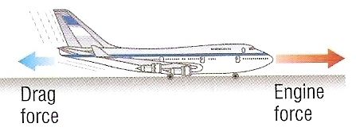
Examples 1 & 2
The box will move when the man’s push force is greater than the friction force.
The plane will accelerate provided that the engine force is greater than the drag force.

Slide 13
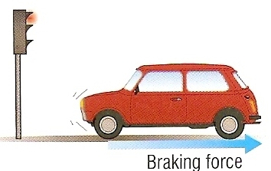
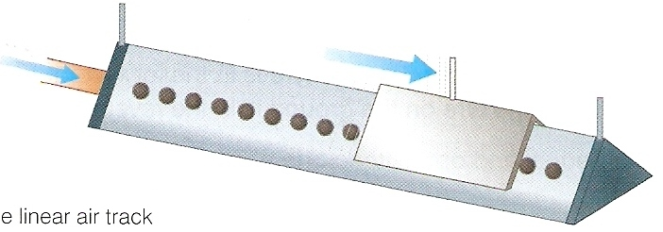
Examples 3 & 4
The brakes exert a resultant force in the opposite direction to the car’s motion causing the car to decelerate.
Once released, the glider moves at a near constant velocity as it experiences a nearly zero horizontal resultant force.

Slide 14
Choose appropriate words to fill in the gaps below:
A single force, called _________ force, can be used to replace a _______ of forces that act on a body.
If the resultant force is _____ then the body will either remain at _____ or continue to move at a constant ________.
If the resultant force is in the same _________ as an object’s motion, the object will __________. A car is decelerated when the braking force acts in the _________ direction to the car’s motion.
resultant
number
zero
rest
velocity
direction
accelerate
opposite
WORD SELECTION:
number
rest
direction
zero
opposite
velocity
accelerate
resultant

Slide 15
Resultant force ANSWERS
In text question:
It stops because friction between the glider and the track is no longer zero.
The crate would slide across the floor after being given a brief push.
They are equal and opposite to each other.
It would have been greater.
Summary questions:
(a) Less than.
(b) Greater than.
(c) Equal to.
(a) it acts in the opposite direction to the direction in which the plane moves.
(b) It is zero.

Slide 16
Force and acceleration
The force, mass and acceleration of an object are related by the equation:
resultant force = mass × acceleration
resultant force is measured in N
mass is measured in kg
acceleration is measured in m/s²

Slide 17
also:
acceleration =
and:
mass =
resultant force
mass
resultant force
acceleration
force
mass
acc

Slide 18
Checking the equation

Slide 19
Question 1
Calculate the force required to cause a car of mass 1200 kg to accelerate by 5 m/s².
resultant force = mass × acceleration
= 1200 kg x 5 m/s²
Force = 6000 N

Slide 20
Question 2
Calculate the acceleration produced by a force of 200N on a mass of 4kg.
resultant force = mass × acceleration
becomes: acceleration = force ÷ mass
= 200N ÷ 4kg
acceleration = 50 m/s²

Slide 21
Question 3
Calculate the force that accelerates a mass of 300kg from rest to 6 m/s over a time of 3 seconds.
acceleration = change in velocity ÷ time
= (6 – 0)m/s ÷ 3s
acceleration = 2 m/s²
resultant force = mass × acceleration
= 300kg x 2 m/s²
force = 600N

Slide 22
Answers
Complete:
Force | Mass | Acceleration
24 N | 4 kg | 6 m/s²
200 N | 40 kg | 5 m/s²
600 N | 30 kg | 20 m/s²
2 N | 5 g | 400 m/s²
5 N | 100 g | 50 cm/s²
24 N
40 kg
20
2 N
5000

Slide 23
Force and acceleration Notes questions from pages 136 & 137
Copy the equation relating force and acceleration, along with the units used, on page 136.
Copy and answer question (a) on page 136.
Copy the abbreviated version of the above equation, along with its variations, found at the top of page 137.
Copy and answer question (b) on page 137.
Copy the heading ‘Speeding up or slowing down’ and the section below it on page 137.
Copy the Key Points on page 137.
Answer the summary questions on page 137.

Slide 24
Force and acceleration ANSWERS
In text questions:
400 N
4.0 m/s²
Summary questions:
(a) Resultant force, velocity.
(b) Mass, resultant force.
(c) Acceleration, resultant force.
(a) 16N (b) 40 kg
(c) 12 m/s²
(d) 2.4 N (e) 25 000 kg

Slide 25
Car forces
When a vehicle travels at a steady speed the frictional forces balance the driving force.

Slide 26
Stopping a car
The total distance required to stop a car, the stopping distance, is equal to the thinking distance plus the braking distance.

Slide 27
Factors affecting stopping distance
The reaction time of the driver
This can be increased if the driver is tired or has consumed alcohol or drugs. The thinking distance is increased.
The speed of the car
The greater the speed the greater will be both the thinking and braking distances.
Doubling the speed increases the overall stopping distance by about four times.
The mass of the car and its contents
The greater the mass the greater will be the braking distance.
The condition of the road
Wet and icy roads will cause the braking distance to increase.
The condition of the vehicle
Worn brakes or worn tyres will both increase the braking distance.

Slide 28
Choose appropriate words to fill in the gaps below:
When a car is moving at a _______ speed the engine force is equal to the resistive force.
The __________ distance of a car is equal to the thinking distance plus the _________ distance.
Tiredness, ________ and drugs are all likely to increase the __________ distance.
A car travelling at 60 m.p.h. will require roughly ______ times stopping __________ of a car travelling at 30 m.p.h..
steady
stopping
braking
alcohol
thinking
four
distance
WORD SELECTION:
braking
thinking
four
steady
alcohol
distance
stopping

Slide 29
On the road Notes questions from pages 138 & 139
Copy Figure 1 on page 138 showing the main forces acting on a car. Explain how the resultant force on a car can be zero when the car is travelling at a constant speed.
Copy and answer question (a) on page 138.
Copy Figure 2 on page 138.
Explain what is meant by (a) thinking distance, (b) braking distance and (c) stopping distance and how these three distances are related to each other.
Explain how car velocity and car mass affect the braking distance of a car.
What other factors affect (a) the thinking distance and (b) the braking distance?
Copy and answer questions (b) and (c) on page 139.
Copy the Key Points on page 139.
Answer the summary questions on page 139.

Slide 30
On the road ANSWERS
In text questions:
The car speeds up
9m, 13.5m, 22.5m
The reaction time of the driver is longer because the road ahead is more difficult to see.
Summary questions:
(a) Braking
(b) Thinking
(c) Braking
(a) (i) 6m
(ii) 24m
(iii) 30m
(b) (i) 12m
(ii) 24m

Slide 31
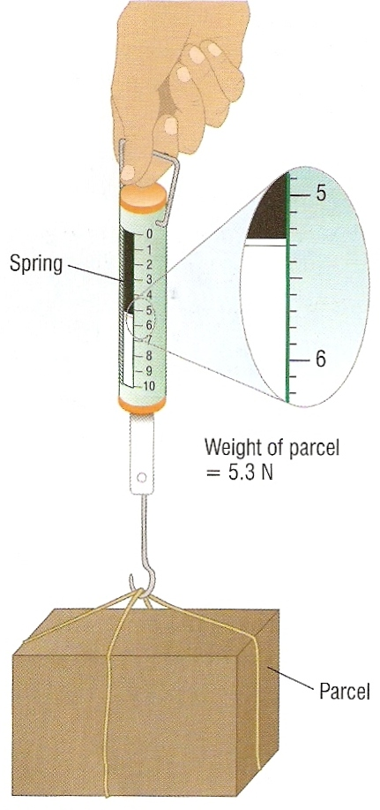
Mass and weight
Mass is the amount of matter in an object.
Mass is measured in kilograms.
The mass of an object is the same on the Moon as on the Earth.
Weight is the force of gravity on an object.
Weight is measured in newtons.
The weight of an object on the Moon is about one sixth that on the Earth.
A newtonmeter is used to determine the weight of the parcel

Slide 32
Gravitational field strength
Gravitational field strength is a measure of how strong gravity is at a particular place.
It is measured in newtons per kilogram (N/kg).
Some examples of gravitational field strength:
Location | N/kg | Location | N/kg
Earth | 10 | Jupiter | 24
Moon | 1.6 | Pluto | 0.7
Mars | 3.7 | The Sun | 270

Slide 33
Calculating weight
weight = mass × gravitational field strength
weight is measured in N
mass is measured in kg
gravitational field strength is measured in N/kg
On the Earth’s surface a mass of 1kg
has a weight of 10N.

Slide 34
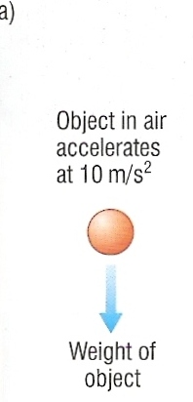
Falling objects
When an object falls through air or some other fluid initially the only significant force acting on it is the downward pull of gravity.
On Earth, it will initially accelerate downwards at 10 m/s².

Slide 35
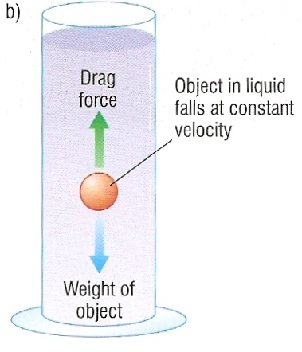
As the object speeds up frictional forces such as air resistance become greater the faster the object moves.
Eventually the resultant force on the object will be zero when the frictional forces equal the weight of the object.
The object then moves at a constant speed called terminal velocity.

Slide 36
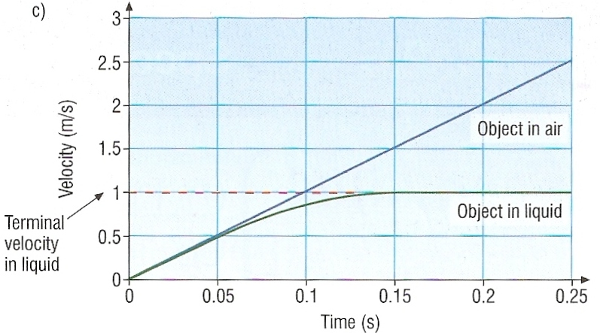
Velocity-time graphs for a falling object

Slide 37
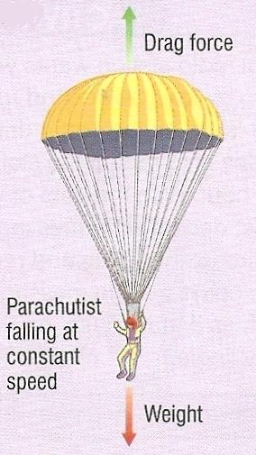
Parachuting
A parachutist will have two different terminal velocities.
Before opening the parachute it is about 60 m/s (140 m.p.h..).
Afterwards, due the much greater drag force, the terminal velocity is about 5 m/s (12 m.p.h.)

Slide 38
Velocity-time graph of a parachutist
velocity
first terminal velocity
parachute opened
ground reached
initial acceleration = 10 m/s²
second terminal velocity
time

Slide 39
Choose appropriate words to fill in the gaps below:
Weight is the ______ of gravity on an object. Gravitational _____ strength is the force in newtons exerted due by gravity per _______ of mass. On the Earth’s surface this is ___ N/kg.
When an object falls through a fluid it initially _________ because of gravity. As its ________ increases so do the frictional forces. Eventually the frictional forces are _____ to the weight of the object. At this stage the _________ force on the object is zero and the object falls with its _______ velocity.
force
field
kilogram
10
accelerates
speed
equal
resultant
terminal
WORD SELECTION:
kilogram
equal
force
accelerates
terminal
10
speed
resultant
field

Slide 40
Falling objects Notes questions from pages 140 & 141
Explain what is meant by (a) mass, (b) weight and (c) gravitational field strength.
Copy the equation relating weight and mass, along with the units used, on page 140.
Copy and answer question (a) on page 140.
Explain why the acceleration of a freely falling body near the Earth’s surface is about 10 m/s².
Copy Figure 2 (all parts) on page 141 and explain the velocity-time for an object falling in a fluid. Your explanation should include what is meant by (a) ‘drag force’ and (b) ‘terminal velocity’.
Copy and answer question (b) on page 141.
Copy the Key Points on page 141.
Answer the summary questions on page 141.

Slide 41
Falling objects ANSWERS
In text questions:
200 N
The drag force on it increases (as its velocity increases) until it is equal and opposite to its weight. The resultant force on it is then zero and its acceleration is zero.
Summary questions:
(a) Less than
(b) Equal to
(c) Equal to
(a) As the parachutist falls, the drag force increases so the resultant force decreases. The resultant force is zero when the drag force becomes equal and opposite to the weight of the parachutist and the parachute. The speed is then constant.
(b) (i) 900 N
(ii) 900 N upwards

Slide 42
Virtual Physics Laboratory Simulations NOTE: Links work only in school
Force and Acceleration - Light gate simulation
Terminal Velocity
Friction – Friction and sliding

Slide 43
Online Simulations
Forces in 1 Dimension - PhET - Explore the forces at work when you try to push a filing cabinet. Create an applied force and see the resulting friction force and total force acting on the cabinet. Charts show the forces, position, velocity, and acceleration vs. time. View a Free Body Diagram of all the forces (including gravitational and normal forces).
Motion produced by a force - linear & circular cases - netfirms
Table Cloth & Other Newton 1st Law Demos - 'Whys Guy' Video Clip (3 mins) (1st of 2 clips)
Inertia of a lead brick & Circular motion of a water glass - 'Whys Guy' Video Clip (3 mins) (2nd of 2 clips)
Air Track - Explore Science
Force on a Wing - Explore Science
Space Cadet - Control a space ship using Newton's 1st law & turning forces - by eChalk
Asteriods Notice how in deep space the vehicle's motion continues in the same state unless acted on by a force (i.e. the ships thrusters). Use your knowledge of physics to guide the spaceship through the asteroid mine field.
Newton's 2nd Law Experiment - Fendt
Pendulum in an accelerated car - NTNU
Acceleration meter - NTNU
Sailing a boat - NTNU
Free-fall Lab - Explore Science
Galileo Time of Fall Demonstration - 'Whys Guy' Video Clip (3 mins) - Time of fall independent of mass - Leads slug and feather with and without air resistance. (1st of 2 clips)
Lunar Lander - PhET - Can you avoid the boulder field and land safely, just before your fuel runs out, as Neil Armstrong did in 1969? Our version of this classic video game accurately simulates the real motion of the lunar lander with the correct mass, thrust, fuel consumption rate, and lunar gravity. The real lunar lander is very hard to control.
Moonlander Use your thrusters to overcome the effects of gravity and bring the moonlander safely down to earth.
Block moving horizontally with friction - NTNU
Friction & Heating - PhET - Learn how friction causes a material to heat up and melt. Rub two objects together and they heat up. When one reaches the melting temperature, particles break free as the material melts away.
Reaction time stopping a car - also plots velocity/time graph - NTNU
Car Accident & Reaction Time - NTNU
BBC KS3 Bitesize Revision:
Weight mass and gravity
Frictional forces
BBC AQA GCSE Bitesize Revision:
BBC AQA GCSE Bitesize Revision:
Resultant force
Force and acceleration
F=ma
Types of forces
Weight
Falling objects
Falling objects - terminal velocity
Stopping distances

Slide 44
Speed limits Notes questions from pages 142 & 143
Answer questions 1 and 2 on pages 142 and 143.

Slide 45
Speed limits ANSWERS
(a) The time interval is getting smaller.
(b) If the marks are equally spaced and the time it takes to move between them is shorter then the ball must be getting faster; it is accelerating.
2. (a) To make sure the athletes do not take drugs that boost performance.
(b) Some food and some drinks might contain traces of banned substances.
(c) Research
(d) Usain Bolt of Jamaica holds the 100m world record at 9.69s – Obtained at the Beijing Olympic Games in 2008

Slide 46
How Science Works ANSWERS
That the force of gravity was much stronger than the forces that might make it fall apart.
That an object falling from a high tower would hit the ground in front of the tower.
That the object would fall behind the tower.
A tall enough tower.
That the comet would reappear at a certain date.
Yes. The comet did appear at the time that Halley predicted from Newton’s calculations.

