Slide 1
OXYGEN
Percentage of Oxygen in the Atmosphere
OXYGEN AND ITS PROPERTIES

Slide 2
By the end of this presentation you should be able to:
Demonstrate an understanding of how to investigate the proportion of oxygen in the atmosphere

Slide 3
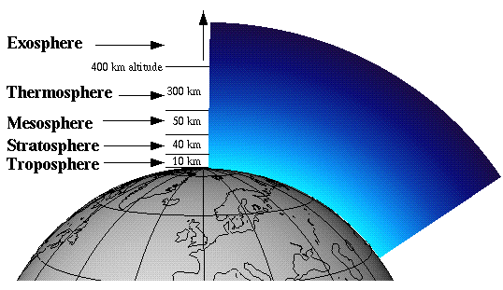
Finding the Percentage of Oxygen in the Atmosphere
The amount of oxygen in the atmosphere depends on where you sample it from.
The higher you go the less there is!
In this lesson we will find the percentage of oxygen in the atmosphere in our laboratory…
500 feet above sea-level!

Slide 4
Finding the Percentage of Oxygen in the Atmosphere
Strategy…
Trap a known amount of air; a cm³
Remove the oxygen!
Measure the amount of ‘air’ left ; b cm³
Calculate amount of oxygen removed
Calculate the percentage of oxygen;
a – b cm³
a – b
x 100
a

Slide 5
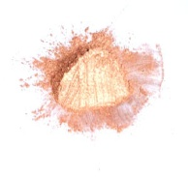


The oxygen in the atmosphere can be removed by passing a sample of the atmosphere over hot copper.
Remove the oxygen!
If copper is heated in air, the hot copper combines with the oxygen, to form…
solid copper oxide…
and so removes it from the air.
Copper + oxygen → copper oxide
2Cu(s) + O₂(g) → 2CuO(s)
+ →

Slide 6
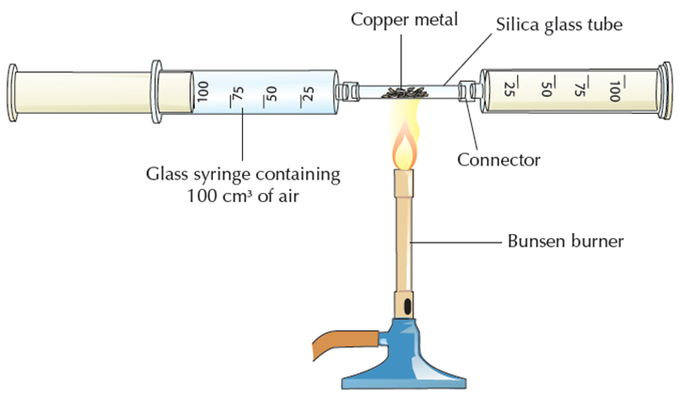

Slide 7
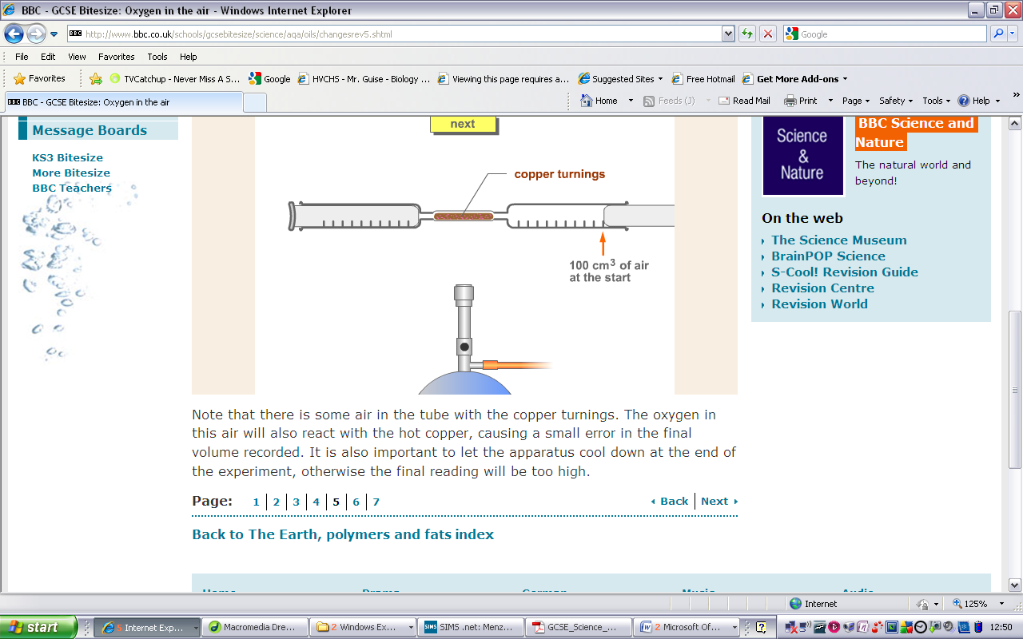
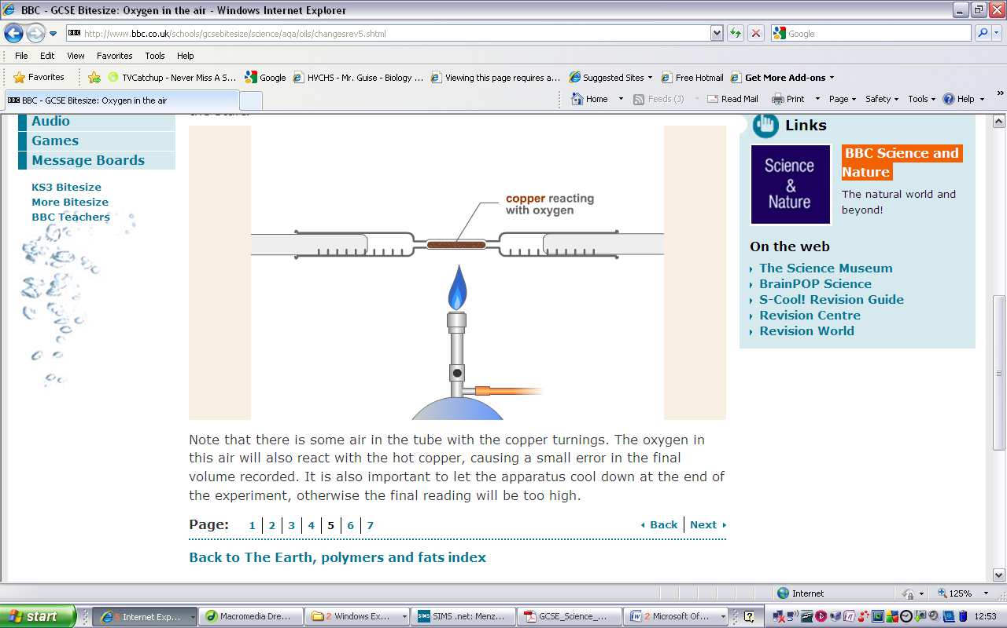
The experiment…
(a cm³)
100 cm³
Copper turnings are put in a combustion boat such that the air can be pushed over them.
Two gas syringes are joined together with one containing a known volume of air, 100 cm³, and the other empty.
The copper turnings are heated.

Slide 8
The experiment…
The air is passed to and fro over the copper to allow the hot copper to react.
The copper goes darker as copper oxide is formed.

Slide 9
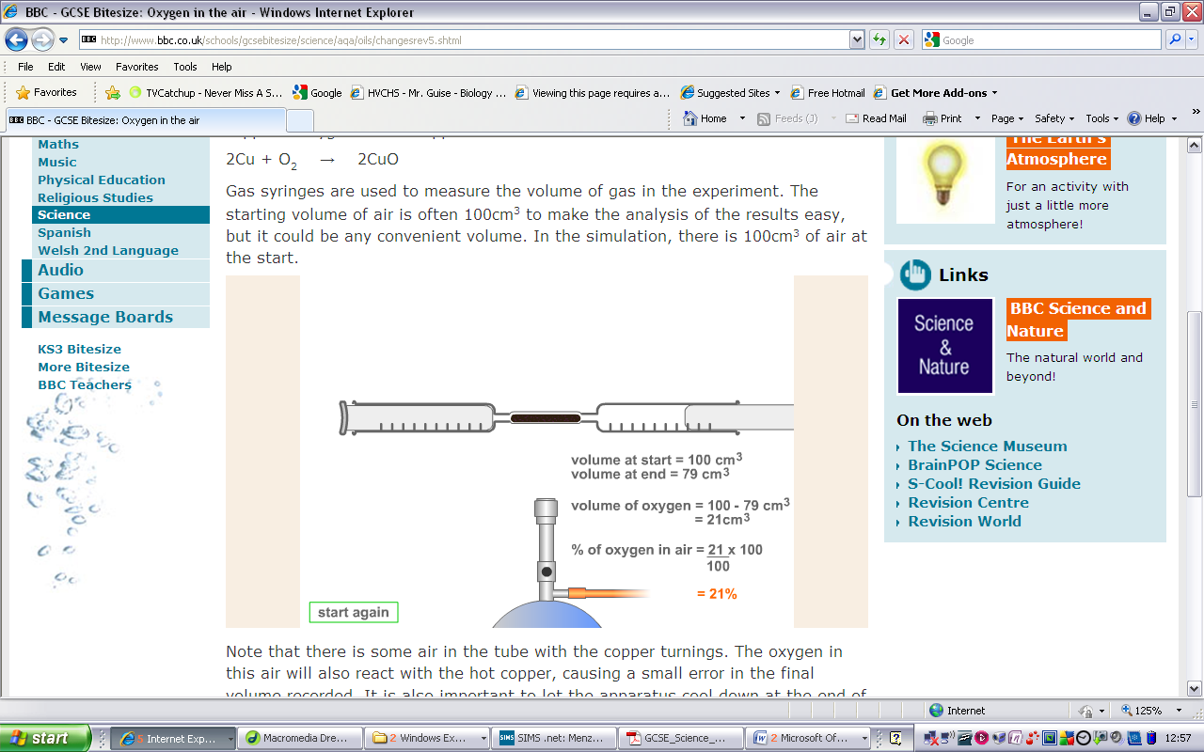
The experiment…
79 cm³
(b cm³)
The apparatus is allowed to cool and the volume of gas remaining in the syringe is measured.
The volume of oxygen is calculated by taking the final volume from the original volume…

Slide 10
The calculation…
100 cm³
(a cm³)
79 cm³
(b cm³)
The apparatus is allowed to cool and the volume of gas remaining in the syringe is measured.
(a cm³)
(b cm³)
(a – b) cm³
a – b
x 100
a
= 21%

Slide 11
Possible errors…
There is some air in the tube with the copper turnings. The oxygen in this air will also react with the hot copper, causing a small error in the final volume recorded.
79 cm³
Since gases occupy greater volumes when hot…
…it is important to let the apparatus cool down at the end of the experiment otherwise the final reading will be too high…
The initial volume and the final volume must be measured at the same temperature.

Slide 12
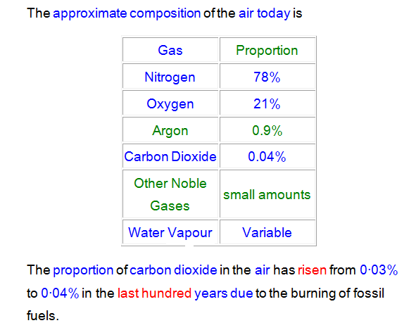

Slide 13
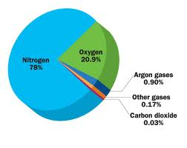

Slide 14
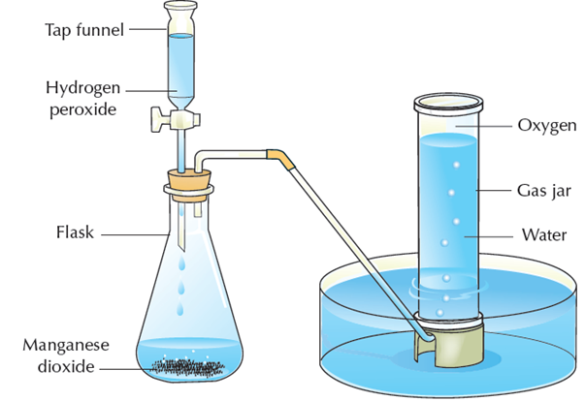
Laboratory Preparation of Oxygen
Oxygen is prepared in the lab by catalytic decomposition of hydrogen peroxide using
manganese (IV) oxide as shown. The gas is then collected over water.

Slide 15

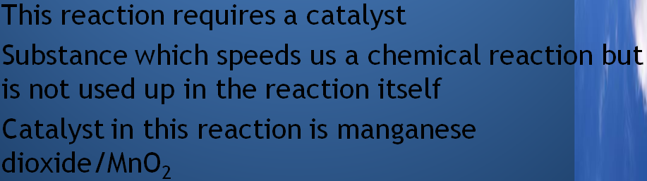
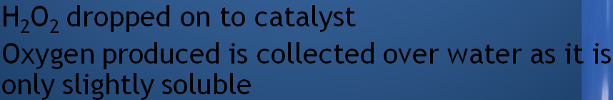

Slide 16
Separation of Oxygen and Nitrogen from Air
1. Air is a mixture and its components can be separated by processes involving physical changes.
Components in air such as oxygen, nitrogen and noble gases have many uses, therefore it is important to obtain them separately.
3. In industry, the components of air can be separated by fractional distillation of liquid air. This is possible because different components in air have different boiling points.

Slide 17
air in
nitrogen gas (b.p. -196ºC)
1
argon gas (b.p. -186ºC)
2
oxygen gas (b.p. -183ºC)
3
4

Slide 18
(i) Purification
1. Dust particles are removed by filter.
2. Water vapour and carbon dioxide are removed as solids at -80ºC
(ii) Liquefaction of air
3. Air is compressed and then cooled.
4. Air is then allowed to expand - it gets very cold and becomes liquid at -200ºC.

Slide 19
(iii) Fractional distillation of liquid air
The liquid air is pumped into a fractionating tower and then allowed to warm up very slowly. Different gases in liquid air boil at their own boiling points, so they can be collected one by one.
The boiling point of nitrogen is -196ºC and it boils off first and is collected at the top of the fractionating tower. Argon follows (boiling point -186ºC) and then oxygen (boiling point -183ºC) which is collected at the lower part of the fractionating tower.

Slide 20
The boiling points of some of the gases found in air are in shown in the table below.
Gas | Boiling point (ºC)
Argon | -186
Nitrogen | -196
Neon | -246
Oxygen | -183
Helium | -269
Krypton | -153

Slide 21
Uses of gases in air
Oxygen – in breathing
Carbon dioxide – in fire extinguisher
Dry ice (solid carbon dioxide) is used in refrigeration
Helium – filling balloons
Argon – filling light bulbs

Slide 22
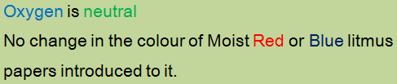
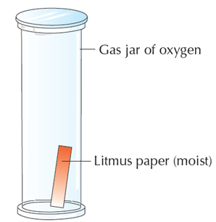
Properties of Oxygen

Slide 23
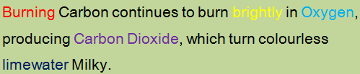
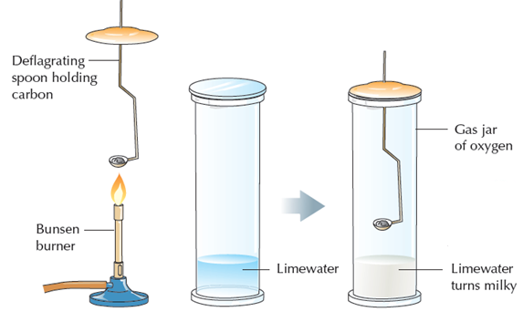
Carbon Burns in Oxygen

Slide 24
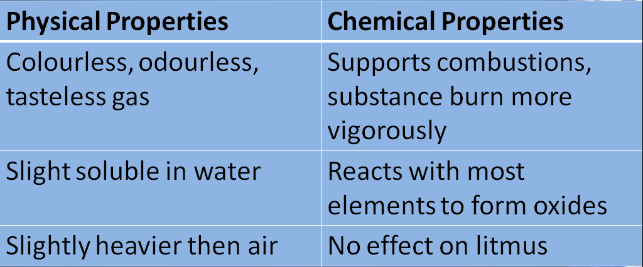
Properties of Oxygen

Slide 25
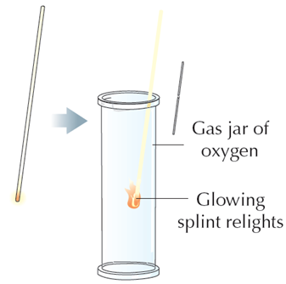
Chemical test for Oxygen
A glowing match or wooden splint will relight when placed in oxygen gas.

Slide 26
To Show That Air contains Carbon Dioxide and Water Vapour

Slide 27
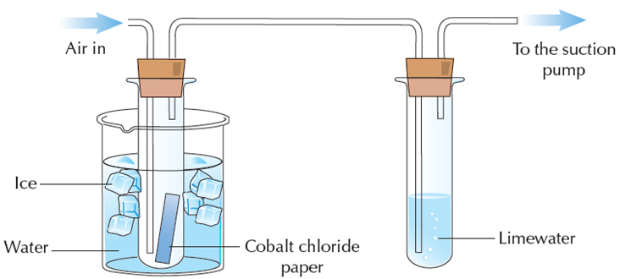
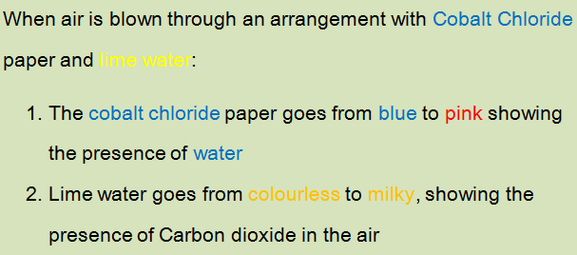

Slide 28
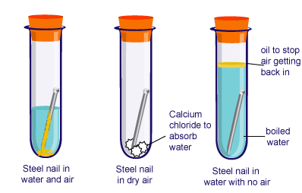
RUSTING OF IRON

Slide 29
Experiment
Place the painted nail in a test tube and totally cover with water – label this painted nail + water
Put a plain nail in a test tube and ½ cover this with water – label this control
Cover a plain nail in Vaseline (using a paper towel) and totally cover with water – label this greased nail
Add some calcium chloride crystals in a test tube, and add a little cotton wool in the top of the test tube, pushing it down with a spatula so that it is just above the crystals. Add a plain nail on top of the cotton wool, and place some more cotton wool in the top of the test tube – label this calcium chloride
Put a plain nail in a test tube and totally cover this with boiled water. Add a little oil on top of the water, and bung the test tube – label this oil
Label your test tube with your group names

Slide 30
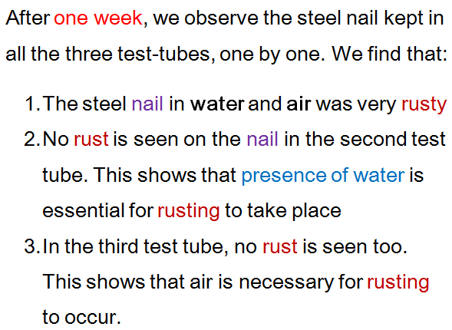

Slide 31
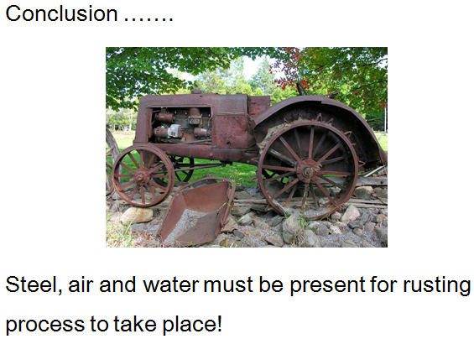

Slide 32
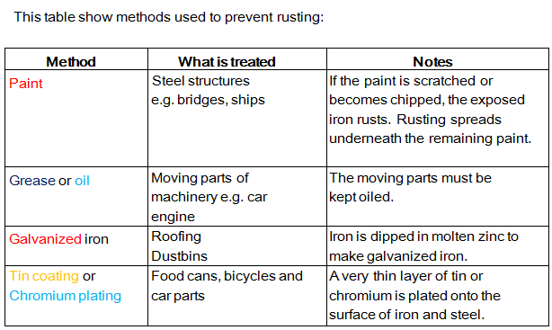

Slide 33
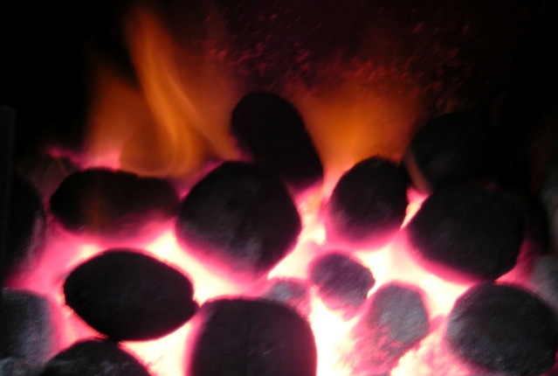
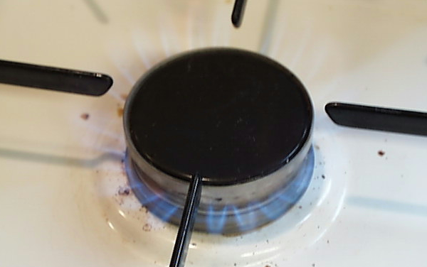
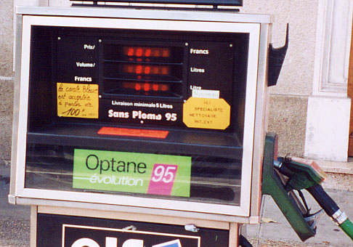
Using combustion
Combustion is the chemical reaction that takes place when
a substance burns.
The substance reacts with oxygen and energy is released as heat and light.
Combustion is an important reaction as more than 90% of
the world’s energy comes from burning fossil fuels like coal, natural gas and petrol.
Where do fossil fuels come from and what other fuels are there?

Slide 34
Incomplete combustion
A good supply of oxygen is needed for a fuel to burn completely and release as much energy as possible.
When carbon reacts completely with oxygen, it is all turned into carbon dioxide. This is called complete combustion:
carbon
oxygen
carbon dioxide
If there is not enough oxygen, a fuel cannot burn completely and less energy is released. Some fuel is wasted.
When carbon does not react completely with oxygen, the product is carbon monoxide, a colourless poisonous gas. This is called incomplete combustion:
carbon
oxygen
carbon monoxide

Slide 35

Demonstration – Burning magnesium in the air
Watch what happens when your teacher burns magnesium in air.
Describe what you see.
What element present in the air reacted with the magnesium?
Describe the product formed.
What is the name of this product?
Wear eye protection.

Slide 36
Demonstration – Burning magnesium in the air
Watch what happens when your teacher burns magnesium in air.
Describe what you see.
What element present in the air reacted with the magnesium?
Describe the product formed.
What is the name of this product?
Wear eye protection.

Slide 37
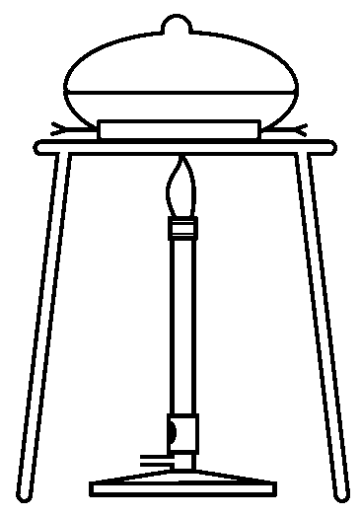
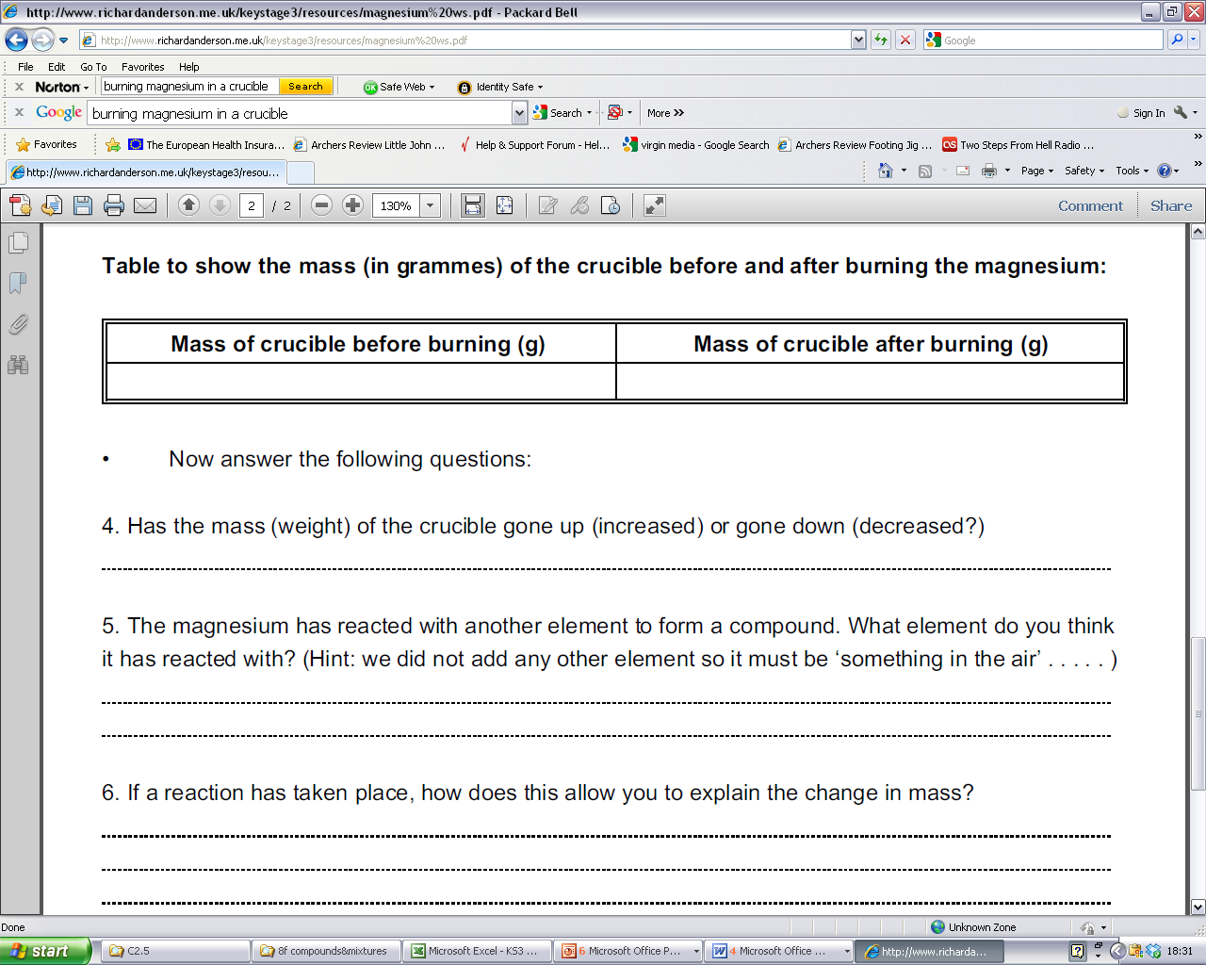
Experiment - Investigating the reaction between magnesium and oxygen
Wear eye protection.
Method
Place the strip of magnesium ribbon into the crucible and put on the lid.
Using the electronic scales, weigh the crucible (including the lid) and magnesium and record the mass.
Heat the crucible strongly, once the magnesium begins burning, use tongs, to lift up the lid to let some air in. Try not to let any smoke out.
When there is no further change to the magnesium, turn off the Bunsen burner and leave the crucible for 10 - 15 minutes to cool.
Draw a labelled diagram of the apparatus, and write the method in the past tense (A strip of magnesium was ….).
When the crucible is cool to the touch re-weigh it with its lid.
Explain the change in mass.
Notes:
Work sheet available

Slide 38
Experiment - Investigating the reaction between
magnesium and oxygen
pipe clay triangle
crucible and lid
bunsen burner
tripod
heat proof mat
Write the word equation for the reaction.
magnesium + oxygen magnesium oxide

Slide 39
Why did the mass increase in the crucible?
magnesium + oxygen magnesium oxide
O
Mg
O
Mg
O
Mg
Mg
O
2Mg + O₂ 2MgO
What was present in the crucible when it was first weighed?
What was present in the crucible at the end of the experiment?
Write your explanation.

Slide 40
Competition for Oxygen

Slide 41
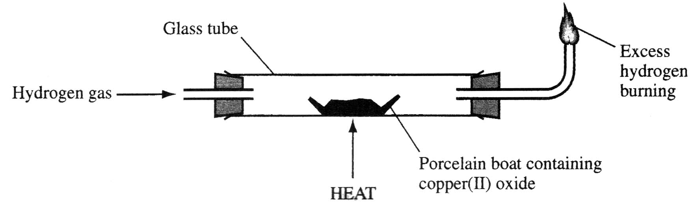
Solid copper(II) oxide can be reduced by passing a stream of hydrogen gas over the heated solid.

Slide 42
Write a balanced symbol equation for the reaction between copper(II) oxide and hydrogen gas.
What would you observe during this reaction?

Slide 43
Write a balanced symbol equation for the reaction between copper(II) oxide and hydrogen gas.
CuO + H₂ → Cu + H₂O
What would you observe during this reaction?
Black solid turns pink/brown flame diminishes in size drops of colourless liquid appear at cooler parts.

Slide 44
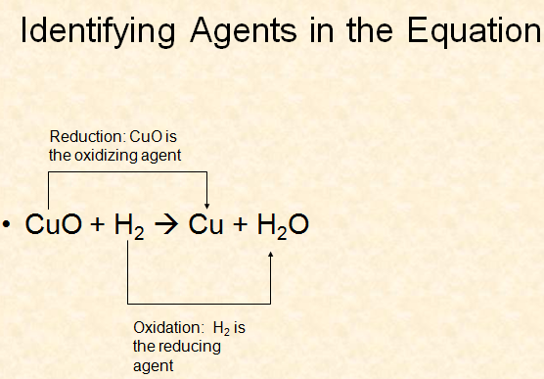

Slide 45
The Reaction Between Magnesium and CO₂

Slide 46
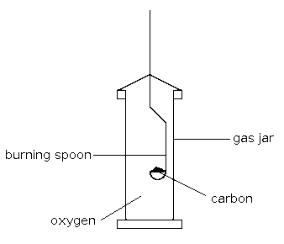
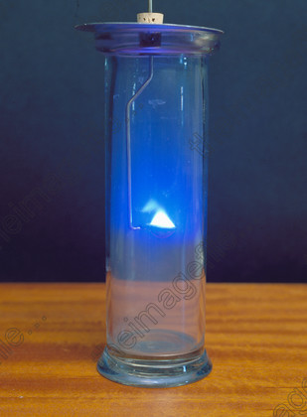

Slide 47
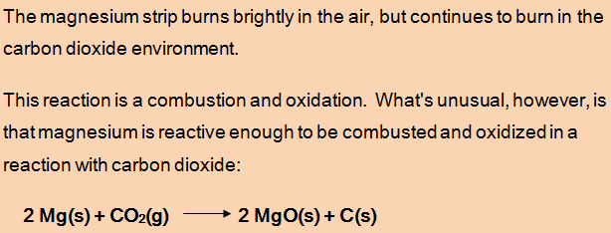
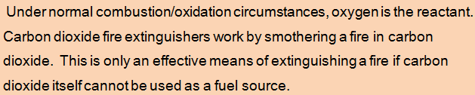

Slide 48
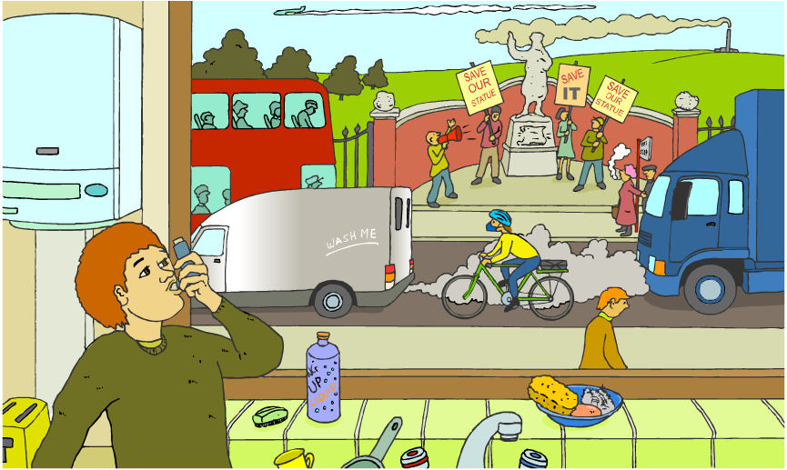
Air Pollution

Slide 49
Air pollution is the presence of substances in the air that are harmful to health or the environment.
It can be easy to spot air pollution in cities, but its effects are not limited to urban areas because air circulates freely all over the world.
Air pollution can cause the destruction of forests, death of fish in lakes and premature death in humans.
How does air pollution cause so many problems?

Slide 50
The most common pollutants found in air are:
carbon dioxide (CO₂)
sulphur dioxide (SO₂)
carbon monoxide (CO)
nitrogen dioxide (NO₂)
All these gases emanate from burning substances in
Oxygen

Slide 51
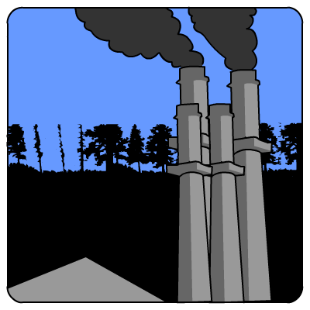
Carbon dioxide is an important atmospheric gas as it prevents heat radiation produced by the Earth from escaping into space.
This is the greenhouse effect, which makes the Earth warm enough for life.
Fossil fuels often contain sulphur and so the pollutant sulphur dioxide can be produced during combustion.
If there is not enough oxygen present when fossil fuels are burned, incomplete combustion occurs.
This reaction produces carbon and carbon monoxide gas.

Slide 52
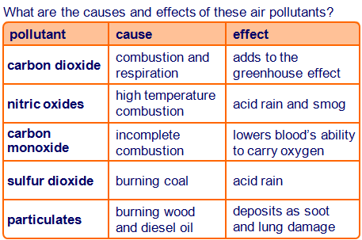
Carbon monoxide gas is extremely harmful to human health because it stops blood from carrying oxygen.

