Slide 1
DENSITY AND PRESSURE

Slide 2
Specification
Solids, liquids and gases
Density and pressure
know and use the relationship:
density = mass / volume ρ = m / V
describe experiments to determine density using direct measurements of mass and volume
know and use the relationship:
pressure = force / area p = F / A
understand that the pressure at a point in a gas or liquid which is at rest acts equally in all directions
know and use the relationship:
pressure difference = height × density × g p = h × ρ × g

Slide 3
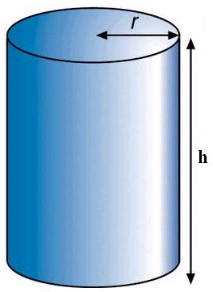
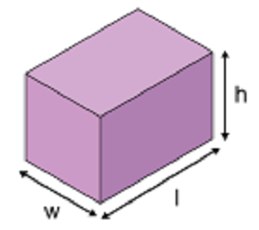
Measuring the volume of a regular solid
V = w x l x h
V = π x r² x h

Slide 4
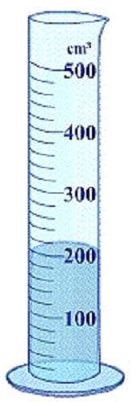
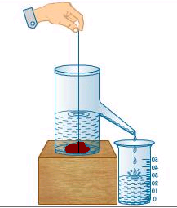
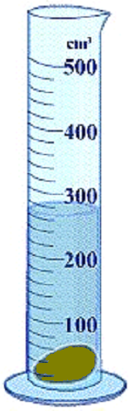
Measuring the volume of an irregular solid
Smaller solid
Measure the change in level of the water in a measuring cylinder
Larger solid
Measure the volume of water displaced. The string is assumed to have no volume.

Slide 5
Volume units
1 cubic metre (1 m³)
= 1m x 1m x 1m
= 100cm x 100cm x 100cm
= 1000 000cm³
1 m³ = 1000 000 cm³
NOTE: 1 cubic centimetre (cm³ OR ‘cc’) is also the same as 1 millilitre (ml)

Slide 6
Density (ρ)
density = mass
volume
ρ = m / V
mass, m is measured in kilograms (kg)
volume, V is measured in cubic metres (m³)
density, ρ is measured
in kilograms per cubic metres (kg/m³)

Slide 7
also:
mass = density x volume
and:
volume = density
volume
m
ρ
V

Slide 8
Conversion between kg/m³ and g/cm³
A 1g mass of water has a volume of 1cm³
but 1g = 0.001kg
and 1cm³ = 0.000 001 m³
Therefore: 1m³ of water will have a mass of 1000 000 x 1g = 1000kg
1000 kg/m³ is the same as 1 g/cm³

Slide 9
Density examples
 | density (kg/m³) |  | density (kg/m³)
Interstellar space |  | iron
hydrogen |  | lead
helium |  | mercury
air |  | uranium
wood (average) |  | gold
lithium
water |  | Sun’s core
plastics |  | neutron star
aluminium |  | black hole
10⁻²⁵ to 10⁻¹⁵
7 900
0.0989
11 300
0.179
13 500
1.29
19 100
700
19 300
0.534
osmium
22 610
1000
150 000
850 to 1400
10¹⁷
2 700
> 4 x 10¹⁷

Slide 10
Question 1
Calculate the density of a metal block of volume 0.20 m³ and mass 600 kg.

Slide 11
Question 1
Calculate the density of a metal block of volume 0.20 m³ and mass 600 kg.
density = mass
volume
= 600 kg / 0.20 m³
density of the metal = 3000 kg / m³

Slide 12
Question 2
Calculate the mass of a block of wood of volume 0.050 m³ and density 600 kg/m³.

Slide 13
Question 2
Calculate the mass of a block of wood of volume 0.050 m³ and density 600 kg/m³.
ρ = m / V
becomes:
m = ρ x V
= 600 kg/m³ x 0.050 m³
mass of wood = 30 kg

Slide 14
Question 3
Calculate the volume of a liquid of mass 45 kg and density 900 kg/m³.
ρ = m / V
becomes:
V = m / ρ
= 45 kg ÷ 900 kg/m³
volume of liquid = 0.05 m³

Slide 15
Question 4
When a small stone is immersed into the water inside a measuring cylinder the level increases from 20.0 to 27.5 ml. Calculate the density of the stone in g/cm³ if its mass is 60g.

Slide 16
Question 4
When a small stone is immersed into the water inside a measuring cylinder the level increases from 20.0 to 27.5 ml. Calculate the density of the stone in g/cm³ if its mass is 60g.
Volume of stone = (27.5 – 20.0) ml
= 7.5 cm³
ρ = m / V
= 60g / 7.5cm³
density of the stone = 8.0 g/cm³

Slide 17
Question 5
Calculate the density in g/cm³ and kg/m³ of a metal cylinder of radius 2cm, height 3cm and mass 400g.

Slide 18
Question 5
Calculate the density in g/cm³ and kg/m³ of a metal cylinder of radius 2cm, height 3cm and mass 400g.
Volume of a cylinder = π x r² x h
= π x (2cm)² x 3cm
= 3.142 x 4 x 3
= 37.7 cm³
ρ = m / V
= 400 g / 37.7 cm³
metal density = 10.6 g/cm³
= 10 600 kg/m³

Slide 19
Question 6
Calculate the mass of a teaspoon full (1 cm³) of a neutron star. Density of a neutron star = 1.0 x 10¹⁷ kg/m³.

Slide 20
Question 6
Calculate the mass of a teaspoon full (1 cm³) of a neutron star. Density of a neutron star = 1.0 x 10¹⁷ kg/m³.
1.0 cm³ = 0.000 0001 m³
ρ = m / V
becomes:
m = ρ x V
= 1.0 x 10¹⁷ kg/m³ x 0.000 0001 m³
mass = 1.0 x 10¹¹ kg
Note: 1 tonne = 1000 kg = 1.0 x 10³ kg
Therefore mass = one hundred million tonnes!

Slide 21
Choose appropriate words to fill in the gaps below:
Density is equal to ______ divided by _________ and can be measured in kilograms per ______ metres.
A density of _______kg/m³ is the same as a density of 1 g/cm³. This is the density of ________.
The ________ of a stone can be measured by immersing the stone into water. The volume of water ________ by the stone is equal to the volume of the stone. The volume of the water displaced is found using a _________ cylinder.
WORD SELECTION:
cubic
density
mass
water
measuring
1000
displaced
volume
Notes:
21
21

Slide 22
Answers:
Density is equal to ______ divided by _________ and can be measured in kilograms per ______ metres.
A density of _______kg/m³ is the same as a density of 1 g/cm³. This is the density of ________.
The ________ of a stone can be measured by immersing the stone into water. The volume of water ________ by the stone is equal to the volume of the stone. The volume of the water displaced is found using a _________ cylinder.
mass
volume
cubic
1000
water
density
displaced
measuring
WORD SELECTION:
cubic
density
mass
water
measuring
1000
displaced
volume
Notes:
22
22

Slide 23
Pressure, p
pressure = force area
p = F
A
units:
force, F – newtons (N)
area, A – metres squared (m²)
pressure, p – pascals (Pa)
Notes:
23

Slide 24
also:
force = pressure x area
and:
area = force
pressure
F
p
A
Note:
1 Pa is the same as 1 newton per square metre (N/m²)

Slide 25
Question 1
Calculate the pressure exerted by a force of 200N when applied over an area of 4m².
p = F / A
= 200N / 4m²
pressure = 50 Pa

Slide 26
Question 2
Calculate the force exerted by a gas of pressure 150 000 Pa on an object of surface area 3m².

Slide 27
Question 2
Calculate the force exerted by a gas of pressure 150 000 Pa on an object of surface area 3m².
p = F / A
becomes:
F = p x A
= 150 000 Pa x 3 m²
force = 450 000 N

Slide 28
Question 3
Calculate the area that will experience a force of 6000N from a liquid exerting a pressure of 300kPa.

Slide 29
Question 3
Calculate the area that will experience a force of 6000N from a liquid exerting a pressure of 300kPa.
p = F / A
becomes:
A = F / p
= 6000 N ÷ 300 kPa
= 6000 N ÷ 300 000 Pa
area = 0.02 m²

Slide 30
Complete:
force | area | pressure
40 N | 8 m² | Pa
500 N | m² | 25 Pa
N | 5 m² | 80 Pa
20 N | 2 cm² | kPa
6 N | mm² | 3 MPa
Notes:
30

Slide 31
Complete:
force | area | pressure
40 N | 8 m² | Pa
500 N | 20 m² | 25 Pa
400 N | 5 m² | 80 Pa
20 N | 2 cm² | 100 kPa
6 N | 2 mm² | 3 MPa
5
20
400
100
2
Notes:
31

Slide 32
Pressure exerted by a block question
The metal block, shown opposite, has a weight of 900 000N. Calculate the maximum and minimum pressures it can exert when placed on one of its surfaces.
Maximum pressure occurs when the block is placed on its smallest area surface (2m x 3m)
p = F / A
= 900 000N / 6m²
Maximum pressure = 150 000 Pa
Minimum pressure occurs when the block is placed on its largest area surface (3m x 5m)
p = F / A
= 900 000N / 15m²
Minimum pressure = 60 000 Pa
2m
5m
3m

Slide 33
Pressure examples
 | pressure in Pa or N/m²
Space (vacuum) | 0
Air pressure at the top of Mount Everest | 30 000
Average pressure of the Earth’s atmosphere at sea level at 0°C | 101 325
Typical tyre pressure | 180 000
Pressure 10m below the surface of the sea | 200 000
Estimated pressure at the depth (3.8km) of the wreck of the Titanic | 41 000 000

Slide 34
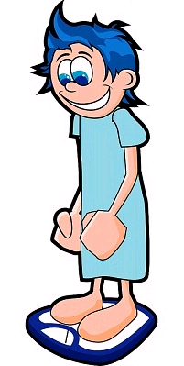
Pressure exerted by a person on a floor
1. Weigh the person in newtons. This gives the downward force, F exerted on the floor.
2. Draw, on graph paper, the outline of the person’s feet or shoes.
3. Use the graph paper outlines to calculate the area of contact, A with the floor in metres squared.
(Note: 1m² = 10 000 cm²)
4. Calculate the pressure in pascals using: p = F / A

Slide 35
Typical results
1. Weight of person: _____ N
2. Outline area of both feet in cm² ____
3. Outline area of both feet in m² _____
4. Pressure = ________
= _______ Pa
500
60
0.006
500 N
0.006 m²
83 000

Slide 36
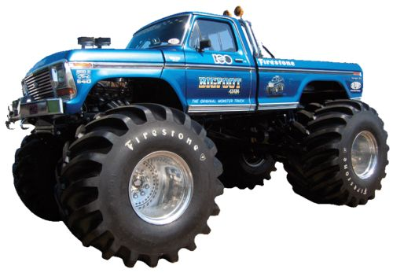
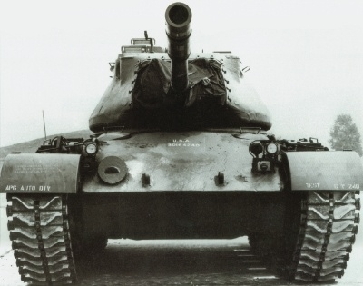
Why off-road vehicles have large tyres or tracks
In both cases the area of contact with the ground is maximised.
This causes the pressure to be minimised as:
pressure = vehicle weight ÷ area
Lower pressure means that the vehicle does not sink into the ground.

Slide 37
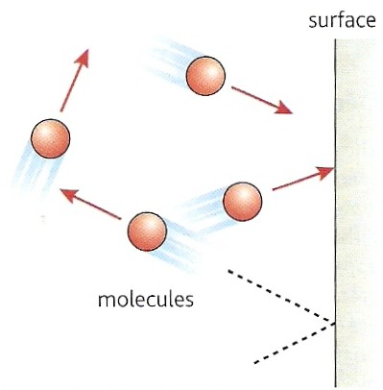
How a gas exerts pressure
A gas consists of molecules in constant random motion.
When a molecule collides with a surface it reverses direction due to the force exerted on it by the surface.
The molecule in turn exerts a force back on the surface.
The pressure exerted by the gas is equal to the total force exerted by the molecules on a particular area of the surface divided by the area.
pressure = force / area
Notes:
37

Slide 38
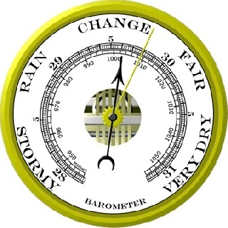
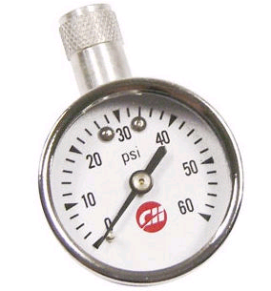
Pounds per square inch (psi)
Often used to measure car tyre pressures.
1 psi = 6895 Pa
1 atm = 101 kPa = 14.7 psi
Inches of mercury (inHg)
Often found on domestic barometers.
1 inHg = 3386 Pa
1 atm = 101 kPa = 29.9 inHg
Examples:
Fair weather – high pressure: 30.5 inHg
Rain – low pressure: 29.0 inHg
tyre pressure gauge
Notes:
38

Slide 39
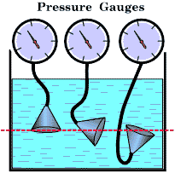
Pressure in liquids and gases
The pressure in a liquid or a gas at a particular point acts equally in all directions.
At the same depth in the liquid the pressure is the same in all directions

Slide 40

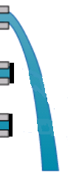

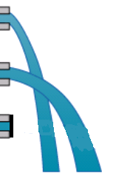
The pressure in a liquid or a gas increases with depth
The pressure of the liquid increases with depth

Slide 41
Pressure, height or depth equation
pressure difference = height × density × g
p = h × ρ × g
units:
height or depth, h – metres (m)
density, ρ – kilograms per metres cubed (kg/m³)
gravitational field strength, g
– newtons per kilogram (N/kg)
pressure difference, p – pascals (Pa)
Notes:
41

Slide 42
Question 1
Calculate the pressure increase at the bottom of a swimming pool of depth 2m.
Density of water = 1000 kg/m³
g = 10 N/kg

Slide 43
Question 1
Calculate the pressure increase at the bottom of a swimming pool of depth 2m.
Density of water = 1000 kg/m³
g = 10 N/kg
pressure difference = h × ρ × g
= 2m x 1000 kg/m³ x 10 N/kg
pressure increase = 20 000 Pa

Slide 44
Question 2
At sea level the atmosphere has a density of 1.3 kg/m³.
(a) Calculate the thickness (height) of atmosphere required to produce the average sea level pressure of 100kPa.
(b) Why is the actual height much greater?
g = 10 N/kg

Slide 45
Question 2
At sea level the atmosphere has a density of 1.3 kg/m³.
(a) Calculate the thickness (height) of atmosphere required to produce the average sea level pressure of 100kPa.
(b) Why is the actual height much greater?
g = 10 N/kg
(a) p = h × ρ × g
becomes:
h = p / (ρ × g)
= 100 kPa / (1.3 kg/m³ x 10 N/kg)
= 100 000 / (1.3 x 10)
= 100 000 / 13
height = 7 692 m (7.7 km)
(b) The real atmosphere’s density decreases with height.
The atmosphere extends to at least a height of 100 km.

Slide 46
Choose appropriate words to fill in the gaps below:
Pressure is equal to _______ divided by ______.
Pressure is measured in _______ (Pa) where one pascal is the same as one newton per ________ metre.
The pressure of the Earth’s ___________ at sea-level is approximately 100 000 Pa.
Pressure increases with ______ below the surface of liquid. Under _______ the pressure increases by about one atmosphere for every ______ metres of depth.
WORD SELECTION:
square
depth
force
atmosphere
water
area
ten
pascal
Notes:
46
46

Slide 47
Choose appropriate words to fill in the gaps below:
Pressure is equal to _______ divided by ______.
Pressure is measured in _______ (Pa) where one pascal is the same as one newton per ________ metre.
The pressure of the Earth’s ___________ at sea-level is approximately 100 000 Pa.
Pressure increases with ______ below the surface of liquid. Under _______ the pressure increases by about one atmosphere for every ______ metres of depth.
force
area
pascal
square
atmosphere
depth
water
ten
WORD SELECTION:
square
depth
force
atmosphere
water
area
ten
pascal
Notes:
47
47

