Slide 1

Nutrients

Slide 2
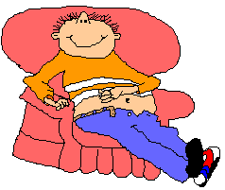
Why do we need food?
Energy
Growth and Repair
(make new protoplasm)
Regulate Body Functions / Maintain health

Slide 3

A Balanced Diet :
Consists of the 7 nutrients at the right amounts to meet the daily requirements of our body.
Carbohydrates
Proteins
Fats
Water
Dietary Fibre
Vitamins
Mineral Salts

Slide 4
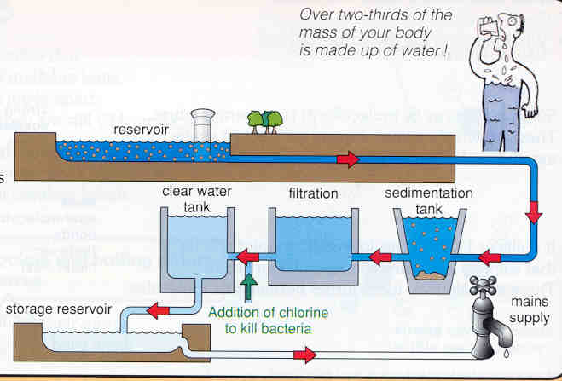
1. Water
Functions :
  Solvent & medium of transport :
  Main constituent of blood & body fluids
  Hydrolysis reactions during digestion.
  Temperature Regulation:
  Sweating. Evaporation of water resulting in removal of body heat (cooling) to prevent overheating.
  Lubrication :
  Water is the main constituent of synovial fluids (for lubrication of joints) and mucus (in the alimentary canal)

Slide 5
2. Carbohydrates:
Monosaccharide, Disaccharide & Polysaccharide
Elements:
  Carbon
  Hydrogen
  Oxygen
Functions:
  Storage (glycogen)
  Structure (cell wall)
  Nucleic acids (DNA)
  Lubrication (e.g. mucus)

Slide 6
Carbohydrates:
What are they?
Carbohydrates are organic compounds made of carbon, hydrogen and oxygen.
The hydrogen and oxygen atoms are in the same ratio as that in water, 2:1.
  E.g.
    Glucose C₆H₁₂O₆
    Sucrose C₁₂H₂₂O₁₁

Slide 7
I. Monosaccharide – C₆H₁₂O₆
SIMPLE SUGARS
glucose fructose galactose

Slide 8
II. Disaccharides – C₁₂H₂₂O₁₁
Maltose Sucrose Lactose
(grains/cereals) (fruits) (milk sugar)
2 glucose units glucose + fructose glucose + galactose

Slide 9
III. Polysaccharides
Starch
  Straight chain of glucose molecules
  Found in plants.
Cellulose
  Straight chain but different chemical bonds from starch. Found in plant cell walls.
Glycogen
  highly branched chain
  found in liver and muscle tissue in animals.

Slide 10
Hydrolysis
Hydrolysis
  A chemical reaction where water is added to split up a molecule.
  + → +
  sucrase
  C₁₂H₂₂O₆ H₂O C₆H₁₂O₆ C₆H₁₂O₆
  Sucrose Water Glucose Fructose

Slide 11
Condensation
Condensation Reaction
  Chemical reaction where two simple molecules are joined to form a larger molecule. Water is removed in the process.
  + → +
  Glucose Glucose Maltose Water
  C₆H₁₂O₆ C₆H₁₂O₆ C₁₂H₂₂O₁₁ H₂O

Slide 12
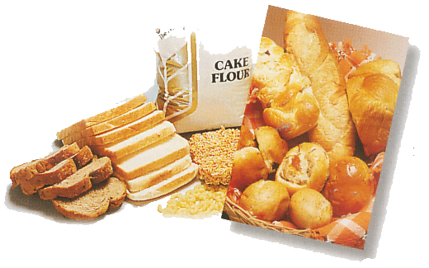
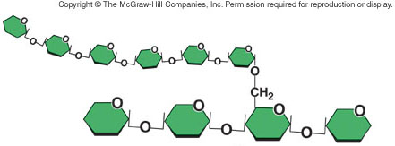
Carbohydrates
Carbohydrates
  Starch
  Cellulose
Both made from linking glucose monomer
Digestion involves the breaking down of starch to glucose molecules that our body use as energy
Glucose : basic unit

Slide 13
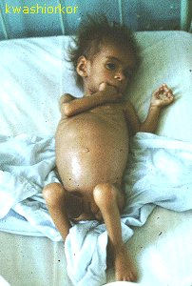
2. Proteins
Proteins are made up of a chain of many different types of amino acids.
Elements
  Carbon
  Hydrogen
  Oxygen
  Nitrogen
  Sulphur
  Phosphorous
Functions:
  Growth and repair
  Enzymes & hormones
  Antibodies (fight diseases)
  Energy
  Deficiency: kwashiorkor

Slide 14
Proteins :
Hydrolysis & Condensation
AMINO
ACID
PROTEIN
POLYPEPTIDE
Hydrolysis
Hydrolysis
Condensation
H₂O
Chemical Structure of Amino Acids
|
H₂N-C-COOH
|
H₂N-C-COOH

Slide 15


3. Fats
Fats are made up of fatty acids and glycerol.
Elements:
  Carbon
  Hydrogen
  Oxygen
Functions:
Storage / source of energy
  Insulation
  Medium for intake of fat soluble vitamins (A,D,E,K)
  Synthesis of cell membranes
  Protects organs from injury

Slide 16
Fats :
Hydrolysis and Condensation
Hydrolysis
Lipase
+ H₂O
+
Condensation
Fat molecule
Glycerol
3 Fatty Acids

Slide 17
FOOD TESTS
Test for
(1) Carbohydrates (Benedict’s Test)
(2) Protein (Biuret’s Test)
(3) Fat ( Emulsion Test)
(4) Starch (Iodine Test)
Click here to watch:
http://www.youtube.com/watch?v=4UjHuvhXXo0&feature=channel_page

Slide 18
Tests for Carbohydrates:
i) Benedict’s Test for Reducing Sugars
  Heat 2 cm³ of sugar solution and 2 cm³ Benedict’s solution in a boiling water bath.
  Red precipitate is obtained when reducing sugars are present (e.g glucose, fructose, galactose, maltose, lactose EXCEPT sucrose)
ii) Starch Test
  Iodine changes from yellow brown to blue black in the presence of starch.

Slide 19
Biuret Test (Protein)
  2 cm³ of Protein solution + 2 cm³ of Sodium hydroxide solution + 1% Copper sulphate added drop by drop, mixing after each drop.
  Solution turns violet when protein is present.

Slide 20
Emulsion Test (Fats)
  Add 2 cm³ ethanol to a chopped sample of the food to be tested.
  Mix to dissolve the fats.
  Decant the ethanol into a clean dry test tube.
  Add 2 cm³ of water to the ethanol.
  If a white emulsion is formed, fats are present

Slide 21

5. Dietary Fibre
Made of cellulose fibres and lignin that cannot be digested by humans.
Functions:
  Prevents constipation
  Adds bulk to assist in peristalsis (stimulates muscles in the gut to contract)
  Absorbs water / retains water therefore softer faeces for easy defecation.

Slide 22
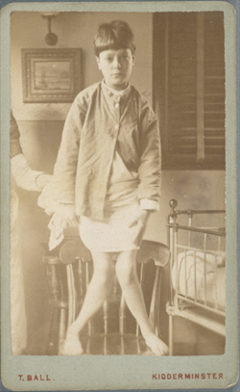
6. Vitamin D
  - Functions
    Absorption of calcium & phosphorous
    Maintain bone and teeth
  Deficiency
    Slight : increased tooth decay
    Severe: Rickets & Bow Legs (Bones do not harden)
  Excess
    Calcification of soft tissues (e.g. kidneys)

Slide 23
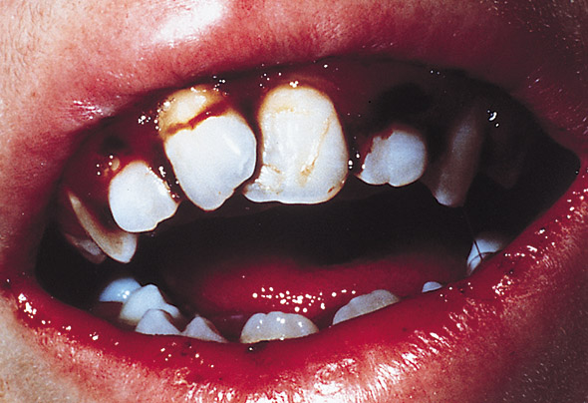
Vitamin C (destroyed by heat / cooking)
  Functions
    Keeps epithelial tissue healthy
    Helps with wound healing
    Helps with iron absorption
  Deficiency
    Scurvy (Swollen bleeding gums & loose teeth)
    Bleeding under the skin
    Slow healing wounds
  Excess
    Excreted

Slide 24
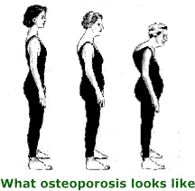
7. Minerals - Calcium
Function:
- Develop strong bones and teeth
  Muscle contraction
  Blood clotting
Deficiency
  Rickets
  Osteoporosis
  Slow blood clotting

Slide 25
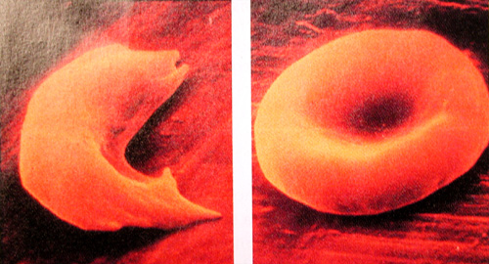
Minerals - Iron
Source
  Liver, Red meat (beef), Egg yolk, Dark green vegetables
Function:
  Essential for the formation of haemoglobin for transport of oxygen around the body.
Deficiency:
  Anaemia (smaller and fewer red blood cells
  Tiredness
  Breathlessness.

Slide 26
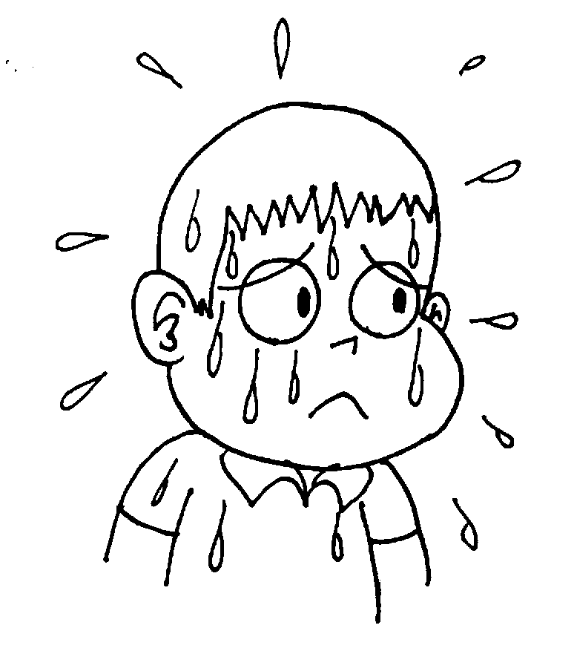
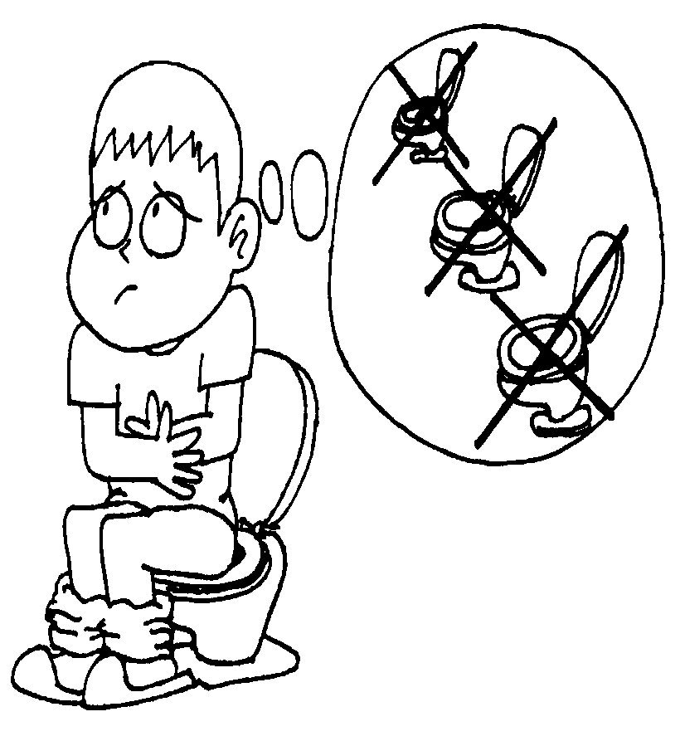

Slide 27
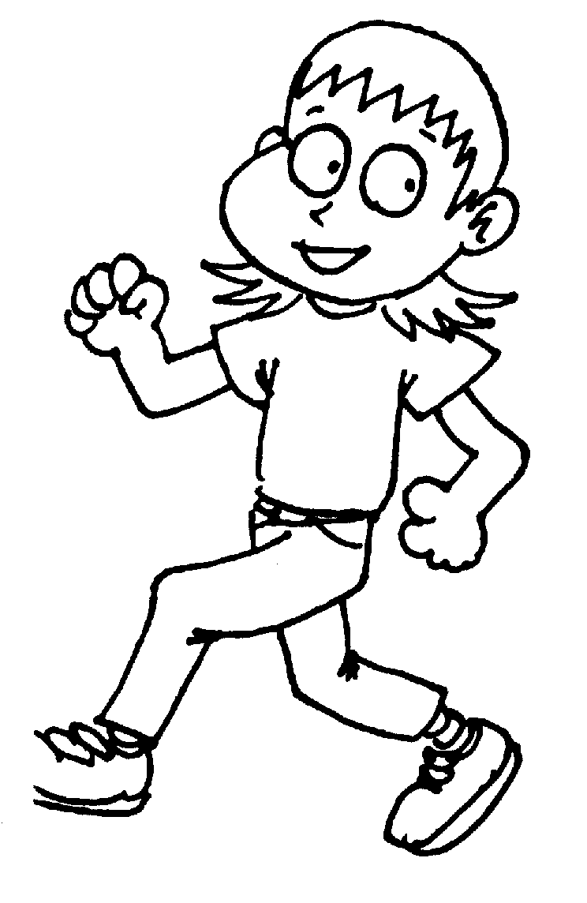
What is a Balanced Diet?
Right amounts of nutrients, such as carbohydrates, proteins, fats, vitamins, minerals, water and fibre to meet the daily requirements of the body.

Slide 28
Energy Balance
Food Energy
Heat
Physical Activity
Basal Metabolism

Slide 29

Basal Metabolic Rate
The amount of energy needed to carry on vital life processes of the body when it is at complete rest.
e.g heartbeat, circulation, breathing, brain functions and other essential reactions in the organs.

Slide 30
Basal Metabolic Rate Depends On:
Climate – higher in colder climates
Body Size – More energy is needed for bigger people.
Age – Energy is needed for growth (Table 5.3)
Sex – Women have more fats to insulate.
Men require more energy to generate more heat.
Health – The thyroid gland secretes thyroxine which speeds up the metabolic rate.
*Growing children and pregnant mothers have higher basal metabolic rate than older people.

Slide 31
Malnutrition & Starvation
Dietary Imbalance over a period of time
Starvation
Insufficient energy in diet to meet basic metabolic needs.
Malnutrition
Over Nutrition
Deficiency
Body uses stored glycogen and fats for energy.
E.g.
Constipation
Rickets
Scurvy
Nutritional Anaemia
Kwashiorkor
Saturated Fats
Proteins
Muscle Wasting
Body starts using proteins from skeletal muscles and may even start to use the heart muscles.
Obesity
Liver and Kidney Damage
Weakened Heart
Arteriosclerosis
Heart Disease
Diabetes
Shorter Life Expectancy
Stroke

Slide 32
Lesson Objectives :
List the chemical elements which make up carbohydrates, proteins and fats.
Describe how to test for starch, reducing sugars, proteins and fats
List the principal sources of, and describe the importance of carbohydrates, fats, proteins, vitamins C & D, mineral salts (iron and calcium), roughage and water.
Describe the deficiency symptoms of Vitamin C nd Vitamin D, Calcium and Iron

Slide 33
Lesson Objectives:
Explain why organisms need food
What is a balanced diet?
Explain why diet, especially energy intake should be related to age, sex and activity of an individual
State the problems and effects of malnutrition in relation to starvation, heart disease, constipation and obesity.

