Slide 1
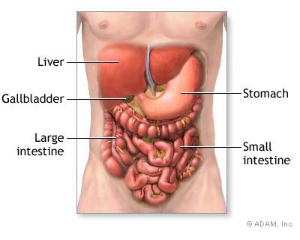
Human Digestion

Slide 2
Nutrition
Process by which organisms obtain and utilize their food.
There are two parts to Nutrition:
1. Ingestion- process of taking food into the digestive system so that it may be hydrolized or digested.
2. Digestion- the breakdown of food (either chemically or mechanically) in order to utilize nutrients

Slide 3



Types of Nutrients
Micronutrients- vitamins, minerals, & water
Macronutrients- proteins, lipids, carbohydrates, etc…

Slide 4
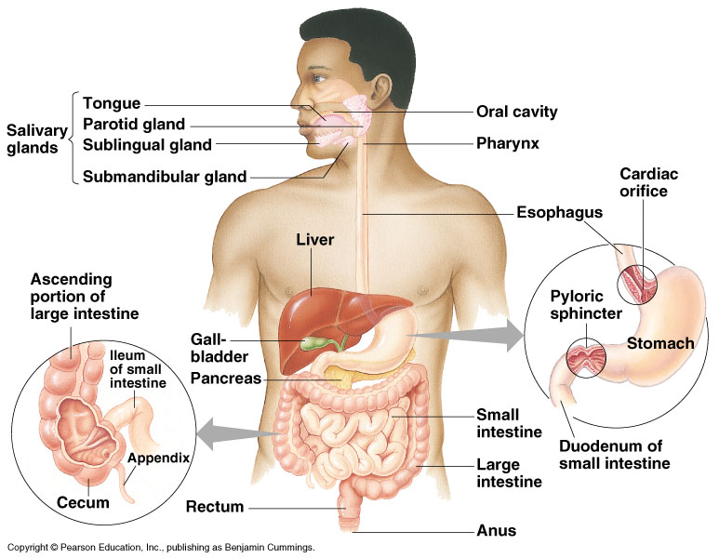
Human digestive system
Notes:
After chewing and swallowing, it takes 5 to 10 seconds for food to pass down the esophagus to the stomach, where it spends 2 to 6 hours being partially digested.
Final digestion and nutrient absorption occur in the small intestine over a period of 5 to 6 hours.
In 12 to 24 hours, any undigested material passes through the large intestine, and feces are expelled through the anus.

Slide 5
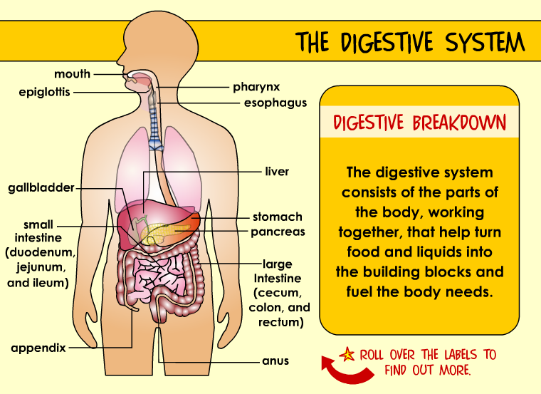
GI (gastrointestinal) tract = alimentary canal

Slide 6
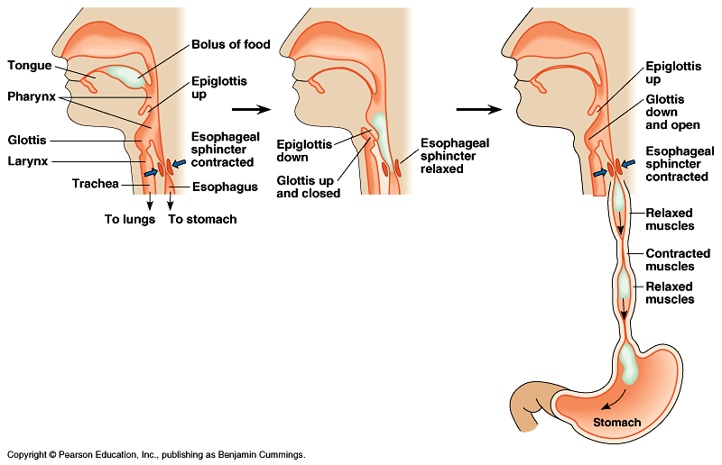
Ingestion
Mouth
  mechanical digestion
    teeth
      breaking up food
  chemical digestion
    saliva
      amylase
        enzyme digests starch
      mucin
        slippery protein (mucus)
        protects soft lining of digestive system
        lubricates food for easier swallowing
      buffers
        neutralizes acid to prevent tooth decay
      anti-bacterial chemicals
        kill bacteria that enter mouth with food

Slide 7
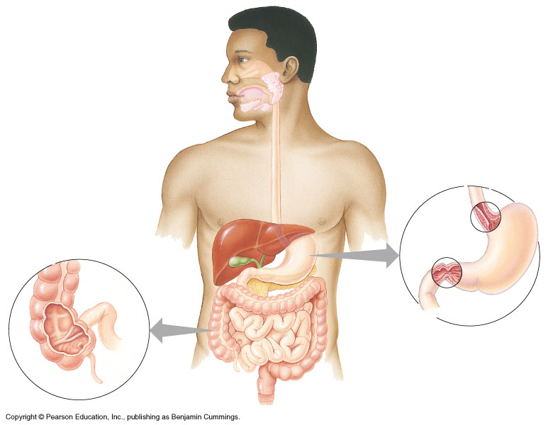
mouth
▪break up food
▪digest starch
▪kill germs
▪moisten food

Slide 8


Mouth
Chemical and mechanical digestion.
Food is chewed (masticated) mechanically.
A bolus (lump) is formed with saliva and the tongue.

Slide 9
Swallowing (& not choking)
Epiglottis
  flap of cartilage
  closes trachea (windpipe) when swallowing
  food travels down esophagus
Peristalsis
  involuntary muscle contractions to move food along

Slide 10
Which type of digestion is the following?
Mechanical
Chewing a saltine? -
2. Saliva breaking the saltine down into molecules of glucose? -
3. Your tongue breaking pieces of a hamburger apart?
4. Pepsin (an enzyme) in your stomach breaking the hamburger into amino acids?
Chemical
Mechanical
Chemical

Slide 11
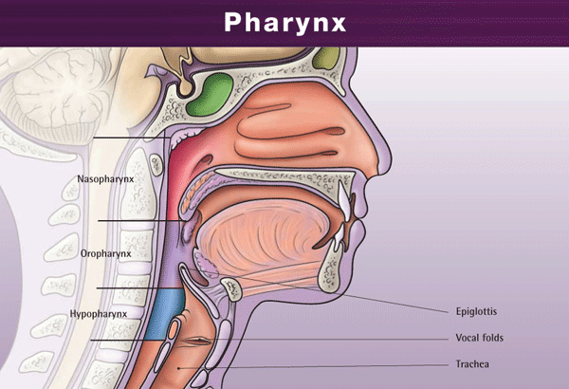
Pharynx
The back of the throat.
Larynx- passage for air, closes when we swallow.
Is approximately 15cm long.

Slide 12
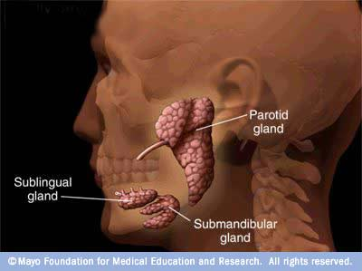
Digestive Glands
Groups of specialized secretory cells.
Found in the lining of the alimentary canal or accessory organs.

Slide 13
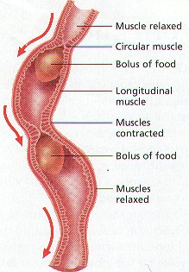
Peristalsis
series of involuntary wave-like muscle contractions which move food along the digestive tract

Slide 14

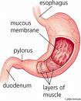
Stomach
Food is temporarily stored here.
Gastric juices are secreted.
Has layers of muscle that line the inside.
Mechanically and chemically breaks down food.

Slide 15
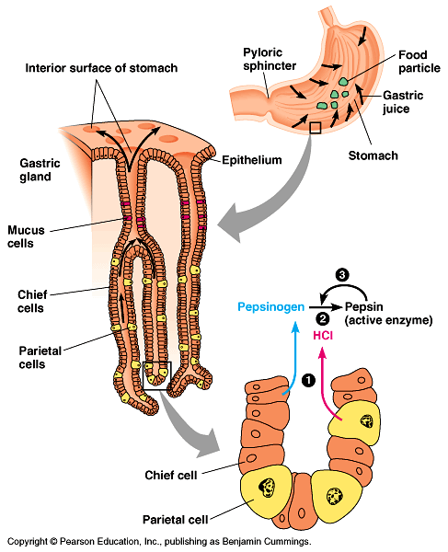
Stomach
Functions
  food storage
    can stretch to fit ~2L food
  disinfect food
    HCl = pH 2
      kills bacteria
  chemical digestion
    pepsin
      enzyme breaks down proteins
But the stomach is made out of protein!
What stops the stomach from digesting itself?
mucus secreted by stomach cells protects stomach lining
Notes:
Still, the epithelium is continually eroded, and the epithelium is completely replaced by mitosis every three days.
Gastric ulcers, lesions in the stomach lining, are caused by the acid-tolerant bacterium Heliobacter pylori.
Ulcers are often treated with antibiotics.
Pepsin is secreted in an inactive form, called pepsinogen by specialized chief cells in gastric pits.
Parietal cells, also in the pits, secrete hydrochloric acid which converts pepsinogen to the active pepsin only when both reach the lumen of the stomach, minimizing self-digestion.
Also, in a positive-feedback system, activated pepsin can activate more pepsinogen molecules.

Slide 16
mouth
▪break up food
▪digest starch
▪kill germs
▪moisten food
stomach
▪kills germs
▪break up food
▪digest proteins
▪store food
sphincter
sphincter

Slide 17

Gastric Juices
Secreted by the stomach.
Acidic (pH 1.5-2.5) (HCl).
Pepsin- an enzyme that breaks down large proteins into amino acids.
Food is further broken down into a thin liquid called chyme.

Slide 18
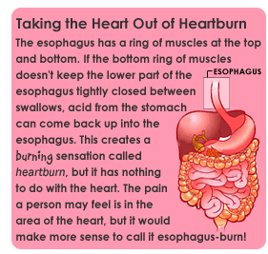

Slide 19
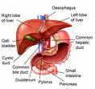
Accessory Organs
Pancreas
Gall Bladder
Spleen

Slide 20
Gall bladder
Pouch structure located near the liver which concentrates and stores bile
Bile duct – a long tube that carries BILE. The top half of the common bile duct is associated with the liver, while the bottom half of the common bile duct is associated with the pancreas, through which it passes on its way to the intestine.

Slide 21
BILE
Bile emulsifies lipids (physically breaks apart FATS)
Bile is a bitter, greenish-yellow alkaline fluid, stored in the gallbladder between meals and upon eating is discharged into the duodenum where it aids the process of digestion.

Slide 22
Pancreas
An organ which secretes both digestive enzymes (exocrine) and hormones (endocrine)
** Pancreatic juice digests all major nutrient types.
Nearly all digestion occurs in the small intestine & all digestion is completed in the SI.

Slide 23
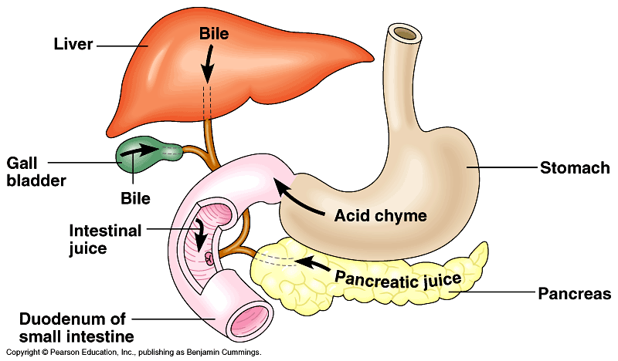
Pancreas
Digestive enzymes
  digest proteins
    trypsin, chymotrypsin
  digest starch
    amylase
Buffers
  neutralizes
  acid from
  stomach

Slide 24
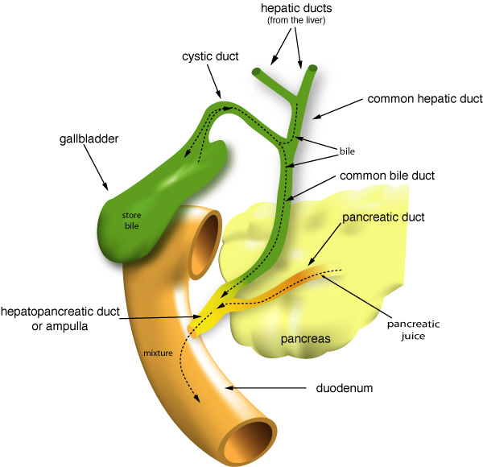

Slide 25
Liver
Function
  produces bile
    bile stored in gallbladder until needed
    breaks up fats
      act like detergents to breakup fats
bile contains colors from old red blood cells collected in liver =
iron in RBC rusts & makes feces brown

Slide 26
mouth
▪break up food
▪digest starch
▪kill germs
▪moisten food
stomach
▪kills germs
▪break up food
▪digest proteins
▪store food
liver
▪produces bile
- stored in gall bladder
▪break up fats
pancreas
▪produces enzymes to
digest proteins & starch

Slide 27

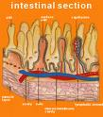
Small Intestine
Most chemical digestion takes place here.
Simple sugars and proteins are absorbed into the inner lining.
Fatty acids and glycerol go to lymphatic system.
Lined with villi, which increase surface area for absorption, one cell thick.

Slide 28
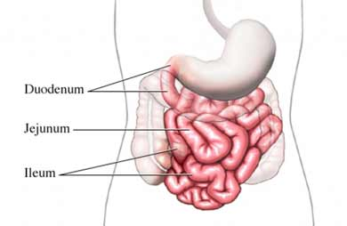
Small intestine
Function
  chemical digestion
    major organ of digestion & absorption
  absorption through lining
    over 6 meters!
    small intestine has huge surface area = 300m² (~size of tennis court)
Structure
  3 sections
    duodenum = most digestion
    jejunum = absorption of nutrients & water
    ileum = absorption of nutrients & water
Notes:
About every 20 seconds, the stomach contents are mixed by the churning action of smooth muscles.
As a result of mixing and enzyme action, what begins in the stomach as a recently swallowed meal becomes a nutrient-rich broth known as acid chyme.
At the opening from the stomach to the small intestine is the pyloric sphincter, which helps regulate the passage of chyme into the intestine.
A squirt at a time, it takes about 2 to 6 hours after a meal for the stomach to empty.

Slide 29
Duodenum
1st section of small intestines
  acid food from stomach
  mixes with digestive juices from:
pancreas
liver
gall bladder

Slide 30
mouth
▪break up food
▪digest starch
▪kill germs
▪moisten food
stomach
▪kills germs
▪break up food
▪digest proteins
▪store food
pancreas
▪produces enzymes to
digest proteins & starch

Slide 31
Absorption in the SI
Much absorption is thought to occur directly through the wall without the need for special adaptations
Almost 90% of our daily fluid intake is absorbed in the small intestine.
Villi - increase the surface area of the small intestines, thus providing better absorption of materials

Slide 32
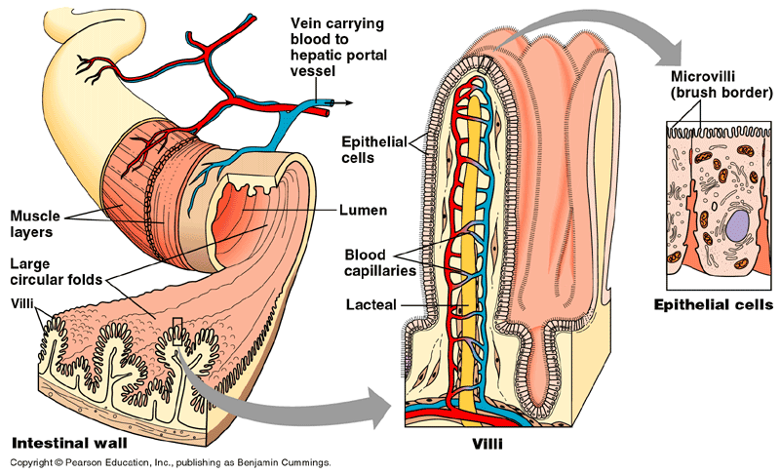
Absorption by Small Intestines
Absorption through villi & microvilli
  finger-like projections
  increase surface area for absorption

Slide 33
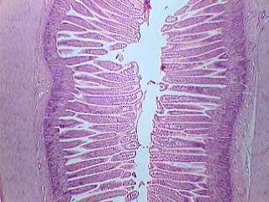
VILLI

Slide 34
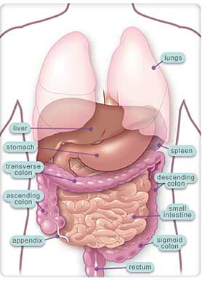
Large intestines (colon)
Function
  re-absorb water
    use ~9 liters of water every
    day in digestive juices
    > 90% of water reabsorbed
      not enough water absorbed
        diarrhea
      too much water absorbed
        constipation

Slide 35
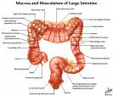
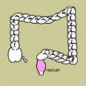
Large Intestine
Solid materials pass through the large intestine.
These are undigestible solids (fibers).
Water is absorbed.
Vitamins K and B are reabsorbed with the water.
Rectum- solid wastes exit the body.

Slide 36
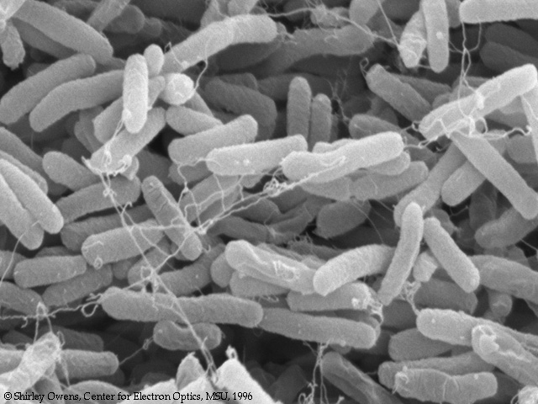
You’ve got company!
Living in the large intestine is a community of helpful bacteria
  Escherichia coli (E. coli)
    produce vitamins
      vitamin K; B vitamins
    generate gases
      by-product of bacterial metabolism
      methane, hydrogen sulfide

Slide 37
Appendix
Vestigial organ

Slide 38
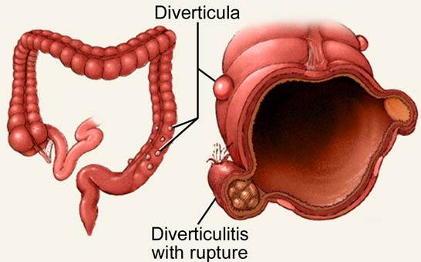
Rectum
Last section of colon (large intestines)
  eliminate feces
    undigested materials
      extracellular waste
        mainly cellulose from plants
        roughage or fiber
      masses of bacteria

Slide 39
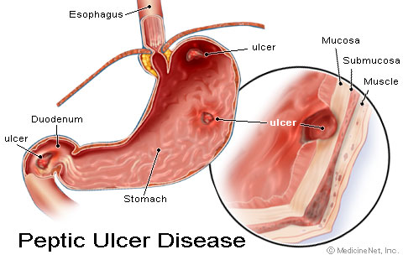
Digestive Homeostasis Disorders
ULCERS – erosion of the surface of the alimentary canal generally associated with some kind of irritant

Slide 40
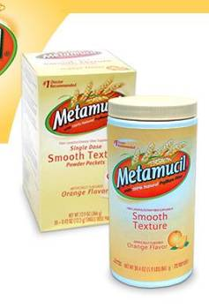
Digestive Homeostasis Disorders
CONSTIPATION – a condition in which the large intestine is emptied with difficulty.
Too much water is reabsorbed
and the solid waste hardens

Slide 41

Digestive Homeostasis Disorders
DIARRHEA – a gastrointestinal disturbance characterized by decreased water absorption and increased peristaltic activity of the large intestine.
This results in increased, multiple, watery feces.
This condition may result in severe dehydration, especially in infants

Slide 42
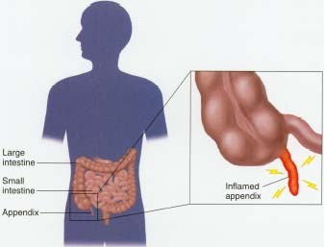
Digestive Homeostasis Disorders
APPENDICITIS – an inflammation of the appendix due to infection
Common treatment is removal of the appendix via surgery

Slide 43
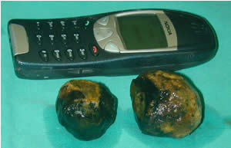
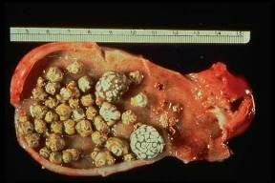
Digestive Homeostasis Disorders
GALLSTONES – an accumulation of hardened cholesterol and/or calcium deposits in the gallbladder
Can either be “passed” (OUCH!!) or surgically removed

Slide 44
Digestive Homeostasis Disorders
ANOREXIA NERVOSA - a psychological condition where an individual thinks they appear overweight and refuses to eat.
Weighs 85% or less than what is developmentally expected for age and height
Young girls do not begin to menstruate at the appropriate age.

Slide 45
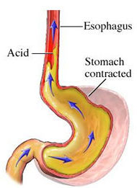
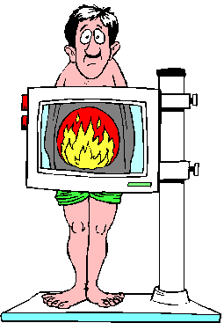
Digestive Homeostasis Disorders
HEART BURN – ACID from the stomach backs up into the esophagus.

Slide 46
Let’s go to the Video!

Slide 47
Digestive System Cadaver

Slide 48
Travel Through the Digestive System

