Slide 1
Modes of Nutrition

Slide 2
Nutrition
Processes by which organisms obtain and use the nutrients required for maintaining life

Slide 3
Modes of nutrition
Ways of obtaining and using nutrients
Nutrition
Autotrophic nutrition
Heterotrophic nutrition
Holozoic nutrition
Saprophytic nutrition
Parasitic nutrition

Slide 4
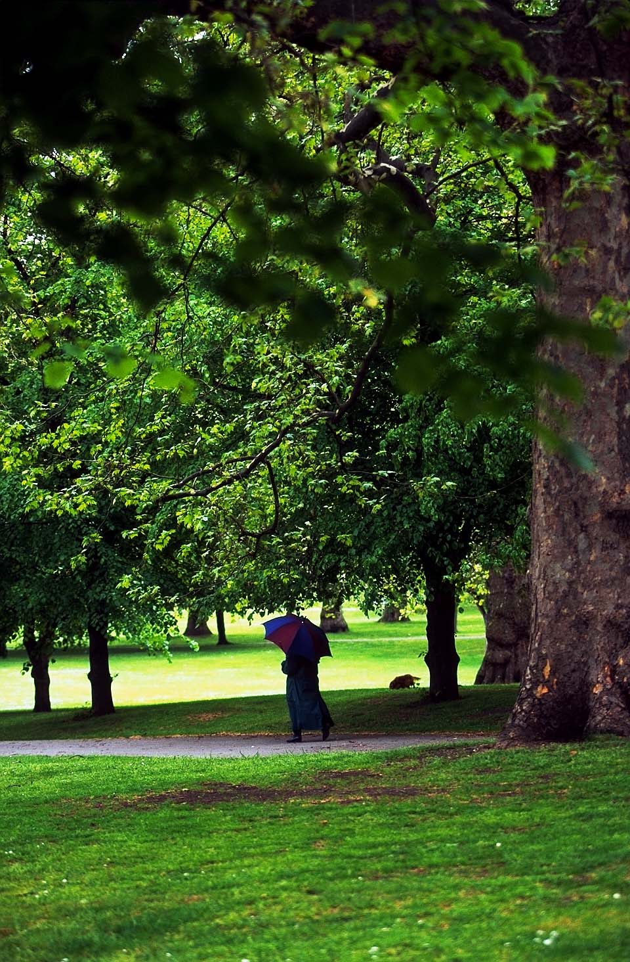
Autotrophic nutrition
Organisms make their own food (complex organic substances) using simple inorganic substances
  Autotrophs
e.g. Green plants
  by photosynthesis

Slide 5
Heterotrophic nutrition
Organisms which depend on other organisms or dead organic matters as their food sources
  Heterotrophs
Cannot make their own food and obtain their food in organic form

Slide 6
Holozoic nutrition
Organisms take in solid organic food from other organisms
  heterotrophs
Food needs to be broken down into small molecules before they can be used by the organisms

Slide 7
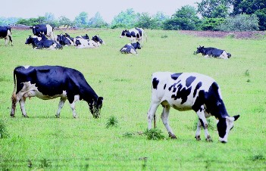
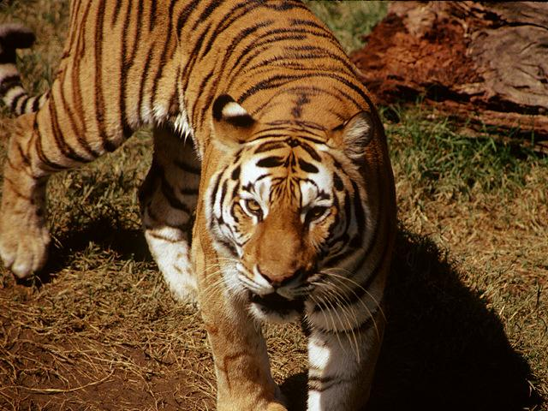
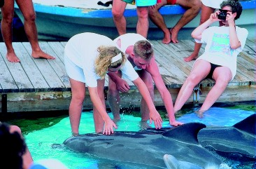
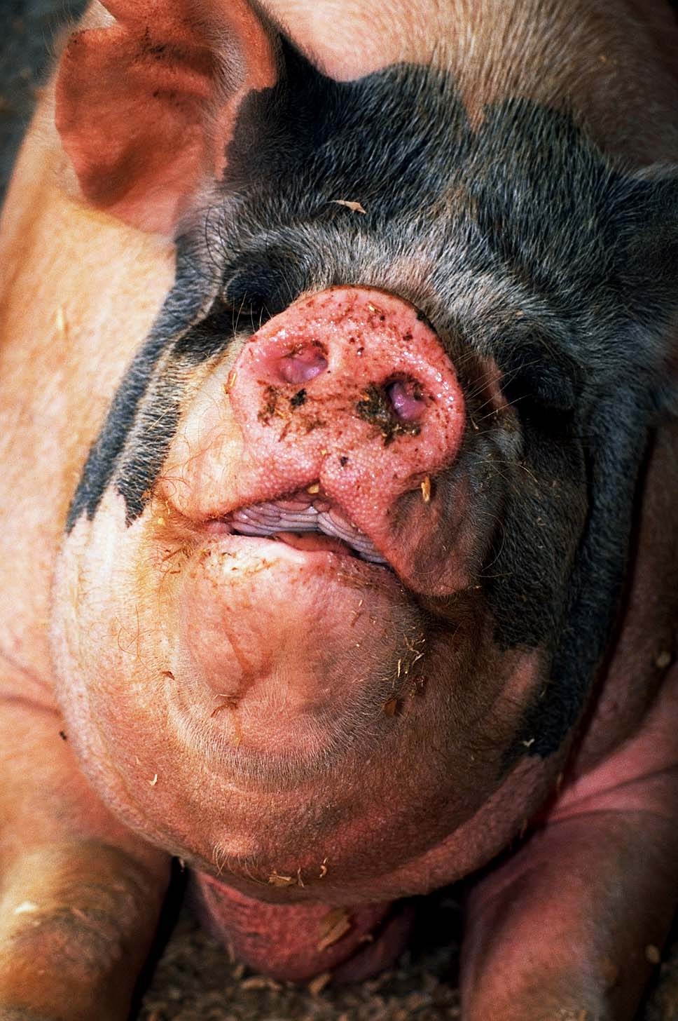
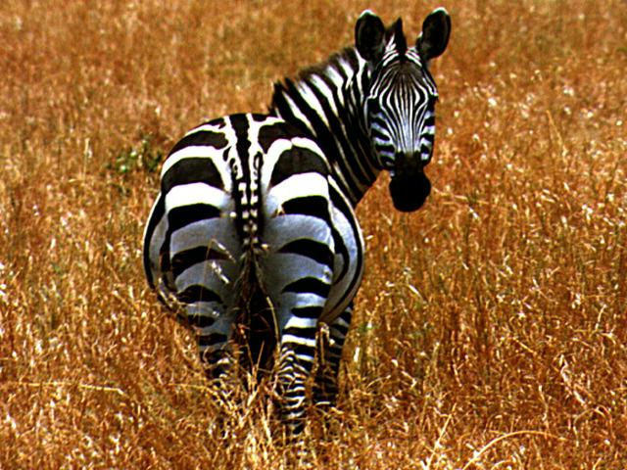
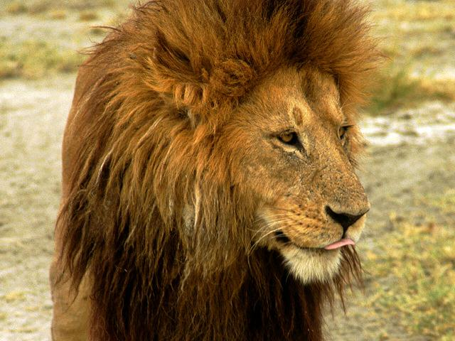

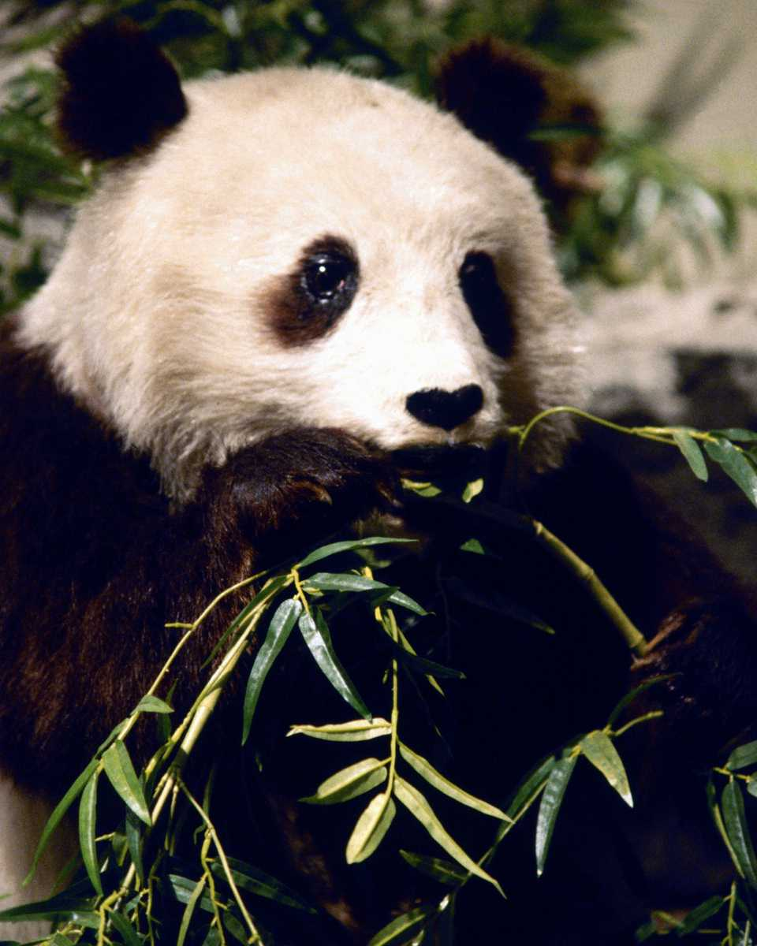
Types of animals taking holozoic nutrition
Herbivores
  Feed on plants only
Carnivores
  Feed on animals only
Omnivores
  Feed on both plants and animals

Slide 8
Saprophytic nutrition
(Saprophytism)
Organisms feed on dead organisms or non-living organic matter
  Saprophytes
  (e.g. fungi, bacteria)

Slide 9
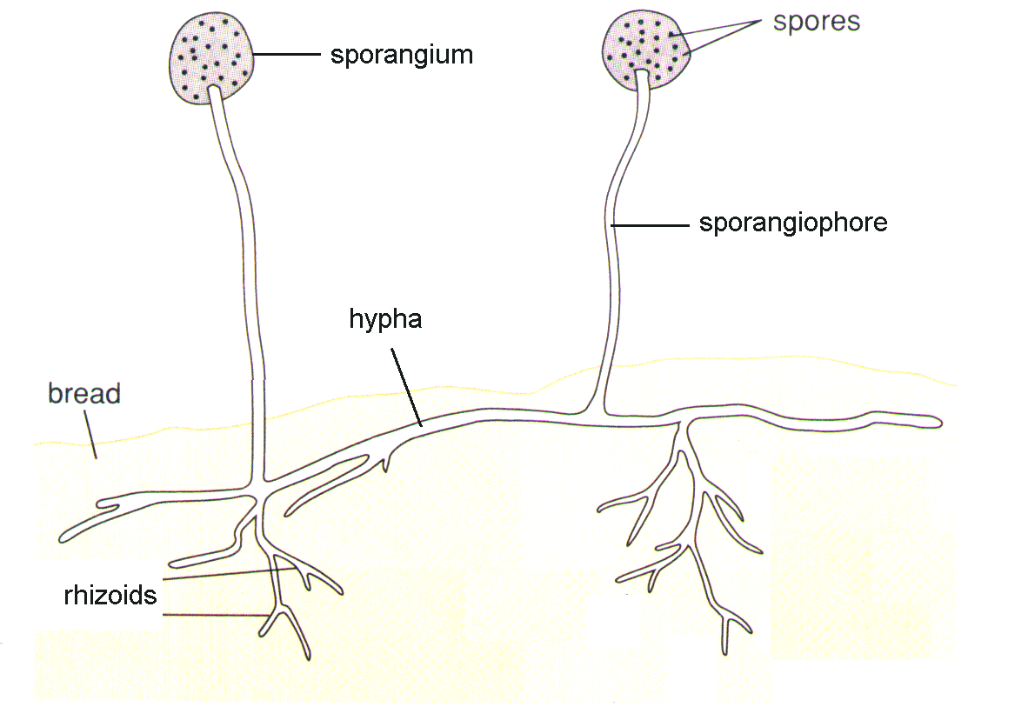
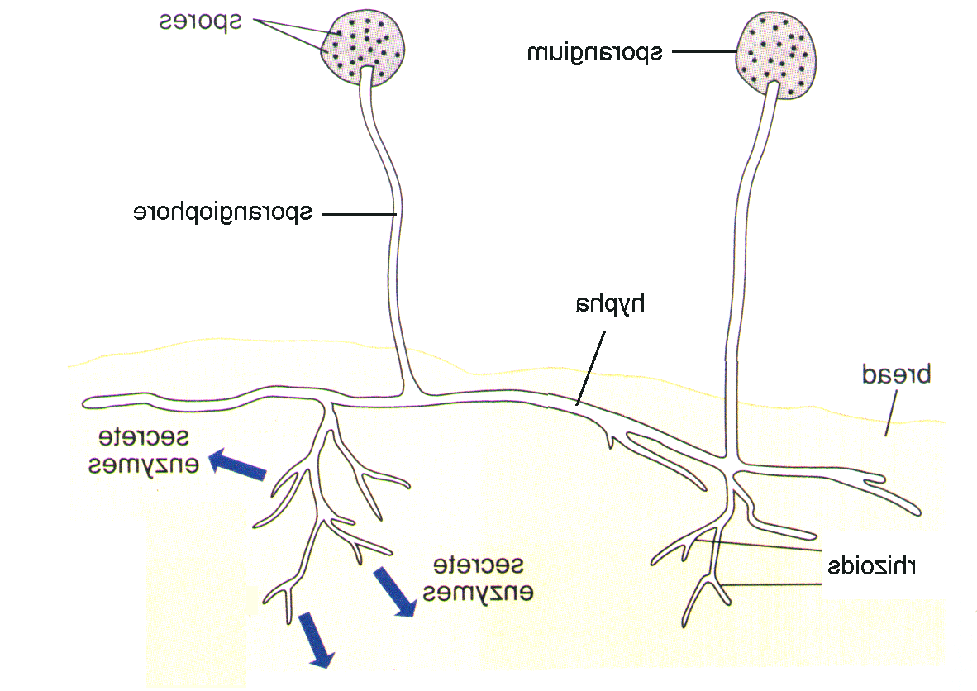
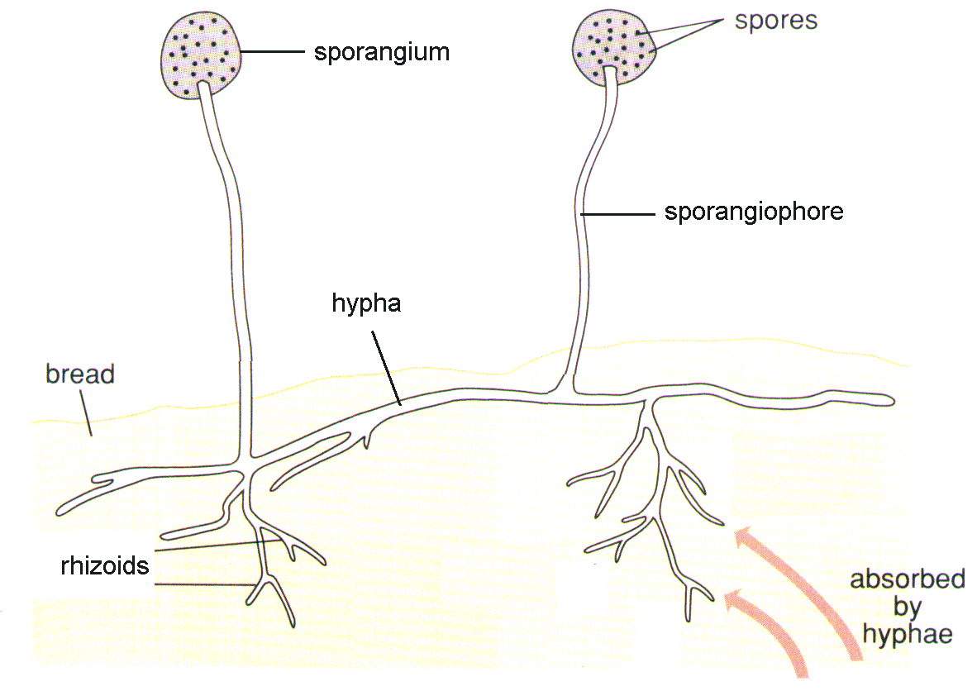
How a saprophyte obtains its nutrients?
Example : Mucor (bread mould)
Rhizoids release enzyme into the bread
Enzymes digest complex organic molecules in bread into simple, soluble molecules
Digested products are absorbed by the rhizoids

Slide 10
Importance of saprophytes
As decomposers
  Allow essential materials (e.g. C, N) to be recycled in the ecosystem

Slide 11
Parasitic nutrition
(Parasitism)
Organisms (parasite) obtain organic compounds from another living organism of a different species (host)
  Parasite is benefited
  Host is harmed

Slide 12
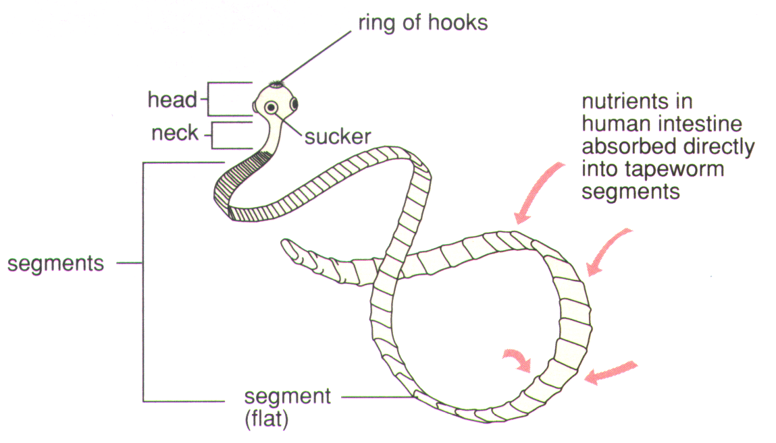
How a tapeworm obtains its nutrient?
Live inside the small intestine of human
Food in small intestine is already digested
∴Can be absorbed directly through the body wall of tapeworm by diffusion

Slide 13
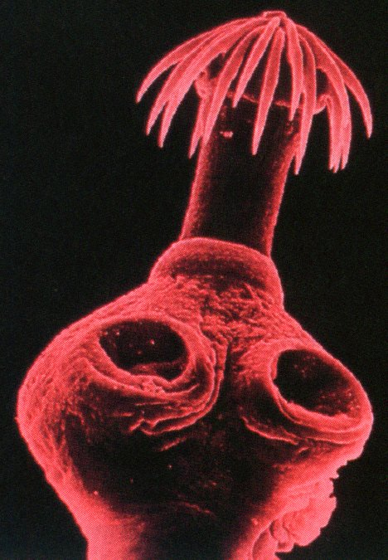
Structural adaptations of tapeworm
Head bears hooks and suckers
  To attach itself to the intestine wall of the host
  ∴Prevent being egested by peristalsis of intestine

Slide 14
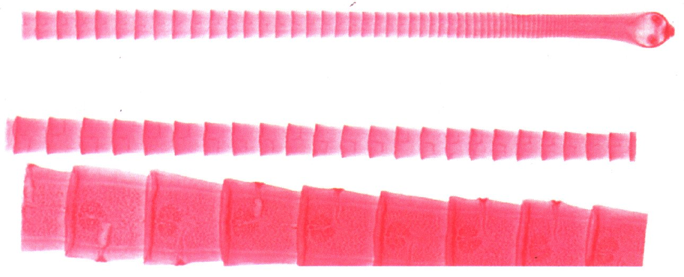
Structural adaptations of tapeworm
Long, flattened body
  To increase the surface area for more absorption of digested food by diffusion
Thin body wall
  To shorten the distance for faster diffusion

Slide 15
Structural adaptations of tapeworm
Body covered by cuticle
  To protect itself from attack of digestive enzymes from the host
No mouth, digestive system
  No needed
Hermaphrodite (bisexual)
  Need not find a mate for reproduction

Slide 16
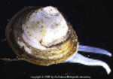
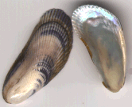
Filter feeder
Bivalves

Slide 17
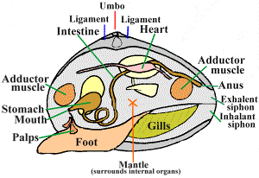
Clam structures

Slide 18
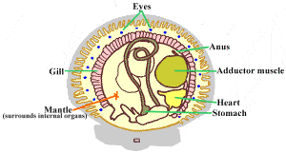
Scallops structures

Slide 19
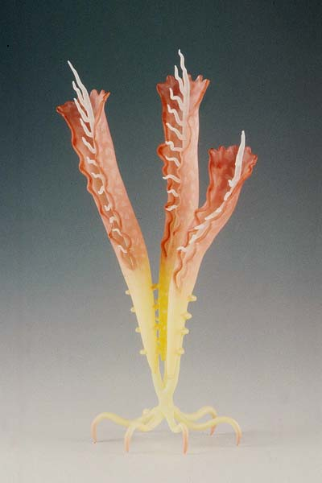
Carol

Slide 20
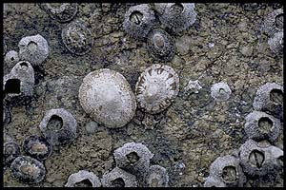
Rock feeder and filter feeder

Slide 21
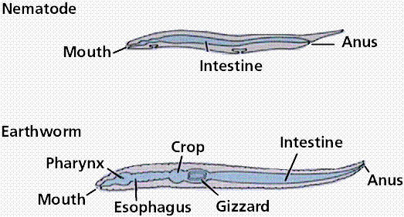
Sand feeder

Slide 22
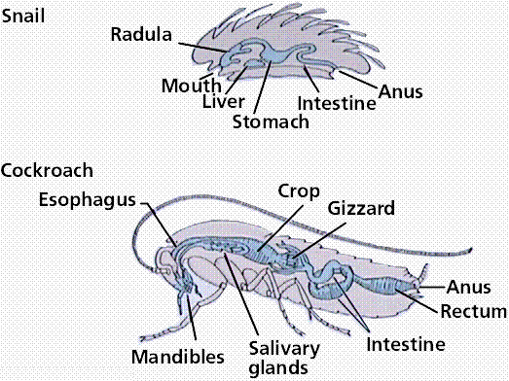
Insect and snail

Slide 23
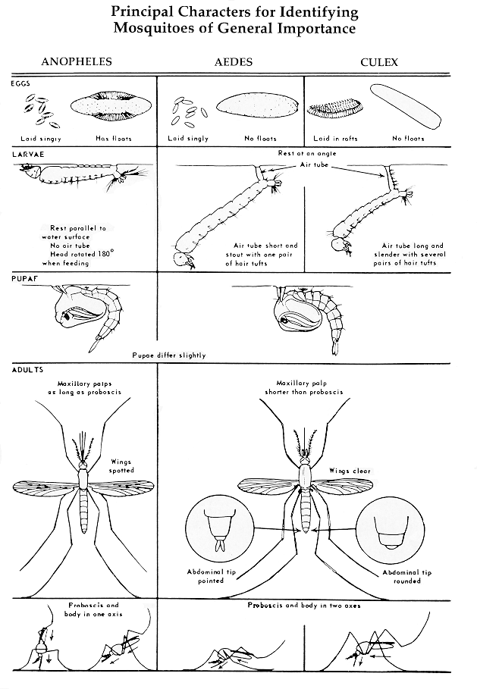

Slide 24
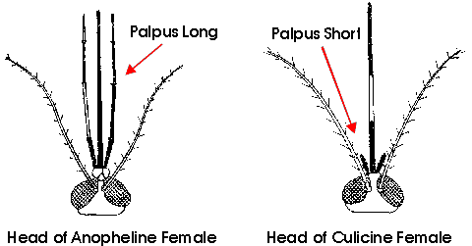
Mosquito head

Slide 25
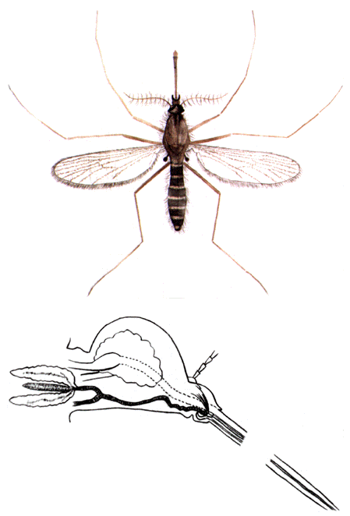
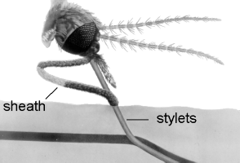
Mouth

Slide 26
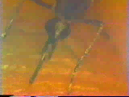
Drilling

Slide 27
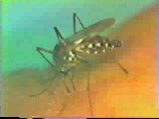
Filling up

Slide 28
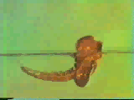
Getting out

Slide 29
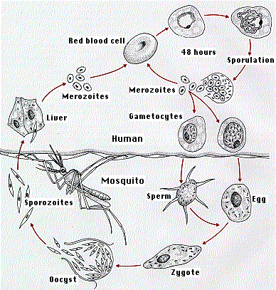
mararia

