Slide 1
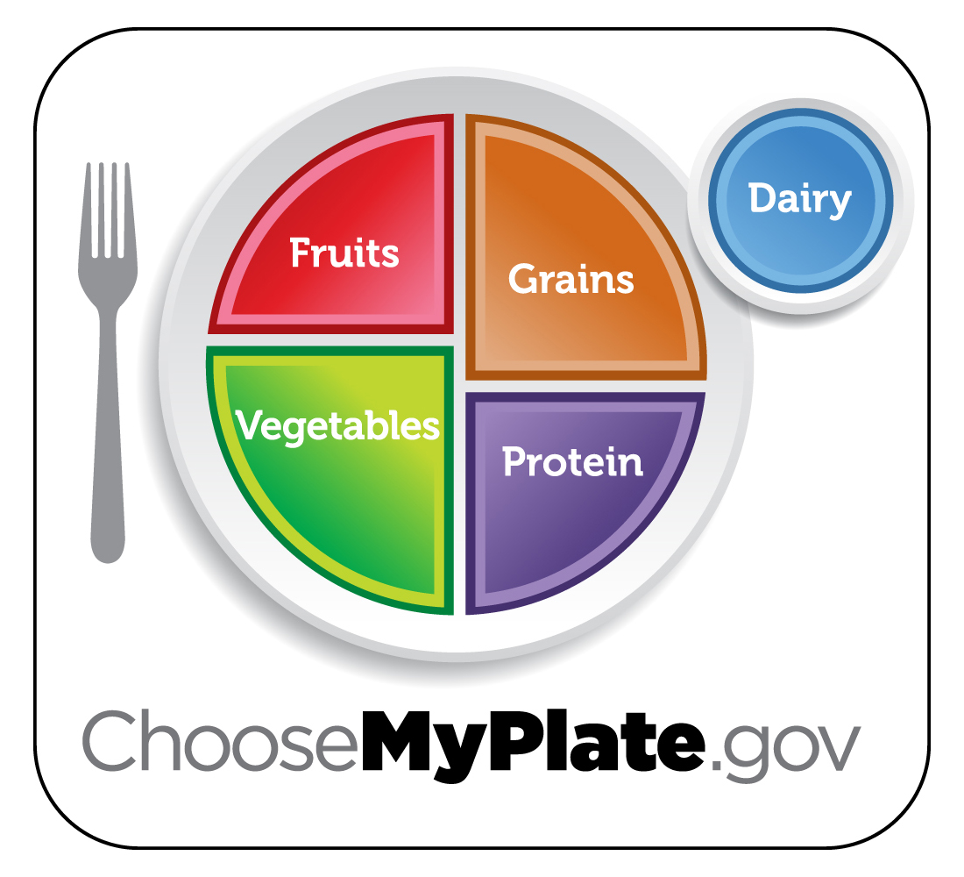
Nutrition

Slide 2
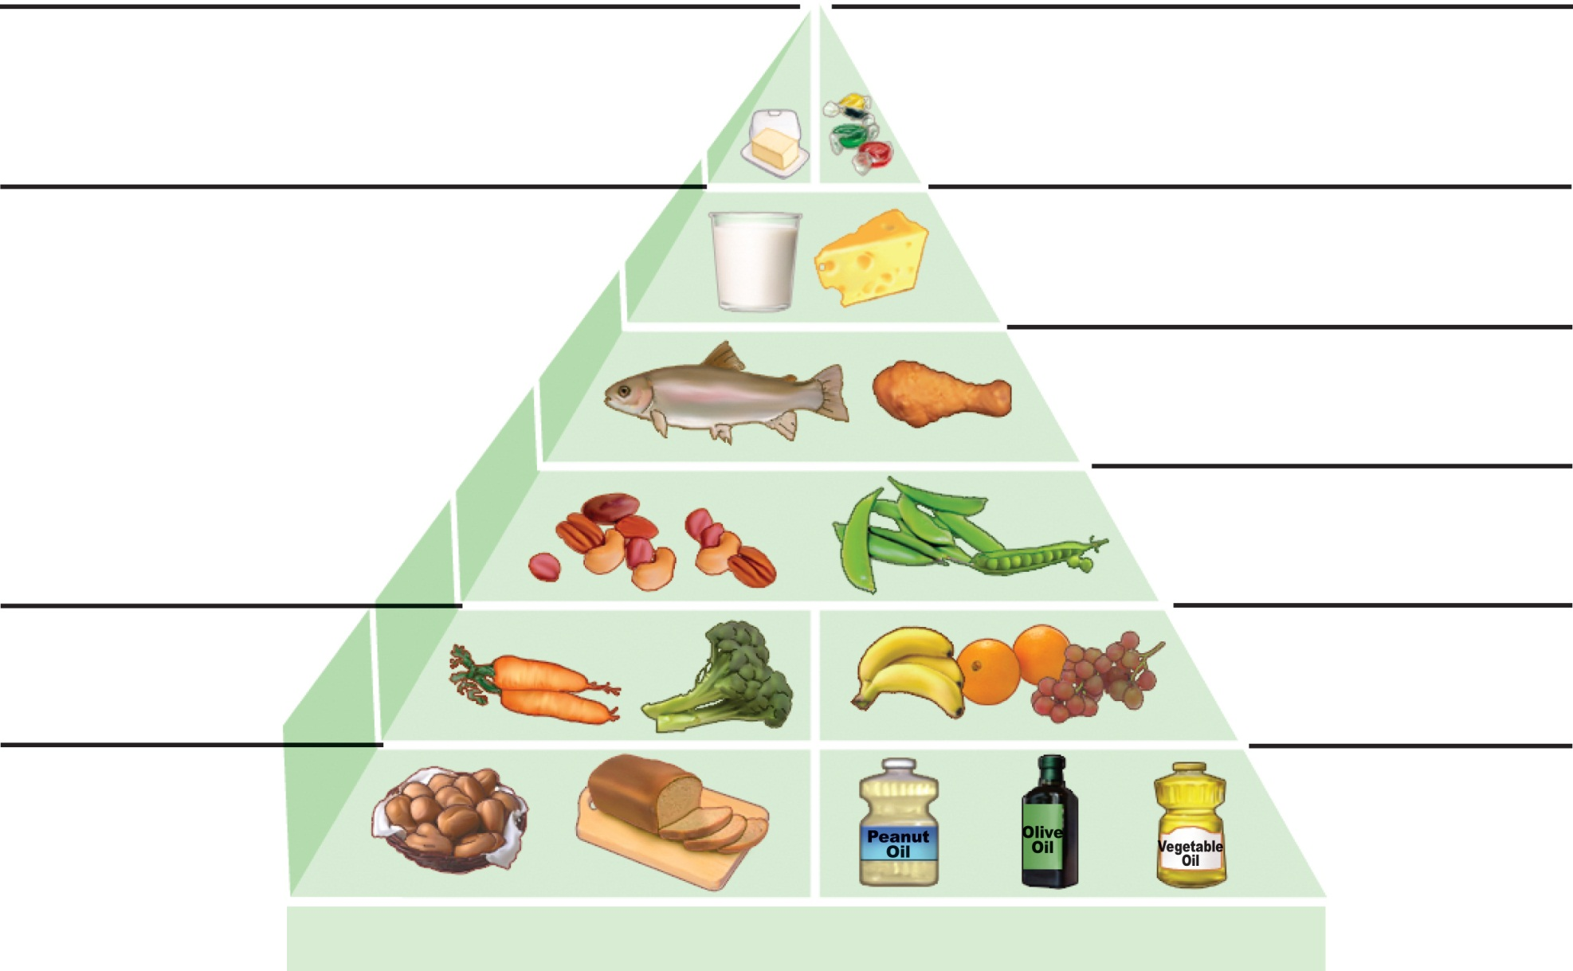
Red meat, butter:
use sparingly
White rice, white bread,
potatoes, pasta, sweets:
use sparingly
Dairy or calcium
supplement: 1–2 servings
Fish, poultry, eggs:
0–2 servings
Nuts, legumes:
1–3 servings
Vegetables in
abundance
Fruits:
2–3 servings
Whole-grain
foods at
most meals
Plant oils
at most
meals
Daily excercise and weight control
(b) Healthy eating pyramid
Figure 24.1b

Slide 3
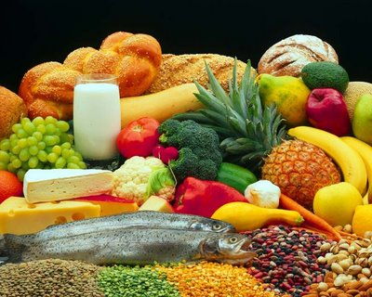
What is a Nutrient?
What are nutrients?
Essential substances that your body needs in order to grow and stay healthy

Slide 4
Nutrients
Some provide energy.
All help build cells and tissues, regulate bodily processes such as breathing.
No single food supplies all the nutrients the body needs to function.

Slide 5
Healthy Diets Require
Six categories of nutrients:
Macronutrients
  Water
  Amino Acids and Proteins
  Lipids
  Carbohydrates
Micronutrients
  Vitamins (B, C, A, D, E, K)
  Minerals (Fe, Ca, P, Na, K)

Slide 6

Water
Solvent in which the chemistry of life occurs
  cell chemistry occurs in an aqueous medium
  water carries essential nutrients to cells
  water carries metabolic wastes away from cells
  hydrolysis & dehydration reaction
  stabilizes body temp
Notes:
Need 1.5 l/day

Slide 7
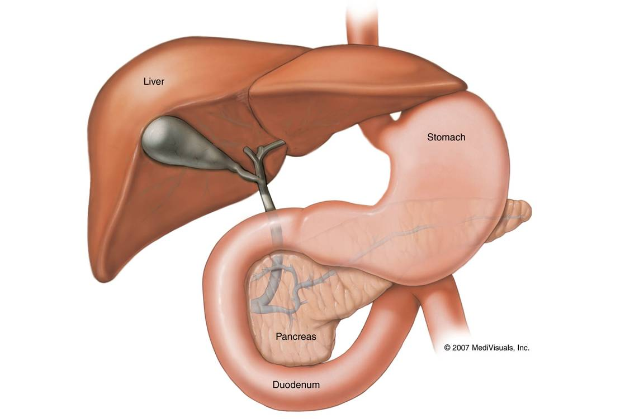
Carbohydrates
Energy Metabolism
  Glucose is the fuel used by cells to make ATP
    Neurons and RBCs rely almost entirely upon glucose
    Excess glucose is converted to glycogen or fat and stored

Slide 8
Carbohydrates
Dietary sources
  Starch (complex carbohydrates) in grains and vegetables
  Sugars in fruits, sugarcane, sugar beets, honey and milk
  Insoluble fiber: cellulose in vegetables; provides roughage
  Soluble fiber: pectin in apples and citrus fruits; reduces blood cholesterol levels

Slide 9
Carbohydrates
Dietary requirements
  Minimum 100 g/day to maintain adequate blood glucose levels
  Recommended minimum 130 g/day
  Recommended intake: 45–65% of total calorie intake; mostly complex carbohydrates

Slide 10
Carbohydrates
Dietary Fiber
  water-insoluble fiber adds bulk to fecal matter facilitating its passage through and elimination from the digestive system
  water-soluble fiber may absorb dietary cholesterol, reducing its absorption by the digestion tract

Slide 11
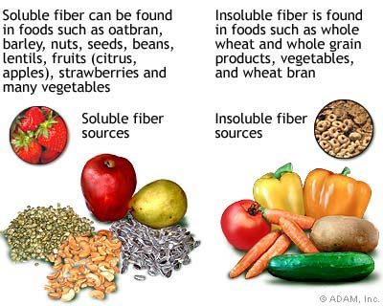
Soluble Fiber
Insoluble Fiber

Slide 12
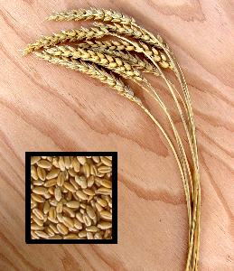
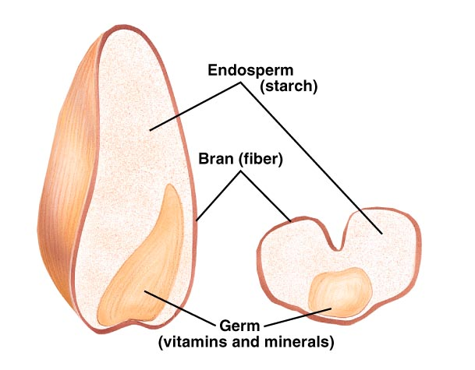
Wheat Seed

Slide 13
Lipids
Dietary sources
  Triglycerides
    Saturated fats in meat, dairy foods, and tropical oils
    Unsaturated fats in seeds, nuts, olive oil, and most vegetable oils
  Cholesterol in egg yolk, meats, organ meats, shellfish, and milk products

Slide 14

Lipids
Essential fatty acids
  Linoleic and linolenic acid, found in most vegetable oils
  Must be ingested

Slide 15
Lipids
Essential uses of lipids in the body
  Help absorb fat-soluble vitamins
  Major fuel of hepatocytes and skeletal muscle
  Phospholipids are essential in myelin sheaths and all cell membranes

Slide 16
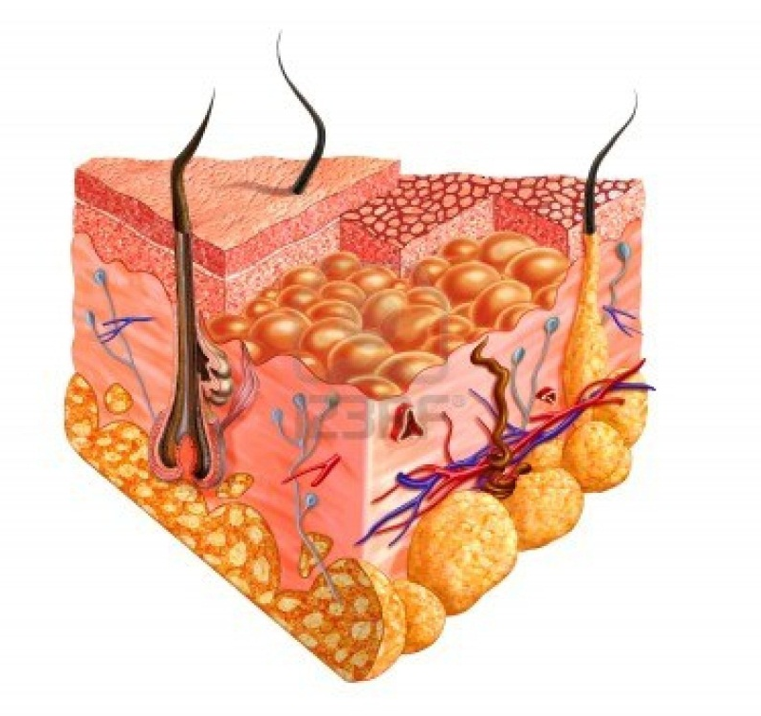
Lipids
Functions of fatty deposits (adipose tissue)
  Protective cushions around body organs
  Insulating layer beneath the skin
  Concentrated source of energy

Slide 17
Lipids
Regulatory functions of prostaglandins
  Smooth muscle contraction
  Control of blood pressure
  Inflammation
Functions of cholesterol
  Stabilizes membranes
  Precursor of bile salts and steroid hormones

Slide 18
Lipids
Dietary requirements suggested by the American Heart Association
  Fats should represent 30% or less of total caloric intake
  Saturated fats should be limited to 10% or less of total fat intake
  Daily cholesterol intake should be no more than 300 mg

Slide 19
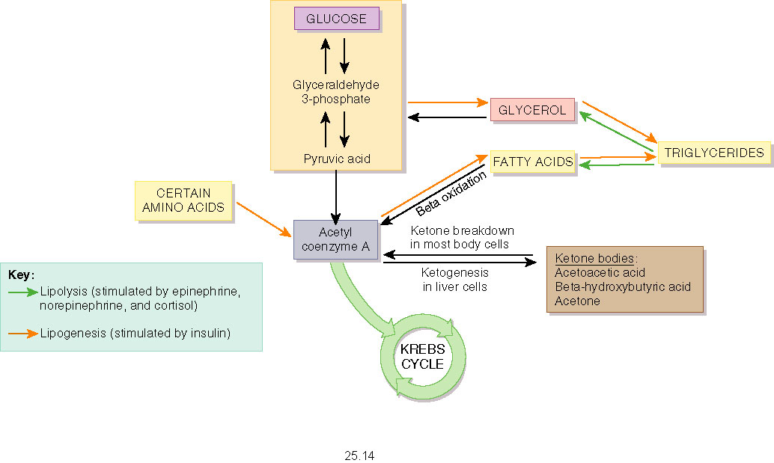
Pathways of Lipid Metabolism

Slide 20
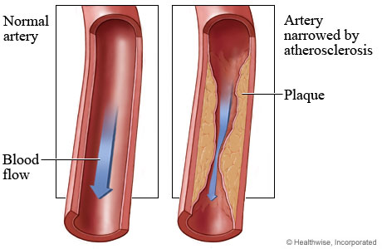
Atherosclerosis
normal
diseased

Slide 21
Your Cholesterol Level
Cholesterol: <175 mg/dl
Triglycerides: blood fats, 30-175 mg/dl
HDL: Good cholesterol, > 35 mg/dl
LDL: Bad Cholesterol, <130 mg/dl
Chol/HDL ratio: < 4.5 indicates heart disease
Notes:
Both types of lipoproteins carry fats around in the blood, but to different places and for different purposes. LDL delivers triglycerides and cholesterol from the liver to tissues, increasing the risk of plaque. In contrast, HDL scavenges excess cholesterol and phospholipids from tissues and returns them to the liver for disposal from the body. As a result, high levels of LDL-cholesterol in the blood indicate increased risk of heart attack, whereas high levels of HDL-cholesterol are associated with lowered risk.
How much is too much and too little? As a general rule, total cholesterol levels should be less than 200 milligrams per deciliter (mg/dl) of blood, ideally less than 160 mg/dl. LDL-cholesterol levels should be less than 130 mg/dl, and ideally less than 100 mg/dl. HDL-cholesterol levels should be at least 35 mg/dl, and ideally 45 mg/dl or higher. If your cholesterol levels are outside these ranges you should see your doctor for a personalized treatment plan which may include cholesterol-lowering medication.
Even with cholesterol-lowering drugs, it's important to adopt life habits that are healthy for your heart. These will help bring a larger drop in your blood cholesterol levels and reduce your risk of heart attack and other chronic diseases.
How does one lower the bad LDL levels without also lowering the good HDL levels? Luckily, the tactics that tend to lower LDL-cholesterol levels usually don't adversely affect HDL-cholesterol. HDL-cholesterol is best raised by increasing activity through exercise, losing weight if you're overweight and quitting smoking if you smoke.
LDL-cholesterol is most affected by diet. The most effective way to lower LDL-cholesterol seems to be to reduce the level of total and saturated fat in the diet. Lowering total fat is not enough; the focus also needs to be on lowering saturated fat levels and replacing some of the saturated fat you eliminate with monounsaturated fat. In food terms this means trimming meats of visible fat, choosing reduced and non-fat dairy products, reading labels, and eliminating or limiting pastries and high-fat desserts. In terms of spreads and salad dressings, it means choosing reduced fat products and ones made with canola, olive or peanut oil. The new margarine products on the market made with sitostanol also can have beneficial cholesterol lowering effects.
And, what about those high-cholesterol foods? Don't they simply turn into cholesterol in the blood? Not exactly. The body primarily uses saturated fat, not dietary cholesterol to make blood cholesterol. After years of "good egg/bad egg" studies, it appears that people respond in different ways to dietary cholesterol. About a third of the population responds to a low-cholesterol diet with reduced blood cholesterol levels. For the rest, the response is minimal. Still, where there's cholesterol, there's usually saturated fat, so prudence is still wise.

Slide 22
Lowering Your Cholesterol Level
Eat healthy
Exercise
Lose wt.
Quit smoking
1 glass of wine or beer
Medications (Lipitor)
Notes:
Cholesterol
AHA Scientific Position Cholesterol is a soft, waxy substance found among the lipids (fats) in the bloodstream and in all your body's cells. It's an important part of a healthy body because it's used to form cell membranes, some hormones and is needed for other functions. But a high level of cholesterol in the blood -- hypercholesterolemia -- is a major risk factor for coronary heart disease, which leads to heart attack.
Cholesterol and other fats can't dissolve in the blood. They have to be transported to and from the cells by special carriers called lipoproteins. There are several kinds, but the ones to focus on are low-density lipoprotein (LDL) and high-density lipoprotein (HDL).
What is LDL cholesterol?
Low-density lipoprotein is the major cholesterol carrier in the blood. If too much LDL cholesterol circulates in the blood, it can slowly build up in the walls of the arteries feeding the heart and brain. Together with other substances it can form plaque, a thick, hard deposit that can clog those arteries. This condition is known as atherosclerosis. A clot (thrombus) that forms near this plaque can block the blood flow to part of the heart muscle and cause a heart attack. If a clot blocks the blood flow to part of the brain, a stroke results. A high level of LDL cholesterol (160 mg/dL and above) reflects an increased risk of heart disease. That's why LDL cholesterol is called "bad" cholesterol. Lower levels of LDL cholesterol reflect a lower risk of heart disease.
What is HDL cholesterol?
About one-third to one-fourth of blood cholesterol is carried by HDL. Medical experts think HDL tends to carry cholesterol away from the arteries and back to the liver, where it's passed from the body. Some experts believe HDL removes excess cholesterol from plaques and thus slows their growth. HDL cholesterol is known as "good" cholesterol because a high HDL level seems to protect against heart attack. The opposite is also true: a low HDL level (less than 40 mg/dL) indicates a greater risk. A low HDL cholesterol level also may raise stroke risk.
What is Lp(a) cholesterol?
Lp(a) is a genetic variation of plasma LDL. A high level of Lp(a) is an important risk factor for developing atherosclerosis prematurely. How an increased Lp(a) contributes to heart disease isn't clear. The lesions in artery walls contain substances that may interact with Lp(a), leading to the buildup of fatty deposits.
What about cholesterol and diet?
People get cholesterol in two ways. The body -- mainly the liver -- produces varying amounts, usually about 1,000 milligrams a day. Foods also can contain cholesterol. Foods from animals (especially egg yolks, meat, poultry, fish, seafood and whole-milk dairy products) contain it. Foods from plants (fruits, vegetables, grains, nuts and seeds) don't contain cholesterol.
Typically the body makes all the cholesterol it needs, so people don't need to consume it. Saturated fatty acids are the main culprit in raising blood cholesterol, which increases your risk of heart disease. Trans-fats also raise blood cholesterol. But dietary cholesterol also plays a part. The average American man consumes about 337 milligrams of cholesterol a day; the average woman, 217 milligrams.
Some of the excess dietary cholesterol is removed from the body through the liver. Still, the American Heart Association recommends that you limit your average daily cholesterol intake to less than 300 milligrams. If you have heart disease, limit your daily intake to less than 200 milligrams. Still, everyone should remember that by keeping their dietary intake of saturated fats low, they can significantly lower their dietary cholesterol intake. Foods high in saturated fat generally contain substantial amounts of dietary cholesterol.
People with severe high blood cholesterol levels may need an even greater reduction. Since cholesterol is in all foods from animal sources, care must be taken to eat no more than six ounces of lean meat, fish and poultry per day and to use fat-free and low-fat dairy products. High-quality proteins from vegetable sources such as beans are good substitutes for animal sources of protein.
How does exercise (physical activity) affect cholesterol?
Exercise increases HDL cholesterol in some people. A higher HDL cholesterol is linked with a lower risk of heart disease. Exercise can also help control weight, diabetes and high blood pressure. Exercise that uses oxygen to provide energy to large muscles (aerobic exercise) raises your heart and breathing rates. Regular moderate to intense exercise such as brisk walking, jogging and swimming also condition your heart and lungs.
Physical inactivity is a major risk factor for heart disease. Even moderate-intensity activities, if done daily, help reduce your risk. Examples are walking for pleasure, gardening, yard work, housework, dancing and prescribed home exercise.
How does tobacco smoke affect cholesterol?
Tobacco smoke is one of the six major risk factors of heart disease that you can change or treat. Smoking lowers HDL cholesterol levels.
How does alcohol affect cholesterol?
In some studies, moderate use of alcohol is linked with higher HDL cholesterol levels. However, because of other risks, the benefit isn't great enough to recommend drinking alcohol if you don't do so already.
If you drink, do so in moderation. People who consume moderate amounts of alcohol (an average of one to two drinks per day for men and one drink per day for women) have a lower risk of heart disease than nondrinkers. However, increased consumption of alcohol brings other health dangers, such as alcoholism, high blood pressure, obesity, stroke, cancer, suicide, etc. Given these and other risks, the American Heart Association cautions people against increasing their alcohol intake or starting to drink if they don't already do so. Consult your doctor for advice on consuming alcohol in moderation.

Slide 23
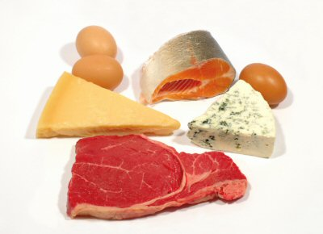
Proteins
Enzymes
Structural proteins (shape and form of cells and tissues)
Hormones
Immunoglobulins (antibodies)

Slide 24
Essential Amino Acids
Tryptophan
Methionine
Valine
Threonine
Phenylalanine
Leucine
Isoleucine
Lysine
Arginine
Histidine
(infants)

Slide 25
Proteins
Dietary sources
  Eggs, milk, fish, and most meats contain complete proteins
  Legumes, nuts, and cereals contain incomplete proteins (lack some essential amino acids)
  Legumes and cereals together contain all essential amino acids

Slide 26
Proteins
Uses:
  Structural materials: keratin, collagen, elastin, muscle proteins
  Most functional molecules: enzymes, some hormones

Slide 27
Proteins
Use of amino acids in the body
  All-or-none rule
    All amino acids needed must be present for protein synthesis to occur
  Adequacy of caloric intake
    Protein will be used as fuel if there is insufficient carbohydrate or fat available

Slide 28
Proteins
  Nitrogen balance
    State where the rate of protein synthesis equals the rate of breakdown and loss
    Positive if synthesis exceeds breakdown (normal in children and tissue repair)
    Negative if breakdown exceeds synthesis (e.g., stress, burns, infection, or injury)

Slide 29
Proteins
  Hormonal controls
    Anabolic hormones (GH, sex hormones) accelerate protein synthesis

Slide 30
Complete Proteins
Versus
Incomplete Proteins

Slide 31
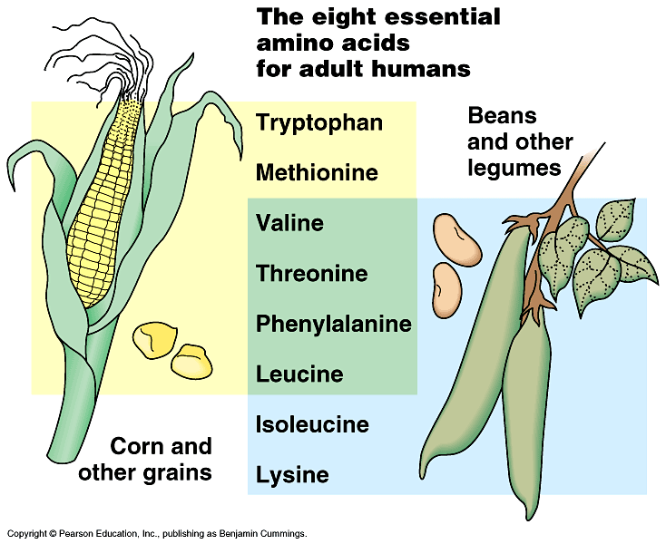
Vegetarian diet may result in protein deficiency
Need essential amino acids
  beans → lysine & isoleucine
  corn → tryptophan & methionine

Slide 32
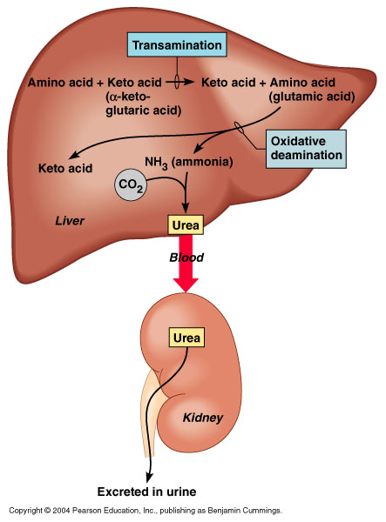
Transamination

Slide 33
Vitamins
Organic compounds needed by the body in small, but essential amounts
Cannot be synthesized by the body in sufficient amounts
Function in a variety of ways in metabolic reactions
Thirteen known vitamins

Slide 34
Water-Soluble Vitamins
Versus
Water-Insoluble Vitamins

Slide 35
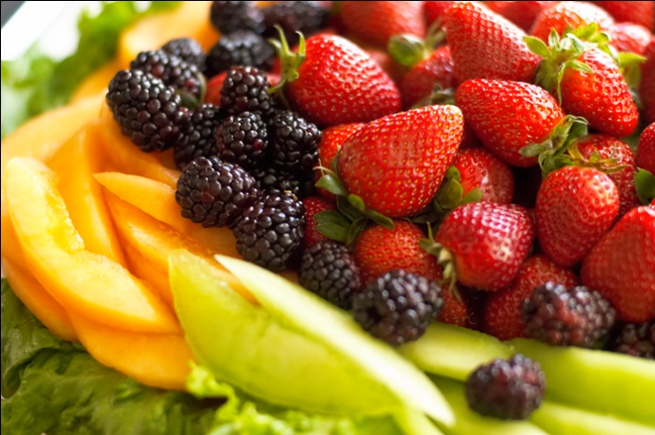
Water-Soluble Vitamins
C (ascorbic acid)
B₁ (thiamin)
B₂ (riboflavin)
Niacin
Pantothenic acid
Biotin
B₁₂ (cyanocobalamin)
Folic acid
B₆ (pyridoxine)

Slide 36



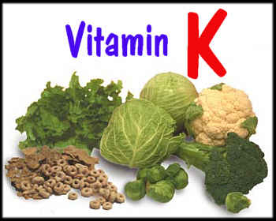
Water-Insoluble Vitamins

Slide 37
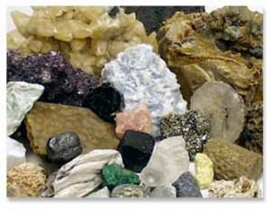
Minerals
Essential inorganic elements
Involved in a variety of metabolic processes
Major minerals versus trace minerals

Slide 38
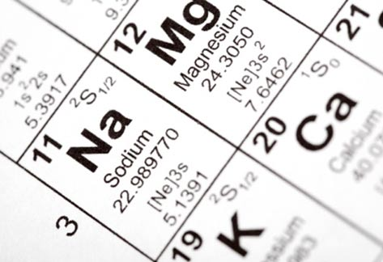
Major Minerals
Calcium
Phosphorus
Magnesium
Sodium
Potassium
Chlorine

Slide 39
Trace Minerals
Iron
Iodine
Fluoride
Zinc
Copper
Manganese
Cobalt
Selenium
Chromium

Slide 40


Malnourishment
An animal whose diet is missing one or more essential nutrients.
Giraffe eats bone to get phosphorus nutrient
Notes:
As we move to greater economic growth rates, the challenge we face is to make this growth more inclusive, ensuring that all of us, especially the most disadvantaged and marginalised groups benefit from this economic growth. Children especially must see the benefits of this growth now if we are to sustain economic growth in the future.
The reality in 2010 is that almost 50 per cent of India’s children are malnourished. In the nation’s capital alone, 42.2 per cent of children under five are stunted and a shocking 26.1 per cent are underweight.
Malnutrition stunts physical, mental and cognitive growth and makes children more susceptible to respiratory and diarrhoeal illnesses. Malnourished children are more likely to die as a result of common and easily preventable childhood diseases than those who are adequately nourished. According to a UNICEF report, 1.95 million children below the age of five die annually in India mainly from preventable causes that are directly or indirectly attributable to malnutrition. The children who survive the ravages of malnutrition are more vulnerable to infection, do not reach their full height potential and experience impaired cognitive development. This means they do less well in school, earn less as adults and contribute less to the economy.

Slide 41
Malnourishment
Impaired cognitive development
Won’t attain full height
More susceptible to disease and infection
Notes:
As we move to greater economic growth rates, the challenge we face is to make this growth more inclusive, ensuring that all of us, especially the most disadvantaged and marginalised groups benefit from this economic growth. Children especially must see the benefits of this growth now if we are to sustain economic growth in the future.
The reality in 2010 is that almost 50 per cent of India’s children are malnourished. In the nation’s capital alone, 42.2 per cent of children under five are stunted and a shocking 26.1 per cent are underweight.
Malnutrition stunts physical, mental and cognitive growth and makes children more susceptible to respiratory and diarrhoeal illnesses. Malnourished children are more likely to die as a result of common and easily preventable childhood diseases than those who are adequately nourished. According to a UNICEF report, 1.95 million children below the age of five die annually in India mainly from preventable causes that are directly or indirectly attributable to malnutrition. The children who survive the ravages of malnutrition are more vulnerable to infection, do not reach their full height potential and experience impaired cognitive development. This means they do less well in school, earn less as adults and contribute less to the economy.

Slide 42
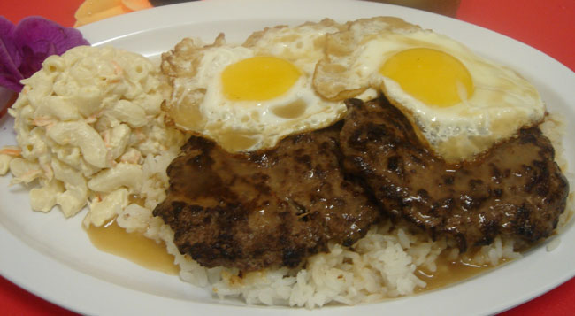

Traditional Food in Hawaii
vs

Slide 43
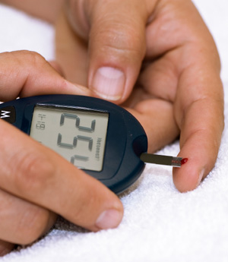
Diabetes Epidemic
Approximately 24 million people in the US have diabetes (10%)
Another 16 million have a condition now known as prediabetes
Notes:
Diabetes Trend Points Up, Up, Up, CDC Stats Say
By Katherine Hobson
Right now about 10% of American adults have diabetes. Fast forward to 2050 and — in addition to possibly finally using jetpacks to commute to work — we may be facing a diabetes rate of between 20% and 33%.
So says a new analysis from the CDC. The projections, published in the journal Population Health Metrics, assumes that the number of new diabetes cases per year will nearly double, from 8 per 1,000 people in 2008 to 15 per 1,000 people in 2050. The estimates cover both type 1 and type 2 diabetes.
The researchers say three demographic trends will fuel the projected increase. First, as we all know, the U.S. population is graying, and the risk of type 2 diabetes increases with age. The population is also becoming more diverse, and many minority groups have a higher risk of the disease. Mexican-American adults, for example, are almost twice as likely to have been diagnosed with the disease as non-Hispanic white adults, according to federal stats.
Finally, people with diabetes are living longer. That’s good news, obviously, but it also means there will be a lot more people who need care.
If you wondered where obesity fits into all this, the CDC tells us that it was “indirectly” included in the calculations. The authors considered a scenario in which the rate of new cases remained constant and another where the rate continued to grow. Obesity rates will influence how much the diabetes incidence rate actually increases.
The study authors say there are limitations to their research. For one, their projections cover only adults aged 18 to 79. Their statistical model also assumed that census projections for migration, births and deaths are accurate, and didn’t take into account that increased awareness of the problem could lead to lower incidence or fewer undiagnosed cases. (The prevalence estimates are based on all cases, diagnosed or not.) And the projections don’t account for things that are tough to foresee such as a change in the definition of diabetes.
“Widespread implementation of reasonably effective preventative interventions focused on high-risk subgroups of the population may not eliminate, but might considerably reduce, future increases in diabetes prevalence,” they write.

Slide 44
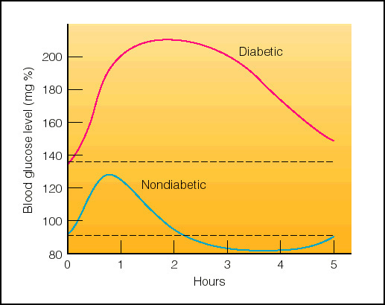
Diabetes Mellitus

Slide 45
Type I Diabetes hyposecretion of insulin insulin dependant juvenile onset
Type II Diabetes late onset (adult) insensitivity of cells to insulin manage by exercise & diet

Slide 46
Symptoms (Type I):
sugar in blood and urine
urinate too often and produce too much urine
Too thirsty
Too hungry

Slide 47
Complications
Arteriosclerosis
Cardiovascular problems
  Heart disease
  Stroke
  High blood pressure
Gangrene
Blindness
Kidney damage

Slide 48
Treatment:
Insulin replacement
Pancreas transplant
Pancreatic cell transplant
Fetal pancreatic islet cell transplant

Slide 49
Cost $$$$
2010: U.S. spends $170 Billion Annually
Per Person:
Individuals with diabetes:
$13,243/year
Individuals without diabetes:
$2,560/year

Slide 50
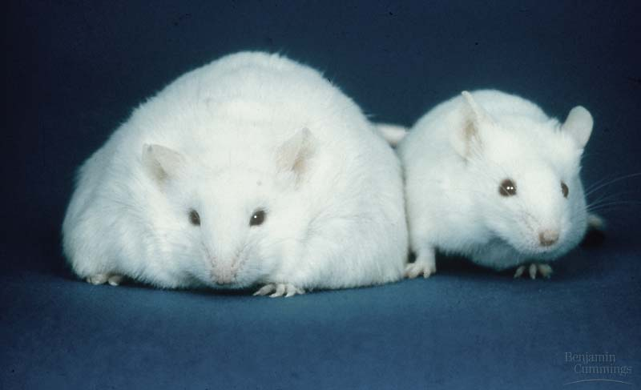
Obesity may be gene related
Leptin
  ↑ leptin levels ↓ appetite
  loss of body fat ↓ leptin levels and ↑ appetite and wt gain
potential medications for obesity

Slide 51
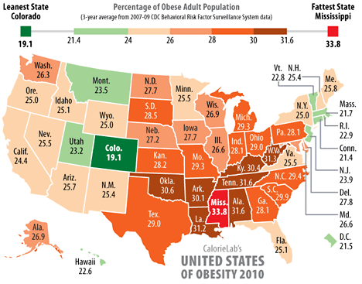
Obesity

Slide 52
Obesity
Here are the top 5 obese countries:
United States (34% of adults were overweight in 2008)
Mexico (30% in 2006)
New Zealand (27% in 2007)
Australia (25% in 2007)
United Kingdom (25% in 2008)
Lowest: Japan & Korea 3.2%

Slide 53
Genetically Modified Foods
Experts say 60% to 70% of processed foods on U.S. grocery shelves have genetically modified ingredients.
Common GM crops:
Soybeans
Corn
Cotton

Slide 54

Genetically Modified Foods
Cons
Introducing allergens and toxins to food
Accidental cross pollination
Antibiotic resistance
Creation of "super" weeds and other environmental risks

Slide 55
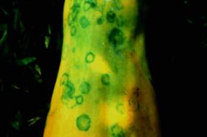
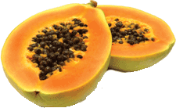
Genetically Modified Foods
Pros
Increased pest and disease resistance
Grow food in harsh climate
Increased food supply (more food/acre)
More nutritional value
Make drugs
Ring spot virus
Notes:
Good For You
With so many food choices available, Hawaii Business looks at what goes into what we eat
By Keala Francis photo: istockphoto
“When I ask students where their food comes from, they say, ‘The supermarket,’” says Carol Okada, plant quarantine branch manager for the Hawaii Department of Agriculture.
These students aren’t alone. Even with raw sewage spills, controversy over taro patents and threats of an avian flu pandemic, studies show that local consumers are almost completely unaware of how their food is grown and what goes into it.
Most Hawaii consumers, like their national counterparts, don’t know that more than 70 percent of processed foods in the U.S. market contain at least one genetically modified (GM) ingredient. Most have never heard of GM foods, even though Hawaii’s papaya industry is more than 50 percent GM and the University of Hawaii’s patents on genetic modifications to taro are a source of deep controversy. In addition, many countries have banned GM foods.
Organic consumers and farmers, whose crops by definition cannot have any genetically modified organisms (GMOs), are the most vocal opponents of biotechnology, the industry behind GM. However, both organics and biotechnology are decades-old agricultural production methods, each with a distinct philosophy, history and industrial scale.
TWEAKING CONVENTION
Modern biotechnology began in the early 1970s, with the discovery of recombinant deoxyribonucleic acid (rDNA) technology, and was designed to introduce beneficial genetic traits, such as pesticide resistance, and add nutritional value.
rDNA technology enables scientists to insert a genetic trait directly into a plant’s DNA and, over the past decade, most biotechnology applications have attempted to introduce traits that reduce pesticide use, increase herbicide resistance and increase crop yields to solve supply problems. Most GM foods, such as corn and soybeans, are grown on an industrial scale.
But GM food sales are hard to quantify, because, unlike organic foods, they are not labeled. A 2005 national consumer study commissioned by the Pew Initiative on Food and Biotechnology found only 41 percent of consumers nationwide are aware of GM foods. Hawaii consumer awareness is at 42 percent, according to preliminary data from a recent statewide survey of 550 consumers conducted by Sabry Shehata, professor of agricultural economics at the University of Hawaii.
Most consumers, even if they are aware, do not understand biotechnology. Although the idea of using genes to cultivate certain traits in a plant began with conventional breeding in the 1860s, with Gregor Mendel’s laws of heredity, biotechnology’s method is very different. The final product, supporters argue, is the same.
According to the U.S. Food and Drug Administration (FDA), GM crops are considered to have “substantial equivalence” to conventional crops. There is no reason then, biotechnology supporters argue, to distinguish GM foods from conventional foods.
INPUTS AND OUTPUTS
Organic foods distinguish themselves from conventional foods mainly through production methods, which are designed on principle to protect the environment, soil and biodiversity. Organic standards prohibit the use of irradiation, sewage sludge and genetic modification.
The organic movement began in the 1920s, with the concept of interrelationship among plants, soil, livestock and people, and grew in reaction to industrialized farming’s use of pesticides in the 1940s.
Based on growing consumer and producer demands for standards, certification programs were created, but it wasn’t until 2002 that the U.S. Department of Agriculture (USDA) implemented national organic standards on organic production and processing to strictly regulate the use of chemicals and other agricultural inputs.
Organic farmers manage pests and other growing problems through various methods, such as: biological, using beneficial pests and parasites; cultural, choosing strategic planting and harvesting dates; mechanical, working with the native soil; and chemical, using organically acceptable pesticides, as defined by the USDA.
Organic foods have always been a niche market, only recently moving onto mainstream shelves in local supermarkets, Wal-Mart and Costco. Organic food sales have grown at a rapid 20 percent per year nationwide over the past decade, but the category still accounted for less than 2 percent of total food sales in 2003.
Most organic farmers in the U.S., and all local organic farmers, are extremely small producers. Currently, demand for organic foods outweighs supply — local organic farmers say they could sell five to 10 times their current production — but organic production accounted for only .001 percent of Hawaii’s overall market value for agricultural products in 2002, according to USDA data.
Hawaii already imports 80 percent of all food, and the percentage of organic product imports is potentially even higher. Down to Earth CEO Mark Fergusson said the local natural foods chain imports at least 80 percent of its organic produce from the Mainland. “We have seen a significant increase in demand since the 1980s, but the supply side is very limited,” he said.
With Whole Foods Market, a national natural foods chain, scheduled to enter the Hawaii market in 2008, local organic supply will grow even tighter — and prices will go up.
Hawaii consumers are long inured to high prices and nationwide consumers are used to paying a premium for organic foods. But even with labeling, they are not necessarily educated on what they are buying. “A lot of people don’t understand organics,” Fergusson said. “Once we start talking about attributes, such as chemical free, people become more interested.”
Organic foods are not risk free, though. There are risks of pathogen contamination from manure-based fertilizers and fungal diseases, according to Carl Evensen, chair and extension specialist in the Department of Natural Resources and Environmental Management at the College of Tropical Agriculture and Human Resources (CTAHR) at the University of Hawaii – Manoa.
Farmers’ decisions are based on economics, necessity and beliefs. Organic farmers are more concerned about biotechnology than consumers, because they worry a GM crop will “contaminate” (or cross-pollinate) their organic crop, which by definition must be GMO free.
However, many conventional farmers support biotechnology as a growing method. Richard Ha, owner of Hamakua Springs on the Big Island, would like to see the development of a GM banana to fight the banana bunchy-top virus (BBTV), which conventional means have not successfully prevented.
“At some point, we have to decide whether we live with BBTV or not, but we’ll also have to live with a real low supply of bananas,” he says.
Ha is experimenting with other growing methods, but has been unable to make organics work economically.
“With our tomatoes, we deliberately chose hydroponic [a non-soil growing method] over organic to reduce pesticide use,” he says. “With organic, you cannot grow on a large enough scale to make a dent in the local supply of produce. If we felt we could do organic, we would do it. We’re trying, but it’s an economic thing. It can’t just be a philosophy.”
Susan Matsushima, president of Alluvion, a local wholesale nursery, has been involved in agricultural issues in the state for years. She is pro-GMO as a way to help farmers remain viable. “In order to feed the masses, I would rather have a process more scientific, so we don’t need pesticides,” Matsushima says. “The most important thing is we need to do things safely.”
CONSUMERS WANT LABELING
Both the Pew study and Shehata’s preliminary findings show consumers overwhelmingly favor labeling of biotechnology products, with support by 90 percent of consumers nationwide and 80 percent statewide (more than 90 percent on Kauai and Maui).
“The most important finding in my study is labeling,” said Shehata. “Consumers want labeling and want to understand why the biotechnology industry is fighting against labeling. Their question is: ‘Why are they fighting it if the technology is kosher?’”
Many anti-GMO organizations believe biotechnology companies are trying to put their products on the market surreptitiously. However, the labeling issue is more complex.
Because the FDA considers GM products to have “substantial equivalence,” the agency only requires labeling if the GMO substantially changes the nutritional content or introduces a new allergen. The FDA also considers GM foods on the market to be safe, and the Pew study shows the majority of Americans trust the FDA. Biotechnology companies undergo a voluntary consultative process, in which the company submits data to petition that a GM crop no longer requires regulatory oversight and states that it is free from risk under current standards.
Global Commercial GM Crops - Traits source: World Health Organization
Multiple scientific groups, such as the American Medical Association, also support the safety of biotechnology. The World Health Organization (WHO) released an international study in 2005, stating that GM foods had undergone risk assessments and were unlikely to present health risks any more than conventional foods. The report did recommend ongoing testing on long-term effects and assessment of ethical and religious issues.
The biotechnology industry has actively fought against mandatory labeling, including a $5.5 million campaign to help defeat a proposed labeling law in Oregon in 2002. Biotechnology proponents argue that labeling is proscribed for food safety reasons, such as quality, nutrition and health hazards, not for production methods. However, organic certification requirements and labeling standards are predominantly focused on production methods, not safety.
Studies show labeling would increase costs by up to 10 percent. Interestingly, consumer support for labeling dropped as prices rose. According to Shehata’s preliminary data, even though 73 percent of Hawaii consumers were willing to purchase GM foods, only 30 percent were willing to buy them if the cost was 10 percent higher.
In comparison, organic products command up to a 50 percent price premium and are the fastest growing agricultural category in the U.S.
Joseph Mendelson, legal director of the Center for Food Safety, a nonprofit public interest and environmental advocacy group, believes biotechnology companies have ignored consumer attitudes. “They are the only purveyor of a new technology that is not selling us on the innovation of that technology,” he said. “The only way it’s accepted is by consumers not knowing that it’s happening.”
Biotechnology representatives say they are trying to change that perception. The Hawaii Crop Improvement Association (HCIA), a local biotechnology trade organization, has an outreach and education group to help legislators and consumers better understand biotechnology. According to Paul Koehler, president of HCIA and the Hawaii business and communications affairs manager for the largest biotechnology company, Monsanto, HCIA’s outreach and education group, gives presentations to local community organizations, legislators and students. Monsanto also provides community tours of its Maui facilities based on consumer interest.
CONSUMERS SUPPORT RESEARCH AND RISK
Globally, governments and consumers continue to demand more transparency from the biotechnology industry. More than 22 countries plan to institute some form of mandatory labeling, and major countries, including those in the European Union, have banned many GM products, although those bans are currently under review. Some American companies, such as Frito Lay refuse to purchase GM products.
Even with the controversy surrounding biotechnology, the 2005 WHO report found that consumers did not demand “zero risk” from biotechnology products. The Pew study shows 65 percent of consumers favor research into GM foods, especially if the purpose is to enhance health and safety. More than 70 percent of consumers favor research into using biotechnology to reduce the use of pesticides. The preliminary Hawaii findings show local consumers are willing to purchase GM foods if the genetic modification reduces the use of pesticides (60 percent) or improves nutrition (65 percent).
Risk assessment also plays a large role in understanding the value of biotechnology. Ania Wieczorek, an assistant professor in biotechnology at CTAHR, notes that all agricultural products have risks.
“All crops we eat contain toxins, but the level of toxins is very low, based on the amount we consume,” Wieczorek says. “On one side, biotechnology crops show a lot of potential. On the other hand, they have a small risk of a negative impact. At what point do you decide what is acceptable? The consumer will have to decide.”
Food safety and the true benefits of biotechnology remain sticking points among proponents and foes. Biotechnology opponents fear weeds will acquire herbicide resistance and need even more chemical spraying. Worldwide, 72 percent of commercial GM crops have an herbicide-tolerant trait, according to the WHO report. That Monsanto, the top biotechnology company, is also one of the largest producers of herbicide has only increased opponents’ distrust.
Conflicting statistics confuse the issue further. HCIA cites lowered pesticide use, down by 380 million pounds globally from 1996 to 2004, as a key benefit to biotechnology. In contrast, a 2004 study by Charles M. Benbrook, a scientist and expert in pesticide regulatory law, reported pesticide use in the U.S. had increased 122 million pounds from 1996 to 2004.
However, in the end, it is consumers, informed or not, who will determine which foods get bought and eaten.
Shehata says, “When consumers are educated, they are the king.”
Hawaii’s Rainbow Connection All commercial papayas grown in the U.S. are grown in Hawaii. More than 50 percent of them are genetically modified to resist the papaya ring virus, which devastated the local papaya industry in the early 1990s.
However, Japan, a major export market for Hawaiian papaya, does not accept genetically modified (GM) papayas. To solve the problem, local farmers adopted an “identity preservation protocol” to ensure papayas sold in the Japanese market did not contain genetically modified organisms (GMOs). The protocol essentially serves as a voluntary labeling standard, with strict certification processes and testing.
Loren Mochida, owner of Tropical Hawaiian Products on the Big Island, has farmed both conventional and GM papayas since 1998 and has only had to destroy two trees that tested “false positive” for GMOs. Using geographic isolation, with defined perimeters and berms to prevent cross-pollination between papaya trees, he actually surrounds his conventional papaya tree plantings with GM papaya plantings to reduce the chance of ring virus infecting his conventional crop.
Mochida says farming conventional papayas is difficult for economic reasons. “Growers are reluctant to plant Kapoho [conventional papaya], because they make more money with Rainbow [GM papaya], because with Rainbow they don’t lose trees and can keep the trees producing longer,” he says. “We are working with the Japanese government to allow Rainbow into their markets. I hope one of these days I can just plant transgenic [GM].”
In the past two years, the commodities branch of Hawaii’s Department of Agriculture has rejected “way less than 1 percent” of conventional papayas shipped to Japan, according to Darrel Kohara, acting Hawaii district supervisor for the Commodities Branch. “Our last rejection was over a year-and-a-half ago, and it was due to an applicant not following procedure,” he says.
However, commercial papayas are the only ones monitored by such a program. GM papayas are unlabeled in stores and home gardeners unknowingly using these seeds are planting GM papaya.
“Hawaii’s GM papayas are a real threat to organic papaya growers,” says Nancy Redfeather, a local organic farmer and GMO-free advocate. “Once a GM crop is introduced into a regional area, it’s only a matter of time until you can no longer grow the crop with the genetic certainty you had before.

Slide 56
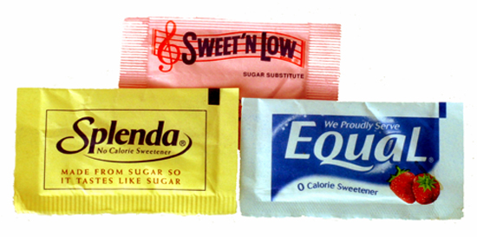
Artificial Sweeteners
Reduced calories
Reduce tooth decay
Diabetes
Lower cost
Notes:
Artificial sweeteners: Understanding these and other sugar substitutes
Whether your goal is cutting calories or eating healthier, options for sugar substitutes abound. Understand their pros and cons to make an informed choice.
By Mayo Clinic staff
If you're trying to reduce the sugar and calories in your diet, you may be turning to artificial sweeteners or other sugar substitutes. You aren't alone. The popularity of artificial sweeteners and other sugar substitutes is on the rise as manufacturers and consumers seek lower calorie alternatives to regular white sugar without sacrificing sweetness.
Today, artificial sweeteners and other sugar substitutes are found in a variety of food and beverages marketed as "sugar-free" or "diet," including soft drinks, chewing gum, jellies, baked goods, candy, fruit juice and ice cream. In addition, other sugar substitutes are being touted as healthier sweeteners than regular sugar, even if they don't have fewer calories, such as honey and agave nectar.
Just what are all these artificial sweeteners and sugar substitutes? And what's their role in your diet?
Understanding artificial sweeteners and other sugar substitutes
Sugar substitutes are loosely considered any sweetener that you use instead of regular table sugar (sucrose). Artificial sweeteners are just one type of sugar substitute. Some sugar substitutes, such as aspartame, are promoted because they add virtually no calories to your diet. Newer sugar substitutes, including stevia and agave nectar, claim to be lower calorie, tastier and healthier options.
The topic of sugar substitutes can be complex and confusing. One problem is that the terminology regarding sugar substitutes is often open to interpretation. For instance, some manufacturers call their sweeteners "natural" even though they're processed or refined, as is the case with stevia preparations. And some artificial sweeteners are derived from naturally occurring substances — sucralose comes from sugar, for example. Sometimes sugar substitutes are categorized by whether or not they contain calories.
Regardless of what they're called or how they're classified, sugar substitutes aren't magic bullets for weight loss. Take a closer look.
Artificial sweeteners
Artificial sweeteners are synthetic sugar substitutes but may be derived from naturally occurring substances, including herbs or sugar itself. Artificial sweeteners are also known as intense sweeteners because they are many times sweeter than regular sugar.
Artificial sweeteners currently approved by the Food and Drug Administration (FDA) are:
Acesulfame potassium (Sunett, Sweet One)
Aspartame (Equal, NutraSweet)
Neotame
Saccharin (SugarTwin, Sweet'N Low)
Sucralose (Splenda)
FDA approval is being sought for other artificial sweeteners. And some sweeteners, such as cyclamate, are not approved in the United States but are approved for use in other countries.
Uses for artificial sweeteners
Artificial sweeteners are attractive alternatives to sugar because they add virtually no calories to your diet. In addition, you need only a fraction compared with the amount of regular sugar you would normally use for sweetness. Artificial sweeteners are widely used in processed products, including tabletop sweeteners, baked goods, soft drinks, powdered drink mixes, candy, puddings, canned foods, jams and jellies, dairy products, and scores of other foods and beverages. Check the food label to see if a product contains artificial sweeteners.
Artificial sweeteners are also popular for home use. Some can even be used in baking or cooking. Certain recipes may need modification, though, because artificial sweeteners provide no bulk or volume, as does sugar. Check the labels on artificial sweeteners for appropriate home use.
Some artificial sweeteners may leave an aftertaste. You may need to experiment with artificial sweeteners to find one or a combination that you enjoy most.
Possible health benefits of artificial sweeteners
Weight control. One of the most appealing aspects of artificial sweeteners is that they are non-nutritive — they have virtually no calories. In contrast, each gram of regular table sugar contains 4 calories. A teaspoon of sugar is about 4 grams. For perspective, consider that one 12-ounce can of a sweetened cola contains 8 teaspoons of added sugar, or about 130 calories. If you're trying to lose weight or prevent weight gain, products sweetened with artificial sweeteners rather than with higher calorie table sugar may be an attractive option. On the other hand, some research has suggested that consuming artificial sweeteners may be associated with increased weight, but the cause is not yet known.
Diabetes. Artificial sweeteners may be a good alternative to sugar if you have diabetes. Unlike sugar, artificial sweeteners generally don't raise blood sugar levels because they are not carbohydrates. But because of concerns about how sugar substitutes are labeled and categorized, always check with your doctor or dietitian about using any sugar substitutes if you have diabetes.
Dental cavities. Unlike sugar, artificial sweeteners don't contribute to tooth decay.
Possible health concerns with artificial sweeteners
Artificial sweeteners have been the subject of intense scrutiny for decades. Critics of artificial sweeteners say that they cause a variety of health problems, including cancer. That's largely because of studies dating to the 1970s that linked saccharin to bladder cancer in laboratory rats. Because of those studies, saccharin once carried a warning label that it may be hazardous to your health.
But according to the National Cancer Institute and other health agencies, there's no sound scientific evidence that any of the artificial sweeteners approved for use in the United States cause cancer or other serious health problems. And numerous research studies confirm that artificial sweeteners are generally safe in limited quantities, even for pregnant women. As a result of the newer studies, the warning label for saccharin was dropped.
Artificial sweeteners are regulated by the FDA as food additives. They must be reviewed and approved by the FDA before being made available for sale. In some cases, the FDA declares a substance "generally recognized as safe" (GRAS). These GRAS substances, including highly refined stevia preparations, are deemed by qualified professionals based on scientific data as being safe for their intended use, or they have such a lengthy history of common use in food that they're considered generally safe and don't require FDA approval before sale.
The FDA has also established an acceptable daily intake (ADI) for each artificial sweetener. This is the maximum amount considered safe to consume each day over the course of your lifetime. ADIs are intended to be about 100 times less than the smallest amount that might cause health concerns. Sucralose: What is the negative side?
A lot of the controversy surrounding sucralose stems from the fact that it was discovered while trying to create a new insecticide. The claim that it is made from sugar is a misconception about the final product. According to the book Sweet Deception, sucralose is made when sugar is treated with trityl chloride, acetic anhydride, hydrogen chlorine, thionyl chloride, and methanol in the presence of dimethylformamide, 4-methylmorpholine, toluene, methyl isobutyl ketone, acetic acid, benzyltriethlyammonium chloride, and sodium methoxide, making it unlike anything found in nature. The Splenda Web site even states that "although sucralose has a structure like sugar and a sugar-like taste, it is not natural." The product Splenda is also not actually calorie-free. Sucralose does have calories, but because it is 600 times sweeter than sugar, very small amounts are needed to achieve the desired sweetness. The first two ingredients in Splenda are dextrose and maltodextrin, which are used to increase bulk and are carbohydrates that are not free of calories. One cup of Splenda contains 96 calories and 32 grams of carbohydrates, which is substantial for people with diabetes but unnoticed due to the label claiming that it's a no calorie sweetener.
The name sucralose is another misleading factor. The suffix -ose is used to name sugars, not additives. Sucralose sounds very close to sucrose, table sugar, and can be confusing for consumers. A more accurate name for the structure of sucralose was purposed. The name would have been trichlorogalactosucrose, but the FDA did not believe that it was necessary to use this so sucralose was allowed.
The presence of chlorine is thought to be the most dangerous component of sucralose. Chlorine is considered a carcinogen and has been used in poisonous gas, disinfectants, pesticides, and plastics. The digestion and absorption of sucralose is not clear due to a lack of long-term studies on humans. The majority of studies were done on animals for short lengths of time. The alleged symptoms associated with sucralose are gastrointestinal problems (bloating, gas, diarrhea, nausea), skin irritations (rash, hives, redness, itching, swelling), wheezing, cough, runny nose, chest pains, palpitations, anxiety, anger, moods swings, depression, and itchy eyes. The only way to be sure of the safety of sucralose is to have long-term studies on humans done.

Slide 57
Artificial Sweeteners
Acesulfame potassium (Sunett, Sweet One)
Aspartame (Equal, NutraSweet)
Neotame
Saccharin (SugarTwin, Sweet'N Low)
Sucralose (Splenda)

Slide 58

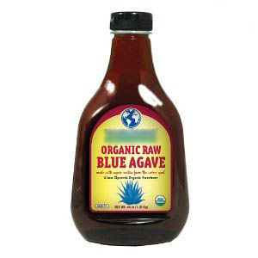
Natural Sweeteners
Agave
Corn syrup
Honey
Maple syrup
Sugar cane
Stevia
Notes:
Artificial sweeteners: Understanding these and other sugar substitutes
Whether your goal is cutting calories or eating healthier, options for sugar substitutes abound. Understand their pros and cons to make an informed choice.
By Mayo Clinic staff
If you're trying to reduce the sugar and calories in your diet, you may be turning to artificial sweeteners or other sugar substitutes. You aren't alone. The popularity of artificial sweeteners and other sugar substitutes is on the rise as manufacturers and consumers seek lower calorie alternatives to regular white sugar without sacrificing sweetness.
Today, artificial sweeteners and other sugar substitutes are found in a variety of food and beverages marketed as "sugar-free" or "diet," including soft drinks, chewing gum, jellies, baked goods, candy, fruit juice and ice cream. In addition, other sugar substitutes are being touted as healthier sweeteners than regular sugar, even if they don't have fewer calories, such as honey and agave nectar.
Just what are all these artificial sweeteners and sugar substitutes? And what's their role in your diet?
Understanding artificial sweeteners and other sugar substitutes
Sugar substitutes are loosely considered any sweetener that you use instead of regular table sugar (sucrose). Artificial sweeteners are just one type of sugar substitute. Some sugar substitutes, such as aspartame, are promoted because they add virtually no calories to your diet. Newer sugar substitutes, including stevia and agave nectar, claim to be lower calorie, tastier and healthier options.
The topic of sugar substitutes can be complex and confusing. One problem is that the terminology regarding sugar substitutes is often open to interpretation. For instance, some manufacturers call their sweeteners "natural" even though they're processed or refined, as is the case with stevia preparations. And some artificial sweeteners are derived from naturally occurring substances — sucralose comes from sugar, for example. Sometimes sugar substitutes are categorized by whether or not they contain calories.
Regardless of what they're called or how they're classified, sugar substitutes aren't magic bullets for weight loss. Take a closer look.
Artificial sweeteners
Artificial sweeteners are synthetic sugar substitutes but may be derived from naturally occurring substances, including herbs or sugar itself. Artificial sweeteners are also known as intense sweeteners because they are many times sweeter than regular sugar.
Artificial sweeteners currently approved by the Food and Drug Administration (FDA) are:
Acesulfame potassium (Sunett, Sweet One)
Aspartame (Equal, NutraSweet)
Neotame
Saccharin (SugarTwin, Sweet'N Low)
Sucralose (Splenda)
FDA approval is being sought for other artificial sweeteners. And some sweeteners, such as cyclamate, are not approved in the United States but are approved for use in other countries.
Uses for artificial sweeteners
Artificial sweeteners are attractive alternatives to sugar because they add virtually no calories to your diet. In addition, you need only a fraction compared with the amount of regular sugar you would normally use for sweetness. Artificial sweeteners are widely used in processed products, including tabletop sweeteners, baked goods, soft drinks, powdered drink mixes, candy, puddings, canned foods, jams and jellies, dairy products, and scores of other foods and beverages. Check the food label to see if a product contains artificial sweeteners.
Artificial sweeteners are also popular for home use. Some can even be used in baking or cooking. Certain recipes may need modification, though, because artificial sweeteners provide no bulk or volume, as does sugar. Check the labels on artificial sweeteners for appropriate home use.
Some artificial sweeteners may leave an aftertaste. You may need to experiment with artificial sweeteners to find one or a combination that you enjoy most.
Possible health benefits of artificial sweeteners
Weight control. One of the most appealing aspects of artificial sweeteners is that they are non-nutritive — they have virtually no calories. In contrast, each gram of regular table sugar contains 4 calories. A teaspoon of sugar is about 4 grams. For perspective, consider that one 12-ounce can of a sweetened cola contains 8 teaspoons of added sugar, or about 130 calories. If you're trying to lose weight or prevent weight gain, products sweetened with artificial sweeteners rather than with higher calorie table sugar may be an attractive option. On the other hand, some research has suggested that consuming artificial sweeteners may be associated with increased weight, but the cause is not yet known.
Diabetes. Artificial sweeteners may be a good alternative to sugar if you have diabetes. Unlike sugar, artificial sweeteners generally don't raise blood sugar levels because they are not carbohydrates. But because of concerns about how sugar substitutes are labeled and categorized, always check with your doctor or dietitian about using any sugar substitutes if you have diabetes.
Dental cavities. Unlike sugar, artificial sweeteners don't contribute to tooth decay.
Possible health concerns with artificial sweeteners
Artificial sweeteners have been the subject of intense scrutiny for decades. Critics of artificial sweeteners say that they cause a variety of health problems, including cancer. That's largely because of studies dating to the 1970s that linked saccharin to bladder cancer in laboratory rats. Because of those studies, saccharin once carried a warning label that it may be hazardous to your health.
But according to the National Cancer Institute and other health agencies, there's no sound scientific evidence that any of the artificial sweeteners approved for use in the United States cause cancer or other serious health problems. And numerous research studies confirm that artificial sweeteners are generally safe in limited quantities, even for pregnant women. As a result of the newer studies, the warning label for saccharin was dropped.
Artificial sweeteners are regulated by the FDA as food additives. They must be reviewed and approved by the FDA before being made available for sale. In some cases, the FDA declares a substance "generally recognized as safe" (GRAS). These GRAS substances, including highly refined stevia preparations, are deemed by qualified professionals based on scientific data as being safe for their intended use, or they have such a lengthy history of common use in food that they're considered generally safe and don't require FDA approval before sale.
The FDA has also established an acceptable daily intake (ADI) for each artificial sweetener. This is the maximum amount considered safe to consume each day over the course of your lifetime. ADIs are intended to be about 100 times less than the smallest amount that might cause health concerns.
Next page
(1 of 2)
See Also
Dietary fiber: Essential for a healthy diet
Water: How much should you drink every day?
Nutrition Facts: An interactive guide to food labels
Added sugar: Don't get sabotaged by sweeteners
Alcohol use: If you drink, keep it moderate
Food pyramids: Explore these healthy diet options
Sodium: How to tame your salt habit now
Caffeine: How much is too much?
Dietary fats: Know which types to choose
Taurine in energy drinks: What is it?
Low-sodium diet: Why is processed food so salty?
High-fructose corn syrup: What are the health concerns?
Juicing: What are the health benefits?
High-protein diets: Are they safe?
Acai berry products: Do they have health benefits?
What are functional foods?
Coffee and health: What does the research say?
Slide show: Guide to a high-fiber diet
Alkaline water: Better than plain water?
Calorie calculator
Slide show: 10 great health foods for eating well
Energy drinks: Do they really boost energy?
Multigrain vs. whole grain: Which is healthier?
Healthy chocolate — Dream or reality?
Yerba mate: Is it safe to drink?
Monosodium glutamate (MSG): Is it harmful?
Nutrition rating system: What's behind the new food labels?
Caffeine: Is it dehydrating or not?
Grape juice: Same heart benefits as wine?
Underweight? See how to add pounds healthfully
High-fiber foods
Diet soda: Is it bad for you?
Stevia: Is it available in the United States?
Fat grams, calories or percentages: Which are more important?
Phenylalanine in diet soda: Is it harmful?
Healthy diet: End the guesswork with these nutrition guidelines
Water softeners: How much sodium do they add?
Olive oil: What are the health benefits?
Foods for healthy skin: Top picks
Slide show: Guide to portion control for weight loss
Can whole-grain foods lower blood pressure?
Junk food blues: Are depression and diet related?
Omega-6 fatty acids: Can they cause heart disease?
Mayo Clinic Healthy Weight Pyramid tool
Cholesterol: Top 5 foods to lower your numbers
Nuts and your heart: Eating nuts for heart health
Trans fat is double trouble for your heart health
Salmonella: Response to latest outbreak and recall
References Duyff RL. American Dietetic Association Complete Food and Nutrition Guide. 3rd ed. Hoboken, N.J.: John Wiley & Sons; 2006.
The Encyclopedia of Foods: A Guide to Healthy Nutrition. San Diego, Calif.: Academic Press; 2002.
Whitney E, et al. Understanding Nutrition. 12th ed. Belmont, Calif.: Wadsworth Cengage Learning; 2011.
Mattes D, et al. Nonnutritive sweetener consumption in humans: Effects on appetite and food intake and their putative mechanisms. American Journal of Clinical Nutrition. 2009;89:1.
Artificial sweeteners and cancer. National cancer Institute. http://www.cancer.gov/cancertopics/factsheet/Risk/artificial-sweeteners. Accessed July 20, 2010.
Is stevia an FDA-approved sweetener? Food and Drug Administration. http://www.fda.gov/AboutFDA/Basics/ucm214864.htm. Accessed Aug. 2, 2010.
Generally recognized as safe. Food and Drug Administration. http://www.fda.gov/Food/FoodIngredientsPackaging/GenerallyRecognizedasSafeGRAS/ucm2006850.htm. Accessed Aug. 2, 2010.
Stevia. Natural Medicines Comprehensive Database. http://www.naturaldatabase.com. Accessed July 22, 2010.
What refined stevia preparations have been approved by FDA to be used as a sweetener? Food and Drug Administration. http://www.fda.gov/AboutFDA/Transparency/Basics/ucm214865.htm. Accessed Aug. 3, 2010.
Position of the American Dietetic Association: Use of nutritive and nonnutritive sweeteners. Journal of the American Dietetic Association. 2004;104:255.
Johnson RK, et al. Dietary sugars intake and cardiovascular health: A scientific statement from the American Heart Association. Circulation. 2009;120:1011.
Hensrud DD (expert opinion). Mayo Clinic, Rochester, Minn. Sept. 7, 2010.
Nelson JK (expert opinion). Mayo Clinic, Rochester, Minn. Sept. 1, 2010.
Bauer BA (expert opinion). Mayo Clinic, Rochester, Minn. Oct. 2, 2010.
MY00073
Oct. 9, 2010
© 1998-2010 Mayo Foundation for Medical Education and Research (MFMER). All rights reserved. A single copy of these materials may be reprinted for noncommercial personal use only. "Mayo," "Mayo Clinic," "MayoClinic.com," "EmbodyHealth," "Enhance your life," and the triple-shield Mayo Clinic logo are trademarks of Mayo Foundation for Medical Education and Research.
Print Share Reprints close window E-mail this page
* Required fields
* Recipient's e-mail address * Your name * Your e-mail Clicking "send" signifies that you have read and agree to our privacy policy.
Share this on ...
StumbleUpon
Digg
del.icio.us
Facebook
MySpace
Link to this page
To link to this page, copy this HTML and paste it onto your Web page. <a href="http://www.mayoclinic.com/health/artificial-sweeteners/MY00073">Artificial sweeteners: Understanding these and other sugar substitutes</a>
Guidelines for sites linking to MayoClinic.com Advertisement
Check out these best-sellers and special offers on books and newsletters from Mayo Clinic.
Get your free trial issue of Women's HealthSource!
Mayo Clinic Five Steps to Controlling High Blood Pressure
Mayo Clinic Wellness Solutions for Fibromyalgia DVD
Try Mayo Clinic Health Letter free!
NOW AVAILABLE! — The Mayo Clinic Diet book
Advertising and sponsorship policy
Advertising and sponsorship opportunities

Slide 59

Ten U.S. Dietary Guidelines
Aim for Fitness
Aim for a healthy weight

Slide 60

2. Be physically active each day

Slide 61

Build a Healthy Base
3. Let the pyramid guide your choices
4. Choose a variety of grains daily, especially whole grains
5. Choose a variety of fruits and vegetables daily.
6. Keep food safe to eat.

Slide 62
Choose Sensibly
7. Choose a diet that is low in saturated fat and cholesterol and moderate in total fat
8. Choose beverages and foods to moderate your intake of sugars
9. Choose and prepare food with less salt
10. If you drink alcoholic beverages do so in moderation

Slide 63


Coffee/Chocolate/Caffeine
Increases blood flow to brain
Increases memory
Lowers blood pressure
Lowers risk of heart disease
More alert and awake

Slide 64
INQUIRY
What are nutrients that the body needs but can’t synthesize on its own called?
Which cells of the body, under normal circumstances, must have energy in the form of glucose in order to survive?
How does the body make use of dietary cholesterol?
What is an incomplete protein?
What trace element is necessary for wound healing?
Neural tube defects are easily prevented by the adequate intake of ____ by pregnant mothers.
What carbohydrate can be found in a steak?
Hemorrhaging could occur because of lack of sufficient vitamin _____.

Slide 65
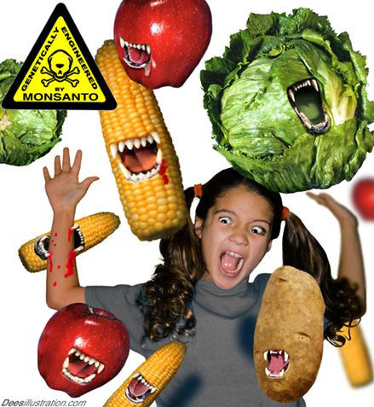
Moment of Zen

