Slide 1


Biology in a Box
A science education outreach program brought to you by a partnership
between The University of Tennessee and the National Institute for Mathematical and Biological Synthesis
Visit us on the web at http://biologyinabox.utk.edu
Biology in a Box Team
Program Director/Author/Lead Editor: Dr. Susan E. Riechert (University of Tennessee)
Science Collaborators: Dr. Thomas C. Jones (East Tennessee State University), Dr. Stan Guffey (University of Tennessee)
Mathematics Collaborators/Editors: Dr. Suzanne Lenhart (NIMBioS), Kelly Sturner (NIMBioS), Lu Howard (University of Tennessee)
Outreach Coordinator: Dr. Lynn Champion (University of Tennessee)
Workshop Coordinators: Kathy DeWein (Austin Peay State University), Gale Stanley (Jacksboro Middle School)
Production/Assistant Editor: J.R. Jones (University of Tennessee)
Previous Contributors: Sarah Duncan, Communications (formerly with NIMBioS), Rachel Leander, Math Collaborator (formerly with NIMBioS)
This unit revised August 2012
Copyright 2012 by Biology in a Box, and the University of Tennessee. All materials in this unit and on the Biology in a Box web server (biologyinabox.utk.edu, eeb.bio.utk.edu/biologyinbox) may not be reproduced or stored in a retrieval system without prior written permission of the publisher, and in no case for profit.

Slide 2
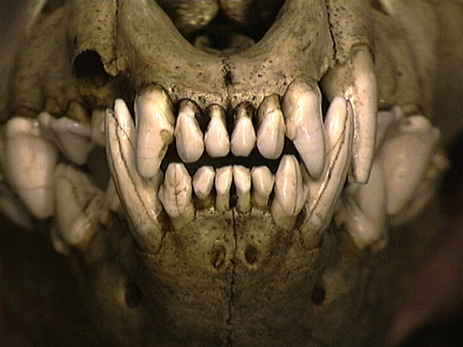
Unit 2: Of Skulls and Teeth

Slide 3
Homepage Unit 2: Of Skulls and Teeth
Click on underlined text to go to information and exercises!
Materials List
Best not to let students see this information until after they have completed Exercise 1!
Introduction
Exercise 1 - Tooth Types & Diet Types
Exercise 2 - Dental formulas
Mathematics: Bilateral symmetry, grouping objects by shape, counting, comparing whole numbers, organizing data into a chart/table, reading and creating bar graphs, proportions
Exercise 3 – Morphometrics: Shape Has Meaning
Mathematics: Measuring in centimeters, the mean, rounding, using formulas to find volume and area, organizing data with a chart, ratios and proportions, recognizing linear equations and graphs, determining if a point is on a line or satisfies a linear equation, converting between point slope and slope intercept form, finding the y-intercept and slope from an equation or a graph, finding the equation of a line from its graph, interpreting the slope of a line, constructing a scatter plot, fitting lines to scatter plots, data extrapolation and interpolation
Suggested Readings & Links
Clicking the icon on other slides will bring you back to this page!

Slide 4
Introduction
An animal’s teeth and the skull the teeth are anchored in can tell you a great deal about the owner.
They tell how the vertebrate…
  feeds
  senses its environment
  communicates with other organisms
  defends itself against enemies

Slide 5
The student will…
Learn about major tooth and diet types in vertebrates, and identify diets of organisms from their teeth in Exercise 1. Tooth Types
Learn about bilateral symmetry, dental formulas, express numbers of tooth types as proportions, construct graphs, compare dentition of various diet types in Exercise 2. Dental Formulas
Explore the structure and function of the skeletal system, compare and contrast various skull and tooth dimensions, and their relationship to an animal’s diet type in Exercise 3. Morphometrics: Shape Has Meaning
Click to go
to Exercise 1
Click to go
to Exercise 2
Click to go
to Exercise 3

Slide 6
Materials List
Sealed plastic container labeled “Tooth Types”, containing mounted teeth
Various numbered plastic containers 11 skulls, numbered from 1-11
Graduated cylinder (50 or 100 mL)
Container with BBs and small plastic cup inside
Funnel
Plastic dishpan (to minimize BB spills)
Ruler
Protractor
Vernier caliper

Slide 7
Exercise 1. Tooth Types & Diet Types
Tooth size, shape, and arrangement in the mouth are
important determinants of the type of food an animal
can obtain and consume.
Teeth can be used to tell what type of diet an animal has.
Four major groups of animals with respect to diet
  carnivore (meat eater)
  herbivore (plant eater)
  insectivore (insect & worm eater)
  omnivore (an animal that eats a variety of foods including meat and plants).

Slide 8
Exercise 1. Tooth Types: Directions
Examine:
The sealed box labeled “Tooth Types”. Think about how these particular teeth helped those organisms process their food.
List A, which describes each tooth type
Diagram showing the positions of the tooth types in the vertebrate mouth
List B, describing diet types

Slide 9
Tooth Types (List A)
Incisors are the flat, chisel-shaped teeth at the front of the mouth (behind the lips) that are used in biting, cutting, nibbling, and stripping.
Canines are behind the incisors, and are located on the cheek-side of the mouth. They are cone-shaped, and may even be dagger-like. They are used for seizing, piercing, and tearing.
Premolars are transitional teeth located between the canines and the molars at the rear. They have 1 or more cusps (points), and are generally used for grinding and crushing, but they may also be used in slicing food.
Molars have many major cusps (e.g., 3-5), and are located in the back of the mouth on the cheek side. Molars function in grinding and crushing.

Slide 10
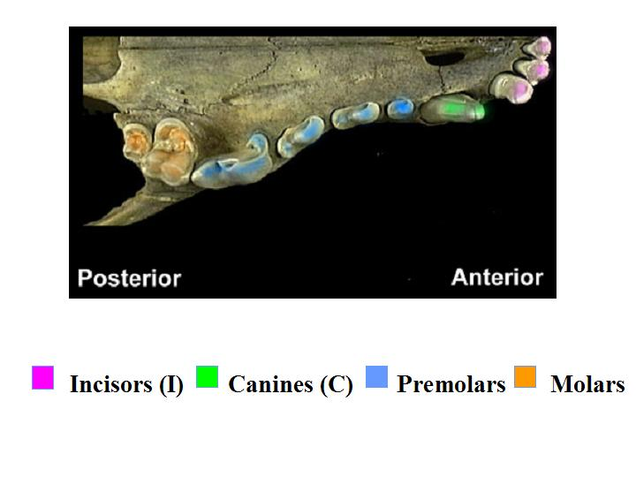
Figure 1. Ventral view of skull showing location and structure of teeth.

Slide 11

Diet Types (List B) - Carnivores
  Carnivores share special adaptations for life as predators.
  Large slicing canines for piercing the skin of prey, and for cutting and chewing meat
  Pointed incisors for tearing flesh
  Even the cusps on a carnivore’s molars are high and pointed, because these teeth too are used in tearing and chewing flesh.
  Long roots on all teeth so that they are well anchored for working on the tough food material
  Carnivores also have front facing eyes, heavy skulls that support the large muscles needed to work the jaws, and jaws that are very strong but that move only up and down, not from side to side.
Pictures of carnivore teeth on next slide

Slide 12
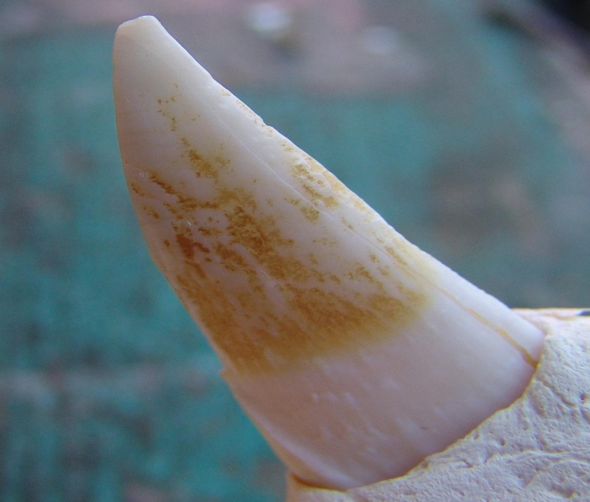
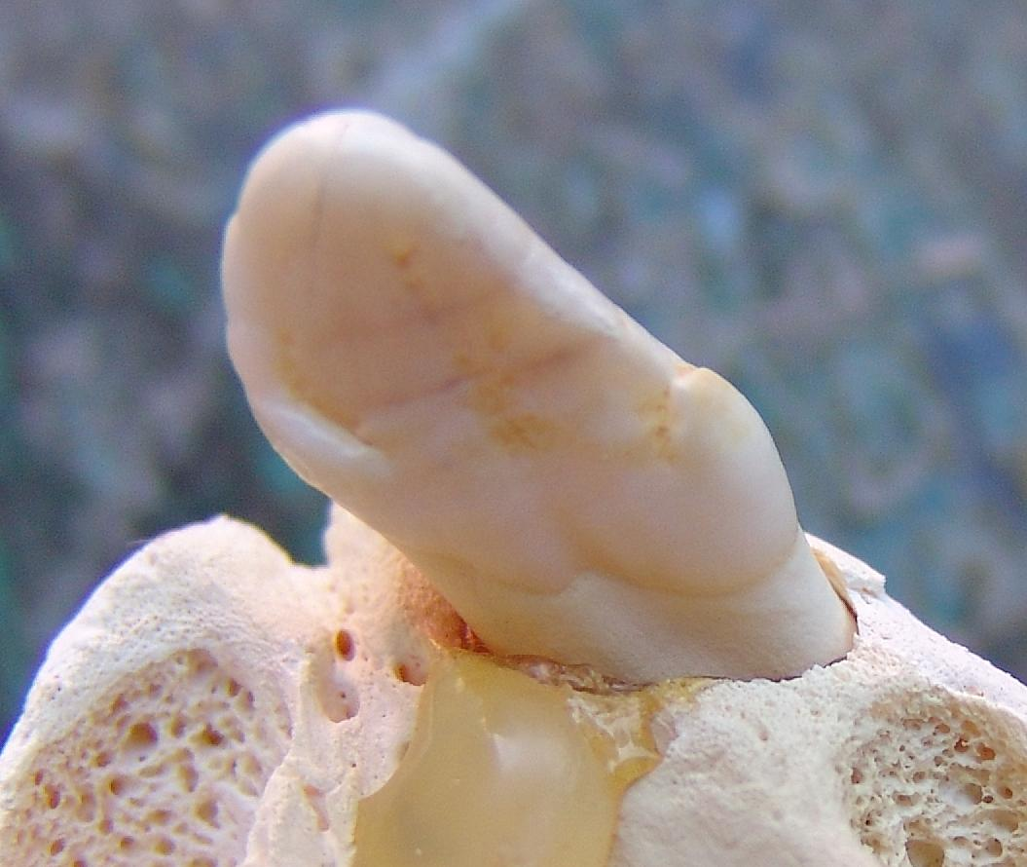
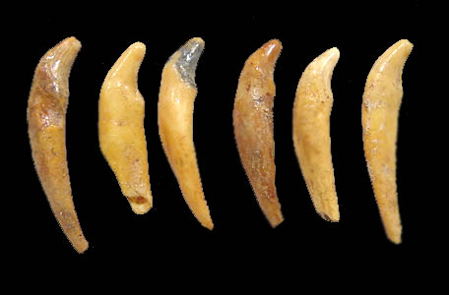
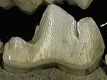
Carnivore Teeth
Incisor
Canine
Molar
Incisors showing long roots

Slide 13

Diet Types (List B) - Herbivores
Herbivores feed on plant material. They need to clip green leafy material off from grass roots (grazers) and tree branches (browsers). The cellulose in leaves is ground down into a mash that can be more easily digested.
Incisors have a flat cutting edge, for use in clipping off plant stems. Since these teeth wear down from this work, there is continuous tooth growth in many species.
Canines are often lacking entirely, as the food does not need to be captured, though squirrels may have pointed incisors that look like canines, which they use to break nuts open.
Molar teeth are tall and very broad. They have flat upper jaw surfaces sometimes with ridges on them to help grind plant material.
Herbivore teeth on next slide

Slide 14

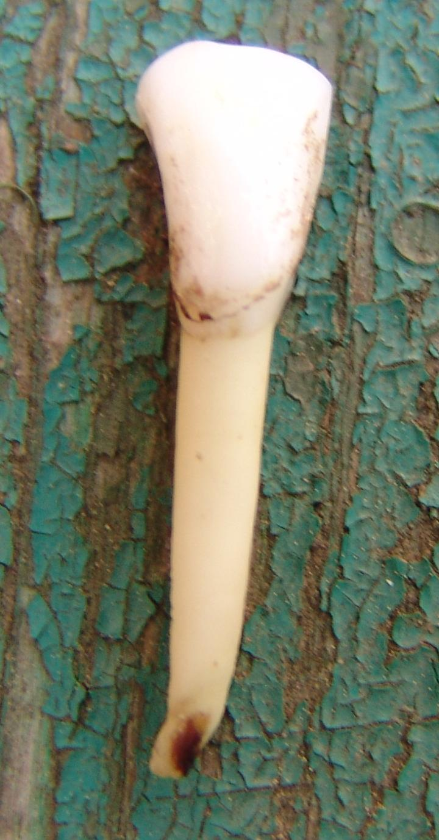

Herbivore Teeth
Molar
Incisor
Deer Molar

Slide 15
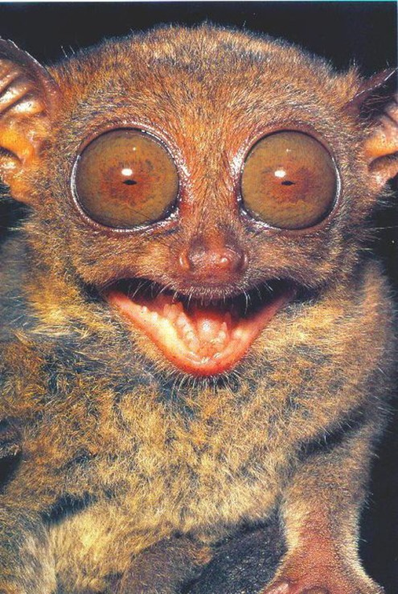
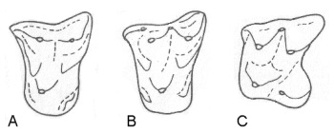
Diet Types (List B) - Insectivores
Insectivores have a mouthful of sharp little peg-like teeth that are similar in size and shape.
  These are used in seizing and crushing hard-shelled insects, and for gripping on to worms as they are pulled from their burrows.

Slide 16
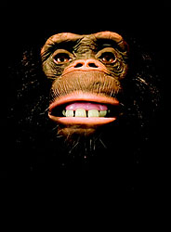
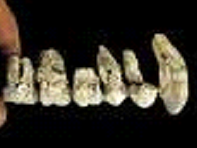
Diet Types (List B) - Omnivores
Omnivores have the most variable teeth, used for eating both plant and animal material that make up their broad diet.
Incisors are more shovel-shaped than pointed
Long, sharp canines are used for puncturing and grabbing onto animal prey.
Wide molar and premolar teeth handle both the chewing of meat and the grinding of plant material. They have low bumpy crowns.
incisors
canine
molar
premolar

Slide 17
Exercise 1. Tooth Types: Directions (cont.)
Your teacher will create 11 stations around the room, one for each skull.
Working in a group of 3-4 students, make a list from 1 to 11 on a sheet of paper.
Carry your list with you as you visit each station, following the instructions below for each skull:
  Examine the skull, paying close attention to the different types of teeth present, and their relative abundance (what type of teeth are most common in a given skull).
  Record what diet this animal has, and what the animal might be (e.g., fox, cat, rat, skunk) under the station number on your list.

Slide 18
Time to check your answers!!!

Slide 19
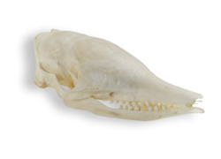
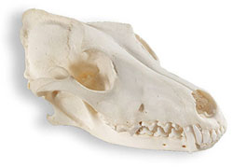
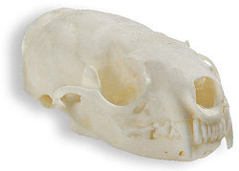
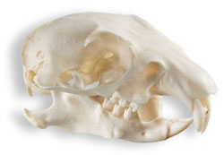
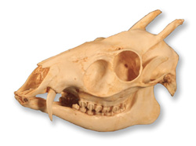
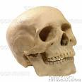
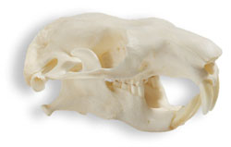
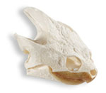
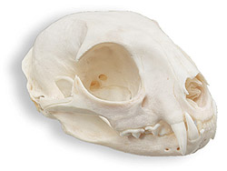
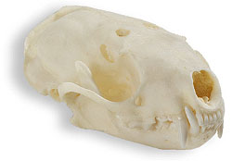
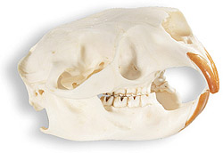
 |  |  | Click on each picture for more information!
1. Insectivore
2. Herbivore
3. Carnivore
4. Carnivore
(toothless)
5. Herbivore
6. Herbivore
7. Omnivore
8. Omnivore
9. Carnivore
10. Omnivore
11. Herbivore

Slide 20
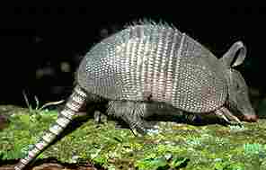
1. Armadillo (Dasypus novemcinctus) - Insectivore
This animal eats insects and worms.
It is a member of the mammal order Edentata.
  Edentata means toothless, but armadillos have teeth .
  Sloths and anteaters are other members of this order.
Armadillos have only one tooth type: peg-like premolars/molars.
Armadillo teeth have no roots and no enamel.

Slide 21

2. Prairie Dog (Cynomys ludovicianus) – Herbivore
Eats grass and herbs/forbs.
Burrowing member of the order Rodentia
  Rodents are the largest group of mammals in the world
Occupies prairies in the western US, and lives in large colonies covering 1-1000 acres
Grasses are the preferred food
Consumes up to two pounds of vegetation per week
Uses its teeth to clear the vegetation at its colony for better view of incoming predators

Slide 22
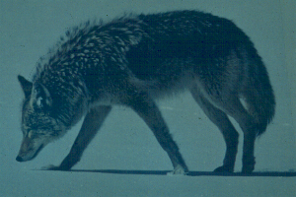
3. Coyote (Canis latrans) - Carnivore
Dog relative that eats rabbits, mice, and other small rodents
The family Canidae is comprised of the thirty-three species of wild dogs (as well as domestic dogs, which represent numerous breeds of one species).
Canine teeth, often known as fangs, are used to hold prey, and in tearing flesh while eating.
Canids are cunning, skillful hunters with good hearing and acute senses of smell.
  They utilize these skills to hunt and consume a variety of herbivorous animals.

Slide 23
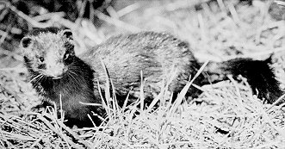
4. Mink (Mustela vison)- Carnivore
A mink is a weasel-like carnivore of the family Mustelidae
Size of a house cat; general color of dark chocolate brown
Mink prey chiefly on muskrats, but also eat mice, rabbits, chipmunks, fish, snakes, frogs, and birds.
They den (rear young) near water in burrows abandoned by other animals
Foxes, bobcats, and great horned owls are known predators of mink.

Slide 24
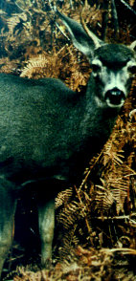
5. Deer (Odocoileus virginianus) - Herbivore
Deer are considered browsers
  feed on bushes, the lower branches of trees, and on bark
Deer belong to the mammalian order Artiodactyla, or even-toed herbivores.
In most species, only the male carries antlers
- bony protrusions that are
shed yearly, & are used in
fights between males over
females.

Slide 25
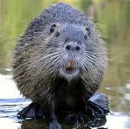
6. Beaver (Castor canadensis) - Herbivore
Beavers are heavy-bodied aquatic rodents
  best known for making dam homes
Rodentia is the largest order of living mammals
Beavers are the largest rodents in North America and Eurasia
They use their single pair of long front incisors to gnaw on trees and branches
Their incisors grow continuously throughout their lives

Slide 26
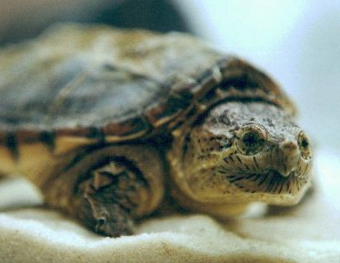
7. Snapping Turtle (Chelydra serpentina) - Omnivore
Reptile with no teeth
  Swallows food whole or tears it with its sharp beak
Major living orders of Class Reptilia:
  1. Chelonia (turtles & tortoises)
  2. Squamata (lizards & snakes)
  3. Crocodilia (crocodilians)
  A fourth order (Sphenodontia) is represented by only two species of tuataras (similar to lizards)
Turtle palate divided into two sections separating food and air passageways so breathing can continue while food is being chewed

Slide 27
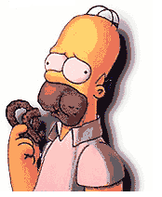
8. Human (Homo sapiens) - Omnivore
Eats both plants and animals
  ultimate omnivores
  greatest variety of teeth of any animal, reflecting our broad diets
Human skull has an enormous cranial vault that protects a large brain for our complex thought processes
Large eye sockets
  suggest the importance of vision to the survival of early man

Slide 28
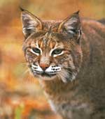
9. Bobcat (Felis rufus) – Carnivore
American cat species that eats small mammals
The cat family Felidae has 37 species that are found throughout the world
All cats share many tendencies, such as:
  Large eyes and good vision.
  Very sharp, retractable claws and long slender canine teeth.

Slide 29
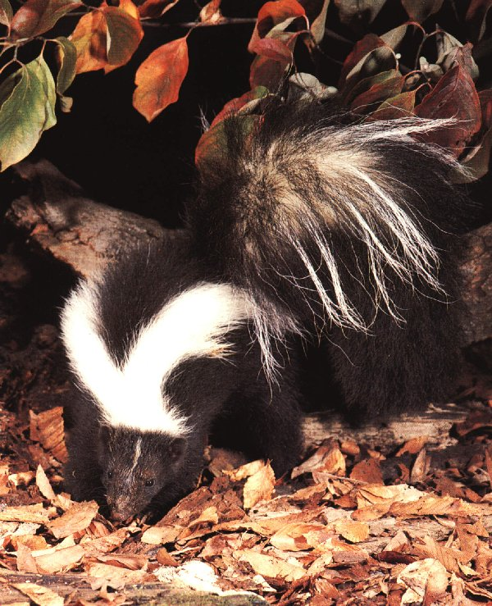
10. Skunk (Mephitis mephitis) – Omnivore
Among the most omnivorous of the flesh-eaters of the order Carnivora
Belongs to the family Mephitidae
Generally nocturnal
Live in a wide variety of habitats (open, wooded, scrub, agricultural, and even urban areas!)
Best known for their defensive smell, which is very offensive!
Use their keen sense of smell to locate food (such as rodents, frogs, fruit, berries, etc.)

Slide 30
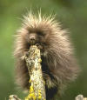
11. Porcupine (Erethizon dorsatum) – Herbivore
Eats bark, twigs, & leaves
Heavy-bodied rodent weighing 20 pounds
Powerful legs and long curved claws for climbing trees
Rump and tail are covered in over 30,000 barbed quills
  protect the slow-moving porcupine from its main predators , the mountain lion, fisher, bobcat, and coyote.

Slide 31
Exercise 2. Dental Formulas
Each type of tooth is adapted to perform the specific functions listed below. See Fig. 1 for tooth location.
Incisors | (I) | Adapted for biting, cutting and stripping
Canines | (C) | Adapted for seizing, piercing and tearing
Premolars | (P) | Adapted for grinding, crushing, shearing and slicing
Molars | (M) | Adapted for grinding and crushing

Slide 32
Figure 1. Ventral view of skull showing location and structure of teeth.

Slide 33
A mammal's dental formula designates the number of each type of tooth found in its dentition
It provides one kind of quantitative measure of the differences between
  different sexes and ages of the same species, different species, and animal groups having different feeding strategies or diets
Exercise 1 used observational skills to assign a skull (representing an animal) to a feeding category. This is what is considered a qualitative measure or approximation.
Quantification, on the other hand, involves actual measurement, and provides for numerical and graphical comparison of two or more samples.
Dental formulas are used to quantify difference between samples

Slide 34
Exercise 2 – Dental Formulas
Your specific goal in this exercise is to quantitatively compare dental formulas for carnivores, herbivores, omnivores, and an insectivore.
Before we do this, however, it is important to learn about frequency tables and graphs.
On the following slides, you will learn how to use frequency tables and graphs to display and help interpret your data.

Slide 35
Exercise 2 – Dental Formulas
Frequency Tables
A frequency table or chart presents the distribution of some item (e.g., cats-eye marbles) according to some type of category (e.g., marble owners).
The data in the table below were collected from four individuals, each of whom had a bag of marbles.
If we count the cats-eye marbles each person has, we can visualize the distribution of this type of marble among the four individuals by placing the marble counts in a table.
As you can see below, Bob has very few cats-eye marbles in his bag, and Meg has the most.
Individual | # of cats-eye marbles
Bob | 2
Susan | 16
Meg | 32
John | 20

Slide 36

Exercise 2 – Frequency Tables
Exercise 2 – Dental Formulas
Frequency Tables
It is easier to visualize relationships between frequencies or counts if these are relativized to some standard, such as 1.
A proportion is a number between zero and one that compares the size/weight/number of things to the cumulative whole.
In our marble example, the whole is the sum of all the cats-eye marbles owned by all individuals. To be precise, the proportion of the whole that is the part is equal to the fraction
Thus Bob has two of the cats-eye marbles, or 2/70 =0.03. Note that proportions are usually given in decimal form. We can show the proportion of cats-eye marbles owned by each individual in a new table.

Slide 37
Exercise 2 – Proportions
Exercise 2 – Dental Formulas
Proportions
The new table below displays the original data, as well as the same information displayed as proportions of the total number of cats-eye marbles.
From this new column, we can easily see that Meg has almost half of the total cats-eye marbles (1/2 = 0.50).
Individual | Number of cats-eye marbles | Proportion of cats-eye marbles
Bob | 2 | 0.03
Susan | 16 | 0.23
Meg | 32 | 0.46
John | 20 | 0.28

Slide 38
Exercise 2 – Bar Graphs
Exercise 2 – Dental Formulas
Bar Graphs
It is easier to compare counts that are presented as proportions. It is even easier to compare values such as counts if these are presented graphically, in visual form.
Below is a bar graph of the previous proportion data.

Slide 39
Exercise 2 – Bar Graphs
Exercise 2 – Dental Formulas
Bar Graphs
A bar graph consists of the following parts:
A title tells the viewer what the bar graph is comparing.
The y-axis is the vertical axis. It measures the value of the quantitative variable. The y-axis should be labeled with the name of the quantitative variable.
The x-axis is the horizontal axis. It charts the value of the qualitative variable. The x-axis should be labeled with the name of the qualitative variable.

Slide 40
Exercise 2 – Bar Graphs
Exercise 2 – Dental Formulas
Bar Graphs
Interpreting bar graphs:
Each value of the qualitative variable has its own bar. Along the x-axis, each bar should be labeled with the value of the qualitative variable.
The height of each bar tells us the value that of the quantitative variable for each qualitative variable associated with the bar. To find this value, draw a horizontal line from the top of the bar to the y-axis. The number on the y-axis that this line hits is the value of the quantitative variable. (If this line falls between two tick marks on the y-axis, you will need to estimate the value of the quantitative variable.)
The example marble graph is a special type of bar graph called a relative frequency bar graph. A relative frequency bar graph displays proportions rather than absolute numbers.

Slide 41
Exercise 2 – Dental Formulas
Bar Graphs
Answer the Following:
Q1. What is the title of the marble example bar graph?
Q2. How is the y-axis labeled in the marble figure?
Q3. How is the x-axis labeled in figure 3a?
Q4. List all the values that the qualitative variable (category) takes in the marble figure.
Q5. Use the table to determine which two individuals have the closest to equal proportions of cats-eye marbles.

Slide 42
Exercise 2 – Dental Formulas
Bar Graphs
Answer the Following:
Q4. List all the values that the qualitative variable (category) takes in the marble figure.
Q5. Use the graph to determine which two individuals have the closest to equal proportions of cats-eye marbles.

Slide 43
Directions
Now you will turn your attention to quantifying the differences among skulls of each of the three diet types.
Work in groups, and follow the procedure below:
Select a skull of each diet type.
Record the ID and diet type of the skull at your station. Count and record the number of each type of tooth (incisor, canine, premolar, and molar) on ONE side of the upper jaw of your group’s skull. If there are any missing teeth, you can look at a tooth in the same position on the other side of the skull, since vertebrates are bilaterally symmetrical (have mirror image right and left sides; see next slide for illustration).
Repeat the procedure above for the lower jaw of your skull.
Repeat the above procedures until your group has counted the teeth on one side of both the upper and lower jaws of each skull.
You will then calculate the dental formula for each skull, as outlined a little later.

Slide 44
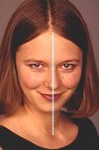
Bilateral Symmetry
Bilaterally symmetrical animals have right and left sides that are mirror images of each other.
  All higher animals except the echinoderms (starfish) are bilaterally symmetrical. Their bodies can be divided into two equal halves along a central longitudinal axis.
  Thus one side of a mammal’s jaw has the same tooth composition as the other side.

Slide 45
Calculating Dental Formulas
You will calculate dental formulas for each skull by using the following equation:
2([I:U# + L#] + [C:U# + L#] + [P:U# + L#] + [M:U#+ L#]) = DF
  Where
I=incisors, C=canines, P=premolars, M=Molars, U=upper jaw, L=lower jaw, # = number of teeth of a type in each jaw, and DF = dental formula number (total number of teeth)
Count the teeth on one side of the jaw only and multiply the numbers of teeth within the parentheses by 2 as shown above. Remember: Sometimes teeth have been lost (count the side that is most complete, correcting for lost teeth by looking on other side).
Dental formula example:
2([I:U3 + L3] + [C:U1 + L1] + [P:U4 + L4] + [M:U3+ L3]) = 44

Slide 46
Skull # | Animal | Diet Type
1 | Armadillo | insectivore
2 | Prairie dog | herbivore
3 | Coyote | carnivore
4 | Mink | carnivore
5 | Deer | herbivore
6 | Beaver | herbivore
7 | Snapping turtle | omnivore
8 | Human | omnivore
9 | Bobcat | carnivore
10 | Skunk | omnivore
11 | Porcupine | herbivore
Back to
instructions
Time to check your answers!

Slide 47
Exercise 2 Dental Formulas Answer Sheet
Numbers of teeth for half of jaw: UJ=upper jaw & LJ=lower jaw
Number of Teeth | Armadillo | Prairie Dog | Coyote | Mink | Deer | Beaver
Incisors UJ | 0 | 1 | 3 | 3 | 0 | 1
Incisors LJ | 0 | 1 | 3 | 3 | 3 | 1
Canines UJ | 0 | 0 | 1 | 1 | 0 | 0
Canines LJ | 0 | 0 | 1 | 1 | 1 | 0
Premolars UJ | 7 | 2 | 4 | 3 | 3 | 1
Premolars LJ | 7 | 1 | 4 | 3 | 3 | 1
Molars UJ | 0 | 3 | 2 | 1 | 3 | 3
Molars LJ | 0 | 3 | 3 | 2 | 3 | 3
SUM | 14 | 11 | 21 | 17 | 16 | 10
Total = Sum×2 | 28 | 22 | 42 | 34 | 32 | 20
More on next slide

Slide 48
Dental Formula Answers (continued)
Number of Teeth | Turtle | Human | Bobcat | Skunk | Porcupine | Rat | Rabbit
Incisors UJ | 0 | 2 | 3 | 3 | 1 | 2 | 1
Incisors LJ | 0 | 2 | 3 | 3 | 1 | 1 | 1
Canines UJ | 0 | 1 | 1 | 1 | 0 | 0 | 0
Canines LJ | 0 | 1 | 1 | 1 | 0 | 0 | 0
Premolars UJ | 0 | 2 | 2 | 3 | 1 | 3 | 0
Premolars LJ | 0 | 2 | 2 | 3 | 1 | 2 | 0
Molars UJ | 0 | 3 | 1 | 1 | 3 | 3 | 3
Molars LJ | 0 | 3 | 1 | 2 | 3 | 3 | 3
SUM | 0 | 16 | 14 | 17 | 10 | 14 | 8
Total=Sum×2 | 0 | 32 | 28 | 34 | 20 | 28 | 16

Slide 49
Exercise 2: Dental Formulas (continued)
Compare the differences in the dental formulas between your sample skulls.
  Which one has the highest dental formula number?
  Which one has the lowest number?
  Is the difference in total tooth number correlated with (related to) differences in diet? For instance, do herbivores have more teeth than carnivores?
  Which tooth type has the greatest numbers in each of the respective diet types?
  You can best answer this last question by making a graph of your tooth type count results.
Examples of graphs you can construct on next slide

Slide 50
The first graph is an example of a graph that compares one characteristic of each skull.
The second example graph compares more than one characteristic, whose values are within the same general range.
To convert tooth type counts into proportion of total teeth, use the following equation:
2× # of teeth of a given type/Dental Formula #
(Proportion of a tooth type equals the total # of teeth of that type divided by the total # of overall teeth)
Go to Ex. 3:
Morphometrics

Slide 51
Exercise 3. Morphometrics:
Shape Has Meaning
Morphometrics is the quantitative analysis of the shape of organisms.
Morphometrics is an integral component of many evolutionary, ecological, and developmental studies in biology .
Morphometrics is important to taxonomists and systematists, who use the physical characteristics of individuals to describe species and their relationships to other species.
It is also applied to the patterns of shape variation within and among samples to better understand the factors that have favored particular traits.

Slide 52
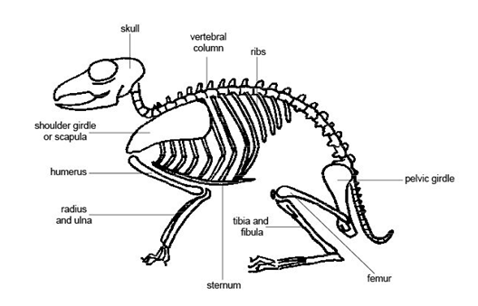
The Skeleton: Form & Function
Although you are examining skulls, remember that the skull is a part of the skeleton, and protects the brain.
Examine the figure (to the right) of a generalized mammalian skeleton. Observe the shape and location of each of the labeled parts, and think about their functions.
Share your ideas with others to see if there is general agreement about the functions you assigned to each part!

Slide 53
Exercise 3. Morphometrics: Directions
You will be working in groups of three or four for this exercise.
Each group should review the suggested measurements on Lists A and B and determine which ones they wish to make on the skulls they will sample.
Note, however, that all students must measure :
Total (greatest) skull length (Fig. 2C & D).
Skull characteristic list A
Tooth characteristic list B
*Lists and figures should be available as handouts

Slide 54
List A. Suggested Skull Measurements
Palate length (LS): G – point equidistant from (midway between) A and E in Fig. 2A
Maximum palate width: distance C – D (Fig. 2A)
Minimum palate width: distance A – E (Fig. 2A)
The above measurements on the palate might be combined
in calculating palate area as a trapezoid, triangle etc.
Foramen magnum diameter distance B – F (Fig. 2A)
This measure could be used in calculating the area (size) of
the spinal cord.
Snout (nasal) width (Fig. 2C)
Snout (nasalia) length (Fig. 2D)
Multiply nasal width by length to get another estimate of
snout or rostrum size.
Continued on next page

Slide 55
List A. Suggested Skull Measurements
Measure the volume (height x length x width) of the tympanic bulbs (H) (Fig. 2A).
Interorbital breadth (Fig. 2C) can be used as an estimate
of the degree to which the eyes face forward versus to the side.*
Biorbital breadth (Fig. 2C)*
*Subtract interobital breadth from biorbital breadth, and divide by 2 to obtain an estimate of eye size.
Measure the height of the sagittal crest (ridge for muscle
attachment) at the midline of the top of the skull (Fig. 2C).
(May be absent in some specimens and recorded as 0 mm)
Measure the length, width and height of the cranium
(Fig. 2C and D). L X W X H will provide a rough estimate of brain size (volume).
Continued on next page

Slide 56
List A. Suggested Skull Measurements (continued)
For a more accurate measure of brain size, fill the cranium with BBs using a funnel extended into the foramen magnum (opening) at the base of the skull (between B and F on Fig. 2A).
(You will need to plug nerve holes with cotton before pouring the BBs in, and be sure to place the skull in the plastic tub while making this measurement to avoid BB spills.)
Pour these BBs that filled the cranium into the graduated cylinder and record the volume in milliliters (ml) that these take up.
Return all of the BBs to the storage container when finished.
Back
To List B
To Figures

Slide 57
List B. Suggested Tooth Measurements
Total tooth row length of mandible (lower jaw): Fig. 2B
Molar tooth row length of lower jaw: Fig. 2B
Total tooth row length of maxilla (upper jaw):
distance E - I (Fig. 2C & 3)
Molar tooth row length for upper jaw: distance I – J (Fig. 2C & 3)
Looking down on the tooth, record the geometric shape (e.g. triangle, rectangle, square) of the surface of a representative of each of the four types (canine, incisor, premolar, molar) of teeth present.
Using a protractor, measure the angle from the cusp (tip) (highest cusp in case of molars) to base of the tooth for a representative tooth of each of the types present.
List continued on next slide

Slide 58
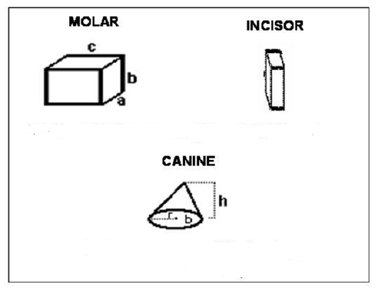
List B. Suggested Tooth Measurements (continued)
Number of cusps (points or ridges) on top surface
of representative tooth of each of the tooth types
Measure the parameters needed to complete
the volume estimates shown in Fig. 1 below for the
representative tooth of each of the four tooth
types that might be present (incisor, canine,
premolar, molar).
Figure 1
Volume rectangular prism = a×b×c
Figures 2-3 follow
Volume cone = 1/3pi×r²×h
where pi ≈ 3.14

Slide 59
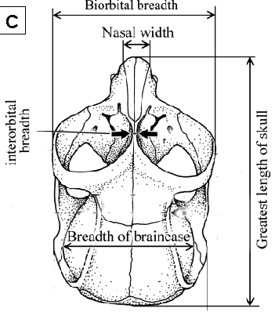
Figures 2A, B, C & D show locations of measurements suggested in List A (skull morphometrics) and some from List B (tooth morphometrics).
Back
Additional Figures

Slide 60
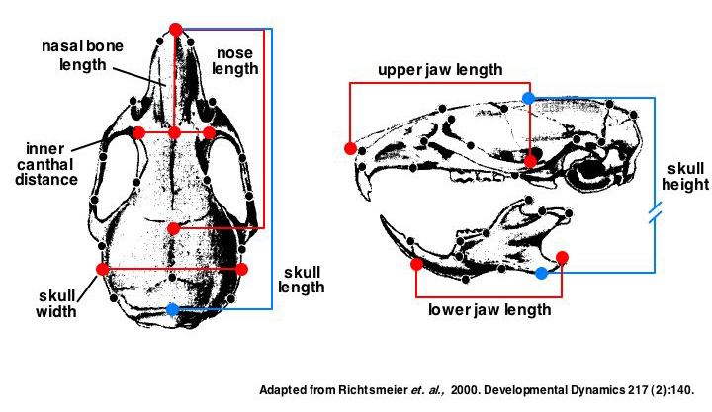
Figure 2. Additional illustration of potential skull measures
Back
Figure 3

Slide 61
Fig. 3. Ventral view of skull showing positions and shapes of respective tooth types.
Back
Continue

Slide 62
Exercise 3. Morphometrics – Directions (continued)
Construct a table similar to the one below.
Note that skulls along the top are grouped by diet type.
Traits measured are listed with room for 3 values (each group member must make each measurement!)
Measurement | bobcat | coyote | mink | beaver | deer | rabbit
Total 1 skull 2 length 3
Foramen 1 magnum 2 diameter 3
Nasalia 1 length 2 3
. . . . . 1 2 3

Slide 63
Exercise 3. Morphometrics – Directions (continued)
Visit the skull stations around the room to take the measurements your group has chosen on the set of skulls your teacher has chosen for this exercise.
You will need to have your table on which to record your measurements, a pencil, and a ruler and/or Vernier caliper.
Record all of your measurements in cm (2.54 cm/inch) with one significant digit (as in 15.6 cm).
Each student in a group should make each measurement, so that each group has three values recorded for each trait on each skull sampled.
One tooth character requires the use of a protractor
A Vernier caliper can be used to take very small measurements such as the heights and diameters of teeth. A Vernier caliper and protractor are included in the trunk, and directions for the use of the Vernier caliper are provided on the next slide.

Slide 64
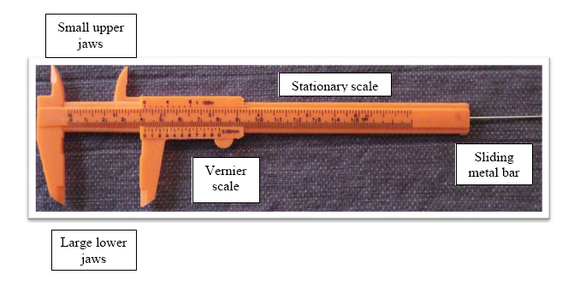
Exercise 3. Using a Vernier Caliper
Learn how to use a Vernier caliper before starting on this exercise!
Below is an image of a Vernier caliper, showing all of the parts, and their names.

Slide 65
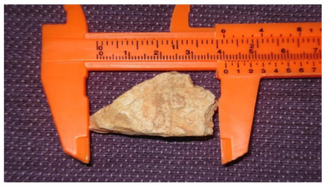
Exercise 3. Using a Vernier Caliper
Measuring the length of an object with the Vernier caliper:
Fit the object to be measured securely between the lower jaws of the caliper.
The zero mark of the Vernier scale marks the length of the object on the stationary scale to the nearest tenth of a centimeter (mm). This value is between 4.0 cm and 4.1 cm in the picture, so the first decimal place is a 0.

Slide 66
Exercise 3. Using a Vernier Caliper
Measuring the length of an object with the Vernier caliper:
Now find the first line of the Vernier scale that exactly corresponds to a line of the stationary scale. The number of this line gives the second decimal of the object’s length. In the picture the first line that exactly matches is line 5 so the length of the object is 4.05 cm .
Record all measures in centimeters (10 mm = 1 cm) with one significant digit (the length of the rock in the picture is 4.1 cm with one significant digit).

Slide 67
Exercise 3. Morphometrics – Directions (continued)
To account for inter-observer differences, scientists have more than one person measure each trait for each specimen. You should have at least three individuals make each measurement you decide to complete.
Insert measurements in the respective cells of your table
Compute the mean value (average) from each of the measurements your group made of each trait.
The mean value refers to central tendency. The formula for calculating the mean for total skull length is: TL mean = S_{x}/n, where
  S_{x} = The sum of each of your group’s values (x₁, x₂, x₃)
  n = the total number of measurements of this trait (3 in this case).
Example: If the three measurements of skull length were 19.5, 19.8 and 20.1, TL mean = (19.5 + 19.8 + 20.1)/3 or TL mean = 19.8 for the particular skull.

Slide 68
Exercise 3. Morphometrics – Directions (continued)
Example: If the three measurements of skull length were
  19.5
  19.8
  20.1
TL mean = (19.5 + 19.8 + 20.1)/3
which simplifies to
TL mean = 19.8 for that skull.

Slide 69
Exercise 3. Morphometrics – Linear Functions
Analyses
Now that you have collected a number of measurements on the two categories of skulls, you need to summarize your data in some way. It is very difficult to identify patterns without organizing and reducing your data.
We will use linear functions to help us organize this data. A few facts about linear functions are summarized below.
Linear Functions:
A linear function is a function of the form y = mx + b, Where m and b are real numbers.
  The number m is called the slope of the line.
  The number b is called the y-intercept of the line.
  The graph of a linear function is a line.
  We say that a point is on the line if mx₁ + b = y₁.

Slide 70
Exercise 3. Morphometrics – Linear Functions
Q1. Check to see if the following points are on the line y = 3x + 4
          (1,8)
          (2,10)
Click for the answer!
The point (1,8) is NOT on the line represented by the equation y = 3x + 4. However, the point (2,10) IS on the line represented by the equation y = 3x + 4.

Slide 71
Exercise 3. Morphometrics – Linear Functions
The slope, m, tells us how the value of y changes with the value of x. The slope is equal to the change in y divided by the change in x, that is the rise over the run. m = rise/run
Q2. Find the slope of the line in the figure.
Click for the answer!
The slope of the line in the figure is equal to 0.4/0.2 = 2. You could have also noted this from the equation describing the line, as the coefficient m, representing slope, is equal to 2!

Slide 72

Exercise 3. Morphometrics – Linear Functions
If x and y are any two points on the line, then the slope of the line m is:
If m is positive, then as x gets bigger, so does y. If m is negative, then as x gets bigger, y gets smaller.
Because the slope is the quotient of the change in y divided by the change in x, it is measured in (y units/x units). For example, if the y-axis of a plot is measured in miles and the x-axis of the plot is measured in minutes, then the slope of a line on the plot is measured in miles/minute.
The y-intercept b is the value that y takes when x is zero. This means that the point (0,b) is on the line.

Slide 73
Exercise 3. Morphometrics – Linear Functions
Q3. What is the y-intercept of the line represented by the equation y = 3x + 4?
Click for the answer!
If you substitute 0 for x, then solve for y, the equation then becomes
y = 3(0) + 4 = 4
This means that the y-intercept of the line represented by the equation is 4. On the graph, this would be represented by the point (0,4)

Slide 74


Exercise 3. Morphometrics – Linear Functions
The formula y = mx + b is called the slope-intercept formula for the line. If (x₁, y₁) is any fixed point on the line, then given any other point (x₂, y₂) on the line we have that
This is called the point-slope formula for the line.
Q4. Suppose that a line has slope m = 2, and that the point (2,7) is on the line. Write down the point-slope formula for the line.
Click for the answer!

Slide 75
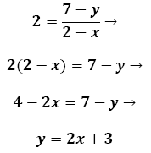
Exercise 3. Morphometrics – Linear Functions
Super problem solver
Q5. Find the slope-intercept formula for the line in Q4.
Click for the answer!

Slide 76
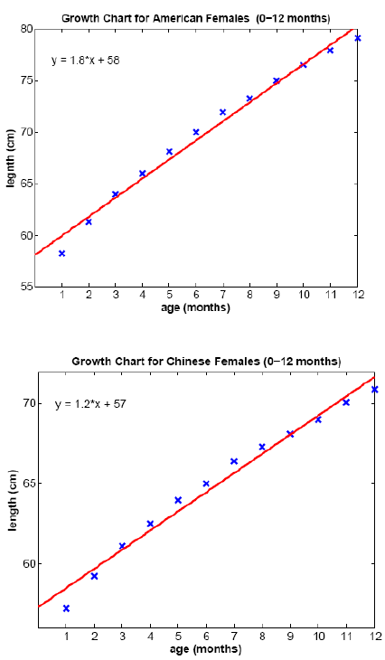
Exercise 3. Morphometrics – Linear Functions
In each figure to the right, length is plotted against infant age. The equation of the best fit line is also displayed. The closer the points are to this line, the stronger the relationship between the two variables. It looks like the relationship between body length and age is very strong in Chinese and American infants.
If many points lie far from the line, there is probably no correlation (relationship) between the traits. If the points cluster in a band from upper left down to lower right, the two traits are negatively correlated. In this case, the slope of the best fit line is negative.

Slide 77
Exercise 3. Morphometrics – Linear Functions
If the points cluster in a band running from lower left to upper right as seen here, the traits are positively correlated, and the slope of the best fit line is positive. Thus older female infants tend to have longer body lengths than younger female infants.
The data points for American females tend to lie above those for Chinese females. This is reflected in the fact that the best fit line for the American data falls above that for the Chinese data. This suggests that in infants, American females are longer than Chinese females. Why might this be the case?

Slide 78
Exercise 3. Morphometrics – Linear Functions
Q6. Record the slope of the best fit line for both the American and Chinese infant growth data. Which best fit line has the largest slope? How would you interpret this fact? Click for the answer!
For American female infants, m = 1.8 cm/month, and for for Chinese female infants, m = 1.2 cm/month. This means that American female infants grow faster than Chinese female infants.

Slide 79
Exercise 3. Morphometrics – Linear Functions
Q7. Record the y-intercept of the best fit line for the Chinese and American infant growth data. Which data set has the smallest y-intercept? How would you interpret this fact? Click for the answer!
For American female infants, b = 58, and for Chinese female infants, b = 57. This means that at birth (age = 0 months), American female infants are larger than Chinese female infants.

Slide 80
Exercise 3. Morphometrics – Directions (continued)
For each trait that you have measured, make two scatter plots, one for herbivores and one for carnivores, plotting the trait’s value vs the skull length. Label the x-axis skull length and the y-axis according to the trait that you are plotting.
Draw a line through your data points so that as many points as possible are as close to your line as possible. (There is a statistical procedure to find the actual ‘best fit’ line for your data, but for our purposes your best guess will suffice.) The line you have drawn is described by a linear equation of the form y = mx + b
The slope of the line is m, and the y-intercept of the line is b.
For graph paper template
Move on

Slide 81


Exercise 3. Morphometrics – Directions (continued)
Find two points on your line, (x₁, y₁) and (x₂, y₂). These points need not be data points. They just need to fall on your line.
Calculate the slope, m, of your line using the formula
Example: If the points (2,4) and (4,9) both fall on the line, then the slope of the line is
Move on

Slide 82

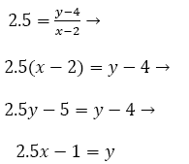
Exercise 3. Morphometrics – Directions (continued)
Use the point slope formula
where (x₁, y₁) is one of the points on your line to determine the value of b.
Example: Assuming that the points (2,4) and (4,9) fall on the line we found that m = 2.5, and so the point slope formula becomes
So for this example we see that b = -1
Click to see ways to analyze your data

Slide 83
Exercise 3. Morphometrics – Directions (continued)
Examine the cluster of points along the lines and the slopes of the lines to determine if there is a potential positive or negative relationship between the two variables.
Examine the points for the herbivores versus those for the carnivores. If one group tends to have higher or lower data values than the other, then that feeding type tends to have a smaller value for that trait relative to body size than the other feeding type.
Compare the measures you have taken on the carnivore skulls relative to those recorded for the herbivore skulls.
For those measures that appear to show a negative or positive correlation with total skull length (our measure of animal size), you will need to express your values in the form of a proportion using the ratio: trait value of interest/total skull length. This corrects for animal size as already discussed.

Slide 84
Exercise 3. Morphometrics – Directions (continued)
You may also wish to compare multiple traits (corrected for skull length) using scatter plots. In this case, however, there will not be an independent variable axis (total skull length) but merely comparison of two traits of equal interest. For example, compare the rough estimate of brain size to the volumetric measure obtained by filling the skull with BBs, or compare molar tooth row lengths of mandibles to the estimates of eye diameter. In this case, you are looking for correlations among a suite of traits that might be associated with a feeding strategy (carnivore or herbivore).
Note that with larger sample sizes (more skulls to measure), you could actually quantitatively determine whether the associations or correlations you found are significant ones. The exercise you have completed here is exploratory in that it can only provide clues as to such relationships.

Slide 85
Exercise 3. Morphometrics
Data Extrapolation and Interpolation
Choose one of your plots for which there appears to be a strong correlation between a trait of interest and skull length.
Use the line that you fit to this plot to estimate the value of the trait in an animal with a skull length that lies outside your data’s range.
Example:If the largest skull you measured was 22 cm long, and the smallest skull you measured was 2 cm long, then your data’s range is 2-22 cm. Since 30 cm is larger than the largest skull you measured, it lies outside your data’s range. (Similarly 1 cm lies outside your data’s range.) Let’s estimate the value of the trait in an animal with a skull 30 cm long. If the equation of the line you fit to the data was y = 2.5x - 1, then your estimate of the value of the trait is 2.5(30) – 1 = 74 cm. You have just extrapolated a value that lies outside of your data range!

Slide 86
Exercise 3. Morphometrics
Data Extrapolation and Interpolation
Use the line that you fit to this plot to estimate the value of the trait of interest in an animal with a skull length that lies within your data’s range. This is interpolation.
Q8. Which type of estimation do you think is more reliable, extrapolation or interpolation? Why? Click for the answer!
Interpolation is more reliable than extrapolation. Outside of your data’s range, other factors might influence the relationship between the two variables of interest so that the linear equation you fit to your data is no longer valid.

Slide 87
Exercise 3. Morphometrics – Directions (continued)
Now you are ready to compare trait values between herbivore and carnivore species (corrected for skull length) using bar graphs as described in Exercise 2. Dental Formulas
You may also wish to test for correlations between the traits you measured as you did for each trait versus total skull length.
  If you do this, there will not be an independent variable (total skull length) plotted on the x-axis, as you are merely comparing two traits of equal interest. You are looking for correlations among a suite of traits that might be associated with feeding strategy (carnivore or herbivore).
To review bar graph construction (in Exercise 2)
Otherwise, to move on:

Slide 88
Exercise 3. Morphometrics – Directions (continued)
With larger sample sizes (more skulls to measure), you could actually quantitatively determine whether the differences in trait values between feeding strategies or correlations in traits you found visually differ from chance (are statistically significant).
Unit 8: Everything Varies introduces the idea of statistical significance.
The exercise you completed here is simply exploratory, in that it can only provide clues as to the presence of such relationships.

Slide 89
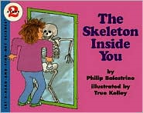
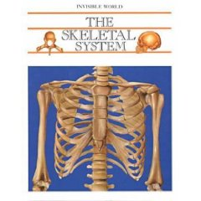
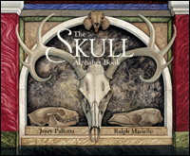
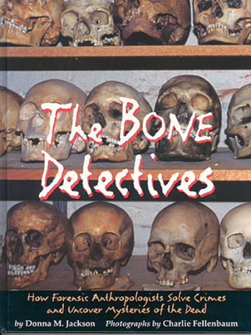
Suggested Reading – Younger Students
Grades K-3
Dem Bones - Bob Barner
You Can't See Your Bones with Binoculars - Harriet Ziefert & Amanda Haley (Illustrator)
Bones - Stephen Krensky
A Book About Your Skeleton - Ruth Belov Gross & Steve Bjorkman (Illustrator)
The Search for the Missing Bones (The Magic School Bus Chapter Book, No. 2) - Eva Moore & Ted Enik (Illustrator)
Skeletons (The Magic School Bus, A Science Fact Finder) - Jackie Glassman, Carolyn Bracken (Illustrator), Lynda Nyse (Illustrator)
A Magic Skeleton Book: Safari Animal Adventure - Shaheen Bilgrami, Chantal Kees (Illustrator), & Chris Shields (Illustrator)
The Skull Alphabet Book - Jerry Pallotta and Ralph Masiello (Illustrator) (Beautiful illustrations, fascinating for ALL ages!)
Grades 4-7
Bones: Our Skeletal System - Seymour Simon
Skeleton - Steve Parker
The Bone Detectives: How Forensic Anthropologists Solve Crimes and Uncover Mysteries of the Dead - Donna M. Jackson & Charlie Fellenbaum (Photographer)
Make This Life-Size Model Skeleton - Iain Ashman, Susanna Addario (Illustrator), Claudia Saraceni (Illustrator), Thomas Trojer (Illustrator)
The Skeletal System - Eduard Arnau & Antonio Munoz Tenllado (Illustrator)

Slide 90
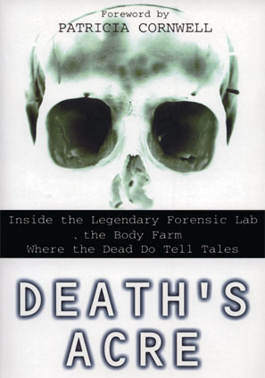
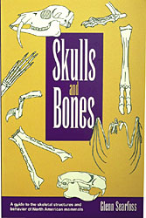
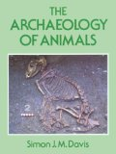
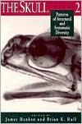
Suggested Reading – Higher Grades
Grades 7+
Death's Acre: Inside the Legendary Forensic Lab the Body Farm Where the Dead Do Tell Tales - William Bass & Jon Jefferson
Skulls and Bones: A Guide to the Skeletal Structures and Behavior of North American Mammals - Glenn Searfoss
The Archaeology of Animals - Simon J. M. Davis
The Skull, Volume 2: Patterns of Structural and Systematic Diversity - James Hanken
Scientific Journal Articles (PDFs included on Teacher CD!)
Dayan, T., D. Wool, and D. Simberloff. 2002. Variation and covariation of skulls and teeth: modern carnivores and the interpretation of fossil mammals. Paleobiology 28(4):508-526.
Mattson, D.J. 1995. Diet and morphology of extant and recently extinct northern bears. Ursus 10:479-496.
Patterson, B.D., E.J. Neiburger, and S.M. Kasiki. 2003. Tooth breakage and dental disease as causes of carnivore -- human conflicts. Journal of Mammalogy 84(1):190-196.
Perez-Barbería, F.J. and I.J. Gordon. 2001. Relationships between oral morphology and feeding style in the Ungulata: A phylogenetically controlled evaluation. Proceedings: Biological Sciences 268(1471):1023-1032.
Wroe, S., C. McHenry, and J. Thomason. 2005. Bite club: Comparative bite force in big biting mammals and the prediction of predatory behaviour in fossil taxa. Proceedings of the Royal Society B 272:619-625.
Zuccarelli, M.D. 2004. Comparative morphometric analysis of captive vs. wild African Lion (Panthera leo) skulls. Bios 75(4):131-138.

Slide 91
Links (all underlined text is clickable!)
Biology4Kids.com: Vertebrates – Good information about vertebrates!
The Truth About Teeth – Good introductory info for younger students about types of teeth and tooth anatomy from KidsHealth.org.
Super Teeth – Part of the American Natural History Museum’s Ology site with an activity for younger students in which they match teeth to their animal owners.
Primate Teeth – An image comparing the upper teeth of several families of primates, hosted by the University of Michigan Museum of Zoology’s Animal Diversity Web, which is a great site to explore!
Primate Dentition – An exercise from the Jane Goodall Institute using dental formulas to compare several groups of primates (prosimians, Old and New World Monkeys, apes, and humans).
Dinosaur Paleoecology – Exercise for older students by David J. Davies (Centenary College of Louisiana) on functional morphology of dinosaur teeth
Tooth Detectives – Exercise by James W. Westgate (Lamar University); good source material for Exercise 1 with information on tooth types.
Rat Teeth – Good information on rodent dentition, as well as mammal teeth in general.
Skulls Unlimited International – Supplier of a huge range of skulls for educational purposes, which has an EXCELLENT Educational Resources section. Also check out the website of their Museum of Osteology!
Dental Formulae of Mammals of North America – Ever wondered how many teeth a particular kind of mammal has? Get the answer here!
Using Dentition to Age Cattle – Good information on herbivore teeth from the USDA, including dental formulas and information on tooth development in cows.
Skull and Dentition Measuring Standards – Excellent images illustrating cranial anatomy and common skull measurements using the skulls of lorises and pottos.

Slide 92
Links (continued)
Researchers put ‘teeth’ into dinosaur classification scheme – Interesting article on identification of dinosaur species from teeth.
www.skullsite.co.uk – Great site with images and information on numerous animal skulls, including dental formulas (check out his Species List), an excellent Glossary of skull terminology, and a section on Skull Preparation.
Standard Protocols and Procedures – Source of Figure 2 (potential skull measurements) for Exercise 3. The homepage of the Jackson Laboratory, which uses mouse models to study inherited craniofacial dysmorphologies in humans may be of interest to teachers at the high school level. An online publication from the Jackson Laboratory is HERE.
Vertebrate Skeleton and Vertebrate Skull – These sites, from a course by Sandra Millen at the University of British Columbia offer images, information, and questions that might be good for high school biology courses.
Key to Skulls of North Dakota Mammals – Though the mammal skulls in your box may not be in the linked key (if they’re not found in ND), the link itself first goes to a key to mammalian orders. All mammal skulls in the box could easily be keyed to at least the level of order by most middle to high school students with maybe some assistance from skullsite.co.uk Glossary linked above! (From Wiehe, J. M. 1978. Key to the skulls of North Dakota mammals. Prairie Naturalist 10(1):1 -16. Jamestown, ND: Northern Prairie Wildlife Research Center Online.)
Digimorph.org – AMAZING site with digitized 3-D images (using X-ray CT technology) of skeletal and cranial structures of over 750 specimens of numerous species of all vertebrate groups (and some invertebrates). Students can view movies displaying rotation of skulls and skeletons along all three body planes, as well as movies of slices through each, allowing visualization of internal features of the skull. SUPER COOL!

Slide 93

Graph paper
template

