Slide 1
Solids, Liquids and Gases

Slide 2
Specification
Solids, liquids and gases
Change of state
understand the changes that occur when a solid melts to form a liquid, and when a liquid evaporates or boils to form a gas
describe the arrangement and motion of particles in solids, liquids and gases

Slide 3
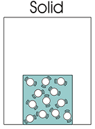
States of matter
Substances can exist as solids, liquids or gases.
1. Solids
In a solid the particles (molecules) vibrate about fixed positions within a close packed regular structure.
The particles cannot move in between each other which results in a solid having a definite shape and fixed volume.
Notes:
3

Slide 4
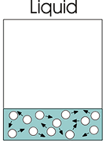
2. Liquids
When a solid is heated it may melt to form a liquid.
In a liquid the particles (molecules) move in-between each other and are approximately the same distance apart as in a solid.
A liquid does not have a definite shape but it does have a fixed volume.
Notes:
4
4

Slide 5
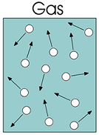
3. Gases
When a gas is heated it may evaporate or boil to form a gas.
In a gas the particles (molecules) move in-between each other and are much further apart than they are in a liquid.
A gas takes up the shape and volume of its container.
Notes:
5
5

Slide 6
Property summary table
Property | Solids | Liquids | Gases
definite shape | yes | no | no
can be easily compressed | no | no | yes
relative density | high | high | low
can flow (fluid) | no | yes | yes
expands to fill container | no | no | yes
fixed volume | yes | yes | no
Notes:
6
6

Slide 7
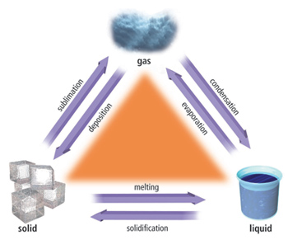

Slide 8
Change of state
ice → water → steam

Slide 9
Change of state
ice → water → steam
Temperature (°C)
Draw a graph of temperature …

Slide 10
Change of state
ice → water → steam
Temperature (°C)
Time
… against the length of time it has been heated

Slide 11
Change of state
ice → water → steam
Temperature (°C)
warming ice
Time
Really cold ice from the freezer

Slide 12
Change of state
ice → water → steam
Temperature (°C)
melting ice
Time
The temperature stays the same as the ice melts

Slide 13
Change of state
ice → water → steam
Temperature (°C)
0°C
Time
Pure water melts at 0°C

Slide 14
Change of state
ice → water → steam
Temperature (°C)
warming
water
0
Time
The temperature goes up as the water is warmed

Slide 15
Change of state
ice → water → steam
boiling
water
Temperature (°C)
0
Time
The temperature stays the same while the water boils

Slide 16
Change of state
ice → water → steam
100°C
Temperature (°C)
0
Time
Pure water boils at 100°C

Slide 17
Change of state
ice → water → steam
Temperature (°C)
100
0
Time
Pure water melts at 0°C and boils at 100°C

Slide 18
Change of state
ice → water → steam
Temperature (°C)
Time
Pure water melts at ………°C and boils at ………°C

Slide 19
Change of state
ice → water → steam
Temperature (°C)
100
0
Time
Pure water melts at 0°C and boils at 100°C

Slide 20
Change of state
ice → water → steam
heating
steam
Temperature (°C)
100
0
Time
Steam can give you a far worse burn than boiling water

Slide 21
Choose appropriate words to fill in the gaps below:
A solid has a definite _______ due to it consisting of closely packed _________ which cannot move in-between each other.
When a solid is ________ to become a liquid the molecules can _______ in-between each other. However, the molecules remain ______ together and so a liquid is as _______ and incompressible as a solid.
When a liquid becomes a gas the molecules fill up the _____ available. A gas is therefore is easily ____________.
shape
molecules
heated
move
close
dense
space
compressed
WORD SELECTION:
molecules
dense
move
shape
heated
close
space
compressed
Notes:
21
21
21

Slide 22
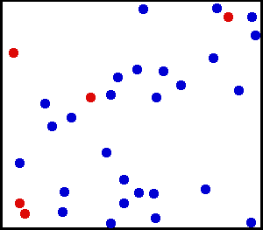
Molecular movement in gases
A gas consists of molecules moving about in random motion.
Due to collisions, the speed and direction of each molecule is continually changing in an unpredictable way.
random motion
Notes:
22
22

Slide 23

Brownian motion
In 1827, Robert Brown observed through a microscope the motion of pollen grains suspended in water.
The grains were seen to jerk about randomly.
A similar observation can be seen with smoke particles suspended in air.
The yellow sphere represents the pollen grain of smoke particle.
The black particles represent water or air molecules.

Slide 24
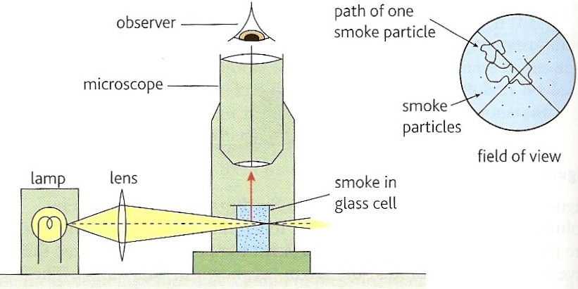
Observing Brownian Motion with Smoke
Notes:
24
24

Slide 25
The significance of Brownian Motion
Einstein, in 1905, proved mathematically that the motion of the smaller, invisible air molecules must be as random as the larger, visible smoke particles.
The smoke particles move much more slowly than the air molecules due to their much greater mass.
The yellow sphere represents the pollen grain of smoke particle.
The black particles represent water or air molecules.
Notes:
25
25

