Slide 1
Effects of Thermal Energy

Slide 2
Learning Objectives
At the end of this unit you should be able to :
1) infer that generally solids, liquids and gases expand when heated and contract when cooled.
2) describe some effects and application of expansion and contraction in everyday life riveting, gaps in bridges, pavement and MRT lines, overhead power and telephone lines, thermostats.
3) discuss the strange expansion of water.

Slide 3
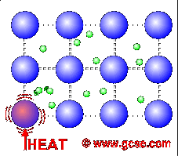
Molecular Explanation of Thermal Expansion
When the rod (say an iron rod) is heated, the vibration of the molecules increases and their displacement, or amplitude, also increases.
As the amplitude of vibration increases, the average distance between molecules of the rod becomes larger and this accounts for its expansion in length.

Slide 4
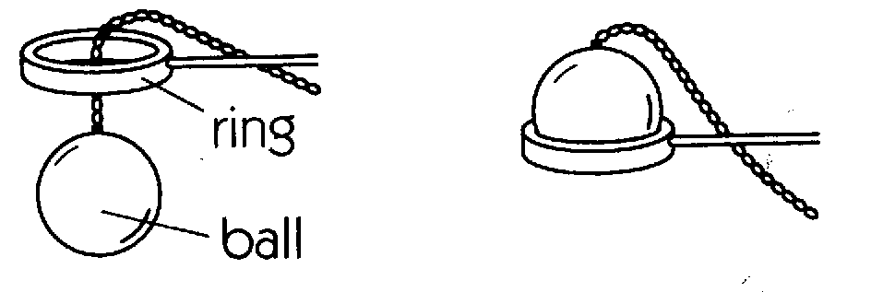
Expansion of Solids
Ball and Ring
A solid expands when heated, contracts when its temperature
decreases.
Before heating the ball
(continue on next slide)
After heating the ball

Slide 5
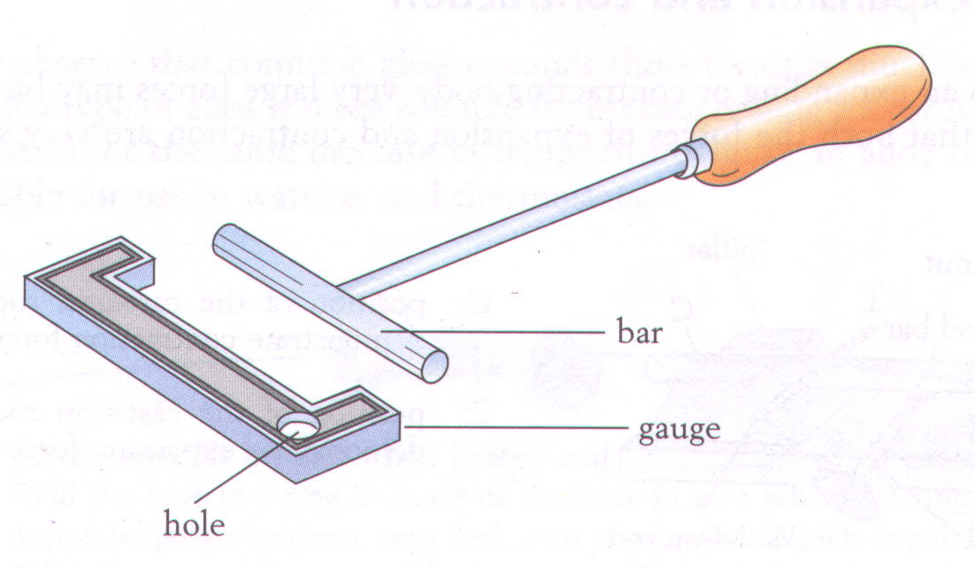
Expansion of Solids
Bar and Gauge
The bar will just fit into the gap when both the bar and gauge are cold.
Heat the bar with Bunsen burner.
Does it fit the gap now ?
What happens when it cools down ?

Slide 6
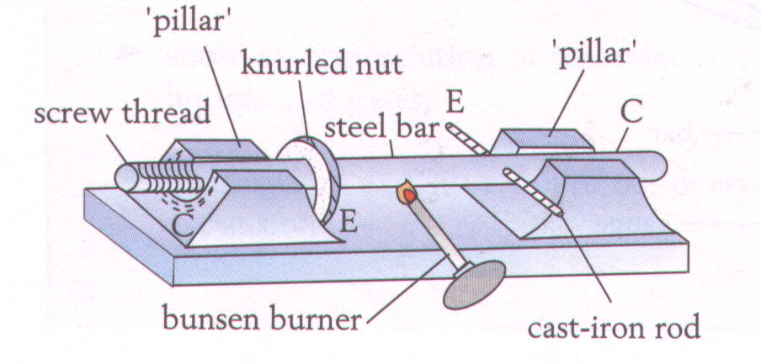
Expansion of Solids
Bar Breaker
The steel bar is heated with Bunsen burner and then the portion with screw thread is tighten by a nut.
What happen when
to the cast-iron rod
when the bar cools
down ?
What conclusions
you may make
from this experiment ?

Slide 7
Expansion of various Solids
Different materials expands by different amount
when heated through the same increase in
temperature.
Materials Increase in length (mm) per m
aluminium 0.25
brass 0.19
iron 0.12
steel 0.11
glass 0.09
invar 0.01

Slide 8
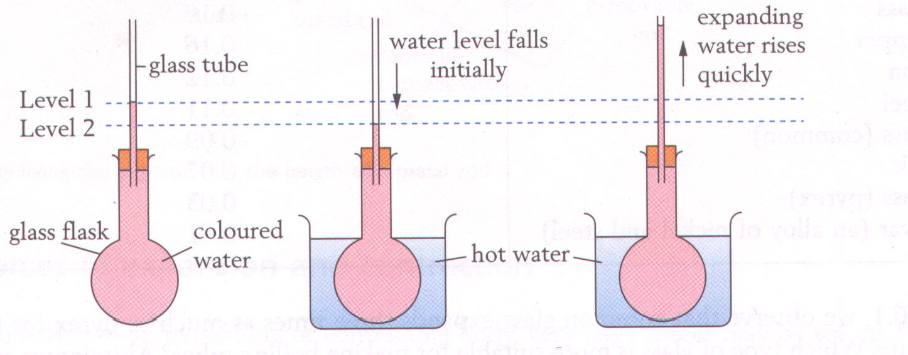
Expansion of Liquids
(a)
(b)
(c)
Fig. (a) shows a glass flask filled with coloured water.
Fig. (b) the water level is seen to fall for first few
seconds when heated. (Why ?)
Fig. (c) later, water level rises quickly. (Why ?)

Slide 9
Forces of expansion and contraction
From the experiment given by Bar Breaker, we may
conclude that:
Expansion and contraction produced a very large
force.

Slide 10
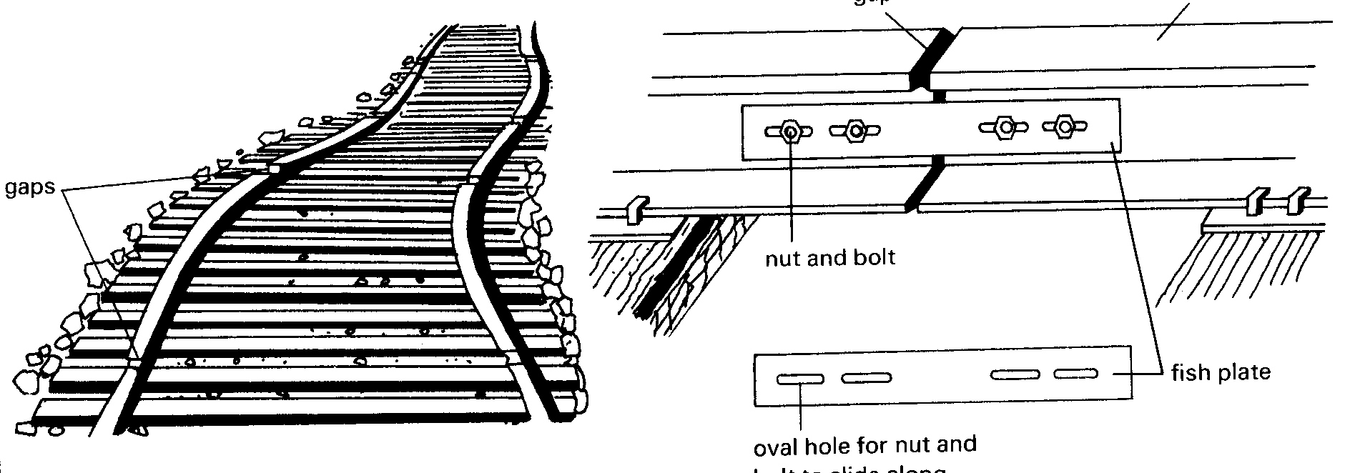
Compensations for Thermal Expansion
gap
rail track
oval hole for nut and bolt to slide along
Railways tracks are laid in sections with gaps between
them. (Why ?)
The railways sections are held together by fish-plate
and fastened by bolts and nuts through oval holes.
(Why ?)

Slide 11
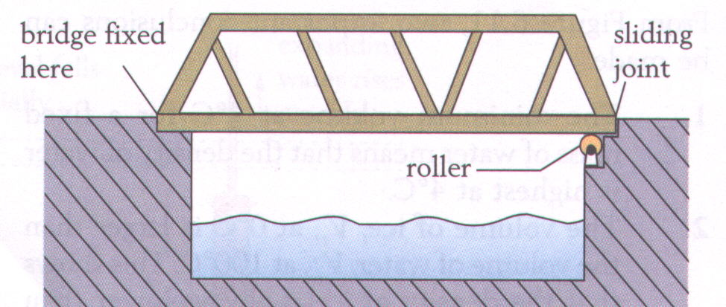
Compensations for Thermal Expansion
Rollers and gap given at one end of the bridge is
used to overcome the problem posed by contraction
in cold weather and expansion in hot weather.

Slide 12
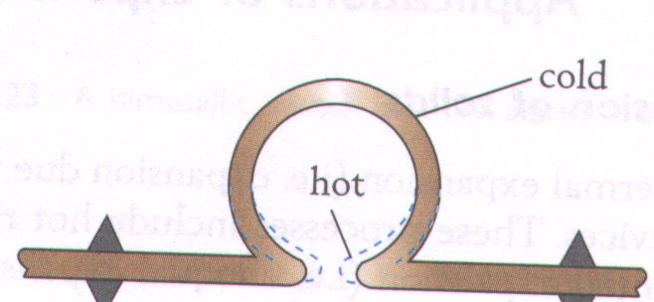
Compensations for thermal expansion
Expansion
Joint
Pipelines carry very hot gases (such as steam), therefore need expansion joint (in ring form) to avoid damages given by expansion.

Slide 13
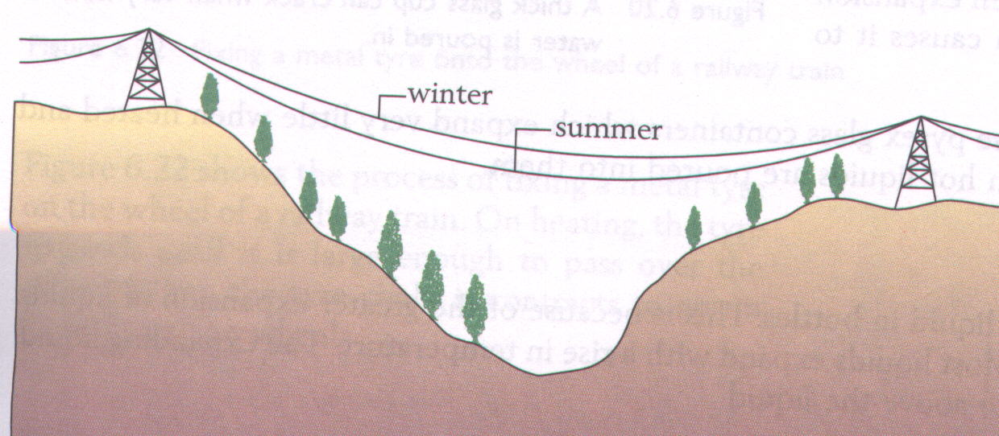
Compensations for thermal expansion
Overhead power lines and telephone wires
In summer and winter, the overhead power lines and
telephone wires will expands and contracts due to the
changing weather. How do you overcome this problem ?

Slide 14
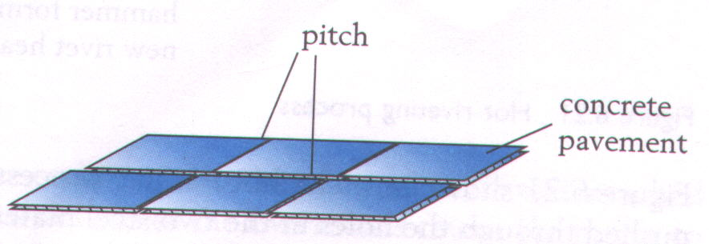
Compensations for thermal expansion
Concrete Pavement
Concrete blocks for pavements and road surfaces are
laid with gaps or joints between them. This allow it expands or contracts during hot or cold weather

Slide 15
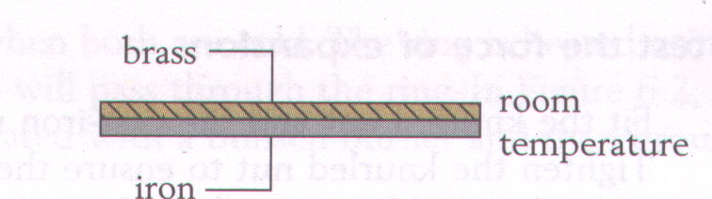
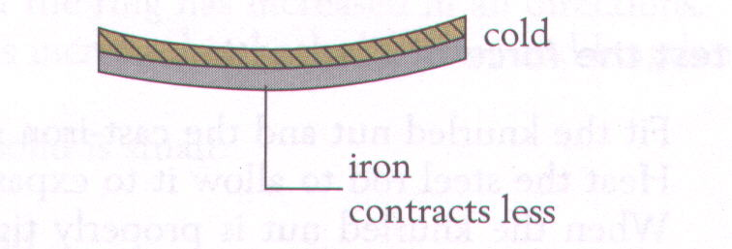
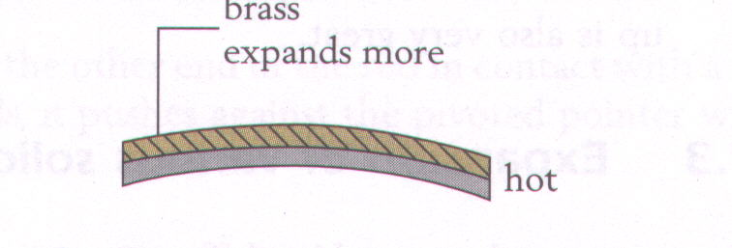
Bimetallic Strip
A bimetallic strips is
made up of two strips
of different metals.
Brass and iron are
common metals been
used.
Brass expands more
than iron when hot,
and contracts more
too.

Slide 16
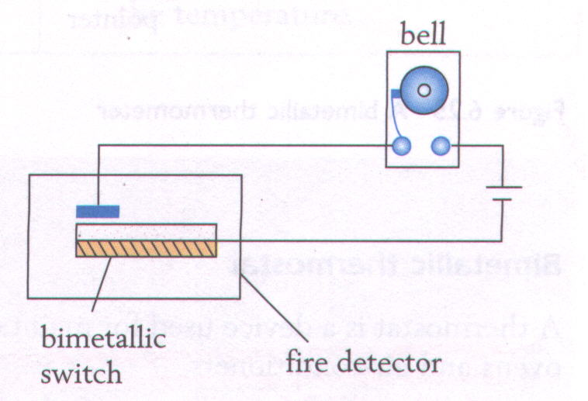
Bimetallic strip & its application
Fire Alarm
If the fire breaks
out, the heat from
the fire will cause
the bimetallic strips
to bend upwards
and complete the
circuit. The alarm
bell then ring.

Slide 17
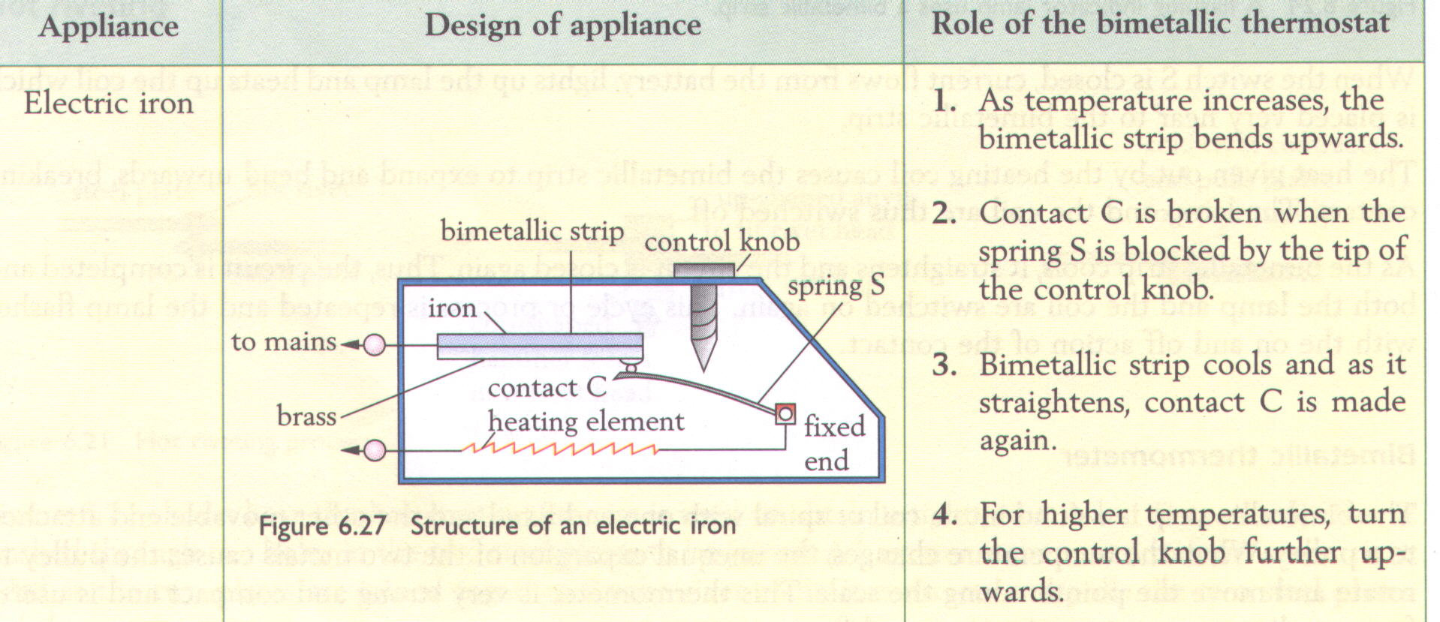
Electric Iron

Slide 18
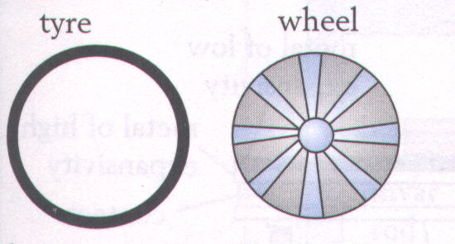

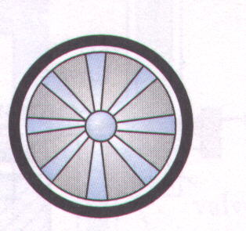
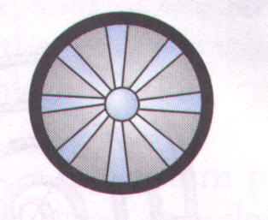
Application of Thermal Expansion
Fig. (a) shows the tyre
is too small when cold.
Fig. (b) shows tyre has
bigger diameter than
wheel when heated.
Fig. (c ) shows that tyre
is firmly secured on the
wheel. (Why ?)
(a)
Metal Tyre Fixing
(b)
(c)

Slide 19
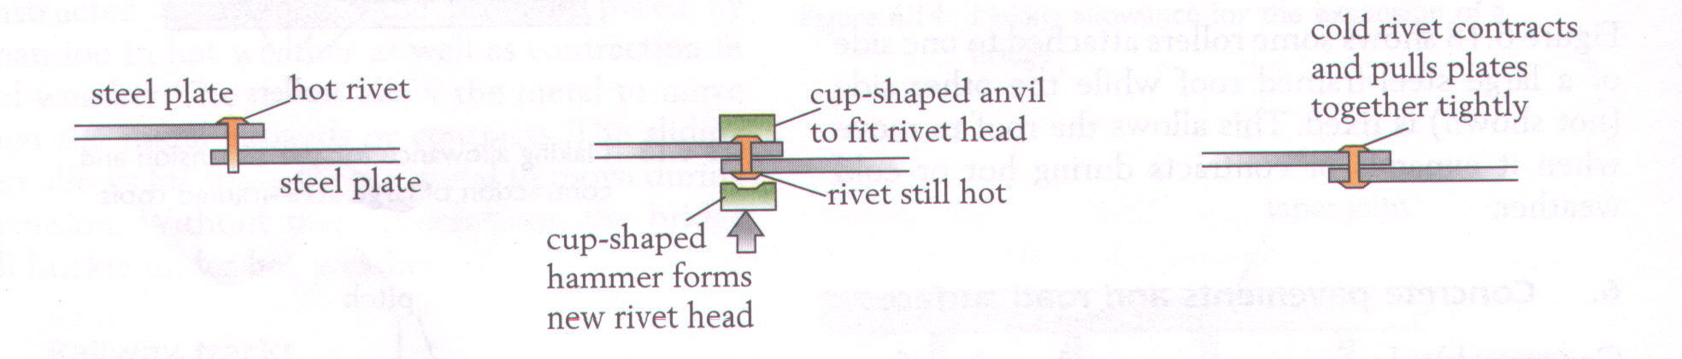
Application of thermal expansion
Hot riveting is a common method to fasten two
metal plates firmly. How ?
(a)
(c)
(b)
Hot Riveting

Slide 20

The unusual behaviour of Water
Most liquids expand when heated and contract when
cooled. Water, however is an exception.
Between 0⁰ C to 4⁰ C, water contracts when temperature increases while water expands when temperature decreases.
Water has highest density and smallest volume at 4⁰C

Slide 21
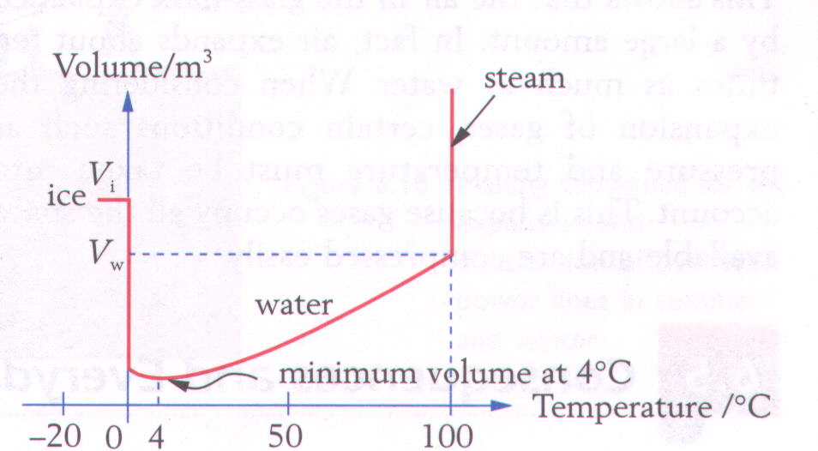
Graph of volume against temperature of water
(continue on next slide)

Slide 22
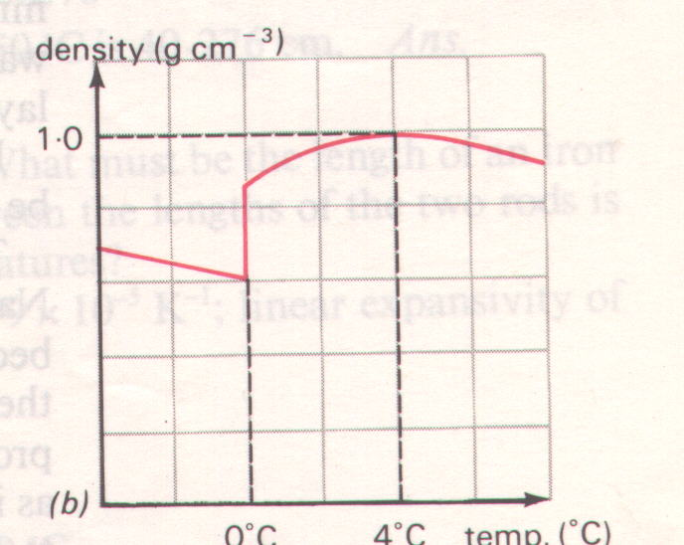
Graph of density against temperature of water

Slide 23
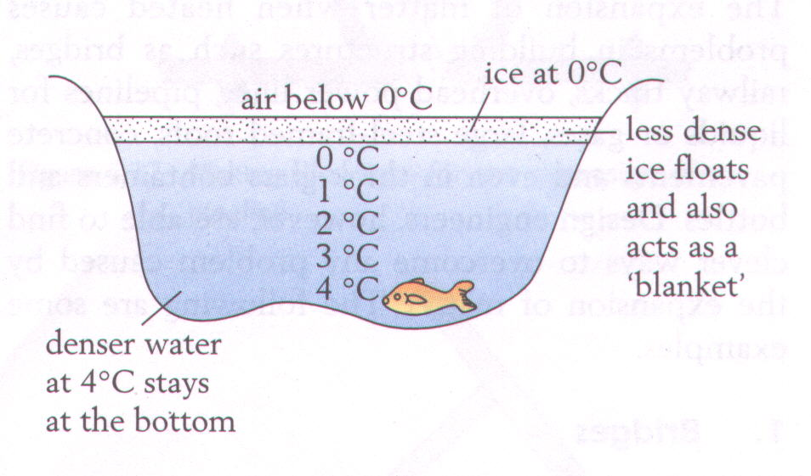
During Winter……
Due to the unusual behaviour of water, at 4°C during
Winter time, at, water at the surface of a pond will sinks
(Why ?). Later, even the surface freezes, the fish inside
the pond still alive. ( Why ? )

