Slide 1
Fractions
Equivalent and Simplifying Fractions
Multiplying Fractions
Dividing Fractions
Adding Fractions
Subtracting Fractions

Slide 2
Starter Questions

Slide 3
Algebraic Fractions
Learning Intention
Success Criteria
  To explain how to simplify algebraic fractions.
  Understand term
  Highest Common Factor.
  2. Simplify algebraic fractions by identifying HCF.

Slide 4

Equivalent Fractions
Multiply top and bottom by any number
Multiply top and bottom by any number or letter
We already know how to create an equivalent fraction for numerical fractions.
The exact same process is used for algebraic fractions.
Numerical Fraction
Algebraic Fraction

Slide 5
Equivalent Fractions
Common Denominator for 2 fractions
Numerical Fraction
Algebraic Fraction

Slide 6
Algebraic Fractions
We can sometimes reduce fractions to a simpler form if the numerator and denominator have a number or letter in common.
Examples
HCF = 3
HCF = Y

Slide 7
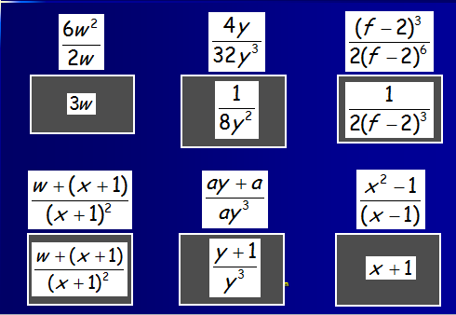
What Goes In The Box ?

Slide 8
Algebraic Fractions
Multiplication
Learning Intention
Success Criteria
  To explain how to multiply algebraic fractions.
  Know rules for multiplication simple fractions.
  2. Apply knowledge to algebraic fractions.

Slide 9
Algebraic Fractions
Multiplication
Numerical fraction
Algebraic Fraction
3
5
1
10
1
2

Slide 10
Algebraic Fractions
Division
Learning Intention
Success Criteria
  To explain how to divide algebraic fractions.
  Know rules for division of simple fractions.
  2. Apply knowledge to algebraic fractions.

Slide 11
Algebraic Fractions
Division
Numerical Fraction
Algebraic Fraction
8
1
15
1

Slide 12
Algebraic Fractions
Division
Example 2
Example 3
4
3

Slide 13
Algebraic Fractions
Division
Example 4
1
1
1
1
1
1

Slide 14

Algebraic Fractions
Addition
Example 1a
Example 1b
4
+
2
3d
+
d
8
d²
÷2
4d
÷d
÷2
d²
÷d

Slide 15
Algebraic Fractions
Addition
Example 2
Example 3
3(x + 1)
+
x(x - 1)
12
+
x²
(x - 1)(x + 1)
4x
3x + 3 + x² – x
(x - 1)(x + 1)
x² + 2x + 3
(x - 1)(x + 1)

Slide 16
Algebraic Fractions
Subtraction
Learning Intention
Success Criteria
  To explain how to subtract algebraic fractions.
  Know how to subtract simple fractions
  2. Apply same knowledge to subtract algebraic fractions.

Slide 17
Algebraic Fractions
Subtraction
Example 1a
Example 1b
15
-
8
3m
-
p
20
pm

Slide 18
Algebraic Fractions
Subtraction
Example 2
Example 3
15
-
fg
3(x + 5)
-
x
5g
x(x + 5)
3x + 15
-
x
x(x + 5)
2x + 15
x(x + 5)

