Slide 1
Reflection

Slide 2
Ray diagrams

Slide 3

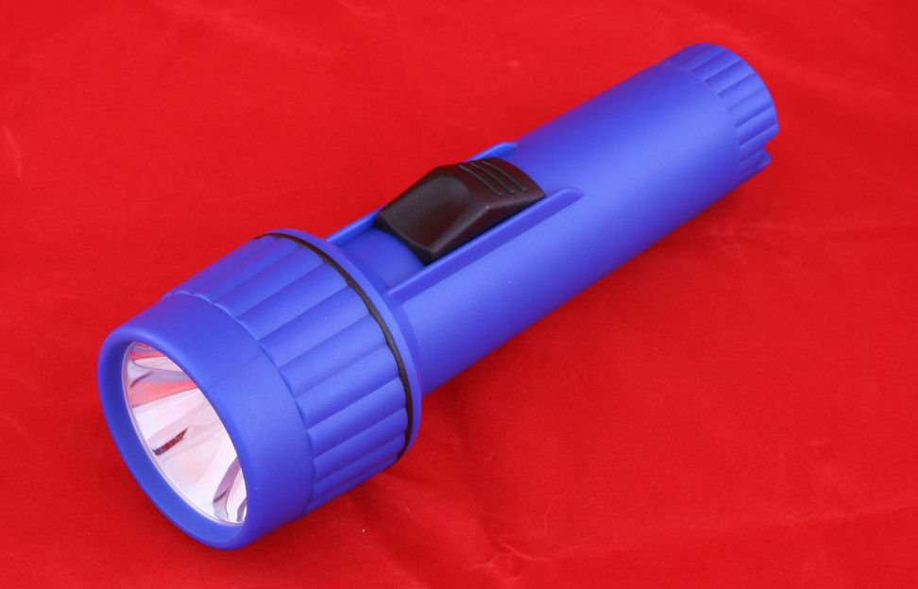
Beams of light
Beams of light travel in straight lines. We can see this when we look beams of light such as search lights, laser beams, car head lights and torches.
This is why we can not see around corners and why shadows are formed.

Slide 4
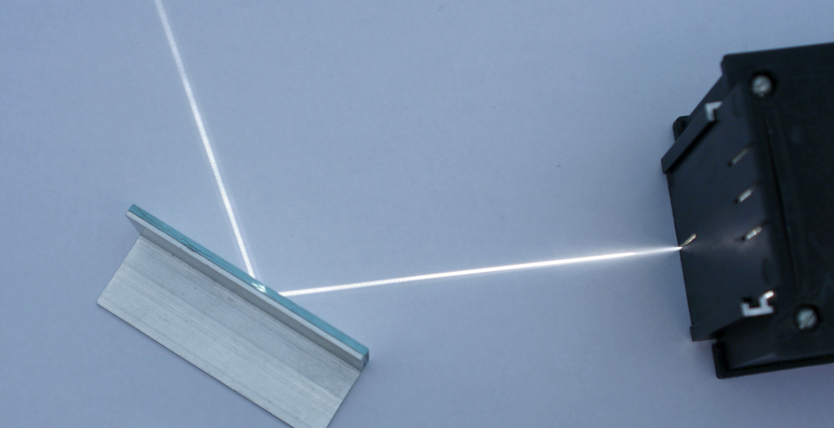
Ray boxes
We can investigate light by using ray boxes in a darkened room. Ray boxes produced a narrow beam of light (called a light ray) which makes it easier to study effects such as reflection and refraction.

Slide 5
Ray diagrams
When we draw a diagram of an experiment using a ray box we represent the beam of light using a straight line. An arrow is placed on the beam showing the direction the light is travelling in.
When we draw a ray diagram we must:
Use a sharp pencil
Draw clearly and
accurately

Slide 6
The normal
When we draw a ray diagram and a ray of light hits the surface of an object we add a line to the diagram called the normal. The normal is drawn at right angles (90°) to the surface the ray has hit.
The normal is drawn in as we can measure the angle between the ray and the normal.
normal

Slide 7
Reflection

Slide 8
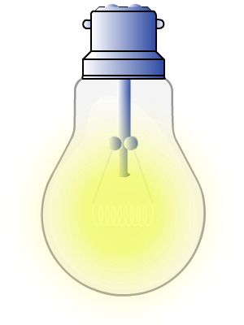
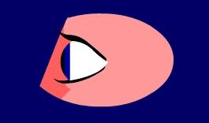
Seeing luminous objects
A luminous object gives out light and can also be called a light source.
How does light from a light bulb and other light sources reach your eye?
Light travels in a straight line directly into your eye.

Slide 9
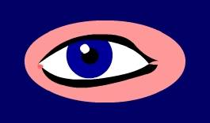
Seeing non-luminous objects
Objects that do not give out light are non-luminous.
How does your eye see non-luminous objects such as a book?
Light from the light source strikes the book and some of the light is reflected into your eye.

Slide 10
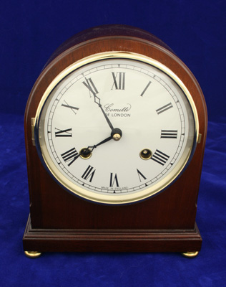
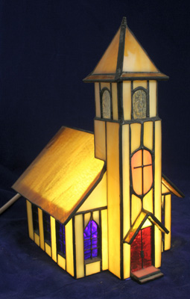
Transparent, opaque and translucent
Transparent materials, such as glass, let nearly all the light that falls on them pass through. Very little light is reflected or absorbed by the material.
Opaque materials, such as wood, do not let any of the light that falls on them pass through. All the light is either reflected or absorbed by the wood.
Translucent materials, such as frosted glass, let some of the light that falls on them pass through. The rest of the light is reflected or absorbed by the material.

Slide 11
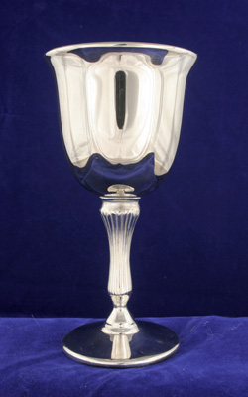
Shiny surfaces
Shiny surfaces reflect a lot more of the light that falls on them than matt surfaces.
They often look brighter than surrounding objects as more of the light falling on them is reflected into our eye. You can often also see reflections of other objects on their surface.
Mirrors are pieces of glass with a coating of silver on one side. The silver reflects the light passing through the glass. If the surface of the silver is flat we are able to see reflected images clearly, because the light from them is reflected by the mirror into our eyes.

Slide 12
Types of mirror
When we draw a ray diagram we represent a mirror by drawing a line with dashes on the silvered (non-shiny) side. Most mirrors are flat and these are called plane mirrors. They give non-distorted lifelike images.
A plane mirror
A concave mirror
Some mirrors are curved. These give distorted images.
If a mirror curves inwards then it is a concave mirror; if it curves outwards it is a convex mirror.
A convex mirror

Slide 13
Plane mirrors

Slide 14
Law of reflection
Incident ray
i
r
Reflected ray
angle of incidence (i) = angle of reflection (r)
This is called the law of reflection and is true for any type of wave being reflected from a surface.

Slide 15
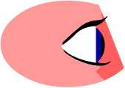
The periscope
By positioning two plane mirrors at 45° to each other at either end of a tube we can make a periscope.
Periscopes are used in submarines to see what is on the surface of the water from underwater.

Slide 16
Lateral inversion
When you look at some writing in a mirror you will notice that it appears backwards. We can work out what is happening by drawing a ray diagram.
The light rays swap over when they are reflected. This causes the image to appear laterally inverted (backwards) when compared to the original object.

Slide 17
Virtual images
When you look at a mirror you see a virtual image that appears to be behind the mirror.
The image appears to be the same size as the original object and the same distance behind the mirror as the object is from the mirror.
distance
distance
object
virtual image

