Slide 1
Squares & Square Roots
Perfect Squares
Lesson 12

Slide 2
Square Number
Also called a “perfect square”
A number that is the square of a whole number
Can be represented by arranging objects in a square.

Slide 3
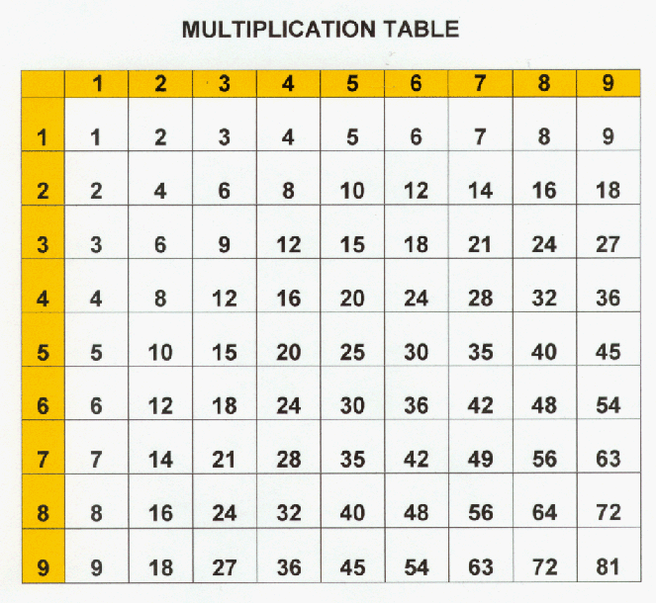
Square Numbers

Slide 4
Square Numbers
1 x 1 = 1
2 x 2 = 4
3 x 3 = 9
4 x 4 = 16

Slide 5
Square Numbers
1 x 1 = 1
2 x 2 = 4
3 x 3 = 9
4 x 4 = 16
Activity:
Calculate the perfect
squares up to 15²…

Slide 6
Square Numbers
1 x 1 = 1
2 x 2 = 4
3 x 3 = 9
4 x 4 = 16
5 x 5 = 25
6 x 6 = 36
7 x 7 = 49
8 x 8 = 64
9 x 9 = 81
10 x 10 = 100
11 x 11 = 121
12 x 12 = 144
13 x 13 = 169
14 x 14 = 196
15 x 15 = 225

Slide 7
Activity: Identify the following numbers as perfect squares or not.
16
15
146
300
324
729

Slide 8
Activity: Identify the following numbers as perfect squares or not.
16 = 4 x 4
15
146
300
324 = 18 x 18
729 = 27 x 27

Slide 9
Squares & Square Roots
Square Root

Slide 10
Square Numbers
One property of a perfect square is that it can be represented by a square array.
Each small square in the array shown has a side length of 1cm.
The large square has a side length of 4 cm.
4cm
4cm
16 cm²

Slide 11
Square Numbers
The large square has an area of 4cm x 4cm = 16 cm².
The number 4 is called the square root of 16.
We write: 4 = 16
4cm
4cm
16 cm²

Slide 12
Square Root
A number which, when multiplied by itself, results in another number.
Ex: 5 is the square root of 25.
5 = 25

Slide 13
Finding Square Roots
We can use the following strategy to find a square root of a large number.
4 x 9 = 4 x 9
36 = 2 x 3
6 = 6

Slide 14
Finding Square Roots
4 x 9 = 4 9
36 = 2 x 3
6 = 6
We can factor large perfect squares into smaller perfect squares to simplify.

Slide 15
Finding Square Roots
Activity: Find the square root of 256
256
= 4 x
64
= 2 x 8
= 16

Slide 16
Squares & Square Roots
Estimating Square Root

Slide 17
Estimating Square Roots
25 = ?

Slide 18
Estimating Square Roots
25 = 5

Slide 19
Estimating Square Roots
49 = ?

Slide 20
Estimating Square Roots
49 = 7

Slide 21
Estimating Square Roots
27 = ?

Slide 22
Estimating Square Roots
27 = ?
Since 27 is not a perfect square, we
have to use another method to
calculate it’s square root.

Slide 23
Estimating Square Roots
Not all numbers are perfect squares.
Not every number has an Integer for a square root.
We have to estimate square roots for numbers between perfect squares.

Slide 24
Estimating Square Roots
To calculate the square root of a non-perfect square
1. Place the values of the adjacent perfect squares on a number line.
2. Interpolate between the points to estimate to the nearest tenth.

Slide 25
Estimating Square Roots
Example: 27
What are the perfect squares on each side of 27?
25
30
35
36

Slide 26
Estimating Square Roots
Example: 27
half
5
6
25
30
35
36
27
Estimate 27 = 5.2

Slide 27
Estimating Square Roots
Example: 27
Estimate: 27 = 5.2
Check: (5.2) (5.2) = 27.04

Slide 28
CLASSWORK
PAGE 302 – 1,3,6,8,9,11,13
PAGE 303 – 16,17,20,22,23,24,26
If finished: Complete page 50 to get ready for your test.

