Slide 1
ELECTROLYSIS

Slide 2
What is a redox reaction?
Oxidation is the addition of oxygen to a substance and
reduction is the removal of oxygen from a substance.
Which substances are oxidized and reduced in this reaction?
oxygen removed
reduction
lead oxide
+
carbon
➔
lead
+
carbon monoxide
oxygen added
oxidation
Reduction and oxidation always take place together. Why is this type of reaction called a redox reaction?
redox = reduction and oxidation

Slide 3

Redox and electrons
Magnesium burns in oxygen to form magnesium oxide.
It is obvious that the magnesium has been oxidized, but what has happened to the oxygen?
A redox reaction can also be explained in terms of the gain or loss of electrons.
What happens to the atoms and electrons in this reaction?
➔
magnesium + oxygen magnesium oxide
2Mg(s)
+
O₂(g)
➔
2MgO(s)
Notes:
Photo credit: Jeronen Ven
Sparks produced by the combustion of magnesium.

Slide 4
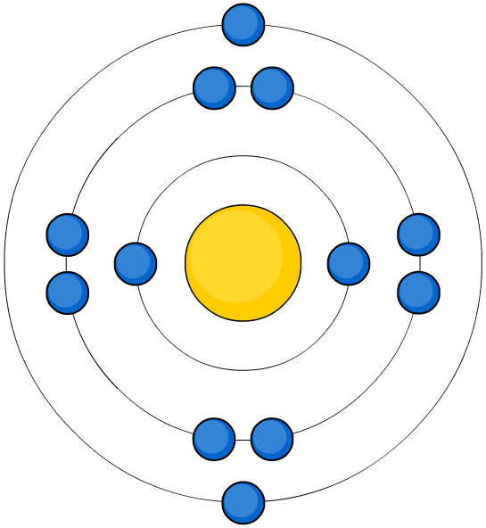
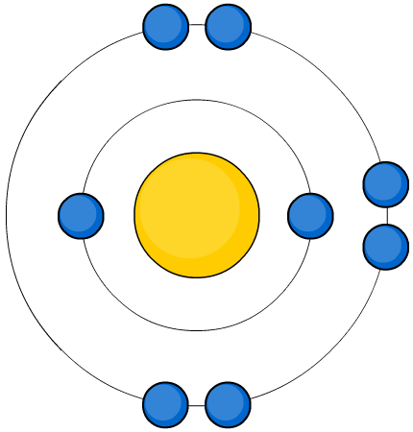
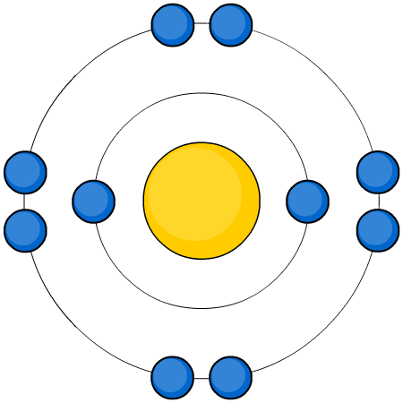
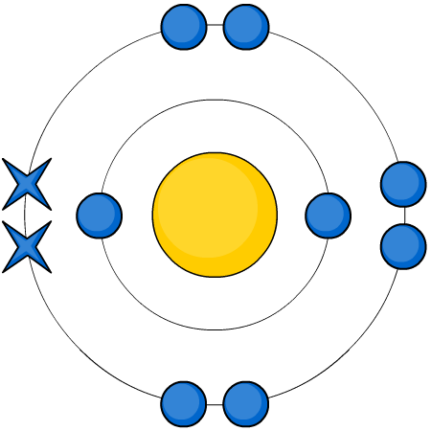
Oxidation and electron loss
When magnesium burns in oxygen to form magnesium oxide, what happens to magnesium and its electrons?
oxidized
(electrons lost)
Mg
+
O
➔
Mg²⁺
O²⁻
The magnesium has been oxidized.
The Mg atom has lost 2 electrons to form a Mg²⁺ ion.
Oxidation is the loss of electrons.

Slide 5
Oxidation and electron gain
When magnesium burns in oxygen to form magnesium oxide, what happens to oxygen and its electrons?
reduced
(electrons gained)
Mg
+
O
➔
Mg²⁺
O²⁻
The oxygen has been reduced.
The O atom has gained 2 electrons to form a O²⁻ ion.
Reduction is the loss of electrons.

Slide 6

Redox and OILRIG
An easy way to remember what happens to the electrons during oxidation and reduction is to think… OILRIG!
Notes:
Teacher notes
This illustration can be used to introduce ‘OILRIG’, which is the well-known mnemonic for remembering the difference between oxidation and reduction, i.e. “Oxidation is Loss, Reduction is Gain”. The scene shows the “REDOX” oil rig, where a helicopter is transferring workers (electrons) to and from the rig and so it can also be used to show that redox reactions involve the transfer of electrons.

Slide 7
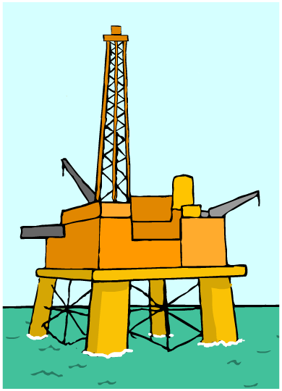
Using OILRIG
What does OILRIG stand for in terms of redox reactions?
Oxidation
Is
Loss of electrons
Reduction
Is
Gain of electrons

Slide 8
What is a half-equation?
Redox reactions involve the transfer of electrons.
Equations written to show what happens to the electrons during oxidation and reduction are called half-equations.
What are the half-equations for the oxidation and reduction processes in this reaction?
➔
magnesium + oxygen magnesium oxide
2Mg (s)
+
O₂ (g)
➔
2MgO (s)
oxidation: Mg → Mg²⁺ + 2e⁻
reduction: O₂ + 4e⁻ → 2O²⁻

Slide 9

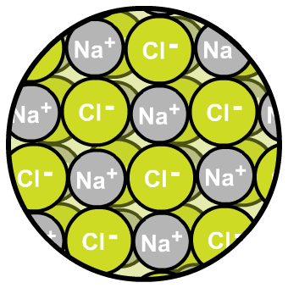
What are ionic compounds?
Ionic compounds are made up of positive metal ions and negative non-metal ions. What ions are in sodium chloride?
positive sodium ions
negative chloride ions
The positive and negative ions in an ionic compound attract each other strongly. It takes a lot of energy to separate them.
How does structure affect the properties of ionic compounds?
Notes:
Photo credit: © 2007 Jupiterimages Corporation
The image show salted pretzels.

Slide 10
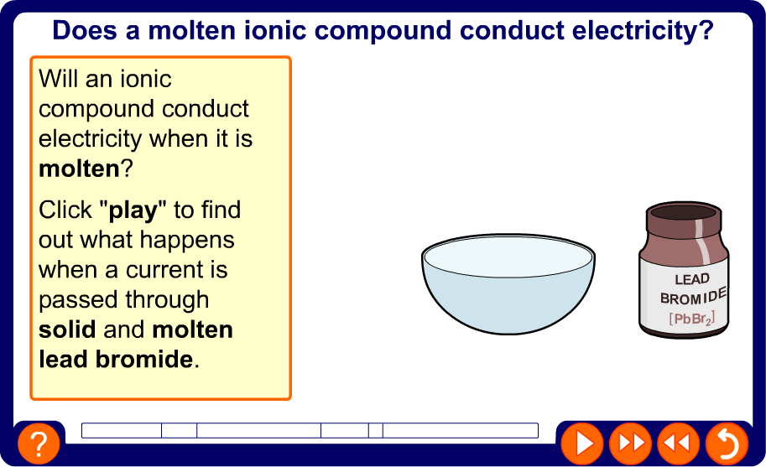
Do molten ionic compounds conduct?

Slide 11
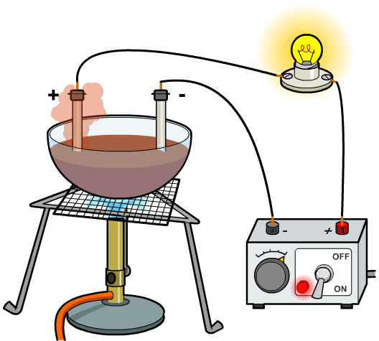
What is electrolysis?
An ionic compound conducts electricity when it is molten or in solution. The current causes the ionic compound
to split up and form new substances.
This process is called electrolysis,
a word which comes from Greek
and means “splitting by electricity”.
Electrolysis has many uses, including:
purifying copper
plating metals with silver and gold
extracting reactive metals, such as aluminium
making chlorine, hydrogen and sodium hydroxide.

Slide 12
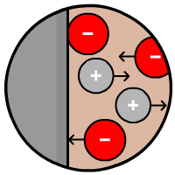
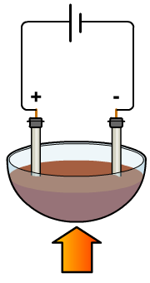
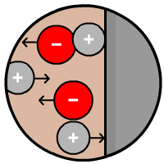
What happens during electrolysis?
In electrolysis, the substance that the current passes through and splits up is called the electrolyte.
The electrolyte contains positive and negative ions.
What happens to these ions during electrolysis?
Negative ions move
to the positive electrode and lose electrons.
This is oxidation.
Positive ions move
to the negative electrode and gain electrons.
This is reduction.
heat

Slide 13
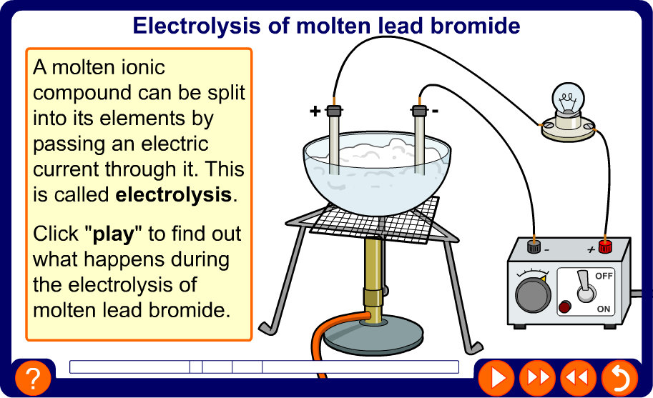
Electrolysis of molten lead bromide

Slide 14
Electrolysis of molten PbBr₂ – redox equations
What redox processes occur at the electrodes during the electrolysis of molten lead bromide (PbBr₂)?
At the negative electrode:
Pb²⁺ + 2e⁻ → Pb (reduction)
At the positive electrode:
2Br⁻ → Br₂ + 2e⁻ (oxidation)
What is the overall equation for the electrolysis of molten lead bromide ?
lead bromide → lead + bromine
PbBr₂ (l) → Pb (l) + Br₂ (g)

Slide 15
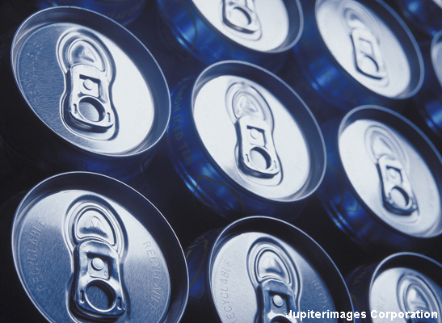
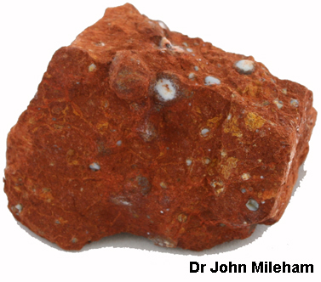
Why and how is aluminium extracted?
Aluminium is one of the most useful metals in the world.
Electrolysis is used to extract aluminium from its ore. Why is it not possible to extract aluminium by heating its ore with carbon?
Aluminium ore (bauxite) has a very high melting point (2050 °C).
For electrolysis, the ore is dissolved in
a compound called cryolite (Na₃AlF₆), which lowers the melting point to 700 °C.
Why is this important economically?
Notes:
Photo credit (top right): © 2007 Jupiterimages Corporation
Aluminum drinks cans
Photo credit (bottom left): Dr John Mileham
Aluminium ore (bauxite)

Slide 16
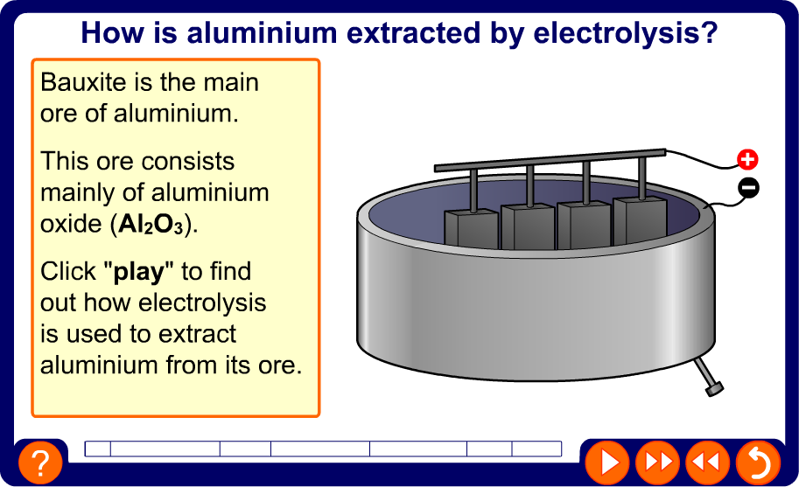
Extracting aluminium

Slide 17
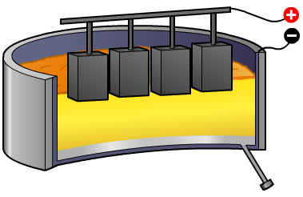
Extracting aluminium – redox equations
What redox processes occur at the electrodes during the electrolysis of aluminium oxide (Al₂O₃)?
At the negative electrode:
Al³⁺ + 3e⁻ → Al (reduction)
At the positive electrode:
2O²⁻ → O₂ + 4e⁻ (oxidation)
What is the overall equation for the extraction of aluminium by electrolysis?
aluminium oxide → aluminium + oxygen
2 Al₂O₃ (l) → 4 Al (l) + 3 O₂ (g)

Slide 18
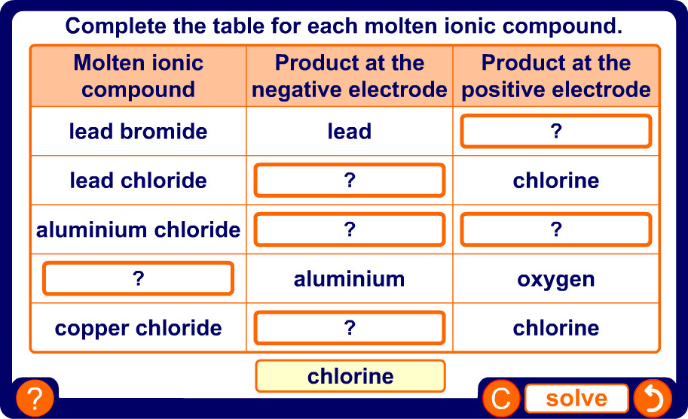
What are the products of electrolysis?
Notes:
Teacher notes
This drag and drop activity provides the opportunity for informal assessment of students’ understanding of the products of electrolysis.

Slide 19
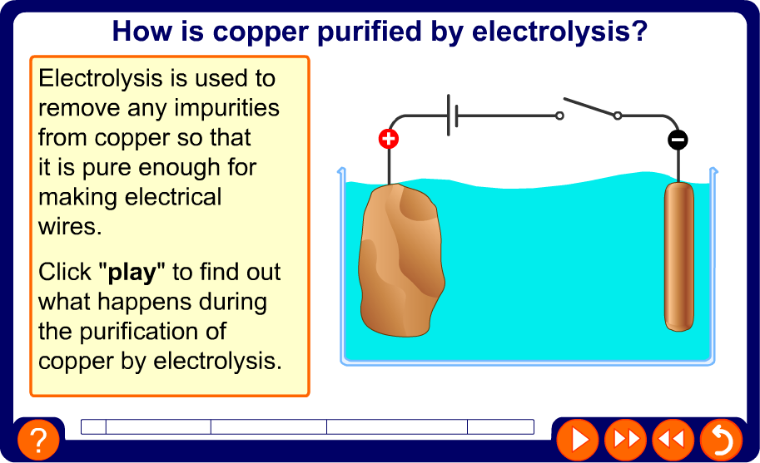
Purifying copper using electrolysis

Slide 20
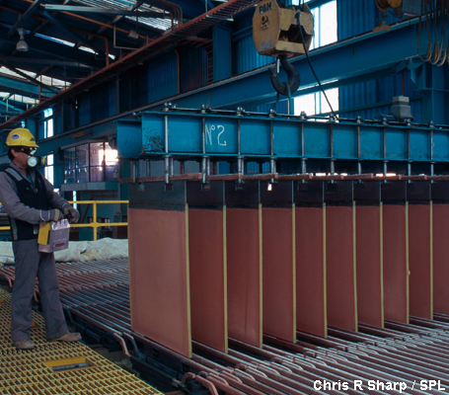
Purifying copper – redox equations
What happens at the electrodes during the purification of copper by electrolysis ?
At the negative electrode:
Cu²⁺ + 2e⁻ → Cu (reduction)
At the positive electrode:
Cu → Cu²⁺ + 2e⁻ (oxidation)
This process is carried out on a huge scale in industry and
the copper formed on the negative electrodes is 99.99% pure.
The precious metals recovered from the impurities are also sold off and help to make this industrial process profitable.
Notes:
Photo credit: Chris R Sharp / Science Photo Library
Copper refinery worker removes copper-coated electrodes from an electrolytic bath.

Slide 21
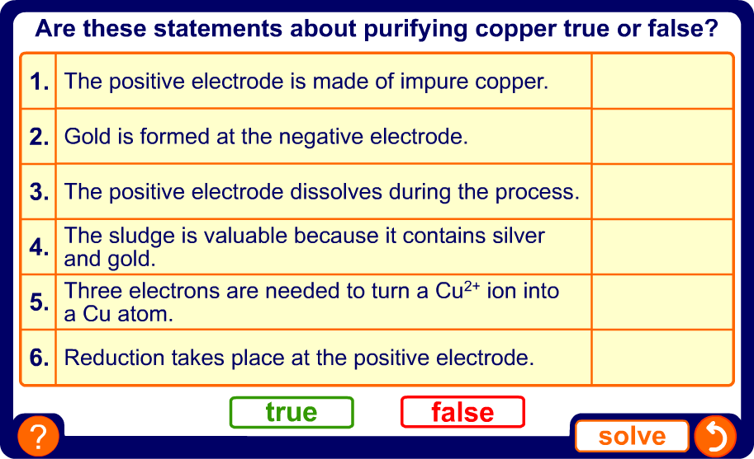
Purifying copper – true or false?
Notes:
Teacher notes
This true-or-false quiz could be used as a summary exercise to work on purifying metals. Students could be given coloured traffic light cards (red = false, green = true) to vote on the statements shown. To stretch students, they could be asked to explain their voting.

Slide 22
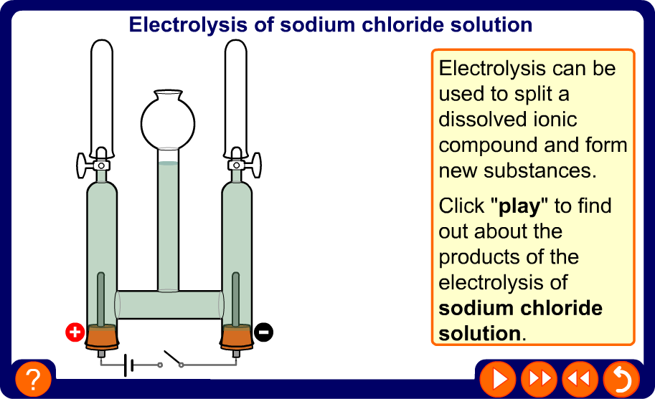
Electrolysis of NaCl solution

Slide 23
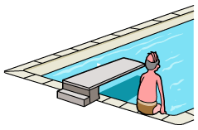

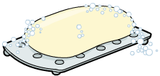
Products of electrolysis of NaCl solution
The electrolysis of sodium chloride solution produces three very useful products:
Chlorine used for killing bacteria in water, for bleach and making plastics like PVC.
Hydrogen used for making margarine and fertilizers, and for rocket fuel.
Sodium hydroxide used in many chemical reactions, such as making soap, neutralizing acids and making paper.
Chlorine is expected as a product of this process but hydrogen and sodium hydroxide are surprising products.
What happens at the electrodes to form these products?

Slide 24
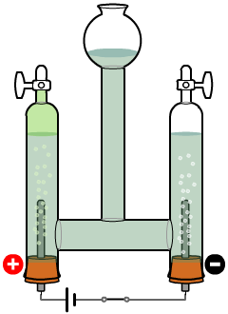
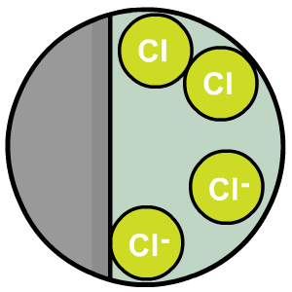
How does the chlorine form?
In the electrolysis of NaCl solution, the negative chloride ions
(Cl⁻) are attracted to the
positive electrode.
Here, the Cl⁻ ions lose
electrons to make
chlorine atoms, which then
form chlorine molecules (Cl₂).
oxidized
Are the Cl⁻ ions oxidized or reduced?
How many electrons are lost by each Cl⁻ ion?
How many Cl⁻ ions join to make a Cl₂ molecule?
What is the half-equation for this redox process?
one
two
2Cl⁻ → Cl₂ + 2e⁻ (oxidation)

Slide 25
Why is sodium not formed?
In the electrolysis of sodium chloride solution, the Na⁺ ions might be expected
to form sodium at the negative electrode.
Instead, hydrogen gas is produced here.
This is because sodium chloride solution also contains H⁺ ions from some of the water: H₂O (l) → H⁺ (aq) + OH⁻ (aq).
At the negative electrode, the H⁺ ions compete with the Na⁺ ions. The H⁺ ions gain electrons; the Na⁺ ions stay in solution.
For all ionic compounds containing a metal that is more reactive than hydrogen, electrolysis of a solution of the compound will produce hydrogen rather than the metal.

Slide 26

How does the hydrogen form?
In the electrolysis of NaCl solution, the positive hydrogen ions
(H⁺) are attracted to the
negative electrode.
Here, the H⁺ ions
gain electrons to make
hydrogen atoms, which then
form hydrogen molecules (H₂).
reduced
Are the H⁺ ions oxidized or reduced?
How many electrons are gained by each H+ ion?
How many H⁺ ions join to make a H₂ molecule?
What is the half-equation for this redox process?
one
two
2H⁺ + 2e⁻ → H₂ (reduction)

Slide 27
How does the sodium hydroxide form?
Sodium chloride solution has four types of ions:
Na⁺ and Cl⁻ ions from the sodium chloride
H⁺ and OH⁻ ions from the water.
The Cl⁻ ions form chlorine at the positive electrode and the H⁺ ions form hydrogen at the negative electrode. So, what’s left?
Na⁺ and OH⁻ ions are left behind and so a solution of sodium hydroxide (NaOH) is formed.
What is the overall equation for the electrolysis of a sodium chloride solution?
2NaCl (aq) + 2H₂O (l) → H₂ (g) + Cl₂ (g) + 2NaOH (aq)

Slide 28
Hydrogen or metal?
If an ionic compound contains a metal
that is more reactive than hydrogen, electrolysis of a solution of the compound will produce hydrogen, not the metal.
potassium
increasing reactivity
sodium
calcium
magnesium
aluminium
Complete the table for these compounds.
(carbon)
Ionic compound
Product at the negative electrode
zinc
iron
lead
potassium chloride
hydrogen
(hydrogen)
copper sulphate
copper
copper
sodium bromide
hydrogen
silver
silver nitrate
silver
gold
platinum
zinc chloride
hydrogen

Slide 29
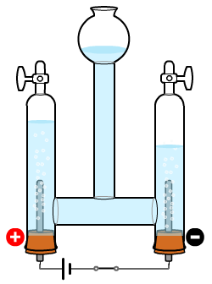
Electrolysis of dilute sulfuric acid
Electrolysis can be used to split water (H₂O) into its elements, hydrogen and oxygen.
This is how hydrogen for fuel cells can be made and how oxygen can be produced from water on spacecraft.
Water is a covalent compound and so is
a poor conductor of electricity. However,
it does contain a few free H⁺ and OH⁻ ions:
H₂O (l) → H⁺ (aq) + OH⁻ (aq).
The conductivity of water can be improved by adding dilute sulfuric acid. This releases more ions so that more current flows during electrolysis, which creates hydrogen and oxygen.
Which product will form at each electrode?

Slide 30
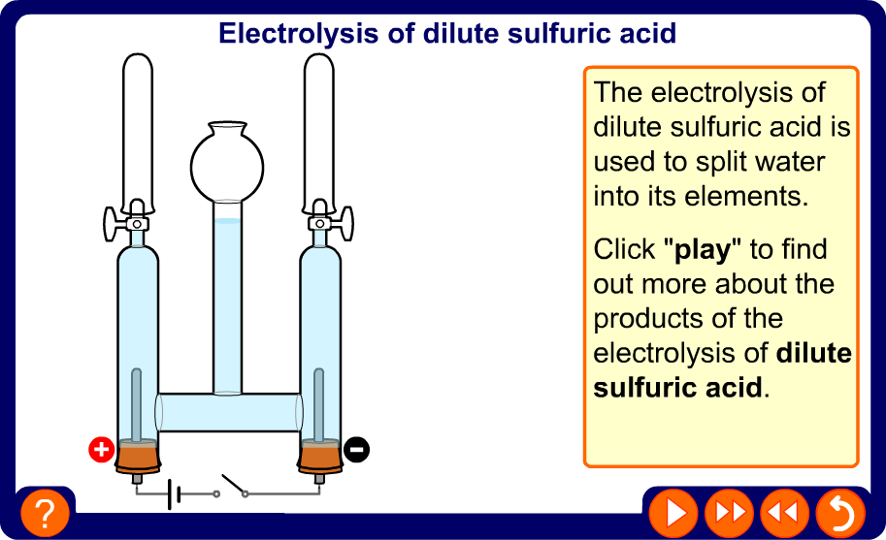
Electrolysis of dilute sulfuric acid

Slide 31
Electrolysis of dilute H₂SO₄ – redox equations
What happens at the electrodes during the electrolysis of dilute sulfuric acid?
At the negative electrode:
2H⁺ + 2e⁻ → H₂ (reduction)
At the positive electrode:
4OH⁻ → 2H₂O + O₂ + 4e⁻ (oxidation)
What is the overall equation for the electrolysis of dilute sulfuric acid?
2H₂O (l) → 2H₂ (g) + O₂ (g)
Twice as much hydrogen forms as oxygen. Why is this?
In water, there are 2 hydrogen atoms for every oxygen atom, so the ratio by volume, of H₂ to O₂, is 2:1.

Slide 32
Glossary
electrode – A solid conductor of electricity, which is used to make electrical contact with an electrolyte.
electrolysis – The process which uses electricity to split up compounds.
electrolyte – A substance which conducts electricity and can be split up by a current when molten or in solution.
ions – Charged particles formed when atoms lose or gain electrons.
oxidation – A type of reaction involving the gain of oxygen or the loss of electrons.
redox – A type of reaction in which oxidation and reduction take place at the same time.
reduction – A type of reaction involving the loss of oxygen or the gain of electrons.

Slide 33
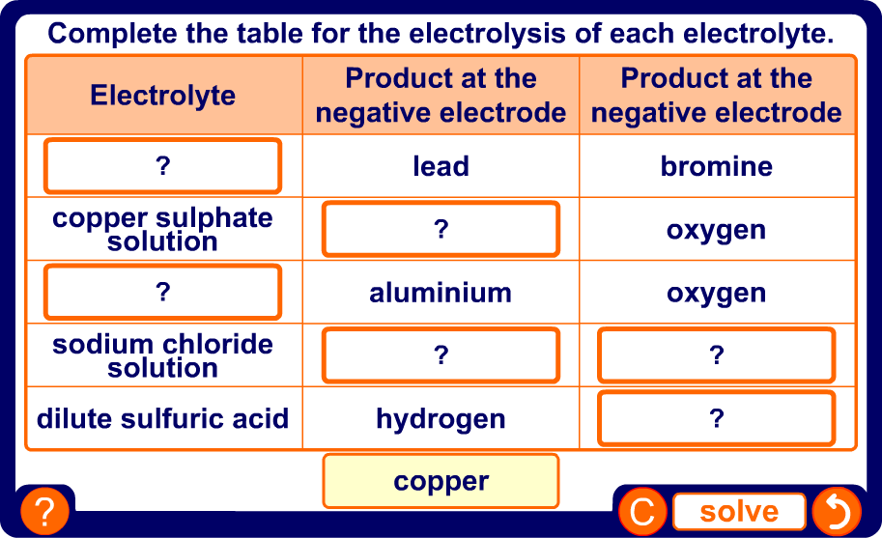
What is involved in electrolysis?
Notes:
Teacher notes
This drag and drop activity could be used to check students’ understanding of the products of electrolysis.

