Slide 1
MAGNETISM

Slide 2
Specification
Magnetism and electromagnetism
Magnetism
understand that magnets repel and attract other magnets and attract magnetic substances
describe the properties of magnetically hard and soft materials
understand the term ‘magnetic field line’
understand that magnetism is induced in some materials when they are placed in a magnetic field
describe experiments to investigate the magnetic field pattern for a permanent bar magnet and that between two bar magnets
describe how to use two permanent magnets to produce a uniform magnetic field pattern.

Slide 3
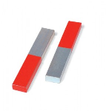
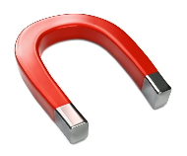
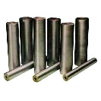
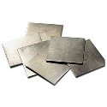
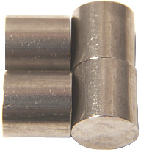
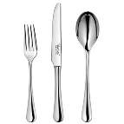
Magnets and magnetic materials
Magnets attract objects made of magnetic materials
Magnetic materials include the elements iron, nickel, cobalt, alloys containing some of these such as steel and some of their compounds.
iron
nickel
cobalt
stainless steel

Slide 4
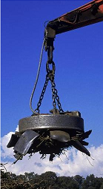
Hard and soft magnetic materials
Permanent magnets are made of magnetically HARD materials such as steel. These materials retain their magnetisation once magnetised.
Magnetically SOFT materials, such as iron, lose their magnetisation easily. They suitable for temporary magnets such as electromagnets.

Slide 5
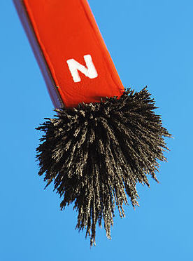
Magnetic poles
Magnetic poles are the parts of a magnet that exert the greatest force.
Magnetic poles occur in pairs usually called north (N) and south (S)
Iron filing are attracted mostly to the poles of a magnet

Slide 6
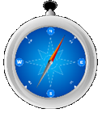
Why poles are called north and south
A magnet suspended so that it can rotate freely horizontally will eventually settle down with one pole facing north and the other south.
This is pole is therefore called the ‘north seeking pole’, usually shortened to just ‘north pole’.
The magnet has been orientated by the Earth’s magnetic field.
A compass is an application of this effect.
north

Slide 7
The law of magnets
Like poles repel unlike poles attract

Slide 8
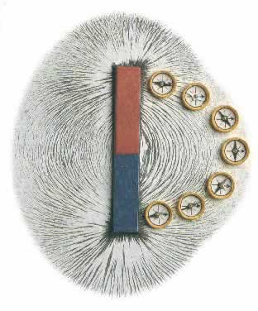
Magnetic fields
A magnetic field is a volume of space where magnetic force is exerted.
All magnets are surrounded by magnetic fields.
The shape of a magnetic field can be shown by iron filings or plotting compasses.

Slide 9
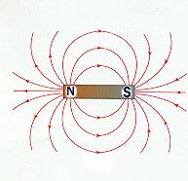
Magnetic field around a bar magnet
magnetic field line
Arrows on the field lines show the direction of the force on a free to move north pole
The stronger the magnetic field the denser the magnetic field lines.

Slide 10
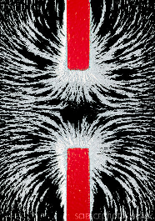
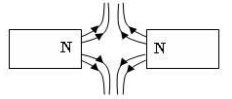
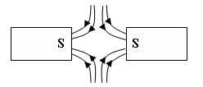
Magnetic fields between two bar magnets

Slide 11
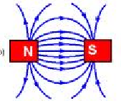
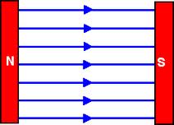
Producing a uniform magnetic field
A uniform magnetic field exerts a constant force over a region.
Such a field will consist of parallel equally spaced magnetic field lines.
This type of field can almost be found between a north and south magnetic pole.

Slide 12
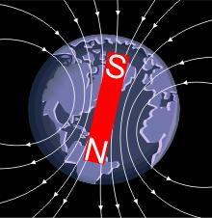
The Earth’s magnetic field
The earth’s magnetic field is similar in shape to that around a bar magnet.
It is thought to be caused by electric currents flowing through the molten outer core of the Earth.
At the present the field pattern is like that with a magnetic SOUTH pole situated somewhere below northern Greenland

Slide 13
Induced magnetism
Magnetism can be induced in a magnetic material if it is placed within a magnetic field.
If the material is magnetically hard it will retain its magnetism once removed from the field.
Certain rocks in the Earth’s crust such as lodestone have been magnetised in this way by the Earth’s magnetic field.
iron bar
N S

Slide 14
Choose appropriate words to fill in the gaps below:
Magnetic materials are either hard or ______. Hard magnetic materials such as ______ retain their magnetisation once magnetised.
A magnetic _____ is a region where the magnetic force is greatest. Magnetic poles always occur in ______. Like poles _______, unlike attract.
A magnetic ______ is a region where magnetic force is exerted. The ________ of the magnetic field around a bar magnet is from north to south.
WORD SELECTION:
pole
repel
steel
pairs
field
direction
soft
Notes:
14

Slide 15
Choose appropriate words to fill in the gaps below:
Magnetic materials are either hard or ______. Hard magnetic materials such as ______ retain their magnetisation once magnetised.
A magnetic _____ is a region where the magnetic force is greatest. Magnetic poles always occur in ______. Like poles _______, unlike attract.
A magnetic ______ is a region where magnetic force is exerted. The ________ of the magnetic field around a bar magnet is from north to south.
soft
steel
pole
pairs
repel
field
direction
WORD SELECTION:
pole
repel
steel
pairs
field
direction
soft
Notes:
15

