Slide 1
TURNING EFFECT OF FORCES

Slide 2
Specification
TURNING EFFECT
know and use the relationship:
moment = force × perpendicular distance from the pivot
know that the weight of a body acts through its centre of gravity
know and use the principle of moments for a simple system of parallel forces acting in one plane
understand that the upward forces on a light beam, supported at its ends, vary with the position of a heavy object placed on the beam

Slide 3
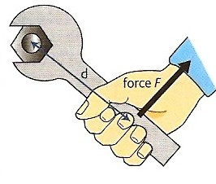
The moment of a force
Also known as the turning effect of a force.
The moment of a force about any point is defined as:
moment = force x perpendicular distance from the pivot
moment = F x d
Unit: newton-metre (Nm)
Moments can be either CLOCKWISE or ANTICLOCKWISE
Force F exerting an ANTICLOCKWISE moment through the spanner on the nut

Slide 4
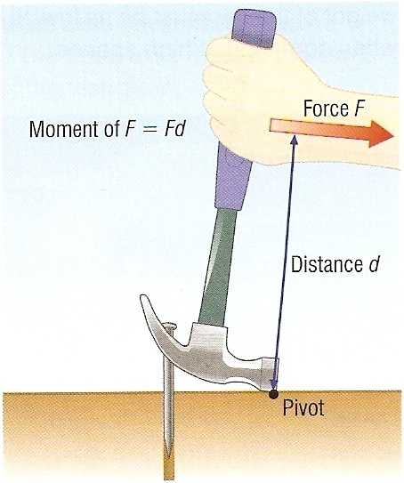
Question
Calculate the moment exerted with the claw hammer if the person exerts a force of 80N and distance d equals 25cm.
moment = F x d
= 80N x 25cm
= 80N x 0.25m
= 20 Nm CLOCKWISE

Slide 5
Complete:
Answers
Force (N) | Distance | Moment (Nm)
40 | 3 m
200 |  | 1000
 | 4 m | 200
3000 | 20 cm

Slide 6
Complete:
Answers
Force (N) | Distance | Moment (Nm)
40 | 3 m | 120
200 | 5 m | 1000
50 | 4 m | 200
3000 | 20 cm | 600
120
5 m
50
600

Slide 7
Question
Choose appropriate words to fill in the gaps below:
The ‘moment of a force’ is another name for the ‘________ effect of force’.
The moment of a force is equal to the ________ multiplied by the perpendicular _________ between the line of ________ of the force and the turning point.
Turning effect is measured in _________ metres.
__________ can be either clockwise or anticlockwise.
WORD SELECTION:
moments
force
distance
newton
turning
action

Slide 8
Question
Choose appropriate words to fill in the gaps below:
The ‘moment of a force’ is another name for the ‘________ effect of force’.
The moment of a force is equal to the ________ multiplied by the perpendicular _________ between the line of ________ of the force and the turning point.
Turning effect is measured in _________ metres.
__________ can be either clockwise or anticlockwise.
turning
force
distance
action
newton
moments
WORD SELECTION:
moments
force
distance
newton
turning
action

Slide 9
Centre of gravity
The centre of gravity of a body is that point at which the weight of the body acts.
The centre of gravity of a symmetrical body is along the axis of symmetry.
Centre of gravity is also sometimes called centre of mass.
centres of gravity of regular shapes

Slide 10
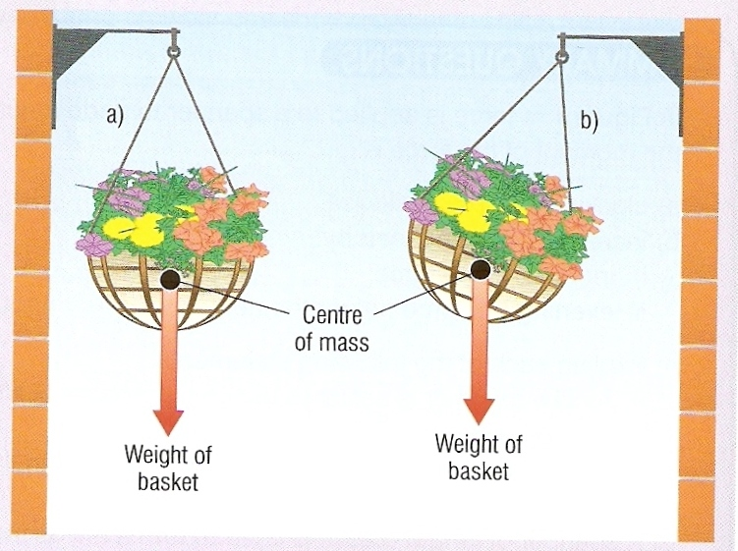
If suspended, a body will come to rest with its centre of gravity directly below the point of suspension.
Centre of gravity

Slide 11
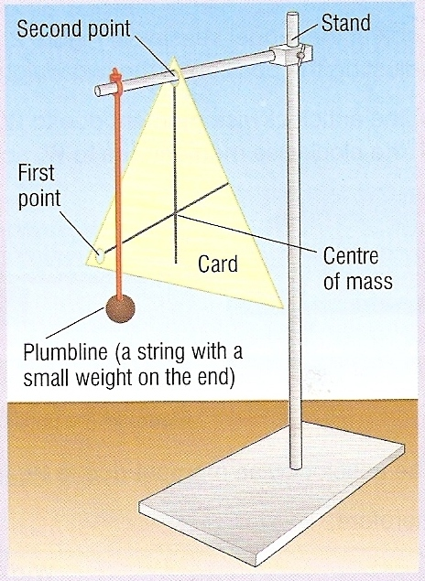
Finding the centre of gravity of a card
Pierce the card in at least two places.
Suspend the card from one of these holes.
Hang a plumbline from the point of suspension.
Using the plumbline as a reference draw a vertical line on the card.
Repeat for the other hole(s).
The centre of gravity is where the lines cross on the card.
Centre of gravity

Slide 12
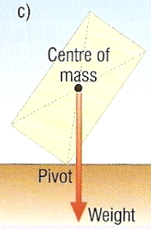
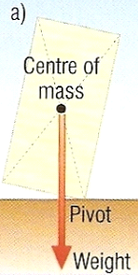
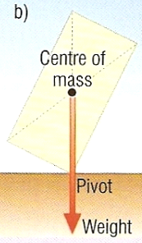
Stability
Centre of gravity
Centre of gravity
Centre of gravity
stable
balanced
unstable - toppling
A body is stable as long as its centre of gravity remains vertically above its base.
If this is not the case, the body will topple.

Slide 13
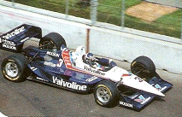
Question
What factors make a modern racing car as stable as possible?
1. A wide wheel base.
2. A low centre of gravity.

Slide 14
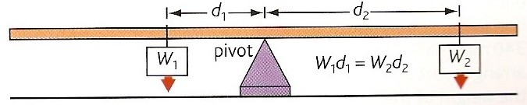
The principle of moments
When an object is not turning (e.g. balanced):
The total clockwise moment equals the total anticlockwise moment
If the ruler above is balanced:
clockwise moment = anticlockwise moment
W₂ x d₂ = W₁ x d₁

Slide 15
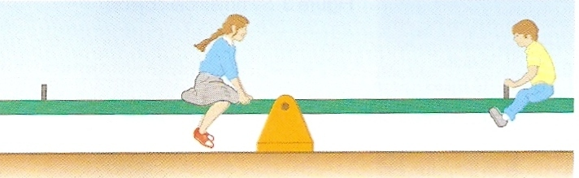
Question 1
On a see-saw Mary, weight 600N balances John, weight 200N when she sits 1.5m away from the pivot. How far from the pivot is John?

Slide 16
Question 1
On a see-saw Mary, weight 600N balances John, weight 200N when she sits 1.5m away from the pivot. How far from the pivot is John?
Applying the principle of moments:
Mary’s weight x distance = John’s weight x distance
600N x 1.5m = 200N x distance
900 = 200 x distance
900 ÷ 200 = distance
John is 4.5m from the pivot

Slide 17
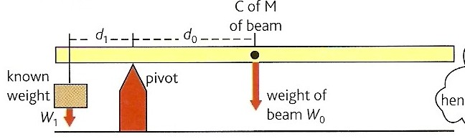
Question 2
Calculate the weight of the beam, W₀ if it is balanced when:
W₁ = 6N;
d₁ = 12 cm;
d₀ = 36 cm.

Slide 18
Question 2
Calculate the weight of the beam, W₀ if it is balanced when:
W₁ = 6N;
d₁ = 12 cm;
d₀ = 36 cm.
Applying the principle of moments:
W₁ x d₁ = W₀ x d₀
6N x 12 cm = W₀ x 36 cm
W₀ = 72 / 36
W₀ the weight of the beam = 2N

Slide 19
Complete for a balanced ruler:
W₁ | d₁ | W₂ | d₂
5 N | 20 cm | 10 N
4 N | 15 cm |  | 10 cm
6 N |  | 2 N | 36 cm
 | 25 cm | 2 N | 100 cm

Slide 20
Complete for a balanced ruler:
W₁ | d₁ | W₂ | d₂
5 N | 20 cm | 10 N | 10 cm
4 N | 15 cm | 6 N | 10 cm
6 N | 12 cm | 2 N | 36 cm
8 N | 25 cm | 2 N | 100 cm
10 cm
6 N
12 cm
8 N

Slide 21


Forces on a beam or bridge
Column A
Column B
When the lorry is at the centre of the bridge its weight will be supported equally by the two columns A and B.
lorry weight = 24 000N
12 000N
12 000N

Slide 22
Column A
Column B
When the lorry was over columns A all of its weight would have been supported by this column
lorry weight = 24 000N
24 000N

Slide 23
Column A
Column B
When the lorry is ¾ the way across the bridge column B will bear ¾ of its weight. Column A bears the remaining ¼.
lorry weight = 24 000N
6 000N
18 000N

Slide 24
What are the column forces when the lorry is one third the way across the bridge?
Column A
Column B
lorry weight = 24 000N
8 000N
16 000N

Slide 25
Question
Choose appropriate words to fill in the gaps below:
The turning effect of a ________ is also called the ________ of a force. Moment is measured in _________ metres.
If a body is balanced the total clockwise moment is _______ to the total ____________ moment.
A body will be _______ if its centre of gravity lies vertically above the _______ of the body. A tractor has a large wheel base to reduce the possibility of it __________.
WORD SELECTION:
toppling
anticlockwise
newton
moment
equal
stable
force
base

Slide 26
Question
Choose appropriate words to fill in the gaps below:
The turning effect of a ________ is also called the ________ of a force. Moment is measured in _________ metres.
If a body is balanced the total clockwise moment is _______ to the total ____________ moment.
A body will be _______ if its centre of gravity lies vertically above the _______ of the body. A tractor has a large wheel base to reduce the possibility of it __________.
force
moment
newton
equal
anticlockwise
stable
base
toppling
WORD SELECTION:
toppling
anticlockwise
newton
moment
equal
stable
force
base

