Slide 1
EQUILIBRIUM AND CENTRE OF GRAVITY

Slide 2
Specification
know that the weight of a body acts through its centre of gravity

Slide 3
Centre of gravity
The centre of gravity of a body is that point at which the weight of the body acts.
The centre of gravity of a symmetrical body is along the axis of symmetry.
Centre of gravity is also sometimes called centre of mass.
centres of gravity of regular shapes

Slide 4
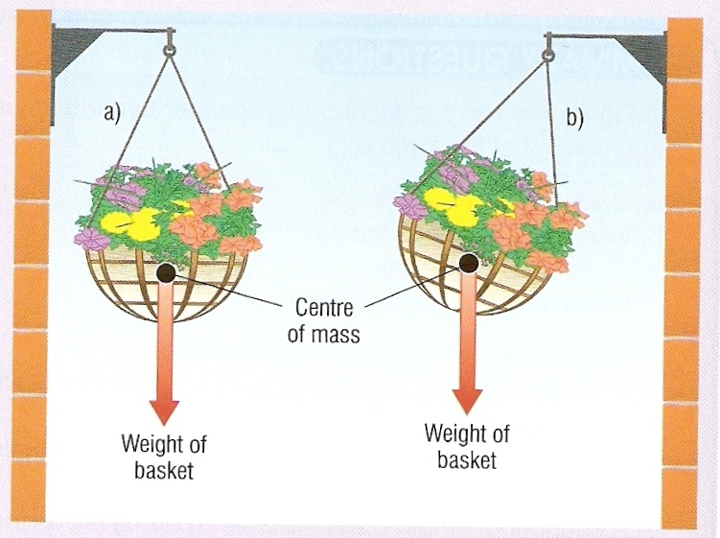
If suspended, a body will come to rest with its centre of gravity directly below the point of suspension.
Centre of gravity

Slide 5
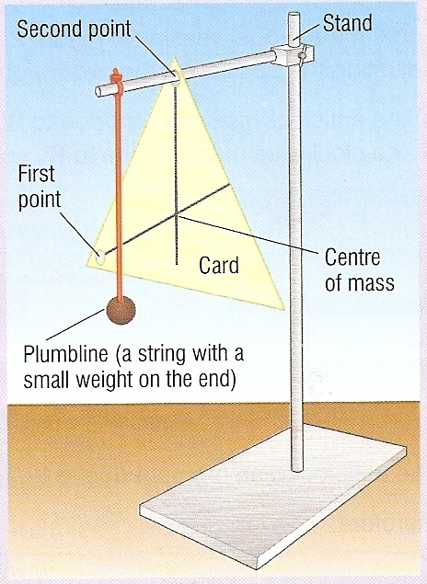
Finding the centre of gravity of a card
Pierce the card in at least two places.
Suspend the card from one of these holes.
Hang a plumbline from the point of suspension.
Using the plumbline as a reference draw a vertical line on the card.
Repeat for the other hole(s).
The centre of gravity is where the lines cross on the card.
Centre of gravity

Slide 6
Stability
Centre of gravity
Centre of gravity
Centre of gravity
stable
balanced
unstable - toppling
A body is stable as long as its centre of gravity remains vertically above its base.
If this is not the case, the body will topple.

Slide 7
Question
What factors make a modern racing car as stable as possible?
1. A wide wheel base.
2. A low centre of gravity.

