Slide 1
MAGNETIC EFFECT OF ELECTRIC CURRENT

Slide 2
Specification
Electromagnetism
understand that an electric current in a conductor produces a magnetic field round it
describe the construction of electromagnets
sketch and recognise magnetic field patterns for a straight wire, a flat circular coil and a solenoid when each is carrying a current

Slide 3
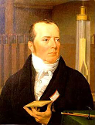
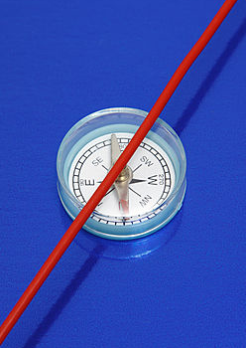
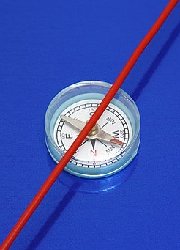
Electromagnetism
In 1820 Hans Ørsted noticed that a wire carrying an electric current caused a compass needle to deflect.
No current, compass points to north
Current, compass deflected
Notes:
3

Slide 4
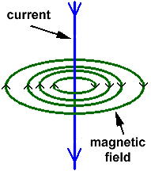
Magnetic field patterns around wires
1. Straight wire
The magnetic field consists of concentric circles centred on the wire.
The magnetic field is strongest near the wire.
This is shown by the field lines being closest together near to the wire.
The strength of the field increases if the electric current is increased.
Notes:
4

Slide 5
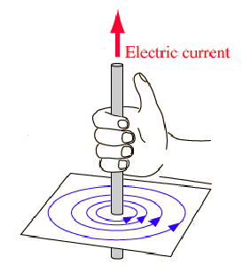
The right-hand grip rule (for fields)
Grip the wire with the RIGHT hand.
The thumb is placed in the direction of the electric current.
The fingers show the direction of the circular magnetic field.
Notes:
5

Slide 6
Complete the diagrams below:
Add field arrows
Add current direction
Add current direction
Add field arrows
Electric current out of the page
Electric current into the page
Notes:
6

Slide 7
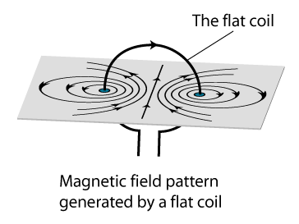
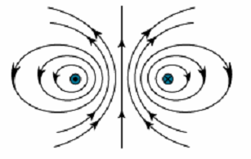
2. Flat circular coil
Plan view
Notes:
7

Slide 8
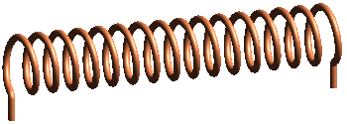
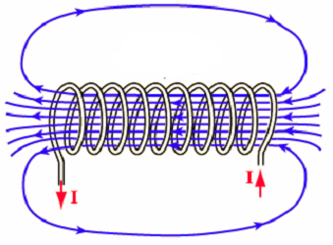
3. Solenoid
A solenoid is a coil of wire carrying an electric current.
The magnetic field is similar in shape to that around a bar magnet.
The strength of the field increases with:
the electric current
the number of turns in the coil
N
S
Notes:
8

Slide 9
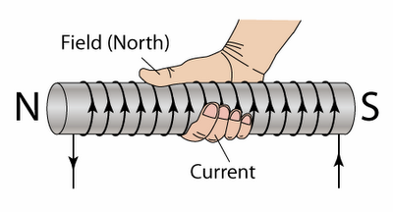
The right-hand grip rule (for poles)
Grip the coil with the RIGHT hand.
The fingers are placed in the direction that the eclectic current flows around the coil.
The thumb points towards the north pole end of the coil.
N
S
Notes:
9

Slide 10
Complete the diagrams below:
1. Locate north
2. Locate south
3. Add current direction
S
N
N
4. Add coils
N
Notes:
10

Slide 11
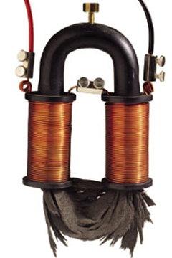
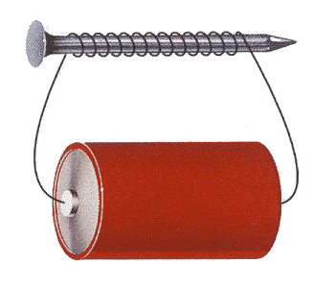
Electromagnets
An electromagnet consists of a current carrying coil wrapped around an iron core.
Notes:
11

Slide 12
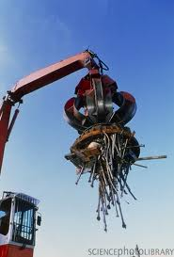
Uses of electromagnets
1. Scrap yard crane
The iron core of the electromagnet is a SOFT magnetic material.
When current flows the iron becomes strongly magnetised and so picks up the scrap iron and steel.
When the current is turned off the iron loses its magnetisation and so releases the scrap.
Notes:
12

Slide 13
2. The electric bell
When the push switch is closed current flows around the circuit turning on the electromagnet.
The soft iron armature is pulled towards the electromagnet and the hammer hits the gong.
This causes the contact switch to open cutting off the electric current.
The spring now pulls the armature back again closing the contact switch.
Current now flows again and the hammer hits the gong again.
push switch
spring
electromagnet
contact switch
soft iron armature
hammer
gong
Notes:
13

Slide 14
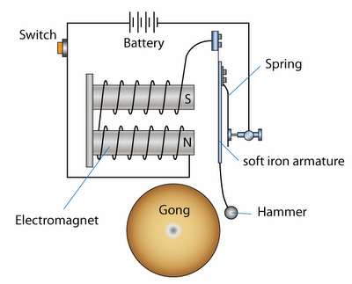
Label the diagram of the electric bell below:
2
5
3
7
Contact switch
6
1
8
4
Notes:
14

Slide 15
3. The relay switch
A relay switch is a way of using a low voltage circuit to switch remotely a high voltage (and possibly dangerous) circuit.
When switch A is closed, the small current provided by the cell causes the electromagnet to become magnetised..
The iron armature is then attracted to the electromagnet causing the springy contact switch B to close in the high voltage circuit.
switch A
iron armature
electromagnet
hinge
springy contact switch B
to high voltage circuit
Notes:
15

Slide 16
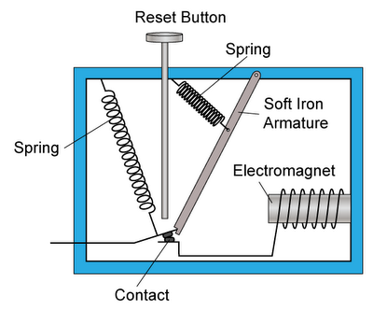
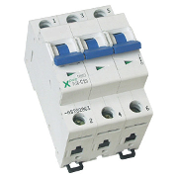
4. Circuit breaker
Current normally flows between terminals A and B through the contact and the electromagnet.
When the current in a circuit increases, the strength of the electromagnet will also increase. This will pull the soft iron armature towards the electromagnet.
As a result, spring 1 pulls apart the contact and disconnecting the circuit immediately, and stopping current flow.
2
1
A
B
Domestic circuit breakers
The reset button can be pushed to bring the contact back to its original position to reconnect the circuit

Slide 17
Choose appropriate words to fill in the gaps below:
A wire carrying an electric ______ produces a magnetic field. This field increases in ________ if the current is increased.
A ________ is a coil of wire carrying an electric current. The field produced increases in strength if the number of _____ in the coil is increased or if _____ is placed inside the coil.
An ____________ consists of a coil of a solenoid wrapped around an iron core. Iron is a ______ magnetic material that loses its magnetisation once the current in the coil is switched off.
WORD SELECTION:
solenoid
iron
strength
turns
electromagnet
current
soft
Notes:
17

Slide 18
Choose appropriate words to fill in the gaps below:
A wire carrying an electric ______ produces a magnetic field. This field increases in ________ if the current is increased.
A ________ is a coil of wire carrying an electric current. The field produced increases in strength if the number of _____ in the coil is increased or if _____ is placed inside the coil.
An ____________ consists of a coil of a solenoid wrapped around an iron core. Iron is a ______ magnetic material that loses its magnetisation once the current in the coil is switched off.
current
strength
solenoid
turns
iron
electromagnet
soft
WORD SELECTION:
solenoid
iron
strength
turns
electromagnet
current
soft
Notes:
18

Slide 19
Charge deflection by a magnetic field
Electric charges are deflected by magnetic fields provided they are not travelling parallel to the field lines.
Positive and negative charges are deflected in opposite directions.
S
-
+
N
Notes:
19

Slide 20
The motor effect
When a current carrying conductor carrying an electric current is placed in a magnetic field, it will experience a force provided that the conductor is not placed parallel to the field lines.
This is called the motor effect.
+
-
S
-
-
+
+
N
-
+

Slide 21
The force increases if:
  – the strength of the magnetic field is increased
  – the current is increased
The direction of the force is reversed if either the direction of the current or the direction of the magnetic field is reversed.

Slide 22
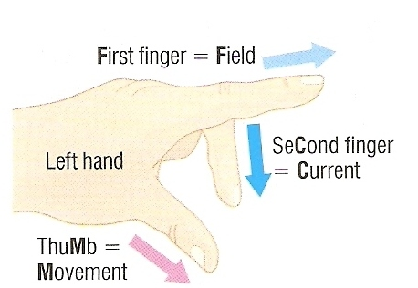
Fleming’s left-hand motor rule
Note:
Magnetic field direction is from NORTH to SOUTH
Current direction is from PLUS to MINUS

Slide 23
Insert the missing information
Q1. Force direction ?
Q2 Current direction ?
N
S
S
N
Q3 N and S poles ?
Q4 Force directions ?
N
S
N
S
Note:
means current out of the page
means current into the page

Slide 24
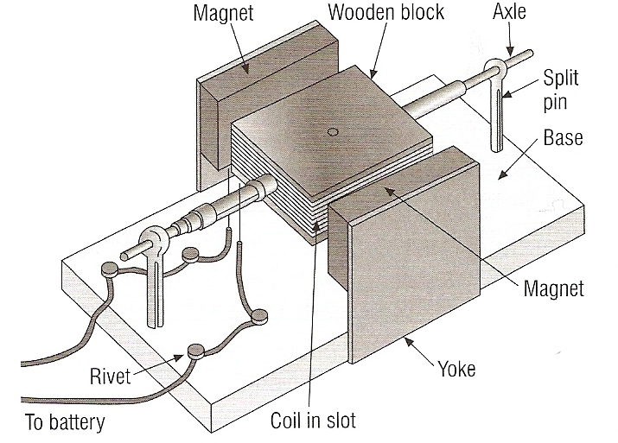
Model electric motor

Slide 25
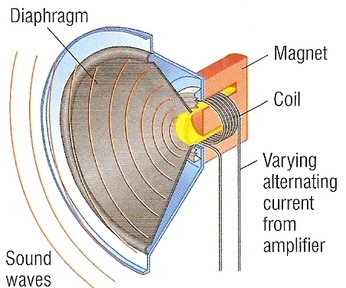
The loudspeaker
The sound signal consists of an alternating current supplied by the amplifier.
This current flows through the coil of the loudspeaker.
Due to the motor effect, the magnetic field around the coil causes the coil to vibrate in step with the alternating current.
The coil causes the diaphragm (speaker cone) to vibrate in step with the original sound signal.
The diaphragm causes air to vibrate and so produces a sound wave.

Slide 26
Question
Choose appropriate words to fill in the gaps below:
The motor effect occurs when a _______ carrying wire is placed inside a ________ field.
The force exerted is __________ when the wire is at 90° to the magnetic field __________ but is zero if the wire is ________ to the field.
The force increases with _________ or current strength, the force __________ in direction if either are reversed.
Applications include the electric motor and ___________.
WORD SELECTION:
parallel
reverses
loudspeaker
direction
current
magnetic
field
maximum

Slide 27
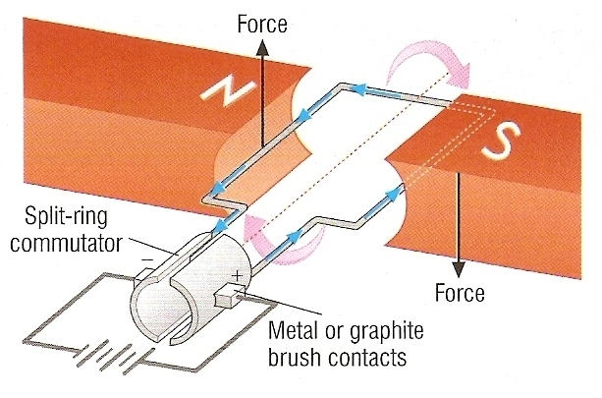
The electric motor
Electric current flowing around the coil of the electric motor produces oppositely directed forces on each side of the coil.
These forces cause the coil to rotate.
Every half revolution the split ring commutator causes the current in the coil to reverse otherwise the coil would stop in the vertical position.

Slide 28
rotation axis
N
S
contact brush
Brushes lose contact with the split ring commutator.
Current no longer flows through the motor coil.
The coil will continue to rotate clockwise due to its momentum.
Brushes in contact with the split ring commutator.
Current flows through the motor coil.
Forces exert a clockwise turning effect on the coil
Brushes regain contact with the split ring commutator.
Current flows through the motor coil but in the opposite direction.
Forces exert a clockwise turning effect on the coil.
Brushes lose contact with the split ring commutator.
Current no longer flows through the motor coil.
The coil will continue to rotate clockwise due to its momentum.
Brushes regain contact with the split ring commutator.
Current flows through the motor coil but in the original direction.
Forces exert a clockwise turning effect on the coil.
split-ring commutator
+

Slide 29
Question
Choose appropriate words to fill in the gaps below:
The motor effect occurs when a _______ carrying wire is placed inside a ________ field.
The force exerted is __________ when the wire is at 90° to the magnetic field __________ but is zero if the wire is ________ to the field.
The force increases with _________ or current strength, the force __________ in direction if either are reversed.
Applications include the electric motor and ___________.
WORD SELECTION:
parallel
reverses
loudspeaker
direction
current
magnetic
field
maximum

Slide 30
Question
Choose appropriate words to fill in the gaps below:
The motor effect occurs when a _______ carrying wire is placed inside a ________ field.
The force exerted is __________ when the wire is at 90° to the magnetic field __________ but is zero if the wire is ________ to the field.
The force increases with _________ or current strength, the force __________ in direction if either are reversed.
Applications include the electric motor and ___________.
current
magnetic
maximum
direction
parallel
field
reverses
loudspeaker
WORD SELECTION:
parallel
reverses
loudspeaker
direction
current
magnetic
field
maximum

