Slide 1
HOOKE’S LAW

Slide 2
Specification
Describe experiments to investigate how extension varies with applied force for helical springs, metal wires and rubber bands
understand that the initial linear region of a force-extension graph is associated with Hooke’s law
describe elastic behaviour as the ability of a material to recover its original shape after the forces causing deformation have been removed.

Slide 3
Changing shape
Force can also change the shape of an object.
A stretching force puts an object such as a wire or spring under tension.
A squashing force puts an object under compression.

Slide 4

Brittle materials such as glass do not change shape easily and break before noticeably stretching.
Resilient materials do not break easily.

Slide 5


Elastic materials return to their original shape when the forces on them are removed.
Plastic materials retain their new shape.

Slide 6
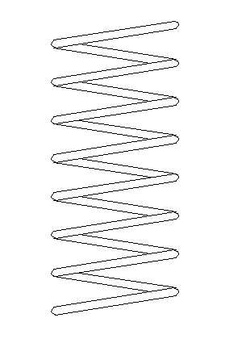
Stretching Springs
Experimental procedure:
1. Place the weight holder only on the spring and note the position of the pin against the metre rule.
2. Add 1N (100g) to the holder and note the new position of the pin.
3. Calculate the extension of the spring.
4. Repeat stages 1 to 3 for 2N, 3N, 4N, 5N and 6N. DO NOT EXCEED 6N.
spring
weights
pin
metre rule
Notes:
6

Slide 7
Typical results
Pin position with holder only (mm) | Added weight or Force (N) | Pin position with weight (mm) | Extension (mm)
450 | 1 | 480 | 30
450 | 2 | 509 | 59
450 | 3 | 541 | 91
450 | 4 | 570 | 120
450 | 5 | 601 | 151
450 | 6 | 629 | 179
Notes:
7

Slide 8
Force against extension graph
Force (N)
0
0
Extension (mm)
Notes:
8

Slide 9
Hooke’s law
Hooke’s law states that the extension of a spring is proportional to the force used to stretch the spring.
‘Proportional’ means that if the force is doubled then the extension also doubles.
The line on a graph of force against extension will be a straight AND go through the origin.

Slide 10
Question
A spring of original length 150mm is extended by 30mm by a force of 4N. Calculate the length of the spring if a force of 12N is applied.

Slide 11
Question
A spring of original length 150mm is extended by 30mm by a force of 4N. Calculate the length of the spring if a force of 12N is applied.
12N is three times 4N
Therefore the new extension should be 3 x 30mm
= 90mm
New spring length = 150mm + 90mm
= 240mm

Slide 12
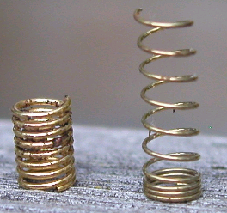
Elastic limit
Up to a certain extension if the force is removed the spring will return to its original length. The spring is behaving elastically.
If this critical extension is exceeded, known as the elastic limit, the spring will be permanently stretched.
Hooke’s law is no longer obeyed by the spring if its elastic limit is exceeded.
The right hand spring has been stretched beyond its elastic limit

Slide 13
Force against extension graph if the elastic limit is exceeded
Force (N)
elastic limit
0
0
Extension (mm)
Notes:
13

Slide 14
Stretching an elastic band
Force
An elastic band does not obey Hooke’s law.
0
0
Extension
Notes:
14

Slide 15
Choose appropriate words to fill in the gaps below:
Hooke’s law states that when a wire or spring is _________ the increase in length or _________ is proportional to the load ______ applied.
This law is not obeyed if the spring is taken beyond its ______ limit after which it will become _____________ stretched.
A ________ band does not obey Hooke’s law.
A graph illustrating Hooke’s law will have a line that is ___________ and passes through the _______.
WORD SELECTION:
stretched
elastic
permanently
extension
origin
force
rubber
straight
Notes:
15

Slide 16
Choose appropriate words to fill in the gaps below:
Hooke’s law states that when a wire or spring is _________ the increase in length or _________ is proportional to the load ______ applied.
This law is not obeyed if the spring is taken beyond its ______ limit after which it will become _____________ stretched.
A ________ band does not obey Hooke’s law.
A graph illustrating Hooke’s law will have a line that is ___________ and passes through the _______.
stretched
extension
force
elastic
permanently
rubber
straight
origin
WORD SELECTION:
stretched
elastic
permanently
extension
origin
force
rubber
straight
Notes:
16

