Slide 1
PROPERTIES OF WAVES

Slide 2
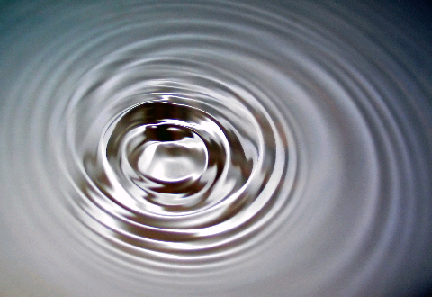
Waves
A wave is a means of transferring energy and information from one point to another without there being any transfer of matter between the two points.
Notes:
2

Slide 3

Transverse Waves
Transverse waves are waves where the direction of vibrations is at 90° to the direction in which the wave travels.
example: water waves
vibrations
wave direction
TRANSVERSE WAVE

Slide 4

Longitudinal Waves
Longitudinal waves are waves where the vibrations of the particles are along the direction in which the wave travels.
example: sound waves
vibrations
wave direction
LONGITUDINAL WAVE
longitudinal wave in slinky

Slide 5
Describing Waves
1. Amplitude (A)
Amplitude is the maximum movement of the particles that make up a wave from their rest position.
amplitude
rest position
amplitude
The amplitude is the height of a crest OR the depth of a trough
Notes:
5

Slide 6
2. Wavelength (λ)
Wavelength is the distance between one wave peak and the next wave peak along the path of a wave.
Wavelength is measured in metres.
wavelength
wavelength
Wavelength is also the distance between the bottom of one trough to the next.
Notes:
6

Slide 7
3. Frequency (f )
Frequency is the number of wave peaks that pass a point in one second.
Frequency is measured in hertz (Hz)
1 Hz = 1 peak per second
2 Hz = 2 peaks per second and so on….
1 kilohertz (1kHz) = 1 000 Hz
1 megahertz (1MHz) = 1 000 000 Hz
1 gigahertz (1GHz) = 1 000 000 000 Hz
1 terahertz (1THz) = 1 000 000 000 000 Hz
Notes:
7

Slide 8
4. Time period (T )
Time period is the time taken for a source to produce one wave.
time period = 1
frequency
and:
frequency = 1
time period
T = 1 / f
f = 1 / T
Notes:
8

Slide 9
Question 1
Calculate the frequency of a wave of time period 8.0 seconds.
f = 1 / T
= 1 / 8
frequency = 0.125 hertz
Notes:
9

Slide 10
Question 2
Calculate the time period of a wave of frequency 50Hz.
T = 1 / f
= 1 / 50
time period = 0.020 second
Notes:
10

Slide 11
The wave equation
speed = frequency x wavelength
v = f x λ
speed in metres per second (m/s)
wavelength in metres (m)
frequency in hertz (Hz)
also: f = v ÷ λ
and: λ = v ÷ f
v
f
λ
Notes:
11

Slide 12
Question 1
Calculate the speed of a water wave of wavelength 3m and frequency 6Hz.
Notes:
12

Slide 13
Question 1
Calculate the speed of a water wave of wavelength 3m and frequency 6Hz.
v = f x λ
= 6Hz x 3m
speed = 18 m/s
Notes:
13

Slide 14
Question 2
Calculate the frequency of a wave in water of wavelength 2.0m if its speed is 16m/s.
Notes:
14

Slide 15
Question 2
Calculate the frequency of a wave in water of wavelength 2.0m if its speed is 16m/s.
v = f x λ
becomes:
f = v ÷ λ
= 16 m/s ÷ 2m
frequency = 8 Hz
Notes:
15

Slide 16
Question 3
Calculate the wavelength of a sound wave in water of frequency 300Hz if its speed is 1500m/s.
Notes:
16

Slide 17
Question 3
Calculate the wavelength of a sound wave in water of frequency 300Hz if its speed is 1500m/s.
v = f x λ
becomes:
λ = v ÷ f
= 1500 m/s ÷ 300 Hz
wavelength = 5 metres
Notes:
17

Slide 18
Question 4
Calculate the speed of a wave that has a wavelength of 30m and time period 0.04s.
Notes:
18

Slide 19
Question 4
Calculate the speed of a wave that has a wavelength of 30m and time period 0.04s.
f = 1 / T
= 1 / 0.04s
f = 25 hertz
v = f x λ
= 25Hz x 30m
speed = 750 m/s
Notes:
19

