Slide 1
SOUND WAVES

Slide 2
GUIDELINES
Light and sound
understand that sound waves are longitudinal waves which can be reflected, refracted and diffracted
know that the frequency range for human hearing is 20 Hz – 20 000 Hz
describe how to measure the speed of sound in air
understand how an oscilloscope and microphone can be used to display a sound wave
describe an experiment using an oscilloscope to determine the frequency of a sound wave
relate the pitch of a sound to the frequency of vibration of the source
relate the loudness of a sound to the amplitude of vibration.

Slide 3
Sound
Sound is produced by vibrating objects.
A sound wave consists of mechanical vibrations in air and other substances.
Sound is a longitudinal wave in which the wave energy travels in the same direction as the particles within the wave vibrate.
LONGITUDINAL WAVE
wave direction
vibrations

Slide 4
loudspeaker
compression
no sound wave
sound wave
wavelength
rarefaction
Through air a sound wave consists of a series of compressions and rarefactions.
A compression is a region of slightly higher pressure where the air molecules are closer together than usual.
A rarefaction is the opposite.
The wavelength of the sound wave is equal to the distance between the centres of two successive compressions.

Slide 5
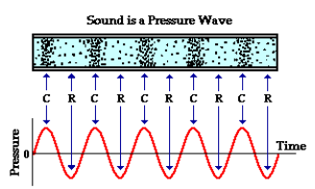

Slide 6
Range of hearing
Humans can hear sound frequencies in the range
20 Hz to 20 000 Hz.
Age and damage reduces the upper limit.
For example an old person or someone exposed to prolonged high sound volume may no longer be able to hear above 10 000 Hz.
Some animals can hear much higher frequencies:
bats and dolphins:
up to 100 000 Hz
dogs – 40 000 to 60 000 Hz (depends on the breed)

Slide 7
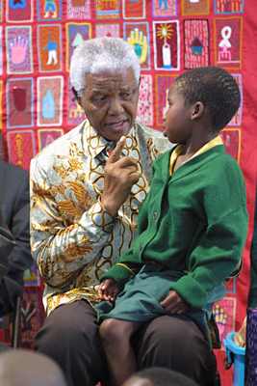
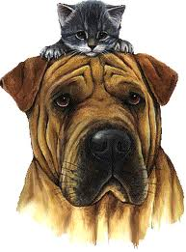
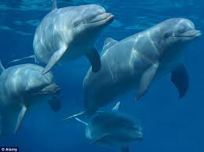
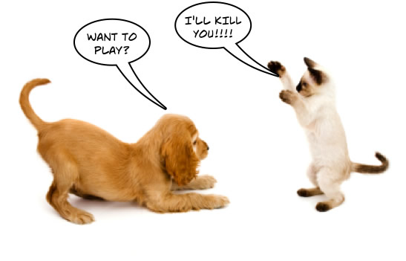

Slide 8
Ultrasound and Infrasound
Ultrasound is high frequency sound, above 20 000 Hz, too high to be heard by humans.
Ultrasound echoes can be used to measure distance (e.g. sonar) and to see inside objects (scans).
Infrasound is low frequency sound, inaudible to human, although we may feel the very slow vibrations.
Earthquake waves are a form of infrasound. Elephants and some other large animals can hear infrasound.

Slide 9
Sound waves in different materials
Sound travels quickest through solids.
A train can often be hared approaching through the rails before it can be heard through the air.
Sound travels well through liquids.
Whales can communicate over great distances under water.
Sound travels slowest through gases.
The speed of sound increases with temperature.
Sound does not travel through a vacuum.
Sound does not travel in space.
Poster for the movie ‘Alien’ (1979)

Slide 10
Bell jar experiment
This experiment shows that sound needs a material medium for transmission.
As the air pressure inside the bell jar is reduced the loudness of the sound heard outside decreases.
The bell can be still seen to be working normally.

Slide 11
Reflection of sound
An echo is a reflected sound wave.
Question:
A misguided child shouts ‘Chelsea!’ at a nearby cliff and hears an echo 1.4 s later. How far away is the cliff?
Take the speed of sound = 340 m/s.
distance, D
The sound travels to and from the cliff, a total distance of 2D
speed = distance / time
becomes: distance = speed x time
= 340 m/s x 1.4 s
= 476 m
= 2D !
Therefore distance to the cliff = 238 m.

Slide 12
Sound refraction
C
A
B
cooler air
The sound produced by person A may be heard more clearly by person B than by person C.
The cooler air over the water refracts the sound waves downwards.

Slide 13
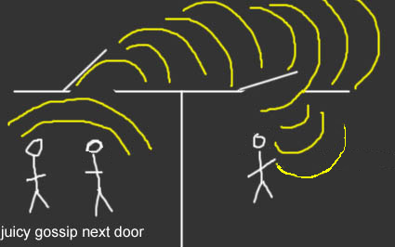
Sound diffraction
A typical sound wave has a wavelength of about 1m.
This is similar in size to the aperture of a doorway.
Therefore sound undergoes significant diffraction at a doorway or around the corner of a building.
This is why we can hear someone in such circumstances even thought we cannot see them.
Why does light not diffract as much as sound?
The wavelength of light is about 0.000 5mm – much smaller than a door aperture.

Slide 14
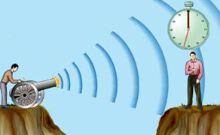
Measuring the speed of sound
Method 1: Using a visible loud event
Use a stopwatch to time the difference between seeing and hearing the event (for example an explosion).
Measure the distance between the event an the timing position.
Speed = distance / time.
Note: The distance should be as large as possible in order to avoid significant reaction time error in the timing measurement.

Slide 15
Question
A group of students measured the time taken between seeing and hearing another student, 250 m away, clashing two pieces of wood together. They obtained the following timings in seconds: 0.73, 0.78, 0.69, 0.81, 0.77. Use their measurements to obtain a speed of sound estimate.

Slide 16
Question
A group of students measured the time taken between seeing and hearing another student, 250 m away, clashing two pieces of wood together. They obtained the following timings in seconds: 0.73, 0.78, 0.69, 0.81, 0.77. Use their measurements to obtain a speed of sound estimate.
average time = (0.73 + 0.78 + 0.69 + 0.81 + 0.77) / 5
= 3.78 / 5
= 0.756 s
speed = distance / time
= 250 m / 0.756 s
= 4 080 m
speed of sound = 331 m/s

Slide 17
Measuring the speed of sound
Method 2: Using echoes
Facing a flat vertical surface (wall or cliff) at least 50m away one person clashes two pieces of wood together. This person should try to clap the pieces of wood in time with the echo they hear coming back from the flat surface.
Another person times 20 claps on a stop-watch. They should count: 0, 1, 2 ,3 …. 20.
Measure the distance, D between the clapping person an the flat surface.
The total distance travelled by the sound will be 20 x 2D
Speed = total distance / time for 20 claps.

Slide 18
Question
In an experiment to measure the speed of sound by the echo method when a student stands 75m away from a wall 20 claps are heard over a time of 8.77s. Calculate the speed of sound.

Slide 19
Question
In an experiment to measure the speed of sound by the echo method when a student stands 75m away from a wall 20 claps are heard over a time of 8.77s. Calculate the speed of sound.
total distance travelled by the sound
= (20 x 2 x 75)m
= 3000m
speed = total distance / time for 20 claps
= 3000m / 8.77s
speed of sound = 342 m/s

Slide 20
Speed of sound examples
Substance and temperature | Speed in m/s
Air at 0ºC | 330
Air at 20ºC
Air at -10ºC
Fresh water at 25ºC
Sea water at 25ºC
Steel at 20ºC
Vacuum
330
342
325
1 497
1 560
5 000
0

Slide 21
Mach numbers
Mach number = object speed
speed of sound

Slide 22
Thunder and lightning
The sound of thunder reaches the observer in about 15 seconds
STORM CLOUD
Light reaches the observer in 16 millionths of a second
LIGHTNING
Every 5 second difference equates to a distance of 1 mile
An observer, 3 miles away, sees a lightning flash about 15 seconds before hearing thunder

Slide 23
Thunder and lightning question
A thunderclap is heard 12 seconds after a lightning flash. Calculate the distance to the lightning flash.
Take the speed of sound = 340 m/s

Slide 24
Thunder and lightning question
A thunderclap is heard 12 seconds after a lightning flash. Calculate the distance to the lightning flash.
Take the speed of sound = 340 m/s
speed = distance / time
becomes: distance = speed x time
= 340 m/s x 12 seconds
= 4 080 m
Distance = 4.08 km

Slide 25
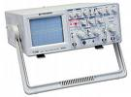
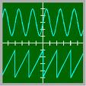
Sound waves on oscilloscopes
An oscilloscope is a device that with a microphone attached can be used to display a sound wave.
The screen displays a graph of how the amplitude of the sound wave varies with time.

Slide 26
Loudness
The loudness of a sound increases with the amplitude of the sound wave.
quiet
loud

Slide 27
Pitch
The pitch of a musical note increases with frequency.
low pitch
high pitch
Examples:
Concert pitch A = 440 Hz; Top C = 523 Hz
Doubling the frequency increases the pitch by one octave. Therefore the ‘A’ above top C will have frequency 880 Hz.

Slide 28
Question
The diagram opposite shows the appearance of a sound wave on an oscilloscope. Draw a second diagram showing the appearance of a sound wave of lower pitch but greater loudness.

Slide 29
Measuring frequency using an oscilloscope
time period
The time taken between peaks on an oscilloscope trace is equal to the time period, T of the sound wave.
frequency = 1 / period
f = 1 / T
example:
if T = 0.05s
f = 1 / 0.05
frequency = 20Hz

Slide 30
Question
The distance between peaks on an oscilloscope trace is 4cm. If the oscilloscope time scale is set at 1ms/cm calculate the frequency of the sound.
1ms/cm means that the trace covers 1cm in one millisecond (0.001s)
time period, T = 4cm x 1ms/cm
= 4ms (0.004s)
f = 1 / T
f = 1 / 0.004
frequency = 250Hz
4 cm

Slide 31
Choose appropriate words to fill in the gaps below:
Sound is a ___________ wave that in air consists of a series of compressions and _____________.
Sound travels fastest through _______ but does not travel at all through a __________.
A ____________ sound wave is called an echo. Sound also undergoes ____.
On average, humans can hear sound frequencies from __________ to ____________.
WORD SELECTION:
rarefactions
refraction
vacuum
20 Hz
solids
longitudinal
reflected
20 000 Hz

Slide 32
ANSWERS:
Sound is a ___________ wave that in air consists of a series of compressions and _____________.
Sound travels fastest through _______ but does not travel at all through a __________.
A ____________ sound wave is called an echo. Sound also undergoes ___________.
On average, humans can hear sound frequencies from __________ to ____________.
longitudinal
rarefactions
solids
vacuum
reflected
refraction
20 Hz
20 000Hz

