Slide 1
KS3 Mathematics
N4 Powers and roots
Notes:
The aim of this unit is to teach pupils to:
Recognise squares and cubes, and the corresponding roots; use index notation and simple instances of the index laws.
Material in this unit is linked to the Key Stage 3 Framework supplement of examples pp 56-59.

Slide 2


Contents
N4 Powers and Roots
N4.1 Square and triangular numbers
N4.2 Square roots
N4.3 Cubes and cube roots
N4.4 Powers

Slide 3

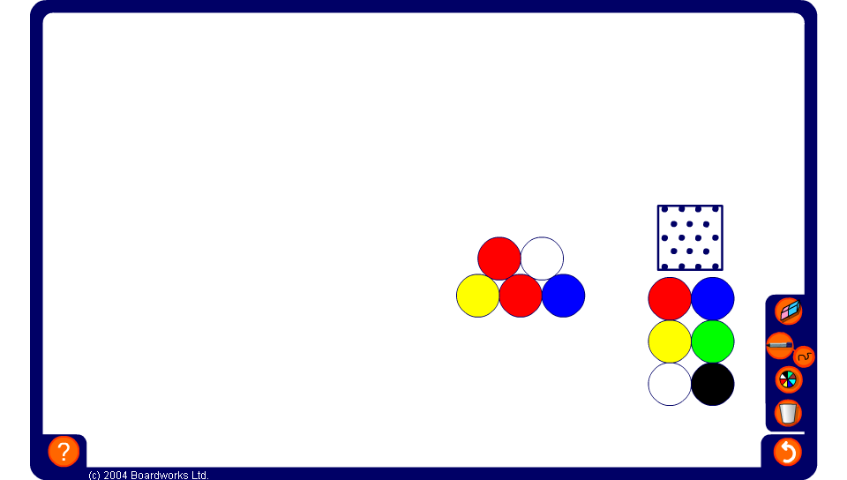
Making triangles
Notes:
Tell pupils that we can arrange counters into triangles by putting consecutive numbers of counters into rows.
For example, we can put one counter at the top, two counters in the next row and three counters in the third.
Demonstrate this arrangement using round counters on the board.
There are six counters in this arrangement. Six is a triangular number.
What is the next triangular number?
Show that we can find the next triangular number by adding a row of four counters.
The next triangular number is ten.

Slide 4
Triangular numbers
The first triangular number is 1.
The second triangular number is 3.
The third triangular number is 6.
The fourth triangular number is 10.
The fifth triangular number is 15.
The sixth triangular number is 21.
The seventh triangular number is 28.
The eighth triangular number is 36.
The ninth triangular number is 45.
The tenth triangular number is 55.
1 + 2 = 3
1 + 2 + 3 = 6
1 + 2 + 3 + 4 = 10
1 + 2 + 3 + 4 + 5 = 15
1 + 2 + 3 + 4 + 5 + 6 = 21
1 + 2 + 3 + 4 + 5 + 6 + 7 = 28
1 + 2 + 3 + 4 + 5 + 6 + 7 + 8 = 36
1 + 2 + 3 + 4 + 5 + 6 + 7 + 8 + 9 = 45
1 + 2 + 3 + 4 + 5 + 6 + 7 + 8 + 9 + 10 = 55
Notes:
Demonstrate the first ten triangular numbers.

Slide 5
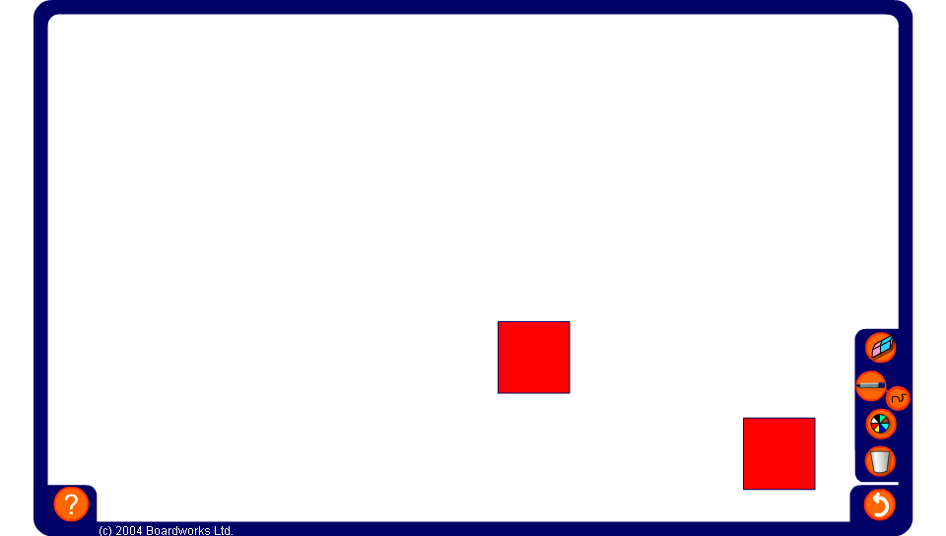
Making squares
Notes:
Ask volunteers to come to the board and arrange 9 tiles to make a square.
Tell pupils that the number 9 is called a square number.
Can we arrange 16 tiles to make a square?
Ask a volunteer to demonstrate this and ask pupils to tell you how we can decide whether or not 16 is a square number. Establish that to make a square we need the same number of rows and columns. We can arrange 16 tiles in 4 rows and 4 columns and so it is a square number. We can make a square number by multiplying a whole number by itself.
Can we arrange 20 tiles to make a square?
What is the next square number? (25)
What is the smallest square number? (1)
Tell pupils that when we multiply a number by itself, for example 6 × 6, it is called squaring the number and that another way of saying 6 × 6 is ‘six squared’. The result, for example, 36, is called a square number.

Slide 6
Square numbers
When we multiply a number by itself we say that we are squaring the number.
To square a number we can write a small ² after it.
For example, the number 3 multiplied by itself can be written as
Three squared
3 × 3 or 3²
The value of three squared is 9.
The result of any whole number multiplied by itself is called a square number.
Notes:
Introduce the notation ² to mean ‘squared’ or ‘to the power of two’.
Pupils sometimes confuse ‘to the power of two’ with ‘times by two’. Point out that raising to a power can be thought of as repeated multiplication. Squaring means that the number is multiplied by itself, while multiplying by two means that the number is added to itself. For example, 4² means 4 × 4 and 4 × 2 means 4 + 4.
Point out that these square numbers form a sequence. Look at the difference between consecutive terms and conclude that we could write a term-to-term rule for this sequence as add consecutive odd numbers. Ask pupils to tell you the position-to-term rule.
Conclude that each square number can be made, not only by multiplying a whole number by itself (raising it to the power of two) but also by adding together consecutive odd numbers starting with one.

Slide 7
Square numbers
Here are the first 10 square numbers:
1² = 1 × 1 =
1
+ 3
2² = 2 × 2 =
4
+ 5
3² = 3 × 3 =
9
+ 7
4² = 4 × 4 =
16
+ 9
5² = 5 × 5 =
25
+ 11
6² = 6 × 6 =
36
+ 13
7² = 7 × 7 =
49
+ 15
8² = 8 × 8 =
64
+ 17
9² = 9 × 9 =
81
+ 19
10² = 10 × 10 =
100
Notes:
Introduce the notation ² to mean ‘squared’ or ‘to the power of two’.
Pupils sometimes confuse ‘to the power of two’ with ‘times by two’. Point out that raising to a power can be thought of as repeated multiplication. Squaring means that the number is multiplied by itself, while multiplying by two means that the number is added to itself. For example, 4² means 4 × 4 and 4 × 2 means 4 + 4.
Point out that these square numbers form a sequence. Look at the difference between consecutive terms and conclude that we could write a term-to-term rule for this sequence as add consecutive odd numbers. Ask pupils to tell you the position-to-term rule.
Conclude that each square number can be made, not only by multiplying a whole number by itself (raising it to the power of two) but also by adding together consecutive odd numbers starting with one.

Slide 8
Adding consecutive odd numbers
The first square number is 1.
The second square number is 4.
The third square number is 9.
The fourth square number is 16.
The fifth square number is 25.
The sixth square number is 36.
The seventh square number is 49.
The eighth square number is 64.
The ninth square number is 81.
The tenth square number is 100.
1 + 3 = 4
1 + 3 + 5 = 9
1 + 3 + 5 + 7 = 16
1 + 3 + 5 + 7 + 9 = 25
1 + 3 + 5 + 7 + 9 + 11 = 36
1 + 3 + 5 + 7 + 9 + 11 + 13 = 49
1 + 3 + 5 + 7 + 9 + 11 + 13 + 15 = 64
1 + 3 + 5 + 7 + 9 + 11 + 13 + 15 + 17 = 81
1 + 3 + 5 + 7 + 9 + 11 + 13 + 15 + 17 + 19 = 100
Notes:
By using a different colour for the counters that are added on between consecutive square numbers we can see how square numbers can be made by adding consecutive odd numbers starting from 1.

Slide 9

Making square numbers
There are several ways to generate a sequence of square numbers.
We can multiply a whole number by itself.
We can add consecutive odd numbers starting from 1.
We can add together two consecutive triangular numbers.

Slide 10
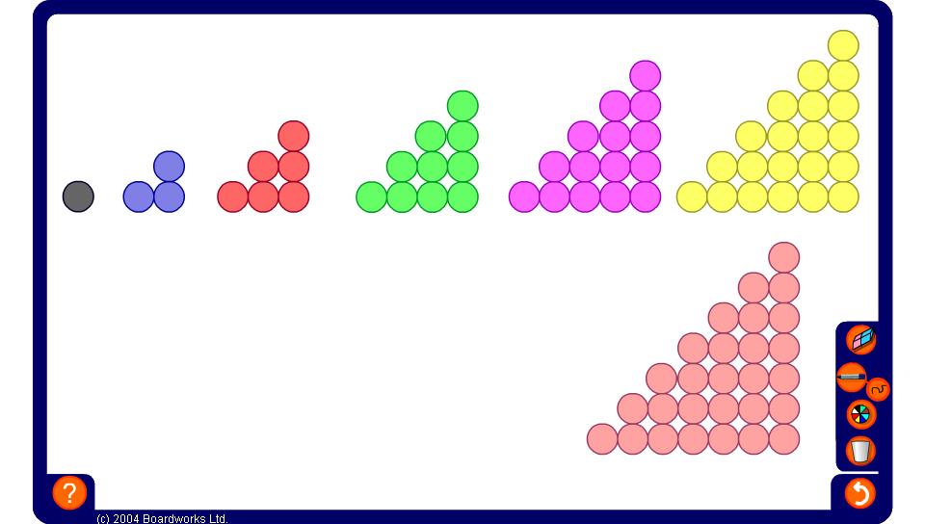
Adding consecutive triangular numbers
Notes:
Drag one red counter into the middle of the board.
One is the first triangular number.
Drag three blue counters into the middle of the board and arrange them to form the next triangular number.
Ask a volunteer to demonstrate on the board how we could combine the first two triangular numbers to make a square.
Next show three counters and six counters arranged in triangles. Again, ask how these could be arranged to make a square. Continue for other pairs of consecutive triangular numbers.
Ask pupils whether this proves that any pair of consecutive triangular numbers can be added together to make a square number.

Slide 11
Adding two consecutive triangular numbers
We can make square numbers by adding two consecutive triangular numbers.
1 + 2 = 3
3 + 6 = 9
6 + 10 = 16
10 + 15 = 25
15 + 21 = 36
21 + 28 = 49
28 + 36 = 64
36 + 45 = 81
45 + 55 = 100
Notes:
Talk about each way of expressing square numbers.

Slide 12
Contents
N4 Powers and Roots
N4.1 Square and triangular numbers
N4.2 Square roots
N4.3 Cubes and cube roots
N4.5 Powers

Slide 13
Square roots
The area of this square is 64 cm².
?
8 cm
?
8 cm
What is the length of the sides?
Notes:
Ask pupils to suggest how we can work out the length of one side of the square before revealing the solution.
Establish that the sides are of equal length and so we are looking for a number that multiplies by itself to give 64.
Reveal the answer and tell pupils that 8 is the square root of 64.

Slide 14
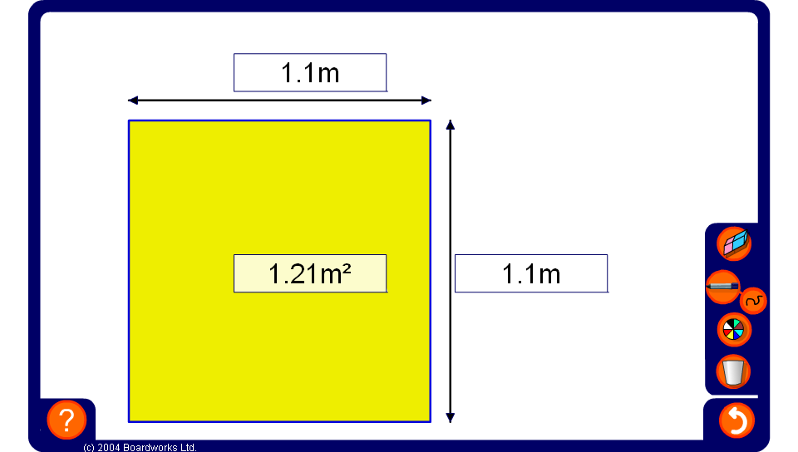
Square roots
Notes:
Ask pupils to suggest how we can work out the length of one side of the square before revealing the solution.
Establish that the sides are of equal length and so we are looking for a number that multiplies by itself to give 64.
Reveal the answer and tell pupils that 8 is the square root of 64.

Slide 15
Square roots
Finding the square root is the inverse of finding the square:
squared
8
64
square rooted
We write
√64 =
8
The square root of 64 is 8.
Notes:
Talk through the slide and introduce the square root symbol.
Explain that to work out the square root we need to ask ourselves ‘what number multiplied by itself will give this answer’.
Does any other number multiply by itself to give 64?
Obtain the answer –8.
Remember that when you multiply two negative numbers together the answer is positive.
Point out that when we use the √ symbol we are usually referring to the positive square root.
Ask verbally for the square root of some known square numbers.
For example,
What is the square root of 81?

Slide 16
Square roots
We can easily find the square root of a square number.
√1 =
1
√36 =
6
√4 =
2
√49 =
7
√9 =
3
√64 =
8
√16 =
4
√81 =
9
√25 =
5
√100 =
10

Slide 17
The product of two square numbers
The product of two square numbers is always another square number.
For example,
4 × 25 = 100
because
2 × 2 × 5 × 5 = 2 × 5 × 2 × 5
and
(2 × 5)² = 10²
We can use this fact to help us find the square roots of larger square numbers.
Notes:
As an extension pupil could be asked to show this algebraically.
For example, if a² and b² are two square numbers then a² × b² = aa × bb = aabb = abab = ab × ab = (ab)².
As an extension ask pupils to investigate which square numbers cannot be expressed as the product of two square numbers (the squares of prime numbers).

Slide 18
Using factors to find square roots
If a number has factors that are square numbers then we can use these factors to find the square root.
For example,
Find √400
Find √225
√400 = √4 × 100
√225 = √9 × 25
= 2 × 10
= 3 × 5
= 20
= 15
Notes:
Ask pupils to find two square numbers that multiply together to make 225 before going through each step.
Similarly, ask pupils to find two square numbers that multiply together to make 196.

Slide 19
Finding square roots of decimals
If a number can be made be dividing two square numbers then we can find its square root.
For example,
Find √0.09
Find √1.44
√0.09 = √9 ÷ 100
√1.44 = √144 ÷ 100
= 3 ÷ 10
= 12 ÷ 10
= 0.3
= 1.2
Notes:
State that if we multiply any two square numbers together the answer will be a square number.
The product of two square numbers is another square number.
For example, 4 × 25 = 100. Ask pupils to find two square numbers that multiply together to make 225 before going through each step.
Similarly, ask pupils to find two square numbers that multiply together to make 196.

Slide 20

Approximate square roots
If a number cannot be written as a product or quotient of two square numbers then its square root cannot be found exactly.
Use the
√
key on your calculator to find out √2.
The calculator shows this as 1.414213562
This is an approximation to 9 decimal places.
The number of digits after the decimal point is infinite.
Notes:
Explain to pupils that the square root of a number that cannot by made by multiplying or dividing two square numbers cannot be found exactly.
A calculator will give an approximation to a given number of decimal places but the number cannot be written exactly as a decimal. The number of digits after the decimal point is infinite. This is called an irrational number.
Ask pupils to find √2 using their calculators. Some calculators will require the √ key to be pressed after the two and some before. Make sure pupils know which way round to do this on their calculators.
Stress that this is an approximation because 1.4142135622 is not 2 but a number slightly less than 2.

Slide 21
Estimating square roots
What is √10?
10 lies between 9 and 16.
10 is closer to 9 than to 16, so √10 will be about 3.2
Therefore,
√9 < √10 < √16
So,
3 < √10 < 4
Use the
√
key on you calculator to work out the answer.
√10 = 3.16 (to 2 decimal places.)
Notes:
Tell pupils that before using a calculator to work something out we should try to estimate the answer.
To estimate the square root of a number that is not square we can estimate the answer by finding the two square numbers that the number lies between.
Ask for pupils to first of all estimate the answer to √20.
We know that no whole number multiplies by itself to give 20 so the answer can’t be a whole number.
What two square numbers does 20 lie between?
Establish that the square root must lie between 16 and 25 before proceeding.
Establish that if √20 lies between 4 and 5, the answer must be 4.something.
Explain that since 20 is closer to 16 than it is to 25, we would expect √20 to be closer to 4 than to 5. A good estimation therefore would be about 4.4.
Ensure that all pupils can locate and use the √ key on their calculators to obtain an answer of 4.472135955.
We can see that our estimate was a little low, the answer was actually closer to 4.5.

Slide 22
Trial and improvement
√
Suppose our calculator does not have a key.
40 is closer to 36 than to 49, so √40 will be about 6.3
Find √40
√36 < √40 < √49
So,
6 < √40 < 7
6.3² =
39.69
too small!
6.4² =
40.96
too big!
Notes:
Establish that 40 lies between 36 and 49, so √40 must lie between 6 and 7.
Ask pupils what they think a good approximation will be considering that 40 is closer to 36 than it is to 49. Accept 6.3 or 6.4 as good approximations.
Instruct pupils to work out 6.3 x 6.3 using their calculators. (Alternatively they could use the x² key.)
Our approximation is too small, so let’s try 6.4.
6.4 is too big. The answer must therefore lie between 6.3 and 6.4.
What number could we try next?
6.35 is half-way between 6.3 and 6.4.
But, look at these answers. Do you think √40 will be closer to 6.3 or 6.4?
Establish that the answer will be closer to 6.3 than to 6.4 because 39.69 is closer to 40 than 40.96.
Let’s try 6.33 next.

Slide 23
Trial and improvement
6.33² =
40.0689
too big!
6.32² =
39.9424
too small!
Suppose we want the answer to 2 decimal places.
6.325² =
40.005625
too big!
Therefore,
6.32 < √40 < 6.325
√40 = 6.32 (to 2 decimal places)
Notes:
6.33 is too big, let’s try 6.32
Reveal the value of 6.322 on the board and establish that the answer must lie between 6.33 and 6.32.
We could continue this way forever, getting closer and closer to the square root of 40.
Suppose we just want the answer to 2 decimal places. Do we have enough information here to do that?
Establish that if the answer was more than 6.325 we would round up to 6.33. If the answer was less than 6.325 we would round down to 6.32.
By looking at these answers 39.9424 is closer to 40 than to 40.689. We would therefore expect the answer to be closer to 6.32.
Let’s work out 6.325², just to make sure.
Reveal the answer on the board.
It’s too big! So the square root of 40 must lie between 6.32 and 6.325. Since the answer is less than 6.325, we need to round down, so the answer 6.32 to 2 decimal places.
This method is called ‘Trial and Improvement’

Slide 24
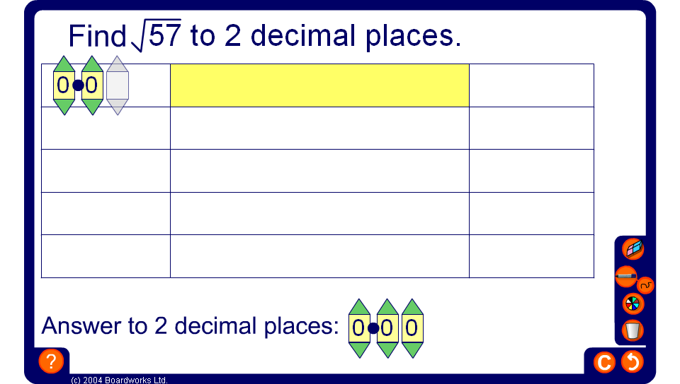
Trial and improvement

Slide 25
Negative square roots
5 × 5 = 25
and
–5 × –5 = 25
Therefore, the square root of 25 is 5 or –5.
When we use the √ symbol we usually mean the positive square root.
We can also write ±√ to mean both the positive and the negative square root.
The equation,
x² = 25
has 2 solutions,
x = 5
or
x = –5
Notes:
Before revealing –5 × –5 = 25, ask,
5 × 5 = 25, does any other number multiplied by itself give an answer of 25?
Explain that the square root symbol refers to the positive square root, by convention.
Pupils need to know that the negative square root exists, for example, in the solution to equations such as that shown.
Ask for other negative square roots verbally.

Slide 26
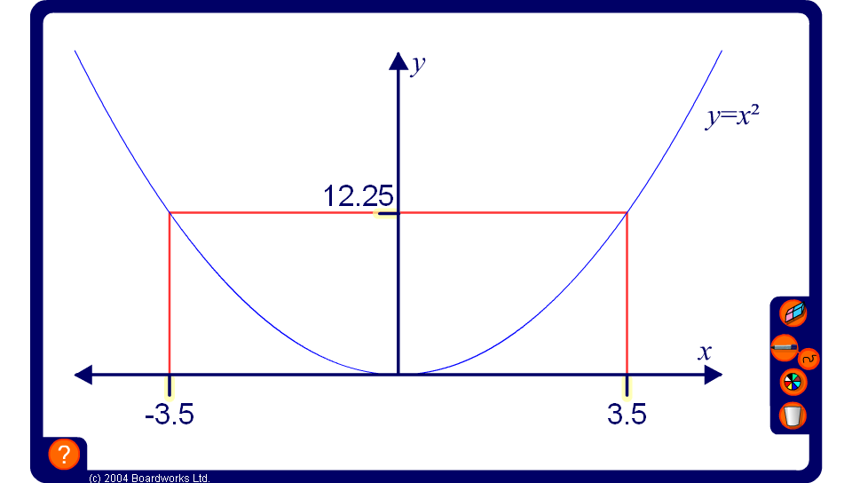
Squares and square roots from a graph
Notes:
Explain to pupils that if we plot numbers against their squares we get a graph of the shape shown on the board. This shape is called a parabola.
Ask pupils to give you the coordinates of some of the points that will lie on this curve. For example, (2, 4), (–3, 9) or (1.5, 2.25).
Drag the red dotted line along the y-axis to show how we can use the graph to find both the positive and negative square roots of the numbers on the y-axis. Point out that most of these numbers have been rounded to two decimal places. Unless a number can be made by multiplying or dividing square numbers, its square root cannot be written as an exact number.
By dragging the the red dotted line along the x-axis, show how we can use the graph to find the squares of given numbers on the y-axis. The squares of these numbers are exact.

Slide 27
Contents
N4 Powers and Roots
N4.1 Square and triangular numbers
N4.2 Square roots
N4.3 Cubes and cube roots
N4.4 Powers

Slide 28
Cubes
1 cube
8 cubes
27 cubes
64 cubes
125 cubes
Notes:
Count the number of small cubes in each large cube by multiplying the number of cubes in each row by the number or layers, as illustrated.
Link to volume = length × width × height.

Slide 29
Cubes
The numbers 1, 8, 27, 64, and 125 are called:
Cube numbers
1³ = 1 × 1 × 1 = 1
‘1 cubed’ or ‘1 to the power of 3’
2³ = 2 × 2 × 2 = 8
‘2 cubed’ or ‘2 to the power of 3’
3³ = 3 × 3 × 3 = 27
‘3 cubed’ or ‘3 to the power of 3’
4³ = 4 × 4 × 4 = 64
‘4 cubed’ or ‘4 to the power of 3’
5³ = 5 × 5 × 5 = 125
‘5 cubed’ or ‘5 to the power of 3’
Notes:
As 1³ is revealed state,
We read this as 1 cubed or 1 to the power of 3.
No matter how many times we multiply 1 by itself we always get an answer of 1.
Ensure that everyone understands the notation, that 4³, for example, means 4 multiplied by itself three times – not 4 × 3.
Tell pupils that they are expected to know the first 5 cube numbers and the answer to 10 cubed.
What is 10 cubed? (1000)

Slide 30
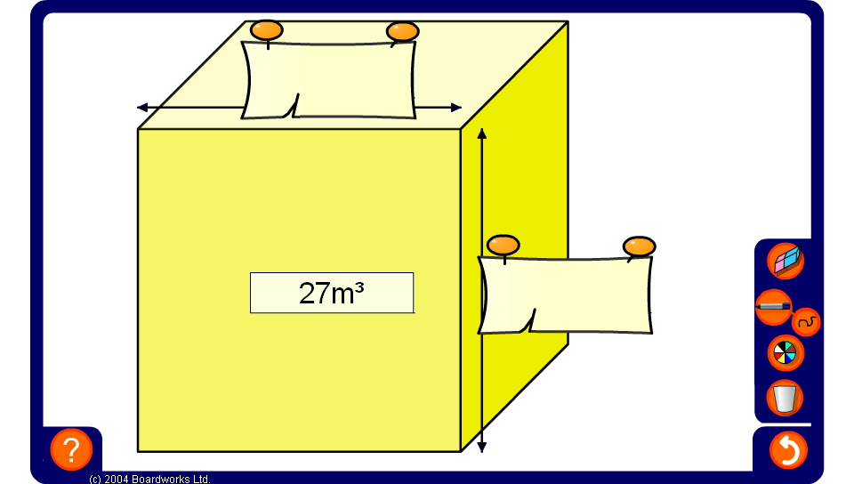
Cubes and cube roots
Notes:
Ask pupils to suggest how we can work out the length of one edge of the cube before revealing the solution.
Establish that the sides are of equal length and so we are looking for a number that when cubed gives that volume.
Allow pupils to use a calculator if needed.

Slide 31
Cube roots
Finding the cube root is the inverse of finding the cube:
cubed
5
125
cube rooted
We write
√125 = 5
³
The cube root of 125 is 5.
Notes:
Explain that to find the cube root we need to think ‘what number multiplied by itself twice will give this answer’.

Slide 32
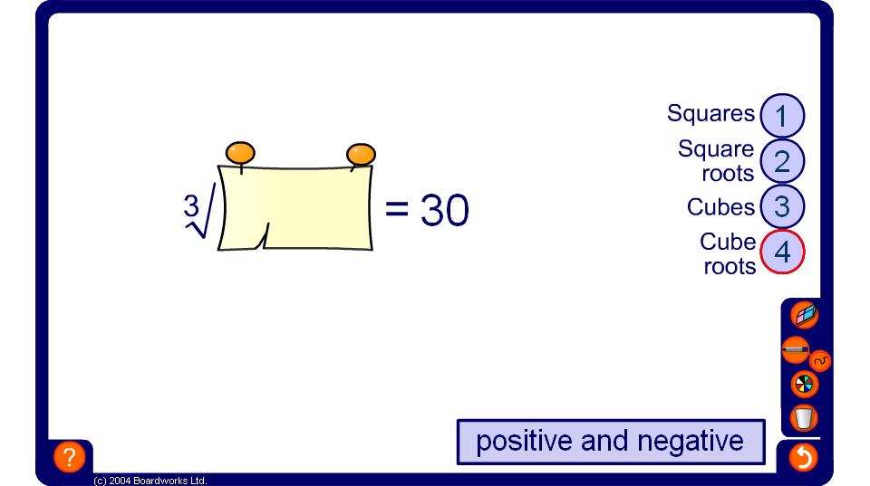
Squares, cubes and roots

Slide 33
Contents
N4 Powers and Roots
N4.1 Square and triangular numbers
N4.2 Square roots
N4.3 Cubes and cube roots
N4.4 Powers

Slide 34
Index notation
We use index notation to show repeated multiplication by the same number.
For example,
we can use index notation to write 2 × 2 × 2 × 2 × 2 as
Index or power
2⁵
base
This number is read as ‘two to the power of five’.
2⁵ =
2 × 2 × 2 × 2 × 2 =
32
Notes:
Talk about the use of index notation as a mathematical shorthand.

Slide 35
Index notation
Evaluate the following:
When we raise a negative number to an odd power the answer is negative.
6² =
6 × 6 =
36
3⁴ =
3 × 3 × 3 × 3 =
81
(–5)³ =
–5 × –5 × –5 =
–125
When we raise a negative number to an even power the answer is positive.
2⁷ =
2 × 2 × 2 × 2 × 2 × 2 × 2 =
128
(–1)⁵ =
–1 × –1 × –1 × –1 × –1 =
–1
(–4)⁴ =
–4 × –4 × –4 × –4 =
64
Notes:
Talk through each example.
Remind pupils that 6² can be said as ‘six squared’ or ‘six to the power of two’ and that –5³ can be said as ‘negative five cubed’ or ‘negative five to the power of three’.

Slide 36

Calculating powers
We can use the x^{y} key on a calculator to find powers.
For example,
to calculate the value of 7⁴ we key in:
7
x^{y}
4
=
The calculator shows this as 2401.
7⁴ = 7 × 7 × 7 × 7 = 2401
Notes:
Reveal the steps on the board. Ensure that pupils are able to locate the power key, x^{y}, on their calculators.
We could also key in 7 × 7 × 7 × 7, but using the x^{y} key is more efficient and we are less likely to make a mistake.
State that 2401 must be a square number and ask pupils how we can show that this is true.

Slide 37
The first index law
When we multiply two numbers written in index form and with the same base we can see an interesting result.
For example,
3⁴ × 3² =
(3 × 3 × 3 × 3) × (3 × 3)
= 3 × 3 × 3 × 3 × 3 × 3
= 3⁶
= 3⁽⁴ ⁺ ²⁾
7³ × 7⁵ =
(7 × 7 × 7) × (7 × 7 × 7 × 7 × 7)
= 7 × 7 × 7 × 7 × 7 × 7 × 7 × 7
= 7⁸
= 7⁽³ ⁺ ⁵⁾
What do you notice?
When we multiply two numbers with the same base the indices are added.
Notes:
Stress that the indices can only be added when the base is the same.

Slide 38
The second index law
When we divide two numbers written in index form and with the same base we can see another interesting result.
For example,
4 × 4 × 4 × 4 × 4
4⁵ ÷ 4² =
=
4 × 4 × 4 =
4³
= 4^{(5 – 2)}
4 × 4
5 × 5 × 5 × 5 × 5 × 5
5⁶ ÷ 5⁴ =
=
5 × 5 =
5²
= 5^{(6 – 4)}
5 × 5 × 5 × 5
What do you notice?
When we divide two numbers with the same base the indices are subtracted.
Notes:
Stress that the indices can only be subtracted when the base is the same.

Slide 39
Zero indices
Look at the following division:
6⁴ ÷ 6⁴ =
1
Using the second index law
6⁴ ÷ 6⁴ = 6^{(4 – 4)} =
6⁰
That means that
6⁰ = 1
In fact, any number raised to the power of 0 is equal to 1.
For example,
10⁰ = 1
3.452⁰ = 1
723 538 592⁰ = 1

Slide 40
Negative indices
Look at the following division:
3 × 3
1
1
3² ÷ 3⁴ =
=
=
3 × 3 × 3 × 3
3 × 3
3²
Using the second index law
3² ÷ 3⁴ = 3^{(2 – 4)} =
3^{–2}
That means that
1
3^{–2} =
3²
1
1
1
Similarly,
6^{–1} =
7^{–4} =
and
5^{–3} =
6
7⁴
5³

Slide 41
Using algebra
We can write all of these results algebraically.
a^{m} × a^{n} = a^{(m + n)}
a^{m} ÷ a^{n} = a^{(m – n)}
a⁰ = 1
1
a^{–1} =
a
1
a^{–n} =
a^{n}
Notes:
Discuss the general form of each result where a is any number and m and n are integers.

Slide 42
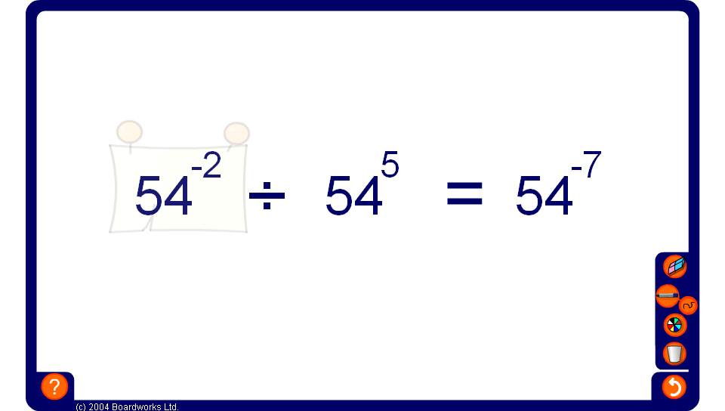
Using index laws
Notes:
Ask pupils to suggest how we can work out the length of one side of the square before revealing the solution.
Establish that the sides are of equal length and so we are looking for a number that multiplies by itself to give 64.
Reveal the answer and tell pupils that 8 is the square root of 64.

