Slide 1
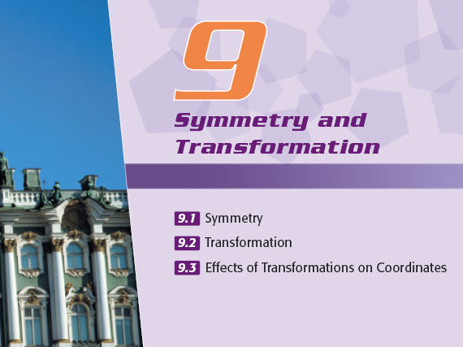

Slide 2
Symmetry
A
Introduction
B
Reflectional Symmetry
C
Rotational Symmetry
Index

Slide 3
Transformation
Introduction to Transformation
A
Reflectional Transformation
B
Rotational Transformation
C
Translational Transformation
D
Enlargement (Reduction) Transformation
Index

Slide 4
Effects of Transformations on Coordinates
A
Translation
B
Reflection
C
Rotation
Index

Slide 5

Symmetry
Example
A)
Introduction
In our everyday life, symmetry is a common scene. Things that are symmetrical can easily be found in natural, art and architecture, the human body and geometrical figures.
2. There are basically two kinds of symmetrical figures, namely reflectional symmetry and rotational symmetry.
Index 9.1
Index

Slide 6


Symmetry
Which the following figures are symmetrical?
C
A
B
D
E
C, D
Key Concept 9.1.1
Index

Slide 7

Symmetry
Example
B)
Reflectional Symmetry
A figure that has reflectional symmetry can be divided by a straight line into two parts, where one part is the image of reflection of the other part. The straight line is called the axis of symmetry.
axes of symmetry
2. A figure that has reflectional symmetry can have one or more axes of symmetry.
Index 9.1
Index

Slide 8
Each of the following figures has reflectional symmetry. Draw the axes of symmetry for each of them.
(a) (b)
Index

Slide 9

C)
Rotational Symmetry
A plane figure repeats itself more than once when making a complete revolution (i.e. 360°) about a fixed point is said to have rotational symmetry. The fixed point is called the centre of rotation.
centre of rotation
Index

Slide 10
Example
C)
Rotational Symmetry
2. If a figure repeats itself n times (n > 1) when making a complete revolution about the centre of rotation, we say that this figure has n-fold rotational symmetry.
E.g. The figure shows on the right has 3-fold rotational symmetry.
Index 9.1
Index

Slide 11

The following figures have rotational symmetry.
A
B
C
Use a dot ‘‧’ to mark the centre of rotation on each figure.
Which figure has 4-fold rotational symmetry?
(b) C
Index

Slide 12


Symmetry
It is known that each of the figures in the table has rotational symmetry.
(a) Use a red dot ‘‧’ to indicate the position of the centre of rotation on each figure.
(b) Complete the table to indicate the
order of rotational symmetry
that each of these figures has.
Index

Slide 13
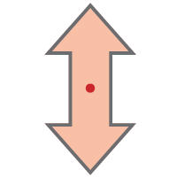

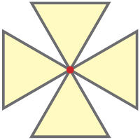

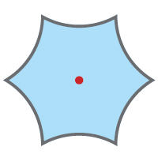
Symmetry
Back to Question
The red dot ‘‧’ in each figure indicates the centre of rotation.
(a)
Figures that have rotational symmetry
(b)
Order of rotational symmetry
2
3
4
5
6
Fulfill Exercise Objective
Problems on rotational symmetry.
Index

Slide 14


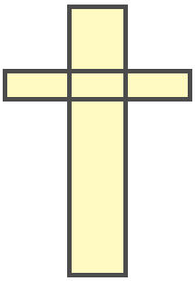
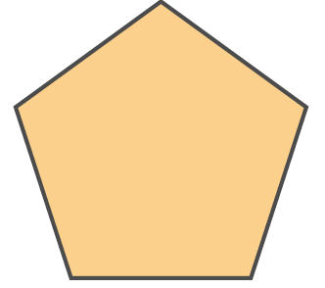

Symmetry
In each of the following figures,
(i) identify the ones that have reflectional symmetry and draw the axes of symmetry with dotted lines,
(ii) identify the ones that have rotational symmetry and use the symbol ‘ * ’ to indicate the position of the centres of rotation.
(a)
(b)
(c)
Index

Slide 15
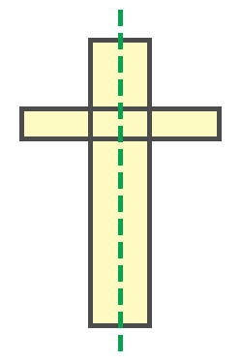

Symmetry
Back to Question
(a)
This figure has reflectional symmetry but NO rotational symmetry.
(b)
This figure has rotational symmetry but NO reflectional symmetry.
【The figure has 2-fold rotational symmetry.】
Index

Slide 16
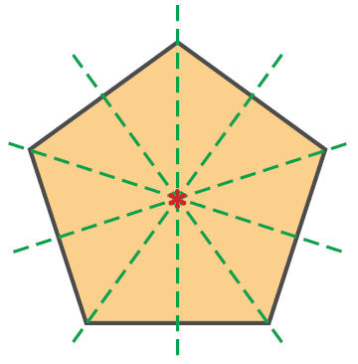
Symmetry
Back to Question
(c)
This figure has reflectional symmetry and also rotational
symmetry.
【The figure has 5-fold rotational symmetry.】
Fulfill Exercise Objective
Identify the figures that have reflectional and/or rotational symmetry.
Key Concept 9.1.3
Index

Slide 17
Transformation
Example
Introduction to Transformation
The process of changing the position, direction or size of a figure to form a new figure is called transformation.
Methods of transformation include reflection, rotation, translation, enlargement and reduction. The new figure obtained through a transformation is called the image of the original figure.
Index 9.2
Index

Slide 18

Transformation
In each of the following pairs of figures, one is the image of the other after transformation. Identify the types of transformation.
(a)
(b)
(c)
(d)
(a) Enlargement
(b) Reflection
Key Concept 9.2.1
(c) Rotation
(d) Reduction
Index

Slide 19
Transformation
Example
A)
Reflectional Transformation
If a figure is flipped over along a straight line, this process is called reflectional transformation and the straight line is called the axis of reflection.
axis of reflection
P
P’
Q
R
R’
Q’
2. The image of reflection has the same shape and the same size as the original one, but the corresponding parts are opposite to one another.
Index

Slide 20

Transformation
Complete the figures below so that each figure has reflectional symmetry along the given axis of symmetry (dotted line).
(a)
(b)
Index

Slide 21


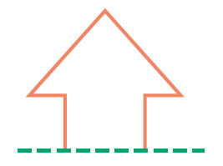
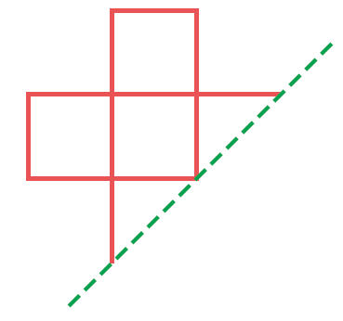
Transformation
Complete the figures below so that they have reflectional
symmetry along the given line of symmetry (dotted line).
(a)
(b)
(c)
Index

Slide 22
Transformation
Back to Question
(a)
(b)
(c)
Fulfill Exercise Objective
Problems on reflectional transformation.
Index

Slide 23


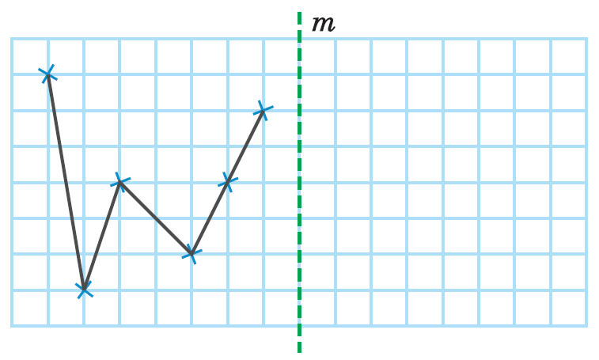
Transformation
The line m on the graph paper below is an axis of reflection. Draw the image of reflection of the given figure ‘ ’.
Index

Slide 24
Transformation
Back to Question
Fulfill Exercise Objective
Problems on reflectional transformation.
Index

Slide 25
Transformation
B)
Rotational Transformation
The process of rotating a figure through an angle about a fixed point (centre of rotation) to form a new figure is called rotational transformation.
B’
E.g. Figure ABCD rotates through 30° in an anticlockwise direction about O to form figure A’B’C’D’.
C’
D’
B
A’
30°
C
O
A
D
Index

Slide 26
Transformation
Example
B)
Rotational Transformation
2. The image obtained from a rotational transformation has the same shape and the same size as the original figure. Every point on the image is the result when the corresponding point on the original figure rotates through the same angle about the centre of rotation.
Index

Slide 27

Transformation
Rotate each of the following figures about O according to the instructions given and draw the image of rotation.
(a)
(b)
270°
180°
O
O
Rotate through 180° in a clockwise direction
Rotate through 270° in an anti-clockwise direction
Index

Slide 28

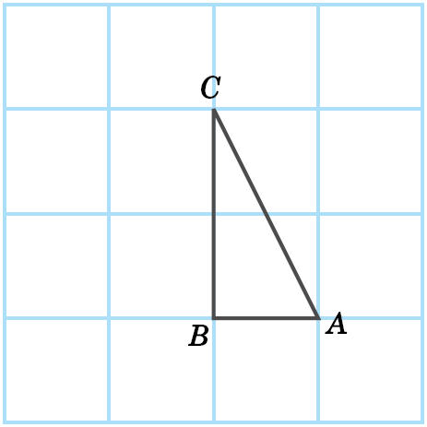
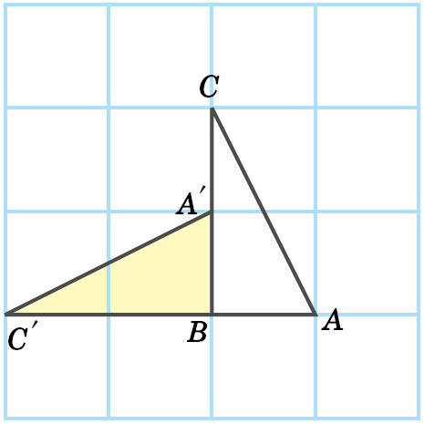
Transformation
The point B on the graph paper on the right is the centre of rotation of △ABC. Draw the image of △ABC if it rotates through 90° in an anticlockwise direction about B.
Fulfill Exercise Objective
Problems on rotational transformation.
Index

Slide 29

Transformation
C)
Translational Transformation
If a figure moves in a fixed direction (without reflection or rotation) to form a new figure, this process is called translational transformation.
X’
E.g. Figure XYZ translates through 2 units upward to form figure X’Y’Z’.
Z’
Y’
2 units
X
Z
Y
Index

Slide 30
Transformation
Example
C)
Translational Transformation
2. The image obtained from a translational transformation has the same shape, the same size and the same direction as the original figure. Every point on the image is the result when the corresponding point on the original figure has moved through the same distance in the same direction.
Index

Slide 31

Transformation
Draw the image of translation of the following figures according to the instructions given.
(a)
(b)
6 small squares
4 small squares
Translated 4 small squares to the right
Translated 6 small squares to the left

Slide 32

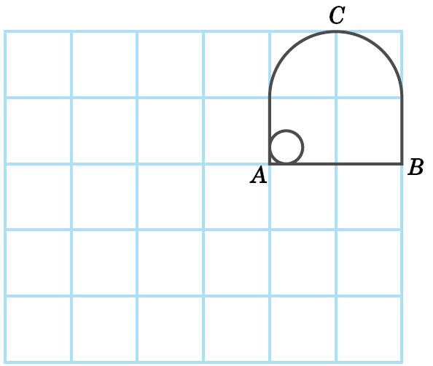
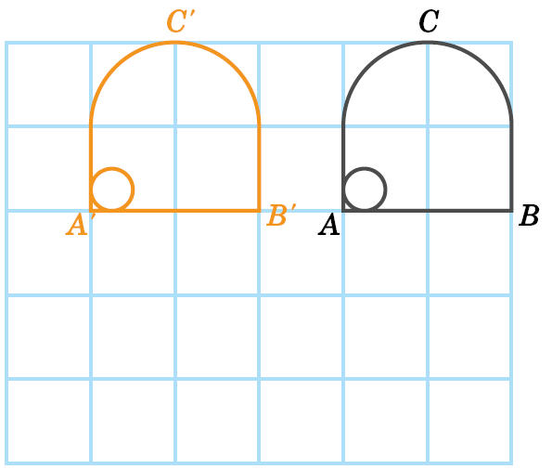
Transformation
On the graph paper below, draw the image of the figure ABC after ABC has translated 3 small squares to the left.
Fulfill Exercise Objective
Problems on translational transformation.
Index

Slide 33

Transformation
D)
Enlargement (Reduction) Transformation
Increasing (decreasing) the size of a figure but retaining its shape can produce a new figure. This process of transformation is called enlargement (reduction).
A
B
Reduction
A’
B’
D’
C’
D
C
Enlargement
Index

Slide 34
Transformation
Example
D)
Enlargement (Reduction) Transformation
2. On the image of such transformation, the area of the original figure has been increased (decreased) after enlargement (reduction), and all the sides of the original figure have been changed by the same factor.
Each side of the enlarged (or reduced) figure will be enlarged (or reduced) by the same factor.The image so formed will retain the shape and the direction of the original figure.
Index

Slide 35

Transformation
Complete the reduced image A’B’C’D’ and the enlarged image A”B”C”D” of ABCD on the graph paper.
A”
A
B”
A’
B
B’
D’
C’
D
C
D”
C”
Index

Slide 36

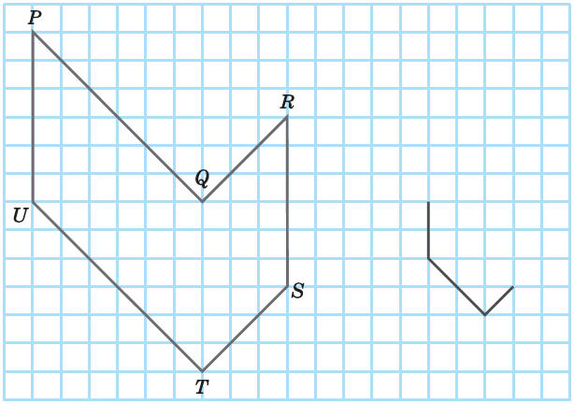
Transformation
Complete the reduced image of the hexagon PQRSTU on the graph paper on the right. Part of the image is already given in the graph paper as shown.
Index

Slide 37
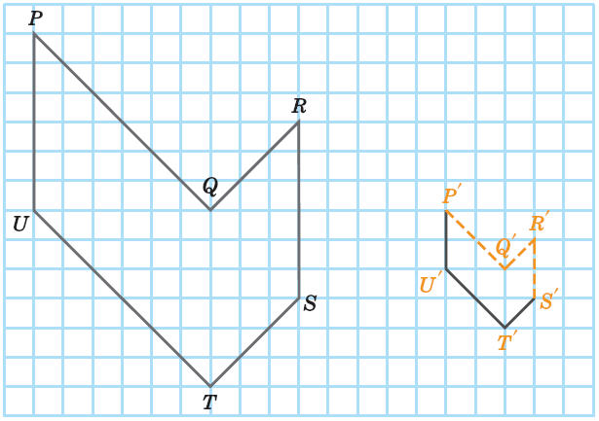
Transformation
Back to Question
【 All the line segments on the reduced image P’Q’R’S’T’U’ are of the corresponding ones on the original figure PQRSTU.】
Fulfill Exercise Objective
Problems on enlargement (or reduction) transformation.
Index

Slide 38
Effects of Transformations on Coordinates
A)
Translation
If P(x, y) is translated to the right or left, the
y-coordinate stays the same. The table below shows the result after P has been translated by m units:
Q(x – m, y)
P(x, y)
R(x + m, y)
m units
m units
Direction of translation
Coordinates of
new position
To the right
(x + m, y)
To the left
(x – m, y)
Index

Slide 39
Effects of Transformations on Coordinates
Example
A)
Translation
Q(x, y + n)
2. If P(x, y) is translated upward or downward, the x-coordinate stays the same. The table below shows the result after P has been translated by n units:
n units
P(x, y)
Direction of translation
Coordinates of
new position
n units
upward
(x, y + n)
downward
(x, y – n)
R(x, y – n)
Index

Slide 40

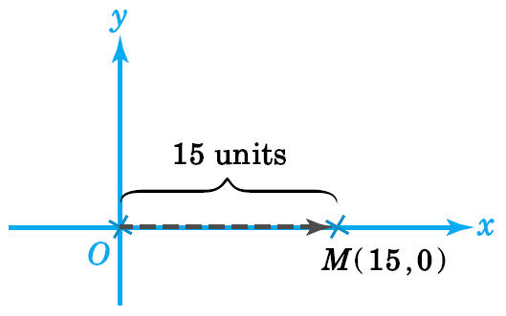
Effects of Transformations on Coordinates
If the origin O is translated 15 units to the right to M, find the coordinates of M in the rectangular coordinate plane.
The required coordinates are (0 + 15, 0).
∴ The coordinates of M are (15, 0).
Index

Slide 41
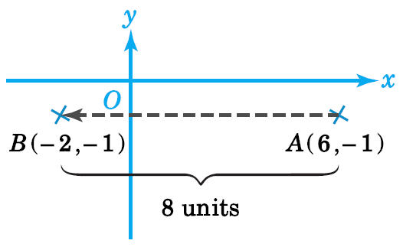
Effects of Transformations on Coordinates
If a point A(6, –1) is translated 8 units to the left to B, find the coordinates of B in the rectangular coordinate plane.
The required coordinates are (6 – 8, –1).
∴ The coordinates of B are (–2, –1).
Index

Slide 42

Effects of Transformations on Coordinates
If a point A(5, –3) is translated 6 units to the left to B, then B is translated 3 units to right to C, find the coordinates of C in the rectangular coordinate plane.
–6
The coordinates of B are (5 – 6, –3), i.e. (–1, –3)
The coordinates of C are (–1 + 3, –3).
∴ The coordinates of C are (2, –3).
+3
Index

Slide 43
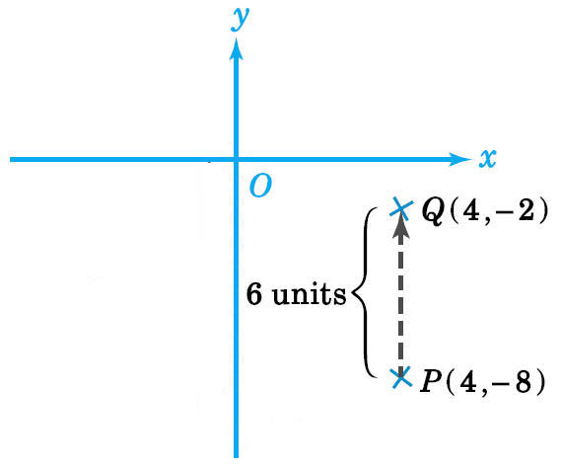
Effects of Transformations on Coordinates
If a point P(4, –8) is translated 6 units upward to Q, find the coordinates of Q in the rectangular coordinate plane.
The required coordinates are (4, –8 + 6).
∴ The coordinates of Q are (4, –2).
Index

Slide 44
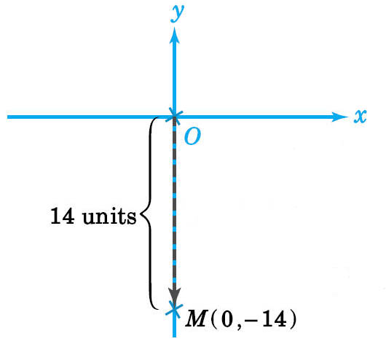
Effects of Transformations on Coordinates
If the origin O is translated 14 units downward to M, find the coordinates of M in the rectangular coordinate plane.
The required coordinates are (0, 0 – 14).
∴ The coordinates of M are (0, –14).
Index

Slide 45

Effects of Transformations on Coordinates
If a point A(–7, –2) is translated 4 units upwards to B, then B is translated 8 downwards to C, find the coordinates of C in the rectangular coordinate plane.
–8
The coordinates of B are (–7, –2 + 4), i.e. (–7, 2)
The coordinates of C are (–7, 2 – 8).
∴ The coordinates of C are (–7, –6).
+4
Index

Slide 46
Effects of Transformations on Coordinates
B)
Reflection
1. Reflection in the Axes
If P(x, y) is reflected in a horizontal line, the
x-coordinate stays the same.
If P(x, y) is reflected in a vertical line, the y-coordinate stays the same.
Index

Slide 47
Effects of Transformations on Coordinates
B)
Reflection
1. Reflection in the Axes
iii. The table below gives the result of reflection:
y
Axis of reflection
Coordinates of new position
R(–x, y)
P(x, y)
x-axis
(x, –y)
x
O
y-axis
(–x, y)
Q(x, –y)
Index

Slide 48
Effects of Transformations on Coordinates
B)
Reflection
2. Reflection in a Horizontal or Vertical Line
i. If a point P in the rectangular coordinate plane is reflected in a horizontal line l to the point Q, then
‧ P and Q have the same x-coordinate;
‧ P and Q are equidistant from l.
y
P(x, y)
a
If P and Q are separated by a distance of 2a units, the coordinates of Q are (x, y – 2a).
l
a
Q(x, y – 2a)
x
O
Index

Slide 49
Effects of Transformations on Coordinates
Example
B)
Reflection
2. Reflection in a Horizontal or Vertical Line
ii. If a point P in the rectangular coordinate plane is reflected in a vertical line l to the point Q, then
‧ P and Q have the same y-coordinate;
‧ P and Q are equidistant from l.
y
l
P(x, y)
Q(x + 2a, y)
If P and Q are separated by a distance of 2a units, the coordinates of Q are (x + 2a, y).
a
a
x
O
Index

Slide 50
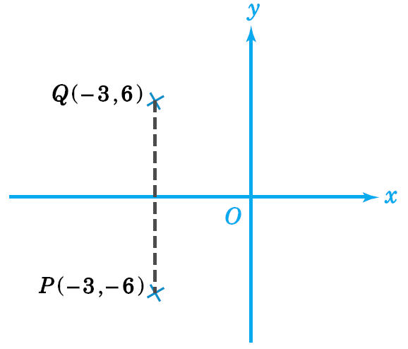
Effects of Transformations on Coordinates
If a point P(–3, –6) is reflected in the x-axis to Q, find the coordinates of Q in the rectangular coordinate plane.
The required coordinates of Q are (–3, 6).
Index

Slide 51
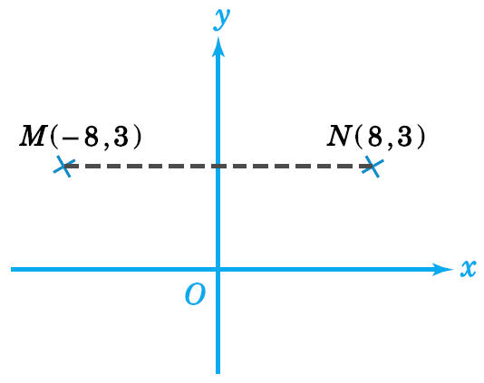
Effects of Transformations on Coordinates
If a point M(–8, 3) is reflected in the y-axis to N, find the coordinates of N in the rectangular coordinate plane.
The required coordinates of N are (8, 3).
Index

Slide 52

Effects of Transformations on Coordinates
If a point A(3, –8) is reflected in the x-axis to B, then B is reflected in the y-axis to C, find the coordinates of C in the rectangular coordinate plane.
The coordinates of B are (3, 8).
∴ The required coordinates of C are (–3, 8).
Index

Slide 53
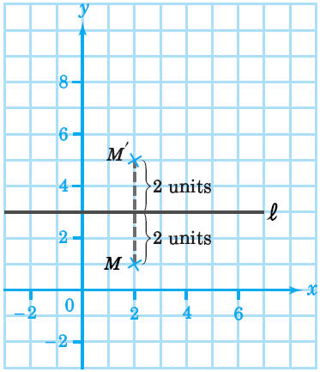
Effects of Transformations on Coordinates
In the figure, a point M(2, 1) in the rectangular coordinate plane is reflected in the horizontal line l to the point M’. Find the coordinates of M’.
From the figure, the coordinates of M’ are (2, 5).
Index

Slide 54
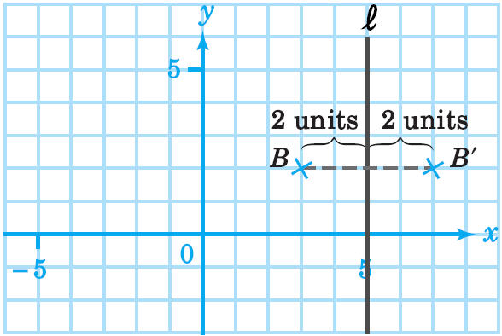
Effects of Transformations on Coordinates
In the figure, a point B(3, 2) in the rectangular coordinate plane is reflected in the vertical line l to the point B’. Find the coordinates of B’.
From the figure, the coordinates of B’ are (7, 2).
Index

Slide 55

Effects of Transformations on Coordinates
l is a line in the rectangular coordinate plane parallel to the x-axis and it passes through a point M(0, –3).
(a) If a point Q is the image when a point P(–2, 1) is reflected in l, find the coordinates of Q.
(b) If a point R is the image when M is
reflected in a vertical line through
Q in (a), find the coordinates of R.
Index

Slide 56
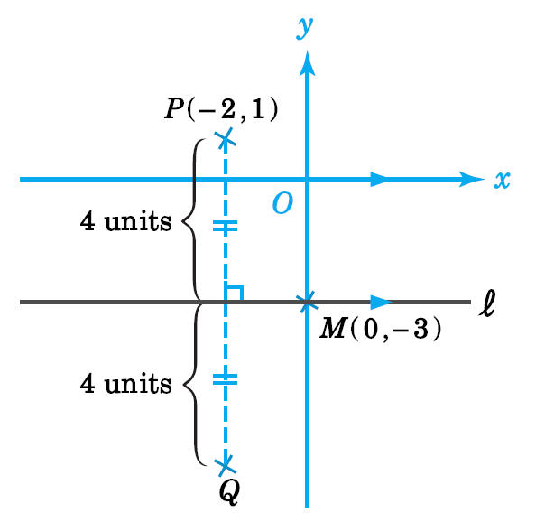
Effects of Transformations on Coordinates
(a) Distance of P(–2, 1) from l = [1 – (–3)] units
= 4 units
∴ Q is 8 units below P.
The coordinates of Q are (–2, 1 – 8), i.e. (–2, –7).
Index

Slide 57
Effects of Transformations on Coordinates
(b) PQ is the vertical line through Q.
Distance of M(0, –3) from PQ = [0 – (–2)] units
= 2 units
∴ R is 4 units to the left of M.
The coordinates of R are (0 – 4, –3), i.e. (–4, –3).
Fulfill Exercise Objective
Find the new coordinates of points after reflection.
Index

Slide 58
Effects of Transformations on Coordinates
C)
Rotation
‧ If P(x, y) is rotated anticlockwise about the origin O, the coordinates of its new position are given in the table below:
Q(–y, x)
y
Angle rotated
New position
P(x, y)
90°
90°
(–y, x)
90°
x
(–x, –y)
O
90°
180°
(y, –x)
90°
270°
R(–x, –y)
S(y, –x)
Index

Slide 59
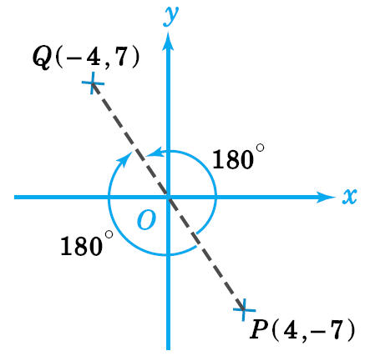
Effects of Transformations on Coordinates
Suppose a point P(4, –7) in the rectangular coordinate plane is rotated about O through 180° to the point Q. Find the coordinates of Q.
The required coordinates of Q are (–4, 7).
Index

Slide 60
Effects of Transformations on Coordinates
Suppose a point A(–4, 4) in the rectangular coordinate plane is rotated anti-clockwise about O through 270° to the point B. Find the coordinates of B.
y
The required coordinates of B are (4, 4).
6
5
4
3
2
1
–1
–2
–3
A(–4, 4)
B(4, 4)
0
x
–7 –6 –5 –4 –3 –2 –1 1 2 3 4 5 6
270°
Index

