Slide 1
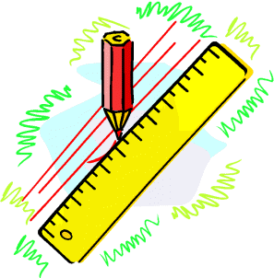
Mathematical Similarity
Scales (Representative Fractions)
Scale Drawings
Working Out Scale Factor
Similar Triangles 1
Similar Triangles 2
www.mathsrevision.com
Similar Triangles 3 with Algebra
Similar Figures
Scale Factor in 2D (Area)
Surface Area of similar Solids
Scale Factor 3D (Volume)

Slide 2
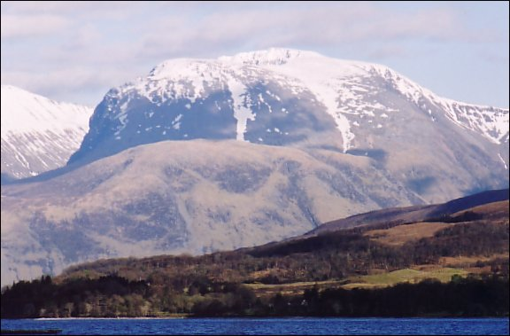
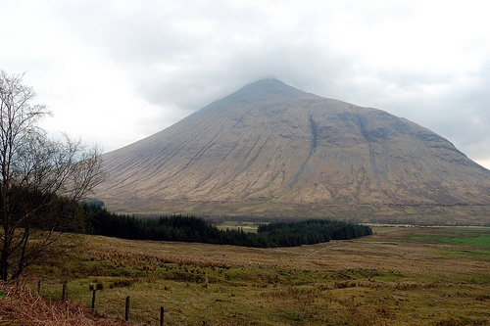
Working out
Scale Factor
Give one distance from the map and the corresponding
actual distance we can work out the scale of the map.
Example :
The map distance from Ben Nevis to Ben Doran is 2cm.
The real-life distance is 50km.
What is the scale of the map.
Map Real Distance
2 ⇨ 50km
1 ⇨ 50 ÷ 2 = 25km
Scale Factor
1 : 250 000

Slide 3
Working out
Scale Factor
Example :
The actual length of a Olympic size swimming pool is 50m.
On the architect’s plan it is 10cm.
What is the scale of the plan.
Plan Real Distance
10 ⇨ 50m
1 ⇨ 5
Scale Factor
1 : 500

Slide 4
Similar Triangles 1
Learning Intention
Success Criteria
To explain how the scale factor applies to similar triangles.
1. Understand how the scale factor applies to similar triangles.
2. Solve problems using scale factor.

Slide 5
Conditions for similarity
Two shapes are similar only when:
Corresponding sides are in proportion and
Corresponding angles are equal
All rectangles are not similar to one another since only condition 2 is true.

Slide 6
If two objects are similar then one is an enlargement of the other
The rectangles below are similar:
Find the scale factor of enlargement that maps A to B
8 cm
Not to scale!
5 cm
A
16 cm
Scale factor = x2
Note that B to A
would be x ½
10 cm
B

Slide 7
If two objects are similar then one is an enlargement of the other
The rectangles below are similar:
Find the scale factor of enlargement that maps A to B
8 cm
Not to scale!
5 cm
A
12 cm
Scale factor = x1½
Note that B to A
would be x 2/3
7½ cm
B

Slide 8
If we are told that two objects are similar and we can find the scale factor of enlargement then we can calculate the value of an unknown side.
13½ cm
The 3 rectangles are similar. Find the unknown sides
Not to scale!
x cm
3 cm
y cm
C
B
24 cm
A
8 cm
Comparing corresponding sides in A and B: 24/8 = 3 so x = 3 x 3 = 9 cm
Comparing corresponding sides in A and C: 13½ /3 = 4½ so y = 4 ½ x 8 = 36 cm

Slide 9
If we are told that two objects are similar and we can find the scale factor of enlargement then we can calculate the value of an unknown side.
y cm
The 3 rectangles are similar. Find the unknown sides
Not to scale!
7.14 cm
2.1 cm
26.88 cm
C
B
x cm
A
5.6 cm
Comparing corresponding sides in A and B: 7.14/2.1 = 3.4 so x = 3.4 x 5.6 = 19.04 cm
Comparing corresponding sides in A and C: 26.88/5.6 = 4.8 so y = 4.8 x 2.1 = 10.08 cm

Slide 10
Similar Triangles
Similar triangles are important in mathematics and their application can be used to solve a wide variety of problems.
The two conditions for similarity between shapes as we have seen earlier are:
Corresponding sides are in proportion and
Corresponding angles are equal
Triangles are the exception to this rule.
only the second condition is needed
Two triangles are similar if their
Corresponding angles are equal

Slide 11
Similar Triangles

Slide 12
These two triangles are similar since they are equiangular.
65º
70º
45º
70º
45º
50º
50º
55º
75º
These two triangles are similar since they are equiangular.
If 2 triangles have 2 angles the same then they must be equiangular
= 180 – 125 = 55

Slide 13
Scale factors
Enlargement Scale factor?
3
ESF =
=
8cm
2
8
8
12
12cm
12
Reduction Scale factor?
5cm
2
RSF =
=
3
7.5cm
Can you see the relationship
between the two scale factors?

Slide 14
Scale factors
Find a given ESF = 3
a
ESF = 3
=
9cm
9
a
27cm
By finding the RSF
Find the value of b.
b
5cm
1
b
5
RSF =
=
=
15cm
3
15
15

Slide 15
Finding Unknown sides (1)
b
20 cm
c
6 cm
18 cm
12 cm
Since the triangles are equiangular they are similar.
So comparing corresponding sides.

Slide 16
Starter Questions
Q1. Find the roots to 1 decimal place
Q2. A freezer is reduced by 20% to £200 in a sale.
What was the original price.
Q3. Calculate

Slide 17
Similar Triangles 2
Learning Intention
Success Criteria
To explain how the scale factor applies to similar triangles with algebraic terms.
1. Understand how the scale factor applies to similar triangles with algebraic terms.
2. Solve problems using scale factor that contain algebraic terms.

Slide 18
Determining similarity
A
B
Triangles ABC and DEC are similar. Why?
C
Angle ACB = angle ECD (Vertically Opposite)
Angle ABC = angle DEC (Alt angles)
E
D
Angle BAC = angle EDC (Alt angles)
Since
ABC
is similar to
DEC
we know that corresponding sides are in proportion
AB→DE
BC→EC
AC→DC
The order of the lettering is important in order to show which pairs of sides correspond.

Slide 19
If BC is parallel to DE, explain why triangles ABC and ADE are similar
A
Angle BAC = angle DAE (common to both triangles)
B
C
Angle ABC = angle ADE (corresponding angles between parallels)
D
E
Angle ACB = angle AED (corresponding angles between parallels)
A line drawn parallel to any side of a triangle produces 2 similar triangles.
A
A
B
B
D
E
D
E
C
C
Triangles EBC and EAD are similar
Triangles DBC and DAE are similar

Slide 20
The two triangles below are similar:
Find the distance y.
C
B
20 cm
y
A
5 cm
E
45 cm
D
AE
5
y
RSF =
=
=
AD
50
20
5x20
y =
=
2 cm
50

Slide 21
The two triangles below are similar:
Find the distance y.
C
Alternate approach to the same problem
B
20 cm
y
A
5 cm
E
45 cm
D
AD
50
20
ESF =
=
=
AE
5
y
5x20
y =
=
2 cm
50

Slide 22
In the diagram below BE is parallel to CD and all measurements are as shown.
Calculate the length CD
Calculate the perimeter of the Trapezium EBCD
A
A
4.5 m
6 m
7.5 cm
10 m
B
E
4.8 m
3 cm
4 m
C
D
8 cm
C
8 cm
D
So perimeter
= 3 + 8 + 4 + 4.8
= 19.8 cm

Slide 23
Similar Triangles 3
Learning Intention
Success Criteria
To explain how the scale factor applies to similar triangles with harder algebraic terms.
1. Understand how the scale factor applies to similar triangles with harder algebraic terms.
2. Solve problems using scale factor that contain harder algebraic terms.

Slide 24
In a pair of similar triangles the ratio of the corresponding sides is
constant, always producing the same enlargement or reduction.
Find the values of x given that the triangles are similar.
A
Corresponding sides are in proportion
AB
EB
3 m
=
AC
DC
E
B
x
3
4
4 m
1.5
=
3 + x
6
D
C
6 m
3x6
=
4(3 + x)
18
=
12 + 4x
4x
=
6
x
=
1.5

Slide 25
In a pair of similar triangles the ratio of the corresponding sides is
constant, always producing the same enlargement or reduction.
Find the values of x given that the triangles are similar.
T
Corresponding sides are in proportion
PQ
PR
Q
x
=
11.25
ST
PT
R
3
18 - x
3
=
18
5
5
x
3x
=
5(18 - x)
P
3x
=
90 - 5x
S
8x
=
90
x
=
11.25

Slide 26
Similar Figures
Learning Intention
Success Criteria
To explain how the scale factor applies to other similar figures.
1. Understand how the scale factor applies to other similar figures.
2. Solve problems using scale factor.

Slide 27
Scale Factor applies to ANY SHAPES that are mathematically similar.
1.4 cm
7 cm
2cm
y
z
3 cm
15 cm
6 cm
Given the shapes are similar, find the values y and z ?
15
1
Scale factor =
ESF =
= 5
Scale factor =
RSF =
= 0.2
3
5
y
is 2 x 5 = 10
z
is 6 x 0.2 = 1.2

Slide 28
Scale Factor applies to ANY SHAPES that are mathematically similar.
b
a
7.5 cm
4 cm
3 cm
8 cm
2cm
10 cm
Given the shapes are similar, find the values a and b ?
4
10
Scale factor =
RSF =
= 0.4
Scale factor =
ESF =
= 2.5
10
4
a
is 8 x 0.4 = 3.2
b
is 2 x 2.5 = 5

Slide 29
Area of Similar Shape
Learning Intention
Success Criteria
To explain how the scale factor applies to area.
1. Understand how the scale factor applies to area.
2. Solve area problems using scale factor.

Slide 30
Area of Similar Shape
Draw an area with
sides 2 units long.
Draw an area with sides 4 units long.
2
y
4
2
y
x
Area = 2 x 2 = 4
4
Area = 4 x 4 = 16
www.mathsrevision.com
x
It should be quite clear that second area is four times the first.
The scaling factor in 2D (AREA) is (SF)².
For this example we have this case SF = 2 (2)² = 4.

Slide 31
Another example of similar area ?
Work out the area of each shape
and try to link AREA and SCALE FACTOR
Connection ?
2cm
6cm
4cm
12cm
Small Area = 4 x 2 = 8cm²
Large Area = 12 x 6 = 72cm²
Scale factor =
ESF =
12
= 3
4
Large Area = (3)² x 8 =
9 x 8 =
72cm²

Slide 32
Example
The following two shapes are said to be similar.
If the smaller shape has an area of 42cm².
Calculate the area of the larger shape.
3cm
Working
4cm
ESF =
So area S.F =
Area of 2nd shape =
X 42
=
X 42
= 74.67cm²

Slide 33
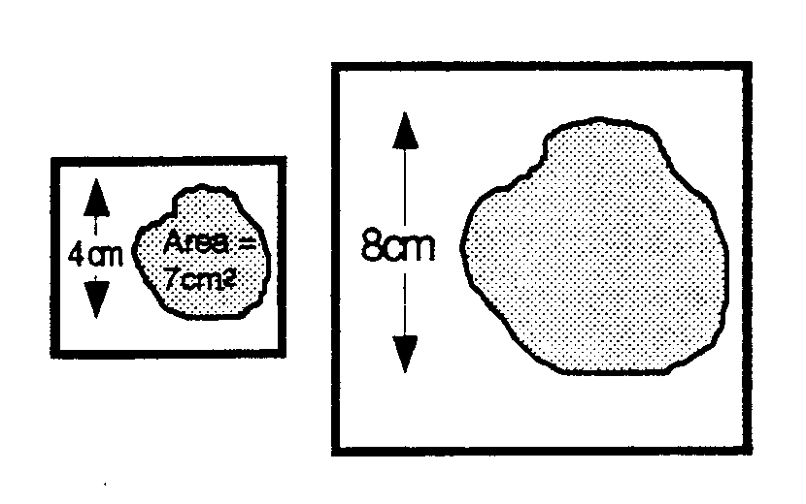
Questions
1.
2.

Slide 34
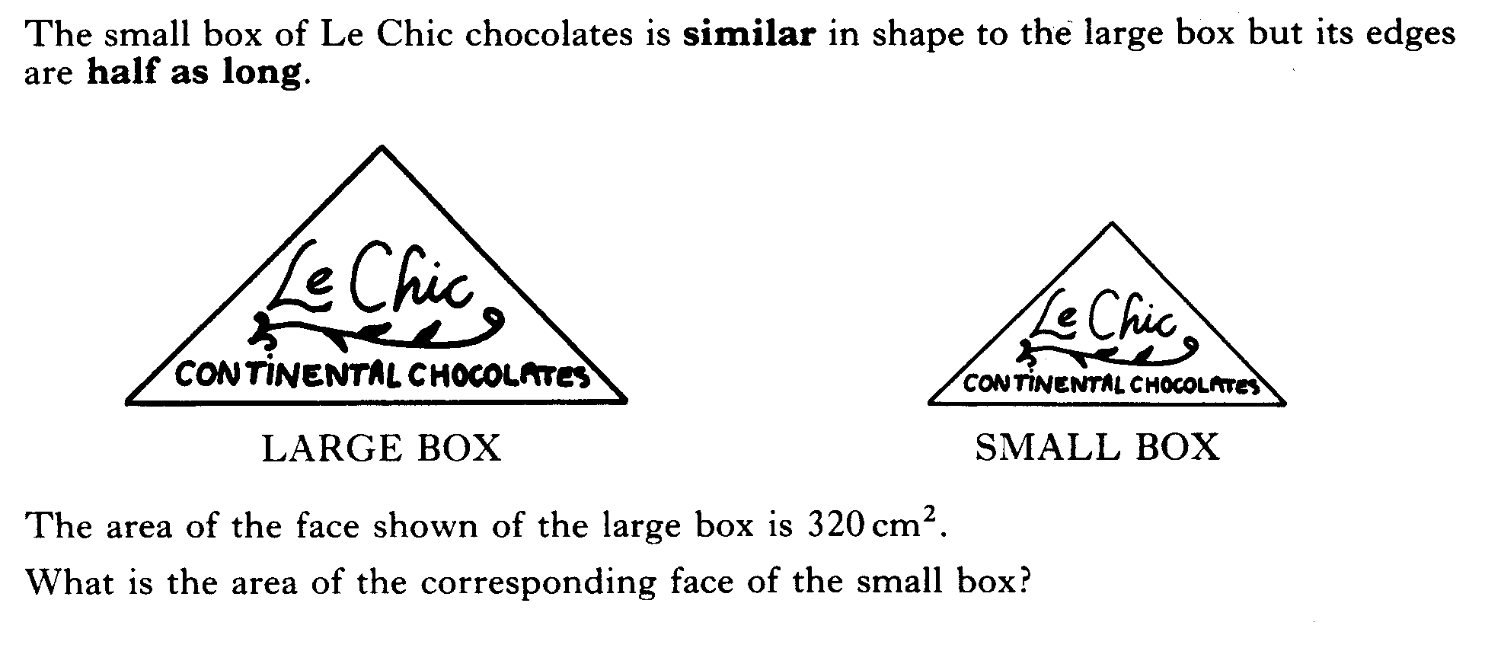
3.
4.

Slide 35
Surface Area
of Similar Solids
Learning Intention
Success Criteria
To explain how the scale factor applies to surface area.
1. Understand how the scale factor applies to surface area.
2. Solve surface area problems using scale factor.

Slide 36
The same rule applies when dealing with Surface Area
Example : Work out the surface area of the larger cuboid.
3cm
2cm
4cm
12cm
Surface Area of small cuboid :
2(2x3) + 2(4x3) + 2(2x4) = 52cm²
12
Surface Area of large cuboid :
ESF =
= 3
4
(3)² x 52 = 468 cm²

Slide 37
Volumes of Similar Solids
Learning Intention
Success Criteria
To explain how the scale factor applies to volume.
1. Understand how the scale factor applies to 3D – volume.
2. Solve volume problems using scale factor.

Slide 38
Volumes of Similar Solids
Draw a cube with sides 2 units long.
2
Draw a cube with sides 4 units long.
y
z
2
2
x
4
Volume = 2 x 2 x 2 = 8
y
z
4
4
x
Volume = 4 x 4 x 4 = 64
Scale factor =
ESF =
4
= 2
2
Using our knowledge from AREA section, (SF)².
For VOLUME the scale factor is (SF)³ = (2)³ = 8

Slide 39
Another example of similar volumes ?
Work out the volume of each shape
and try to link volume and scale factor
Connection ?
4cm
2cm
2cm
4cm
3cm
6cm
V = 3 x 2 x 2 = 12cm³
V = 6 x 4 x 4 = 96cm³
Scale factor =
ESF =
6
= 2
3
Large Volume = (2)³ x 12 =
8 x 12 =
96cm³

Slide 40
Given that the two boxes are similar, calculate the volume of the large box if the small box has a volume of 15ml
2cm
6cm
6
ESF =
=
3
2
So volume of large box =
=
= 405 ml

Slide 41
Example
ESF =
So volume of large jug =
=
= 2.7 litres

Slide 42
(a) SD : B = 4 : 3
SD : M = 8 : 5
(b) RSF =
900cm²
(c) RSF =
1562.5cm³

Slide 43
ESF =
So volume of large jug =
=
= £1.35

Slide 44
(SF )³ =
SF = 2.1544
So surface area ratio = (SF)² =
= 4.64
Ratio of their surface area is 1 : 4.6 (to 1 d.p.)

