Slide 1
The Tangent Ratio
The Tangent using Angle
The Tangent Ratio in Action
The Tangent (The Adjacent side)
The Tangent (Finding Angle)
The Sine of an Angle
The Sine Ration In Action
The Sine ( Finding the Hypotenuse)
The Cosine of an Angle
Mixed Problems

Slide 2
Angles & Triangles
Learning Intention
Success Criteria
  To identify the hypotenuse, opposite and adjacent sides in a right angled triangle.
  1. Understand the terms hypotenuse, opposite and adjacent in right angled triangle.
  2. Work out Tan Ratio.

Slide 3
Trigonometry means “triangle” and “measurement”.
We will be using right-angled triangles.
Opposite
hypotenuse
x°
Adjacent

Slide 4


Mathemagic!
Opposite
hypotenuse
30°
Adjacent
Opposite
=
0.6
Adjacent

Slide 5
Try another!
Opposite
hypotenuse
45°
Adjacent
Opposite
=
1
Adjacent

Slide 6
Opposite
For an angle of 30°,
=
0.6
Adjacent
Opposite
is called the tangent of an angle.
Adjacent
We write tan 30° = 0.6

Slide 7
Tan 25° | 0.466
Tan 26° | 0.488
Tan 27° | 0.510
Tan 28° | 0.532
Tan 29° | 0.554
Tan 30° | 0.577
Tan 31° | 0.601
Tan 32° | 0.625
Tan 33° | 0.649
Tan 34° | 0.675
The ancient Greeks
discovered this and
repeated this for
all possible angles.
Tan 30° = 0.577
Accurate to
3 decimal places!

Slide 8

Now-a-days we can use calculators instead of tables to find the Tan of an angle.
On your calculator press
Tan
Followed by 30, and press
=
Notice that your calculator is incredibly accurate!!
Accurate to 9 decimal places!

Slide 9

What’s the point of all this???
Don’t worry, you’re about to find out!

Slide 10
How high is the tower?
Opp
60°
12 m

Slide 11

Opposite
hypotenuse
Copy this!
60°
12 m
Adjacent

Slide 12
Opp
Tan x° =
Copy this!
Adj
Opp
Tan 60° =
12
12 x Tan 60°
= Opp
Opp =
12 x Tan 60°
= 20.8m (1 d.p.)

Slide 13
So the tower’s 20.8 m high!
20.8m
Don’t worry, you’ll be trying plenty of examples!!

Slide 14
Opp
Tan x° =
Adj
Opposite
x°
Adjacent

Slide 15


Example
Find the height h
S^{O}H C^{A}H T^{O}A
Opp
Hyp
Opp
h
Tan x° =
Adj
65°
h
Tan 65° =
8m
8
Adj
8 x Tan 65°
= h
h =
8 x Tan 65°
= 17.2m (1 d.p.)

Slide 16
Angles & Triangles
Learning Intention
Success Criteria
  To use tan of the angle to solve problems.
  1. Write down tan ratio.
  2. Use tan of an angle to solve problems.

Slide 17
Using Tan to calculate angles

Slide 18
Example
Calculate the tan xº ratio
P
S^{O}H C^{A}H T^{O}A
Opp
Hyp
18m
Opp
Tan x° =
Adj
x°
Q
18
R
12m
Tan x° =
Adj
12
Tan x°
= 1.5

Slide 19
Calculate the size of
angle xº
Tan x°
= 1.5
How do we find x°?
We need to use Tan ⁻¹on the calculator.
Tan ⁻¹
Tan ⁻¹is written above
Tan
To get this press
2nd
Followed by
Tan

Slide 20
Tan x°
= 1.5
Tan ⁻¹
Press
2nd
Tan
Enter
1.5
=
x =
Tan ⁻¹1.5
= 56.3° (1 d.p.)

Slide 21
Process
1. Identify Hyp, Opp and Adj
2. Write down ratio Tan xº = Opp
Adj
Tan ⁻¹
3. Calculate xº
2nd
Tan

Slide 22
Angles & Triangles
Learning Intention
Success Criteria
  To use tan of the angle to solve REAL LIFE problems.
  1. Write down tan ratio.
  2. Use tan of an angle to solve REAL LIFE problems.

Slide 23
Use the tan ratio to find the height h of the tree
to 2 decimal places.
S^{O}H C^{A}H T^{O}A
rod
47º
8m

Slide 24

S^{O}H C^{A}H T^{O}A
Example 2
Q1. An aeroplane is preparing to land at Glasgow Airport. It is over Lennoxtown at present which is 15km from the airport. The angle of descent is 6º.
What is the height of the plane ?
Aeroplane
c
6º
Airport
a = 15
Lennoxtown

Slide 25
Angles & Triangles
Learning Intention
Success Criteria
  To use tan of the angle to find adjacent length.
  1. Write down tan ratio.
  2. Use tan of an angle to solve find adjacent length.

Slide 26
Use the tan ratio to calculate how far the ladder is away from the building.
S^{O}H C^{A}H T^{O}A
ladder
12m
45º
d m

Slide 27
Example 2
Q1. An aeroplane is preparing to land at Glasgow Airport. It is over Lennoxtown at present. It is at a height of 1.58 km above the ground. It ‘s angle of descent is 6º.
How far is it from the airport to Lennoxtown?
S^{O}H C^{A}H T^{O}A
Aeroplane
a = 1.58 km
6º
Airport
Lennoxtown

Slide 28
Angles & Triangles
Learning Intention
Success Criteria
  To show how to find an angle using tan ratio.
  1. Write down tan ratio.
  2. Use tan ratio to find an angle.

Slide 29

Use the tan ratio to calculate the angle that the support wire makes with the ground.
S^{O}H C^{A}H T^{O}A
11m
xº
4 m

Slide 30

Use the tan ratio to find the angle of take-off.
S^{O}H C^{A}H T^{O}A
88m
xº
500 m

Slide 31
Angles & Triangles
Learning Intention
Success Criteria
  Definite the sine ratio and show how to find an angle using this ratio.
  1. Write down sine ratio.
  2. Use sine ratio to find an angle.

Slide 32
The Sine Ratio
Opp
Sin x° =
Hyp
Opposite
hypotenuse
x°

Slide 33
Example
Find the height h
11cm
Hyp
h
Opp
Opp
Sin x° =
Hyp
34°
h
Sin 34° =
11
S^{O}H C^{A}H T^{O}A
11 x Sin 34°
= h
h =
11 x Sin 34°
= 6.2cm (1 d.p.)

Slide 34
Using Sin to calculate angles

Slide 35
Example
Find the xº
9m
Hyp
6m
Opp
x°
Opp
Sin x° =
Hyp
S^{O}H C^{A}H T^{O}A
6
Sin x° =
9
Sin x°
= 0.667 (3 d.p.)

Slide 36
Sin x°
=0.667 (3 d.p.)
How do we find x°?
We need to use Sin ⁻¹on the calculator.
Sin ⁻¹
Sin ⁻¹is written above
Sin
To get this press
2nd
Followed by
Sin

Slide 37
Sin x°
= 0.667 (3 d.p.)
Sin ⁻¹
Press
2nd
Sin
Enter
0.667
=
x =
Sin ⁻¹0.667
= 41.8° (1 d.p.)

Slide 38
Angles & Triangles
Learning Intention
Success Criteria
  To show how to use the sine ratio to solve
  REAL-LIFE problems.
  1. Write down sine ratio.
  Use sine ratio to solve
  REAL-LIFE problems.

Slide 39
The support rope is 11.7m long. The angle between the rope and ground is 70º. Use the sine ratio to calculate the height of the flag pole.
S^{O}H C^{A}H T^{O}A
11.7m
h
70º

Slide 40

Use the sine ratio to find the angle of the ramp.
S^{O}H C^{A}H T^{O}A
20 m
10m
xº

Slide 41
Angles & Triangles
Learning Intention
Success Criteria
  To show how to calculate the hypotenuse using the sine ratio.
  1. Write down sine ratio.
  2. Use sine ratio to find the hypotenuse.

Slide 42
Example
S^{O}H C^{A}H T^{O}A
A road AB is right angled at B.
The road BC is 5 km.
Calculate the length of
the new road AC.
Opp
Sin x° =
Hyp
B
A
5
Sin 72° =
72°
r
5km
r =
r
r =
C
5.3 km

Slide 43
Angles & Triangles
Learning Intention
Success Criteria
  Definite the cosine ratio and show how to find an length or angle using this ratio.
  1. Write down cosine ratio.
  2. Use cosine ratio to find a length or angle.

Slide 44
The Cosine Ratio
Adj
Cos x° =
Hyp
hypotenuse
x°
Adjacent

Slide 45
Example
Find the adjacent length b
b
Adj
40°
Adj
Cos x° =
Opp
Hyp
Hyp
35mm
b
Cos 40° =
35
S^{O}H C^{A}H T^{O}A
35 x Cos 40°
= b
b =
35 x Cos 40°
= 26.8mm (1 d.p.)

Slide 46
Using Cos to calculate angles

Slide 47
Example
Find the angle xº
34cm
Adj
Adj
x°
Cos x° =
Hyp
Opp
Hyp
45cm
34
Cos x° =
45
S^{O}H C^{A}H T^{O}A
Cos x°
= 0.756 (3 d.p.)
x =
Cos ⁻¹0.756
=41°

Slide 48
The Three Ratios
opposite
adjacent
Cosine
Tangent
Sine
hypotenuse
Sine
adjacent
adjacent
Cosine
Cosine
Tangent
hypotenuse
opposite
opposite
Sine
Sine
hypotenuse

Slide 49
Opp
Adj
Opp
Sin x° =
Cos x° =
Tan x° =
Hyp
Hyp
Adj
S^{O}H
C^{A}H
T^{O}A

Slide 50
Process
1. Write down
S^{O}H C^{A}H T^{O}A
2.
Identify what you want to find
3.
what you know
Copy this!

Slide 51
Past Paper Type Questions
S^{O}H C^{A}H T^{O}A

Slide 52
Past Paper Type Questions
S^{O}H C^{A}H T^{O}A
(4 marks)

Slide 53
Past Paper Type Questions
S^{O}H C^{A}H T^{O}A

Slide 54
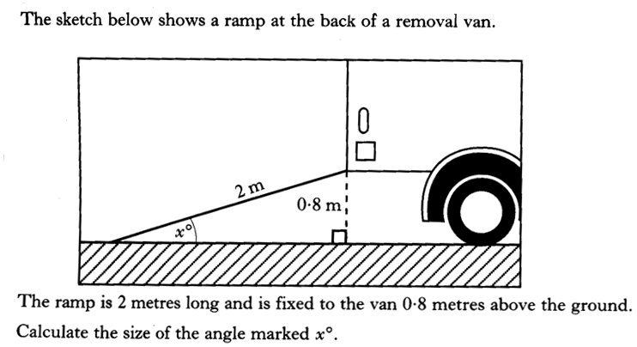
Past Paper Type Questions
S^{O}H C^{A}H T^{O}A
4 marks

Slide 55
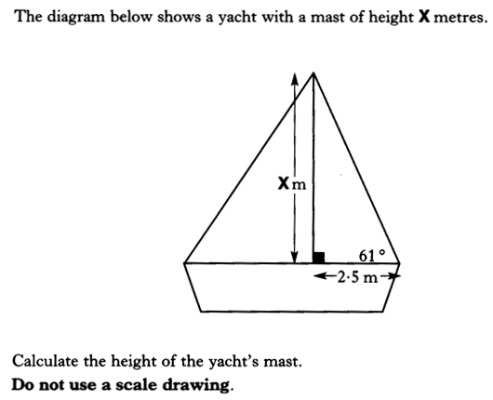
Past Paper Type Questions
S^{O}H C^{A}H T^{O}A

Slide 56
Past Paper Type Questions
S^{O}H C^{A}H T^{O}A
(4marks)

Slide 57
Past Paper Type Questions
S^{O}H C^{A}H T^{O}A

Slide 58
Past Paper Type Questions
S^{O}H C^{A}H T^{O}A
(4marks)

