Slide 1
Statistics
Interpreting Graphs.
Scattergraphs & Codes
Stem and Leaf Diagram
Drawing Graphs
Mean, Median, Mode and Range of a Data Set
Line of best fit
Constructing Frequency Tables (Tally Tables)
Range Mode & Median from Frequency Table
Mean from a Frequency Table

Slide 2
Interpreting Graphs
Learning Intention
Success Criteria
  To explain how to interpret various graphs.
  1. Understand key information on various graphs.
  2. Solve problems involving graphs.

Slide 3
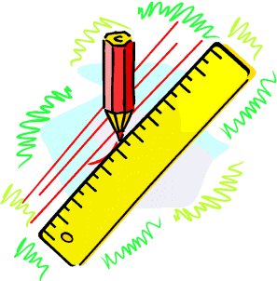

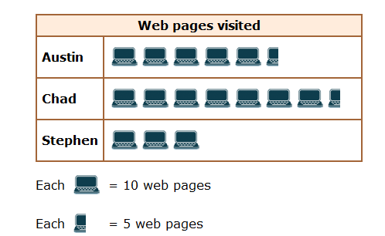
What does
1 computer represent
You have 1 minute to come up with a question
Interpreting Graphs

Slide 4

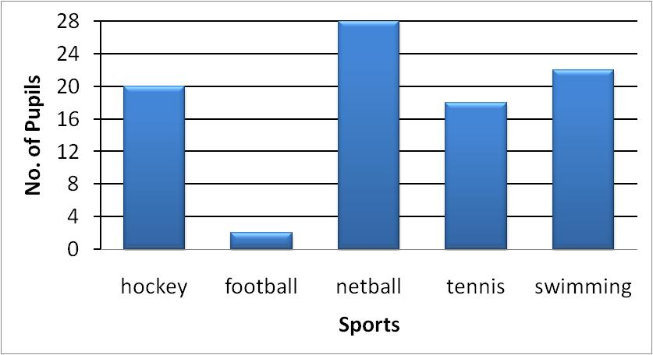
Interpreting Graphs

Slide 5
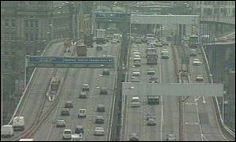
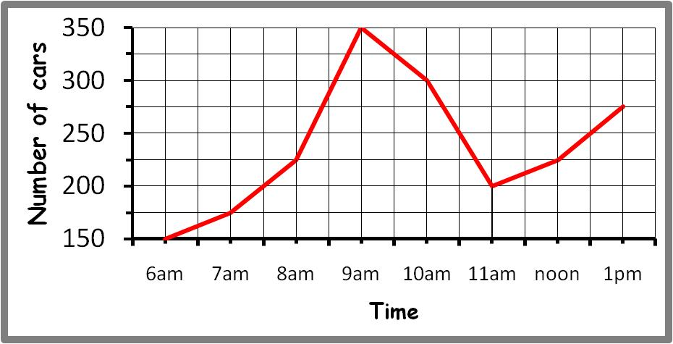
Interpreting Graphs
General

Slide 6
Drawing Pie Charts
Favourite Sport
In a survey, 300 people were asked to indicate which one of five sports they liked best. Using the graph calculate the number people who liked each sport.
Rugby
75
Football
90
Cricket
45
Ice Hockey
60
Squash
30
Total
300
Football
Rugby
90º
108º
36º
54º
72º
Squash
Cricket
Ice Hockey

Slide 7
Constructing Graphs
Learning Intention
Success Criteria
  1. To construct various graphs accurately.
  Understand how to construct various graphs from given information.

Slide 8
Bar Graphs
A survey of S1 pupils asked
what their favourite pet was.
The results are shown below
Lets construct a Bar graph for the following table
Remember graph has to be labelled and neat !

Slide 9
What labels should we use for the Bar Chart
Title, Scale, Labels and Units where appropriate
Favourite Pets
12
10
8
Number of Pupils
6
4
2
0
Cat
Dog
Rabbit
Hamster
Snake
Pets

Slide 10
Line graphs
Line graphs are most often used to show trends over time.
If the temperature in Aberdeen, in ºC, over a 12-hour period is plotted, the line graph shows the temperature trend.

Slide 11
Constructing a Line Graph
A hospital nurse recorded a patient’s temperature every hour
Temperature versus Time
103
102
101
100
Temperature F
99
98
97
6:00 am
7:00 am
8:00 am
9:00 am
10:00 am
11:00 am
Temp C
101
102
102
101
100.5
101
Time Hours

Slide 12
Different Averages
Learning Intention
Success Criteria
  To define the terms Mean Median, Mode and Range for a set of data.
  1. Know the terms Mean, Median, Mode and Range.
  2. Work out values of Mean, Median, Mode and Range.

Slide 13
Mean (Average)
Find the mean of the set of data 1, 1, 1, 1, 2, 3, 26
Can you see that this is not the most suitable of averages since
five out of the six numbers are all below the mean of 5

Slide 14
Different Averages
An average should indicate a
“measure of central tendency”
but should also indicate
what the distribution of data looks like.
This is why we have 3 different types of averages to consider
The Mean
The Median (put the data in order then find the MIDDLE value)
3. The Mode (the number that appears the most)
For the above data the Median or Mode is a better average = 1

Slide 15
Different Averages
Example :
Find the mean, median, mode and range for the set of data.
Range = Highest number – Lowest Number
10, 2, 14, 1, 14, 7

Slide 16
Aims of the Lesson
1. Understand the term Frequency Table.
2. Construct a Frequency Table.
3. Interpret information from Frequency Tables.

Slide 17
Frequency tables
Raw data can often appear untidy and difficult to understand. Organising such data into frequency tables can make it much easier to make sense of (interpret) the data.
Data | Tally | Frequency
llll
represents a tally of 5
Sum of Tally is the Frequency

Slide 18
Frequency tables
Example 1. A tomato grower ideally wants his tomatoes to have diameters of 60mm, but a diameter ranging from 58mm to 62mm will be acceptable. Organise the diameters given below into a frequency table.
58
56
59
57
60
56
62
62
58
56
58
59
56
59
56
59
57
58
60
62
61
58
59
62
60
58
60
59
56
59
60
61
56
60
62
59
61
58
60
61
62
58
57
62
59
61
58
60
Lowest number
56
Highest number
62

Slide 19
Frequency tables
X
X
X
X
X
X
58
56
59
57
60
56
62
60
58
60
58
59
57
59
56
59
57
58
60
59
61
58
59
62
60
58
60
59
59
60
59
61
59
60
62
59
61
58
60
61
59
58
57
62
59
61
58
60
Diameter | Tally | Frequency
56
57
58
59
60
61
62
l
l
l
l
l
l

Slide 20
Frequency tables
X
X
X
X
X
X
X
X
X
X
X
X
58
56
59
57
60
56
62
60
58
60
58
59
X
X
X
X
X
X
X
X
X
X
X
X
57
59
56
59
57
58
60
59
61
58
59
62
X
X
X
X
X
X
X
X
X
X
X
X
60
58
60
59
59
60
59
61
59
60
62
59
X
X
X
X
X
X
X
X
X
X
X
X
61
58
60
61
59
58
57
62
59
61
58
60
Diameter | Tally | Frequency
56
57
58
59
60
61
62
lll
3
llll
4
llll
llll
9
llll
llll
lll
13
llll
llll
10
llll
5
llll
4

Slide 21
Frequency Tables
Range, Mode & Median
Learning Intention
Success Criteria
  1. To explain how to work out the range , mode & median from a frequency table.
  Understand how to work out the range, mode and median from a frequency table.
  2. Solve problems using a frequency Table.

Slide 22
Frequency Tables
Range, Mode & Median
Reminder !
Range : The difference between highest and Lowest
values. It is a measure of spread.
Median : The middle value of a set of data.
When they are two middle values
the median is half way between them.
Mode : The value that occurs the most in a set
of data. Can be more than one value.

Slide 23
Different Averages
Example :
Find the median and mode for the set of data.
10, 2, 14, 1, 14, 7

Slide 24
Range Mode & Median from Frequency Table
Mode
value that occurs the most
= 0
High – Low
= 6 – 0
= 6
20 + 17 = 37
20 + 17 + 15 = 52
Here are the results of a sports survey carried out
among university students.
General
Numbers of sports played | Frequency
0 | 20
1 | 17
2 | 15
3 | 10
4 | 9
5 | 3
6 | 2
Range =
6
Mode =
0
Median harder to calculate
20 + 17 + 15 + 10 + 9 + 3 + 2 = 76
Middle value of 76 is 38
38 lies in here
Median =
2

Slide 25
Range Mode & Median from Frequency Table
Mode
value that occurs the most
= 5
High – Low
= 7 – 1
= 6
25 + 29 = 54
25 + 29 + 20 = 74
Here are the results of a S3 maths exam survey carried out
among St. Ninian’s High School students.
Grade scored in exam | Frequency
1 | 25
2 | 29
3 | 20
4 | 20
5 | 31
6 | 10
7 | 5
Range =
6
Mode =
5
Median harder to calculate
25 + 29 + 20 + 20 + 31 + 10 + 5 = 140
Middle value of 130 is 70
70 lies in here
Median =
3

Slide 26
Frequency Tables
Working Out the Mean
Learning Intention
Success Criteria
  1. To explain how to work out the mean by adding in a third column to a Frequency Table.
  Add a third column to a frequency table.
  2. Work out the mean from a frequency Table.

Slide 27
Frequency Tables
Working Out the Mean
Example : This table shows the number
of coins in the pockets of some children.
No of Coins (c) | Freq. (f)
f x C
Adding a third column to this table
will help us find the total number of
coins and the ‘Mean’.
1
5
5 x 1 =5
2
5
5 x 2 = 10
3
1
1 x 3 = 3
4
3
3 x 4 = 12
5
2
2 x 5 = 10
Totals
16
40

Slide 28
Frequency Tables
Working Out the Mean
Example : This table shows the number
of brothers and sisters of pupils in an
S2 class.
No of Siblings (S) | Freq. (f)
S x f
Adding a third column to this table
will help us find the total number of
siblings and the ‘Mean’.
0
9
0 x 9 =0
1
13
1 x 13 = 13
2
6
2 x 6 = 12
3
1
3 x 1 = 3
5
1
5 x 1 = 5
Totals
30
33

