Slide 1
CIRCLE THEOREMS

Slide 2
Circle Theorems
Lesson Objectives - Students will:
Apply your knowledge of circle properties to solving problems.
Identify and apply circle theorems.
Level 1 LEARN | Complete “Circle Theorem” lesson
Level 2 REVISE | Revise Circle Properties page 408 – 409 Theorem 1 – Subtended angle at centre (p. 411), Theorem 2 – Angle in a semi-circle (p. 412), Theorem 3 – Angle in same segment (p. 415) Theorem 4 – Angles in cyclic quadratic (p. 415) (GCSE Math TEXT – red and blue) Try these: Page 410 #2,3 , Page 413 #1,5,6, Page 417 #1,2,4,10
Level 3 TEST | Circle Theorem TEST Go to http://www.bbc.co.uk/schools/gcsebitesize/maths/shapes/ Scroll to “Circle - Higher”, then click “Test”

Slide 3



Contents
S5 Circles
A
S5.1 Naming circle parts
A
S5.2 Angles in a circle
A
S5.3 Tangents and chords
A
S5.4 Circumference and arc length
A
S5.5 Areas of circles and sectors

Slide 4
Naming the parts of a circle
A circle is a set of points equidistant from its centre.
The distance around the outside of a circle is called the circumference.
diameter
The radius is the distance from the centre of the circle to the circumference.
radius
centre
The diameter is the distance across the width of the circle through the centre.
circumference

Slide 5
Arcs and sectors
arc
An arc is a part of the circumference.
sector
a sector is formed.
When an arc is bounded by two radii
Notes:
You may like to add that an arc that is shorter than a semicircle is a minor arc and an arc that is longer than a semicircle is a major arc.

Slide 6

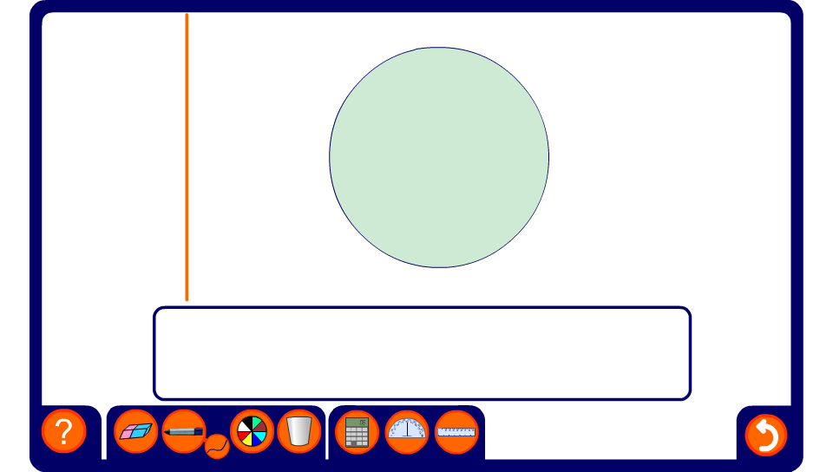
A line moving through a circle
Notes:
Drag the line through the circle to define the tangent, chords, segments, semicircles and diameter.

Slide 7
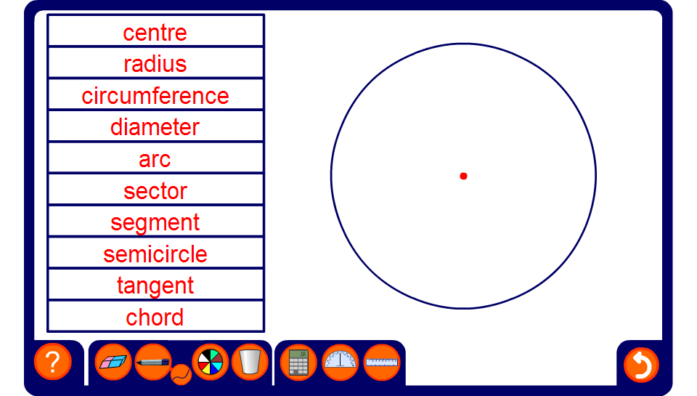
Naming the parts of a circle
Notes:
Use the activity to review the names of circle parts.
The two most commonly confused parts are segments and sectors. This can be remembered by thinking of a sector of cake (they both contain the letter c).

Slide 8
Contents
S5 Circles
A
S5.1 Naming circle parts
A
S5.2 Angles in a circle
A
S5.3 Tangents and chords
A
S5.4 Circumference and arc length
A
S5.5 Areas of circles and sectors

Slide 9
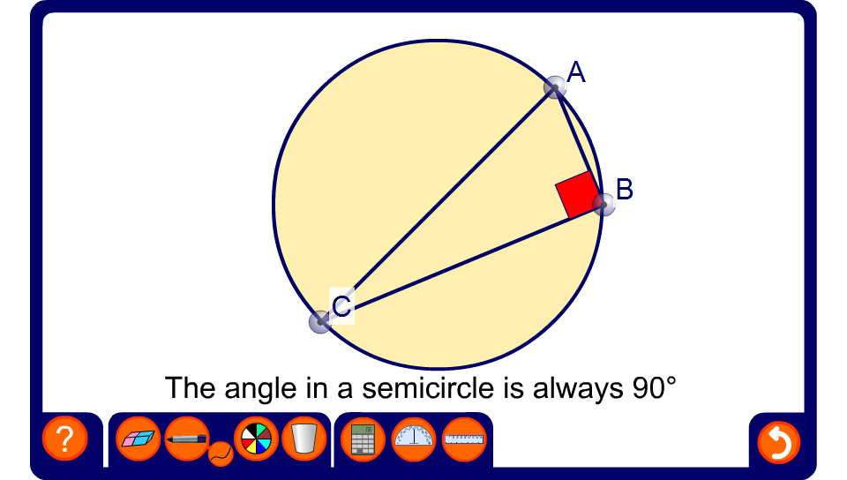
Right angles in a semicircle
Notes:
Drag the points around the circumference of the circle to demonstrate this theorem.

Slide 10
Right angles in a semicircle
We have just seen a demonstration that the angle in a semicircle is always a right angle.
We can prove this result as follows:
C
Draw a line from C to O. This line is a radius of the circle.
x
In triangle AOC,
x
OA = OC
(both radii)
A
B
O
So, angle OAC = angle OCA
(angles at the base of an isosceles triangle)
Let’s call these angles x.
Notes:
Stress the difference between a mathematical proof and a demonstration.
Tell pupils that we have to label each vertex and the centre of the circle. This is so that we can refer to angles and line segments using these letters. The centre of a circle is usually called O.
Stress the importance of giving a reason for each statement. These reasons are shown in orange.

Slide 11
Right angles in a semicircle
We have just seen a demonstration that the angle in a semicircle is always a right angle.
We can prove this result as follows:
C
In triangle BOC,
x
y
OB = OC
(both radii)
So, angle OBC = angle OCB
x
y
A
B
O
(angles at the base of an isosceles triangle)
Let’s call these angles y.

Slide 12
Right angles in a semicircle
We have just seen a demonstration that the angle in a semicircle is always a right angle.
We can prove this result as follows:
C
In triangle ABC,
x
y
x + x + y + y = 180°
(angles in a triangle)
2x + 2y = 180°
x
y
A
B
O
2(x + y) = 180°
x + y = 90°
Angle ACB = x + y = 90°

Slide 13
Calculating the size of unknown angles
Calculate the size of the labeled angles in the following diagram:
a = 37° (angles at the base of an
isosceles triangle)
b = 90° – 37°
= 53° (angle in a semi-circle)
37°
O
c = 53° (angles at the base of an
isosceles triangle)
e
d
d = 180° – 2 × 53°
= 74° (angles in a triangle)
c
a
b
e = 180° – 74°
= 106° (angles on a line)
Notes:
Stress that each time the size of an angle is given a reason must be included. Stress that in an examination marks can be awarded for correct reasons even if the angle given is incorrect.

Slide 14
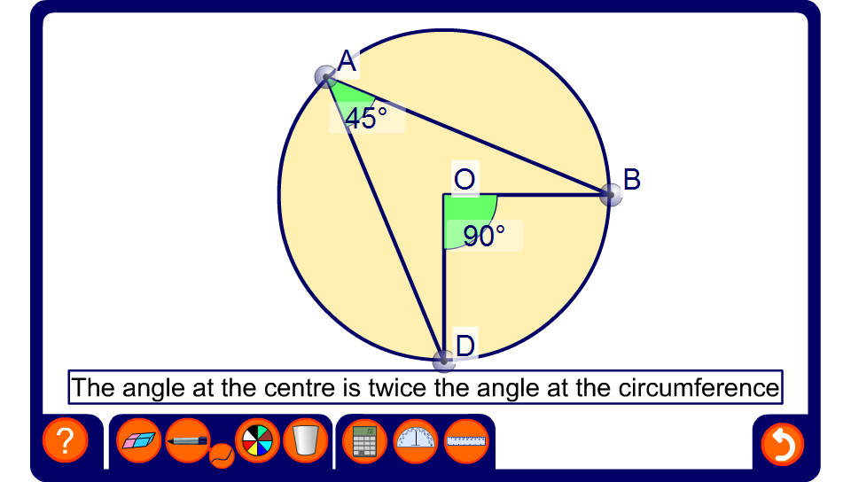
The angle at the centre
Notes:
Drag the points around the circumference of the circle to demonstrate this theorem.
Hide one of the angles, modify the diagram and ask pupils to calculate the size of the missing angle. Be aware that the angles have been given to the nearest degree.

Slide 15
The angle at the centre
We have just seen a demonstration that the angle at the centre of a circle is twice the angle at the circumference.
We can prove this result as follows:
B
Draw a line from B, through the centre O, and to the other side D.
x
In triangle AOB,
O
OA = OB
(both radii)
So, angle OAB = angle OBA
x
C
(angles at the base of an isosceles triangle)
A
D
Let’s call these angles x.

Slide 16
The angle at the centre
We have just seen a demonstration that the angle at the centre of a circle is twice the angle at the circumference.
We can prove this result as follows:
B
In triangle BOC,
OB = OC
(both radii)
x
y
So, angle OBC = angle OCB
O
y
(angles at the base of an isosceles triangle)
x
C
A
Let’s call these angles y.
D

Slide 17
The angle at the centre
We have just seen a demonstration that the angle at the centre of a circle is twice the angle at the circumference.
We can prove this result as follows:
B
angle AOD = 2x
and angle COD = 2y
x
y
(the exterior angle in a triangle is equal to the sum of the opposite interior angles)
O
y
x
2x
2y
angle AOC = 2x + 2y
C
A
= 2(x + y)
D
angle ABC = x + y
∴ angle AOC = 2 × angle ABC

Slide 18
Calculating the size of unknown angles
Calculate the size of the labeled angles in the following diagram:
a = 29° (angles at the base of an
isosceles triangle)
c
b = 180° – 2 × 29°
= 122° (angles in a triangle)
O
c = 122° ÷ 2
= 61° (angle at the centre is
twice angle on the
circumference)
b
41°
d
a
29°
d = 180° – (29° + 29° + 41° + 61°)
= 20° (angles in a triangle)
Notes:
Stress that each time the size of an angle is given a reason must be included. Stress that in an examination marks can be awarded for correct reasons even if the angle given is incorrect.

Slide 19
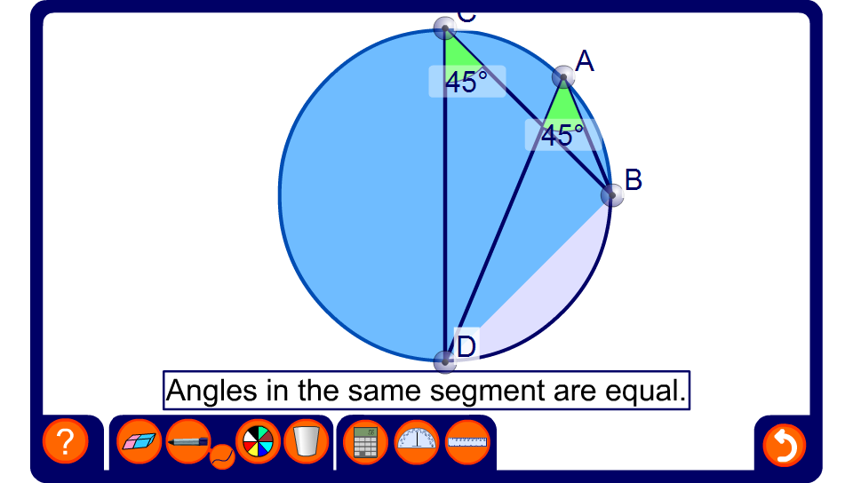
Angles in the same segment
Notes:
Drag the points around the circumference of the circle to demonstrate this theorem.
Hide one of the angles, modify the diagram and ask pupils to calculate the size of the missing angle.

Slide 20
Angles in the same segment
We have just seen a demonstration that the angles in the same segment are equal.
We can prove this result as follows:
C
Mark the centre of the circle O and angle AOB.
D
angle ADB = ½ of angle AOB
O
and angle ACB = ½ of angle AOB
B
(the angle at the centre of a circle is twice the angle at the circumference)
A
∴ angle ADB = angle ACB
Notes:
Discuss the fact that we can prove this circle theorem using the previous circle theorem.

Slide 21
Calculating the size of unknown angles
Calculate the size of the labeled angles in the following diagram:
a = 90° – 51°
= 39° (angle in a semi-circle)
c
b = 180° – (90° + 44°)
= 46° (angles in a triangle)
d
O
44°
b
c = 46° (angles in the same
segment)
51°
a
d = 51° (angles in the same
segment)
Notes:
Stress that each time the size of an angle is given a reason must be included. Stress that in an examination marks can be awarded for correct reasons even if the angle given is incorrect.

Slide 22
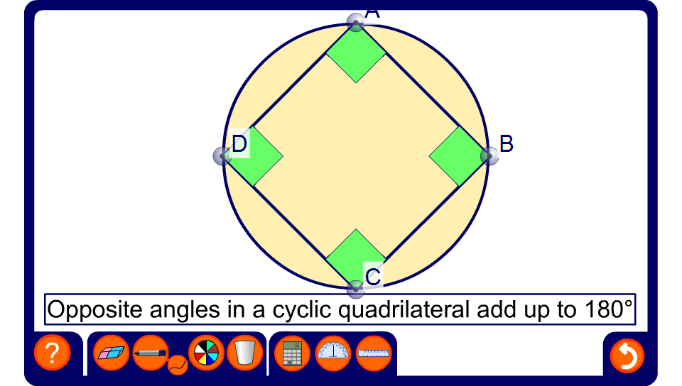
Angles in a cyclic quadrilateral
Notes:
Drag the points around the circumference of the circle to demonstrate this theorem.
Hide some of the angles, modify the diagram and ask pupils to calculate the sizes of the missing angles.

Slide 23
Angles in a cyclic quadrilateral
We have just seen a demonstration that the opposite angles in a cyclic quadrilateral add up to 180°.
We can prove this result as follows:
B
Mark the centre of the circle O and label angles ABC and ADC x and y.
x
The angles at the centre are 2x and 2y.
O
2y
(the angle at the centre of a circle is twice the angle at the circumference)
2x
C
A
y
2x + 2y = 360°
D
2(x + y) = 360°
x + y = 180°

Slide 24
Angles in a cyclic quadrilateral
As a result of this theorem we can conclude that is the opposite angle of a quadrilateral add up to 180° a circle can be drawn through each of its vertices.
For example, the opposite angles in this quadrilateral add up to 180°.
67°
It is a cyclic quadrilateral.
109°
Remember that when two angles add up to 180° they are often called supplementary angles.
113°
71°

Slide 25
Calculating the size of unknown angles
Calculate the size of the labeled angles in the following diagram:
a = 64° (angle at the centre)
b = c = (180° – 128°) ÷ 2
= 26° (angles at the base of
an isosceles triangle)
c
f
b
d = 33° (angles at the base of an
isosceles triangle)
d
128°
O
e = 180° – 2 × 33°
= 114° (angles in a triangle)
e
33°
a
f = 180° – (e + c)
= 180° – 140°
= 40° (opposite angles in a
cyclic quadrilateral)
Notes:
Stress that each time the size of an angle is given a reason must be included. Stress that in an examination marks can be awarded for correct reasons even if the angle given is incorrect.

Slide 26
Contents
S5 Circles
A
S5.1 Naming circle parts
A
S5.2 Angles in a circle
A
S5.3 Tangents and chords
A
S5.4 Circumference and arc length
A
S5.5 Areas of circles and sectors

Slide 27
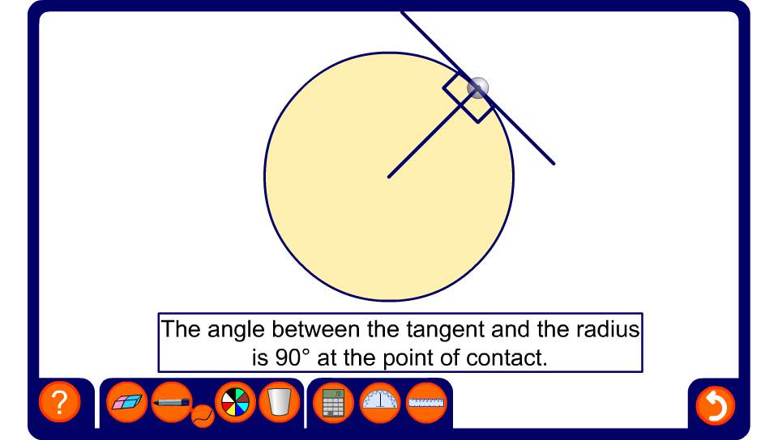
The tangent and the radius
Notes:
Change the position of the point where the tangent meets the radius to show that they are always at right angles.

Slide 28
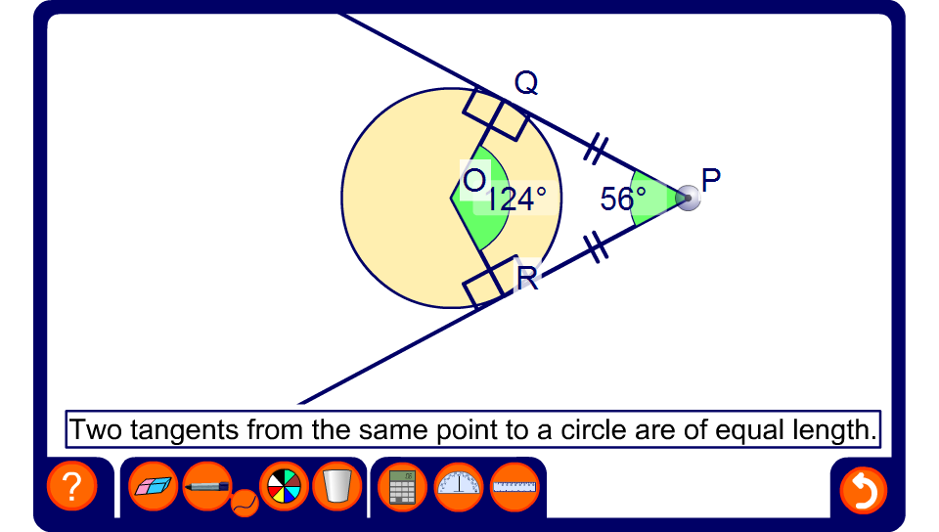
Two tangents from a point
Notes:
Change the position of P to demonstrate this theorem.
Ask pupils to explain why angles QPR and QOR are supplementary angles.
Hide one of the angles, modify the diagram and ask pupils to calculate the size of the missing angle.
Establish that the shape PQOR is a kite.

Slide 29
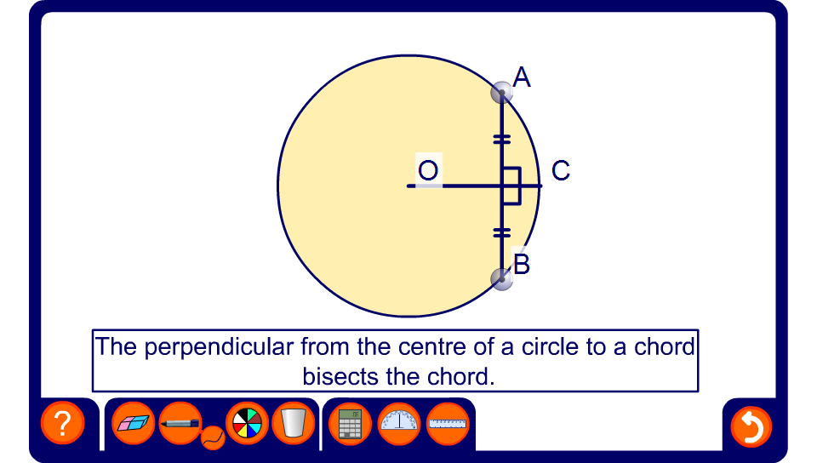
The perpendicular from the centre to a chord
Notes:
Drag the end-point of the cord to investigate this theorem.

Slide 30
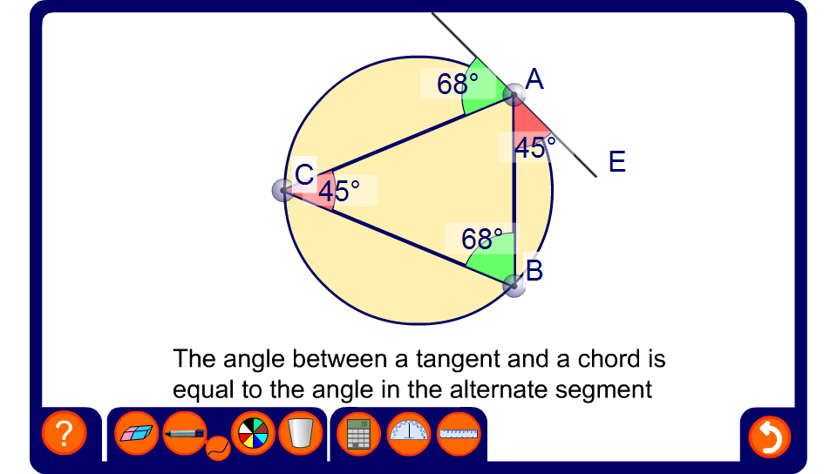
The alternate segment theorem
Notes:
Drag the point around the circumference of the circle to investigate the alternate segment theorem.
Hide some of the angles, modify the diagram and ask pupils to calculate the sizes of the missing angles.
A formal proof of this theorem is not required.

Slide 31
Contents
S5 Circles
A
S5.1 Naming circle parts
A
S5.2 Angles in a circle
A
S5.3 Tangents and chords
A
S5.4 Circumference and arc length
A
S5.5 Areas of circles and sectors

Slide 32
The value of π
For any circle the circumference is always just over three times bigger than the radius.
The exact number is called π (pi).
We use the symbol π because the number cannot be written exactly.
π = 3.141592653589793238462643383279502884197169
39937510582097494459230781640628620899862803482
53421170679821480865132823066470938446095505822
31725359408128481117450284102701938521105559644
62294895493038196 (to 200 decimal places)!
Notes:
Explain that pi is just a number. We call it pi because it is not possible to write the number exactly. Even written to 200 decimal places, although extremely accurate, is an approximation.

Slide 33
Approximations for the value of π
When we are doing calculations involving the value π we have to use an approximation for the value.
For a rough approximation we can use 3.
22
Better approximations are 3.14 or .
7
We can also use the π button on a calculator.
Most questions will tell you what approximations to use.
When a calculation has lots of steps we write π as a symbol throughout and evaluate it at the end, if necessary.
Notes:
It is useful to approximate pi to a value of 3 when approximating the answers to calculations.

Slide 34
The circumference of a circle
For any circle,
circumference
π =
diameter
or,
C
π =
d
We can rearrange this to make an formula to find the circumference of a circle given its diameter.
C = πd
Notes:
Pupils should be asked to learn these formulae.

Slide 35
The circumference of a circle
Use π = 3.14 to find the circumference of this circle.
C = πd
9.5 cm
= 3.14 × 9.5
= 29.83 cm
Notes:
Tell pupils that when solving a problem like this they should always start by writing down the formula that they are using.
This will minimize the risk of using the radius instead of the diameter, for example.

Slide 36
Finding the circumference given the radius
The diameter of a circle is two times its radius, or
d = 2r
We can substitute this into the formula
C = πd
to give us a formula to find the circumference of a circle given its radius.
C = 2πr

Slide 37
The circumference of a circle
Use π = 3.14 to find the circumference of the following circles:
C = πd
9 m
C = 2πr
4 cm
= 3.14 × 4
= 2 × 3.14 × 9
= 12.56 cm
= 56.52 m
C = πd
C = 2πr
58 cm
23 mm
= 3.14 × 23
= 2 × 3.14 × 58
= 72.22 mm
= 364.24 cm
Notes:
For each one, start by asking pupils what formula we have to use.
Estimate each answer first using π = 3, or use this to check the answer.

Slide 38
Finding the radius given the circumference
Use π = 3.14 to find the radius of this circle.
12 cm
C = 2πr
How can we rearrange this to make r the subject of the formula?
C
r =
?
2π
12
=
2 × 3.14
= 1.91 cm (to 2 d.p.)
Notes:
Link:
A3 Formulae – changing the subject of a formula

Slide 39
Finding the length of an arc
What is the length of arc AB?
A
An arc is a section of the circumference.
6 cm
The length of arc AB is a fraction of the length of the circumference.
To work out what fraction of the circumference it is we look at the angle at the centre.
B
In this example, we have a 90° angle at the centre.
Notes:
Discuss how we can think of the length of an arc as a proportion of the length of the circumference.

Slide 40
Finding the length of an arc
What is the length of arc AB?
A
1
The arc length is of the circumference of the circle.
4
6 cm
This is because,
90°
1
=
360°
4
B
So,
1
Length of arc AB = × 2πr
4
=
1
× 2π × 6
4
Length of arc AB = 9.42 cm (to 2 d.p.)

Slide 41
Finding the length of an arc
A
B
r
θ
For any circle with radius r and angle at the centre θ,
θ
This is the circumference of the circle.
Arc length AB =
× 2πr
360
2πrθ
πrθ
Arc length AB =
=
360
180
Notes:
Remind pupils that in finding the length of an arc, we are finding a fraction of the circumference of the circle.

Slide 42
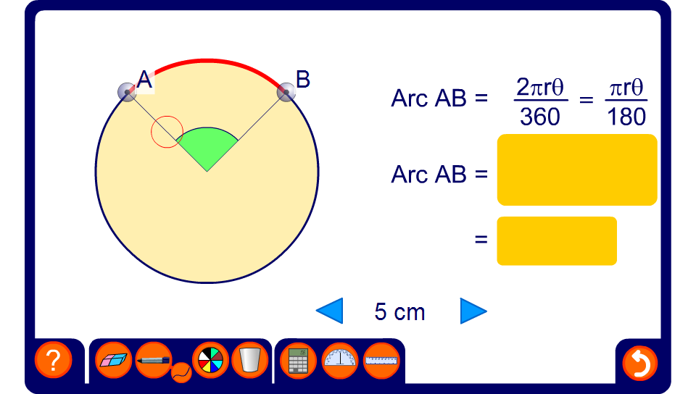
Finding the length of an arc
Notes:
Reveal the size of the angle and the length of the radius and ask pupils to find the length of the arc.
Change these values to give a new problem.
Extend the activity by hiding the angle at the centre of the circle. Reveal the length of the arc and ask pupils to find the unknown angle using the formula.

Slide 43
The perimeter of shapes made from arcs
Find the perimeter of these shapes on a cm square grid:
40°
The perimeter of this shape is made from three semi-circles.
40°
1
=
360°
9
1
× π × 6 +
1
× π × 12 +
Perimeter =
Perimeter =
2
9
1
× π × 4 +
1
× π × 6 +
2
9
1
× π × 2
3 + 3
2
= 6π cm
= 2π + 6
= 18.85 cm (to 2 d.p.)
= 12.28 cm (to 2 d.p.)
Notes:
For the first example ask pupils to explain why the perimeter can be written as 6π cm.
Similarly, in the second example, ask pupils to explain why the perimeter can be written as 2π + 6.

Slide 44
Contents
S5 Circles
A
S5.1 Naming circle parts
A
S5.2 Angles in a circle
A
S5.3 Tangents and chords
A
S5.4 Circumference and arc length
A
S5.5 Areas of circles and sectors

Slide 45
Formula for the area of a circle
We can find the area of a circle using the formula
Area of a circle = π × r × r
r
or
Area of a circle = πr²

Slide 46
The area of a circle
Use π = 3.14 to find the area of this circle.
7 cm
A = πr²
= 3.14 × 7²
= 153.86 cm²
Notes:
Remind pupils that when finding an area the units must be squared.

Slide 47
Finding the area given the diameter
The radius of a circle is half of its radius, or
d
r =
2
We can substitute this into the formula
A = πr²
to give us a formula to find the area of a circle given its diameter.
πd²
A =
4

Slide 48
The area of a circle
Use π = 3.14 to find the area of the following circles:
A = πr²
A = πr²
2 cm
10 m
= 3.14 × 2²
= 3.14 × 5²
= 12.56 cm²
= 78.5 m²
A = πr²
A = πr²
78 cm
= 3.14 × 23²
= 3.14 × 39²
23 mm
= 1661.06 mm²
= 4775.94 cm²
Notes:
Explain that rather than use the formula on the previous slide, it is usually easier to halve the diameter mentally to give the radius, before substituting it into the formula.
The most common error is to neglect to halve the diameter to find the radius and to substitute this value into the formula. Ensure that pupils do not make this mistake.

Slide 49
Finding the area of a sector
What is the area of this sector?
72°
Area of the sector =
× π × 6²
360°
72°
6 cm
1
= × π × 6²
6
= π × 6
= 18.85 cm² (to 2 d.p.)
We can use this method to find the area of any sector.
Notes:
Discuss how this area could be calculated before revealing the solution.
The area of a sector is a fraction of the area of a full circle. We can find this fraction by dividing the angle at the centre by 360°.

Slide 50
Finding the area of a sector
A
B
r
θ
O
For any circle with radius r and angle at the centre θ,
θ
This is the area of the circle.
Area of sector AOB =
× πr²
360
πr²θ
Area of sector AOB =
360
Notes:
Remind pupils that in finding the area of a sector, we are finding a fraction of the area of the circle.

Slide 51
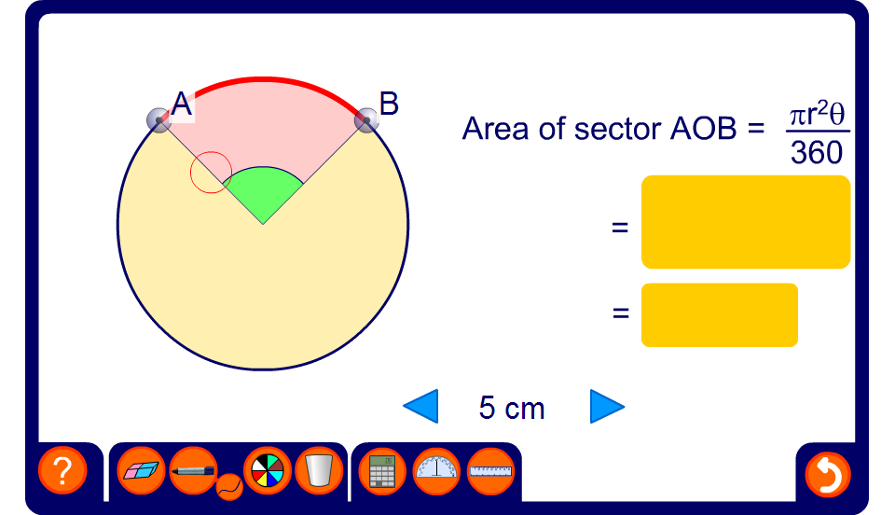
Finding the area of a sector
Notes:
Reveal the size of the angle and the length of the radius and ask pupils to find the area of the sector.
Change these values to give a new problem.
Extend the activity by hiding the angle at the centre of the circle. Reveal the area of the sector and ask pupils to find the unknown angle using the formula.

Slide 52
The area of shapes made from sectors
Find the area of these shapes on a cm square grid:
40°
40°
1
1
=
Area =
× π × 3²
360°
9
2
+
1
× π × 1²
1
× π × 6²
2
Area =
9
–
1
× π × 2²
1
2
–
× π × 4²
9
= 3π cm²
1
= cm²
× π × 20
9
= 9.42 cm² (to 2 d.p.)
= 6.98 cm² (to 2 d.p.)
Notes:
Explain that we can think of the first shape as a semi-circle of radius 3 + a semi-circle of radius 1 – a semi-circle of radius 2. By factorizing, we can write this as
½π(3² + 1² – 2²)
= ½π(9 + 1 – 4)
= ½π × 6
= 3π

