Slide 1
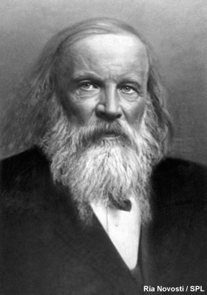
What is periodicity?
The term periodicity describes a repeating pattern in properties of elements across periods of the periodic table.
The Russian chemist Dmitry Mendeleev is credited with being the creator of the first version of the periodic table. He observed that when the elements are arranged in order of atomic mass, there are recurring patterns in certain properties.
The modern periodic table can be used
to analyse trends in properties such as atomic radius across periods and down groups.
Notes:
Photo credit: Ria Novosti / Science Photo Library
Teacher notes
Dmitry Ivanovich Mendeleev (1834-1907), Russian chemist. Mendeleev (or Mendeleyev) was initially an indifferent student, but left college at the top of his class. After attending the 1st Karlsruhe Congress (1860), Mendeleyev worked on organising trends in atomic weights and valency. From this, he developed the first true periodic table of the elements (final version published in 1871). This contained some gaps, but as new elements were discovered to have the properties predicted by the table, Mendeleev became famous worldwide. This image was created on 1 June 1900.
See the ‘Trends in Group 2’ presentation for more information about trends in properties.

Slide 2
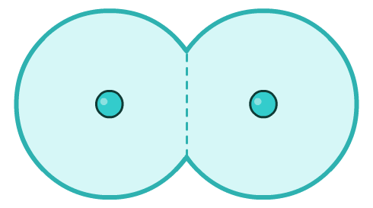
What is atomic radius?
The atomic radius of an element is difficult to precisely define because of the uncertainty over the size of the electron cloud. Several definitions are used.
One definition is half the shortest internuclear distance found in the structure of the element.
For non-metallic elements, the covalent radius is often used as the atomic radius. This is half the internuclear distance between two identical atoms in a single covalent bond.
covalent radius
Notes:
Teacher notes
Atomic radius is a very difficult quantity to measure directly because the electron cloud is not fixed in shape and size. Covalent or metallic radii are more commonly used and are sometimes referred to as the atomic radius. However, these radii also vary in different circumstances. A particular bond will have a slightly different length in different compounds containing that bond, due to the effect of the surrounding atoms. One way in which covalent radii can be determined is to measure the bond length in a variety of different compounds and compare the values. This introduces a further problem because covalent bonds in different compounds will have different degrees of ionic character. Ionic radius varies with the coordination number and spin state of the ion. An alternative way to determine atomic radii is to calculate them mathematically. This gives slightly different values to those obtained by observation.
In this presentation, atomic radii used are calculated values. Data from www.webelements.com.

Slide 3

More on atomic radius
For non-bonded adjacent atoms (e.g. in a covalent crystal of a non-metallic element), the van der Waals radius is used as a value for atomic radius. This is half the shortest internuclear distance between two similar non-bonded atoms.
van der Waals radius
For metallic elements, the metallic radius is often used as the atomic radius. This is half the shortest internuclear distance between two adjacent atoms in a metallic bond.

Slide 4
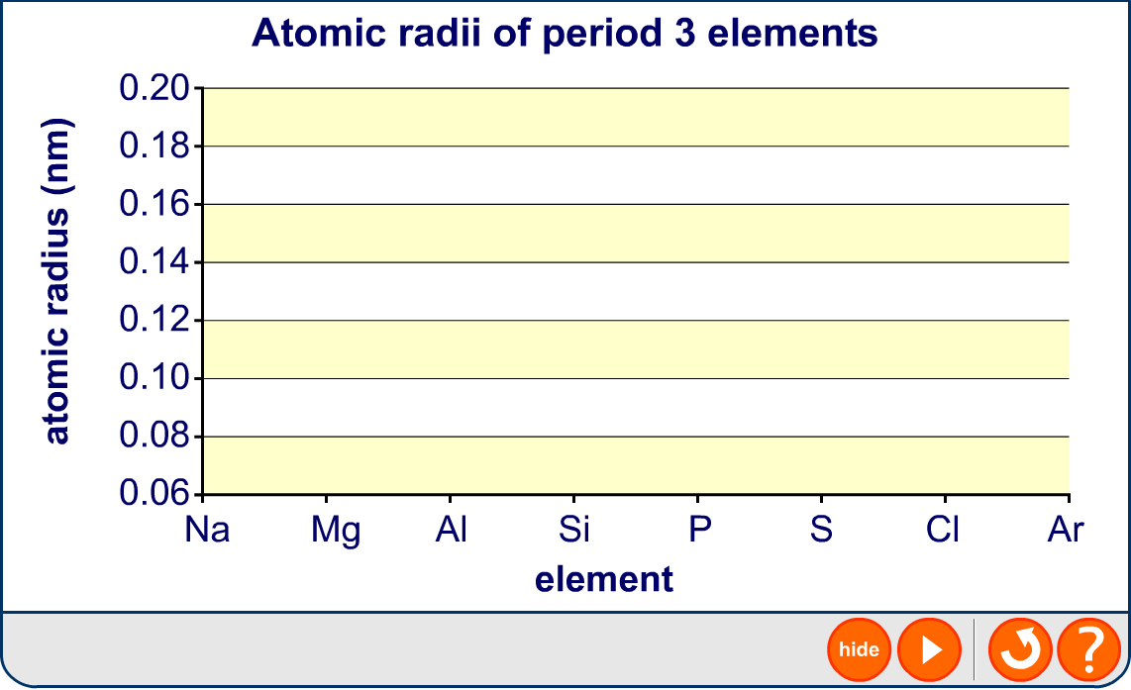
Trends in atomic radius in period 3

Slide 5


Trends in atomic radius in period 3
The atomic radius of the elements across period 3 decreases.
Atomic radius (nm)
Element
Na
0.190
This might seem counter-intuitive, because as the numbers of sub-atomic particles increase, the radius might be expected to also increase.
Mg
0.145
Al
0.118
Si
0.111
P
0.098
However, more than 99% of the atom is empty space – the nucleus and electrons themselves occupy a tiny volume of the atom.
S
0.088
Cl
0.079
Ar
0.071
Notes:
Teacher notes
Observed values for covalent radii follow the same trend as the calculated values given here, apart from the value for argon. The covalent radius is half the covalent bond length. Argon does not normally form covalent bonds (it is monatomic) therefore either no value is given for argon or the value is anomalously high.
Covalent bond lengths are:
Na 0.166nm
Mg 0.141nm
Al 0.121nm
Si 0.111nm
P 0.107nm
S 0.105nm
Cl 0.102nm
Ar 0.106nm

Slide 6
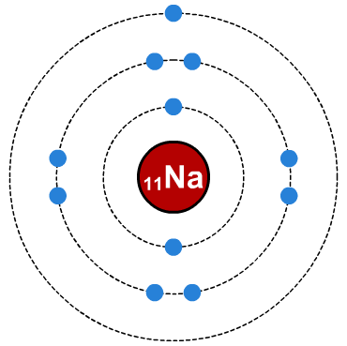
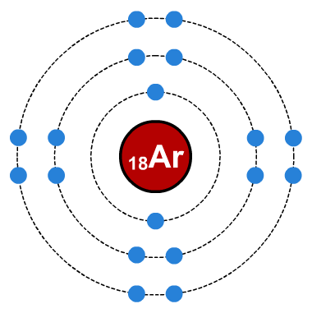
Increase in proton number
The number of protons in the nucleus of the atoms increases across period 3.
Element
₁₁Na
₁₂Mg
₁₃Al
₁₄Si
₁₅P
₁₆S
₁₇Cl
₁₈Ar
proton number
This increase in the number of protons increases the nuclear charge of the atoms. The nucleus has stronger attraction for the electrons, pulling them in closer and so the atomic radius decreases across the period.
increased nuclear charge pulls electrons closer

Slide 7

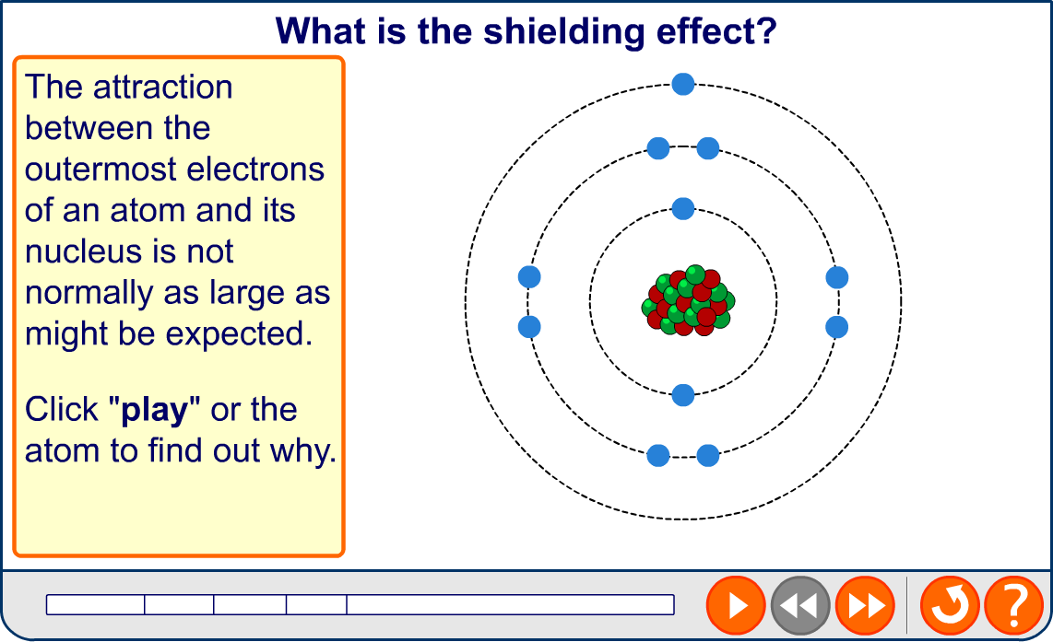
What is shielding?
Notes:
Teacher notes
This animation only describes the shielding effect. In the final stage, each atom is portrayed as being of a similar size across the period because there is very little variation in shielding. It may be worth reminding students that, when the increase in nuclear charge is taken into account, atomic radius decreases across the period.

Slide 8
Explaining atomic radius in period 3
Proton number increases across period 3, but shielding remains approximately constant.
Atomic radius (nm)
Proton number
Element
Na
11
0.190
Mg
12
0.145
This causes an increase in effective nuclear charge, leading to a greater attraction between the nucleus and the outermost electrons.
Al
13
0.118
Si
14
0.111
P
15
0.098
S
16
0.088
Cl
17
0.079
This pulls these electrons closer to the nucleus and results in a smaller radius.
Ar
18
0.071

Slide 9
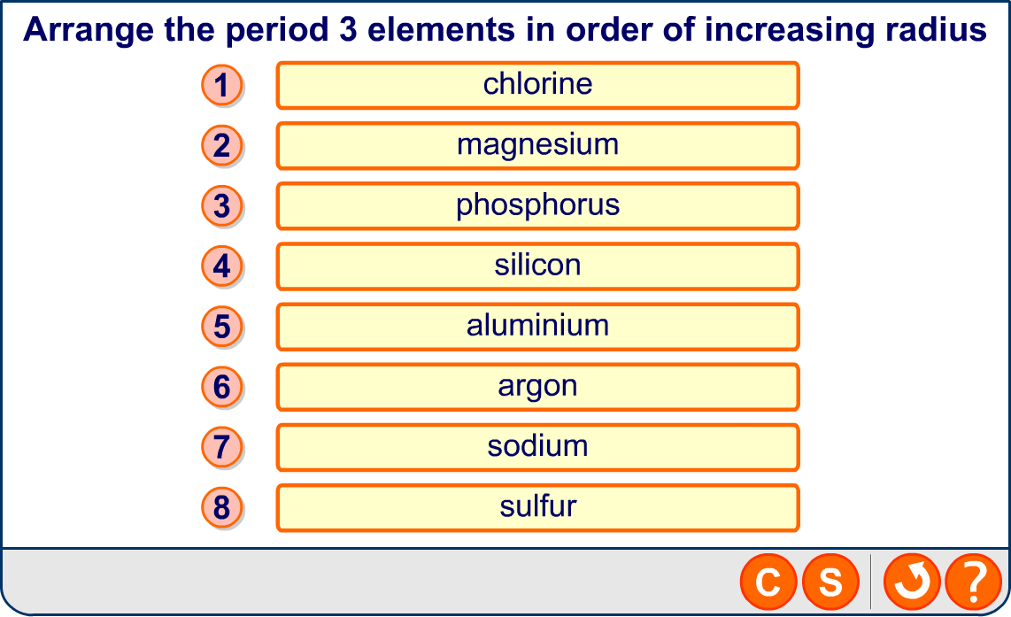
Atomic radius in period 3

Slide 10
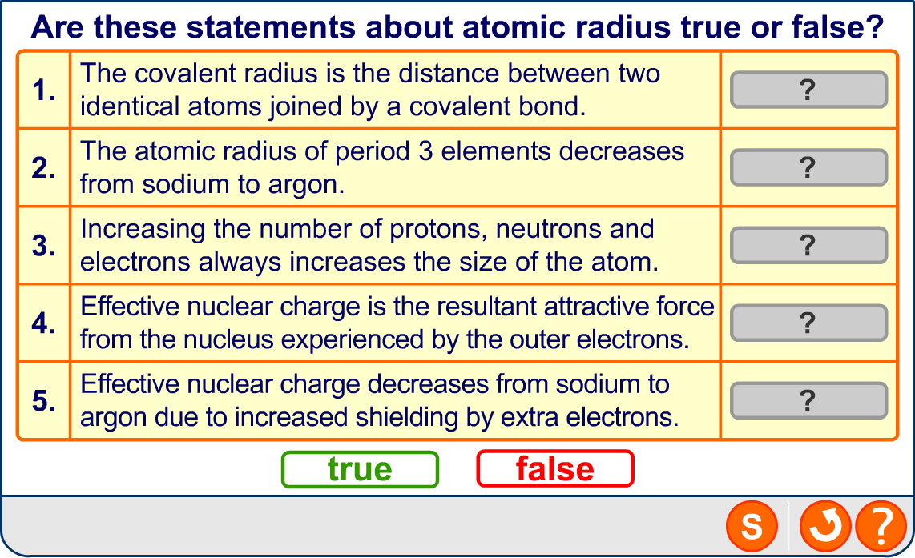
Atomic radius: true or false?

Slide 11
What is first ionization energy?
Ionization is a process in which atoms lose or gain electrons and become ions.
The first ionization energy of an element is the energy required to remove one electron from a gaseous atom.
M(g) → M⁺(g) + e⁻
The first ionization energy is therefore a measure of the strength of the attraction between the outermost electrons and the nucleus.
The first ionization energies of the elements in periods 2 or 3 can give information about their electronic structure.
Notes:
Teacher notes
Technically, the first ionization energy is the energy required to remove one mole of electrons from one mole of gaseous atoms. Successive ionization energies are those required to remove further moles of electrons.
Students could be made aware that, at this level, ionization generally refers to the removal of electrons. The gain of electrons is generally discussed in terms of ‘electron affinity’.

Slide 12
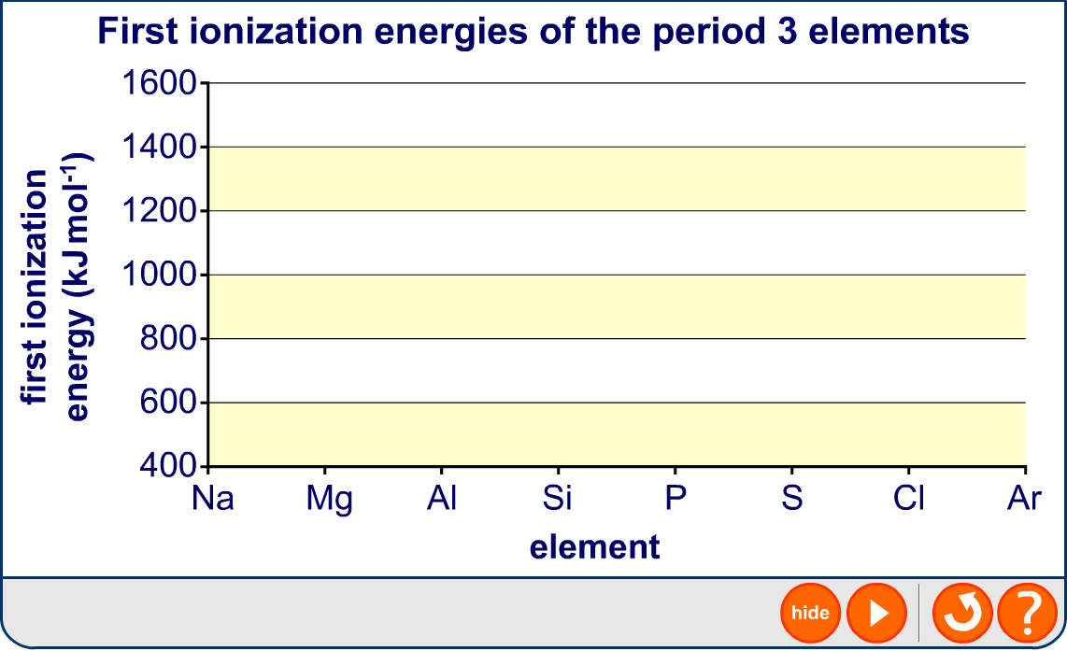
Plot of the first ionization energies

Slide 13
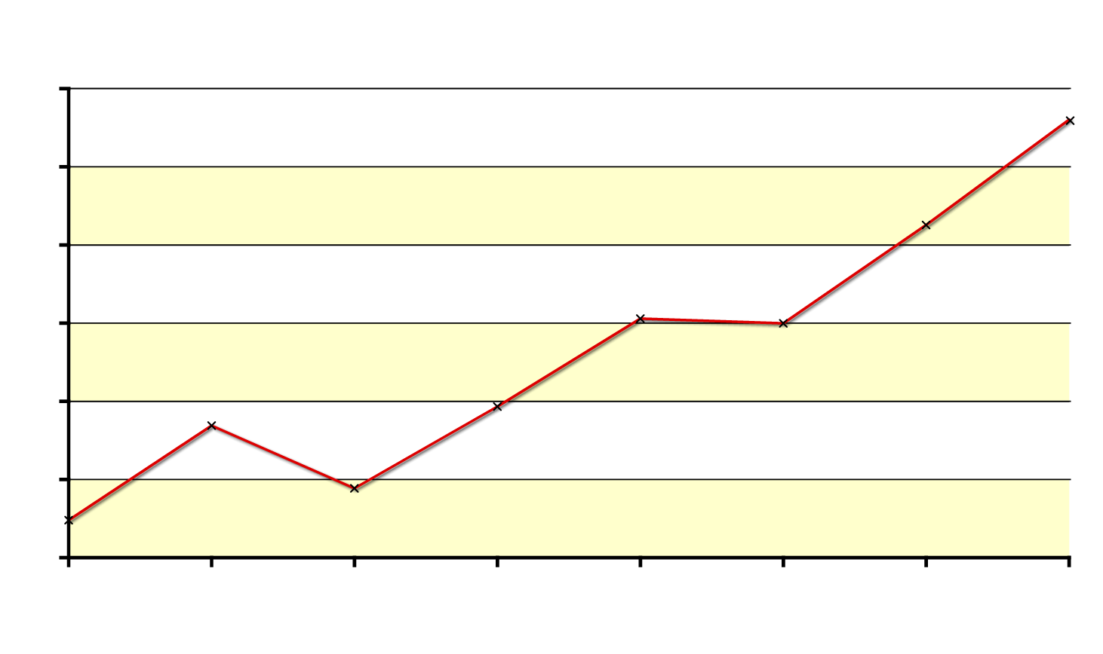
General trend in first ionization energy
There is a general increase in the first ionization energies across period 3.
1600
1400
1200
ionization energy (kJ mol⁻¹)
1000
Across period 3, the proton number increases but the amount of shielding does not change
800
600
400
Na
Mg
Al
Si
P
S
Cl
Ar
element
significantly.
The effective nuclear charge therefore increases.
The greater attraction between the nucleus and the outermost electrons means that more energy is required to remove an electron.

Slide 14
Trend in first ionization energy: exceptions
There are two exceptions to the general trend in first ionization energy: both aluminium and sulfur have lower ionization energies than might be expected.
1600
1400
lower ionization energies than expected
1200
ionization energy (kJ mol⁻¹)
1000
800
600
400
Na
Mg
Al
Si
P
S
Cl
Ar
element

Slide 15
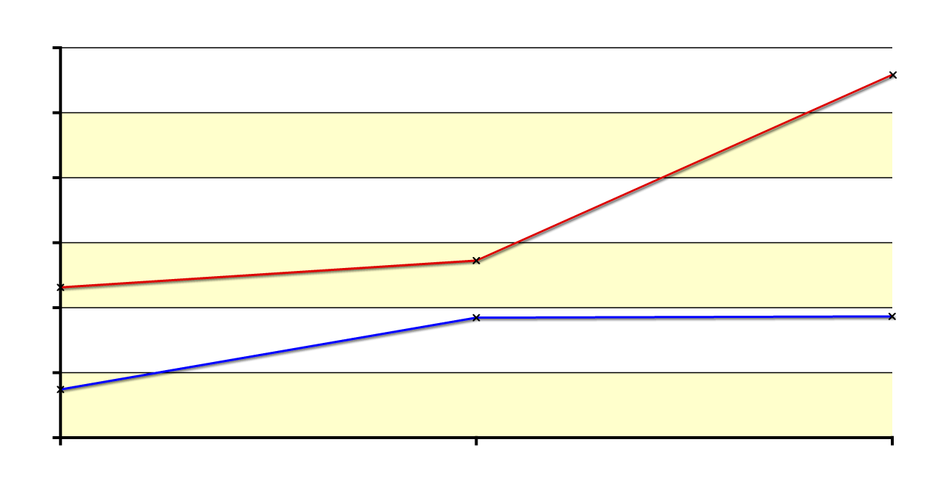
Na, Mg and Al: melting and boiling points
The melting and boiling points increase for the three metallic elements from sodium to aluminium.
3000
This is because the strength of the metallic bonds increases. More energy is needed to break the stronger metallic bonds, so melting and boiling points are higher.
2500
2000
boiling point
1500
temperature (K)
1000
melting point
500
0
Na
Mg
Al
element
Notes:
Teacher notes
The blue line from Mg to Al appears horizontal but there is a slight increase in melting point, from 923K for Mg to 933K for Al.
See the ‘Bonding and Intermolecular Forces’ presentation for more information about metallic bonding.

Slide 16
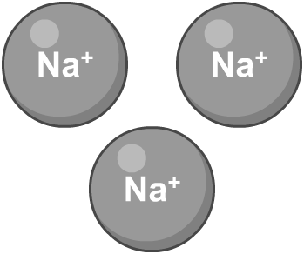
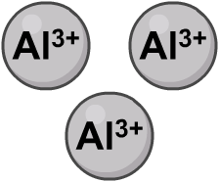
Na, Mg and Al: metallic bond strength
The increase in metallic bond strength from sodium to aluminium is due to two factors:
1. Charge density. This is the ratio of an ion’s charge to its size. Na⁺ ions are large with a small charge, so have a low charge density. Al³⁺ ions are smaller with a larger charge, and so have a higher charge density. They are therefore more strongly attracted to the delocalized electrons.
2. Number of free electrons. Sodium has one free electron per metal ion, whereas aluminium has three. This leads to more attractions that must be broken in aluminium.

Slide 17
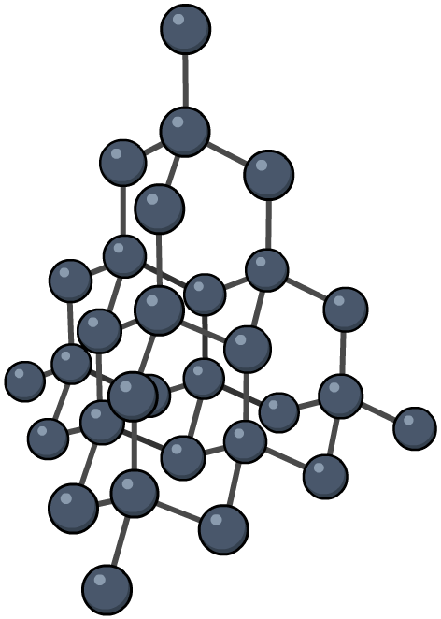
Silicon
Silicon has a macromolecular structure similar to that of diamond.
Each silicon atom is bonded to four neighbouring silicon atoms by strong covalent bonds. These must be broken in order for silicon to melt. This requires a lot of energy, so silicon's melting and boiling points are high.
Notes:
Teacher notes
See the ‘Structure and Shape’ presentation for more information about macromolecular structures in general and the structure of diamond in particular.
Students could be reminded that silicon is neither a metal nor a non-metal but a metalloid.

Slide 18
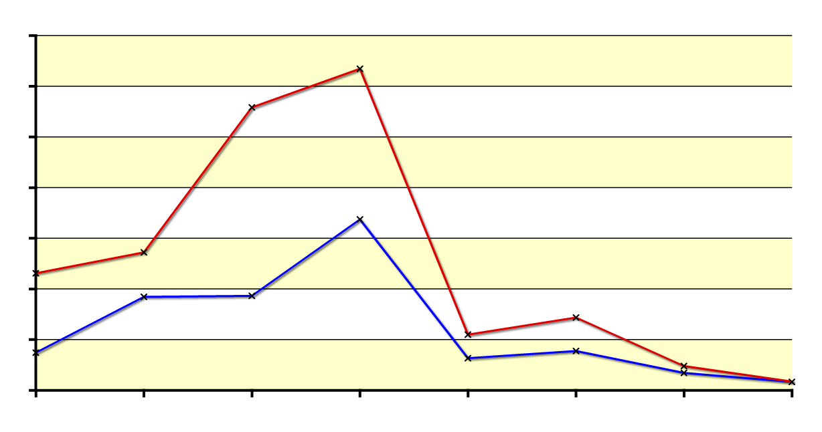
Period 3 non-metals
The melting and boiling points of phosphorus, sulfur and chlorine are much lower than those of silicon.
3500
This is because they have a
simple molecular structure with weak van der Waals forces holding the molecules together.
3000
2500
2000
temperature (K)
1500
1000
500
0
Na
Mg
Al
Si
P
S
Cl
Ar
element
Breaking these forces of attraction requires much less energy than breaking covalent bonds.
Notes:
Teacher notes
See the ‘Structure and Shape’ presentation for more information about molecular structures, and the ‘Bonding and Intermolecular Forces’ presentation for more information about covalent bonds and van der Waals forces.

Slide 19
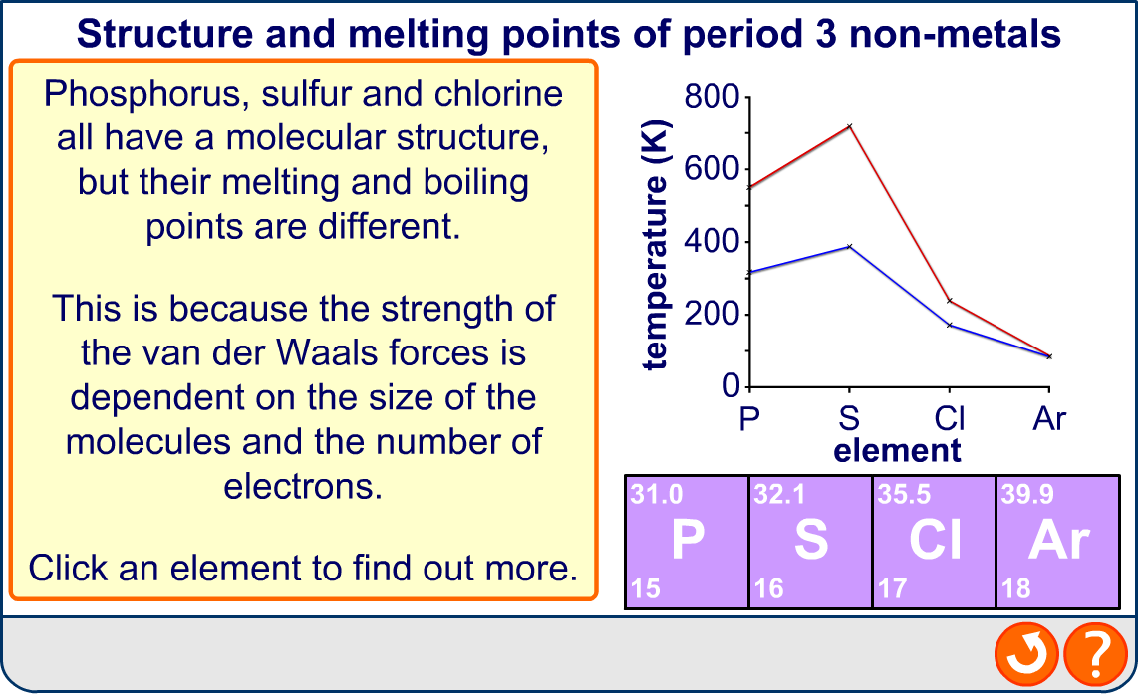
Period 3 non-metals: structure
Notes:
Teacher notes
Note that the size of the atoms of each element are approximately to scale relative to each other.
See the ‘Structure and Shape’ presentation for more information about molecular structures, and the ‘Bonding and Intermolecular Forces’ presentation for more information about van der Waals forces.

Slide 20
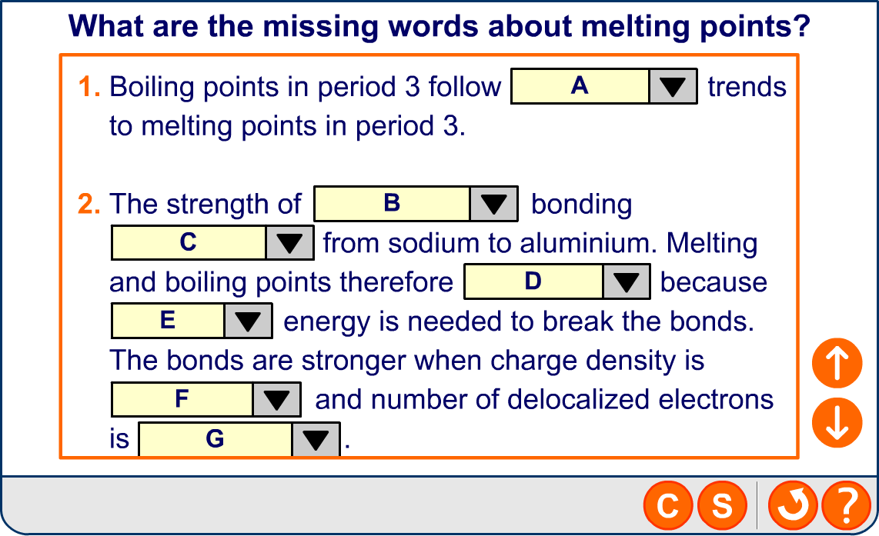
Melting points in period 3

